Slide 1

VADER Sentiment Analysis
of Shopping App Reviews
Data Science Project | E-commerce review mining
630K
11
8+
review rows
shopping apps
dataset columns
Shopping App Reviews Sentiment Analysis | 1

Slide 2
Introduction
Why sentiment analysis matters for shopping platforms
Shopping apps receive thousands of short, emotional reviews every day.
Manual reading does not scale when teams need quick product feedback.
Sentiment analysis converts review text into Positive, Neutral, and Negative signals.
The project compares major apps such as Alibaba, Aliexpress, Amazon, Flipkart, Myntra, Shein, Walmart, and others.
Shopping App Reviews Sentiment Analysis | 2

Slide 3
Dataset Collection
Combined review data across multiple e-commerce applications
630,000
629,999
Aliexpress
125,999
total CSV rows
clean reviews used
largest source
largest source rows
Key fields: reviewId, content, score, thumbsUpCount, at, replyContent, repliedAt, appName.
Each row represents a user review and its numerical rating.
The appName field enables grouped comparisons across platforms.
Shopping App Reviews Sentiment Analysis | 3

Slide 4
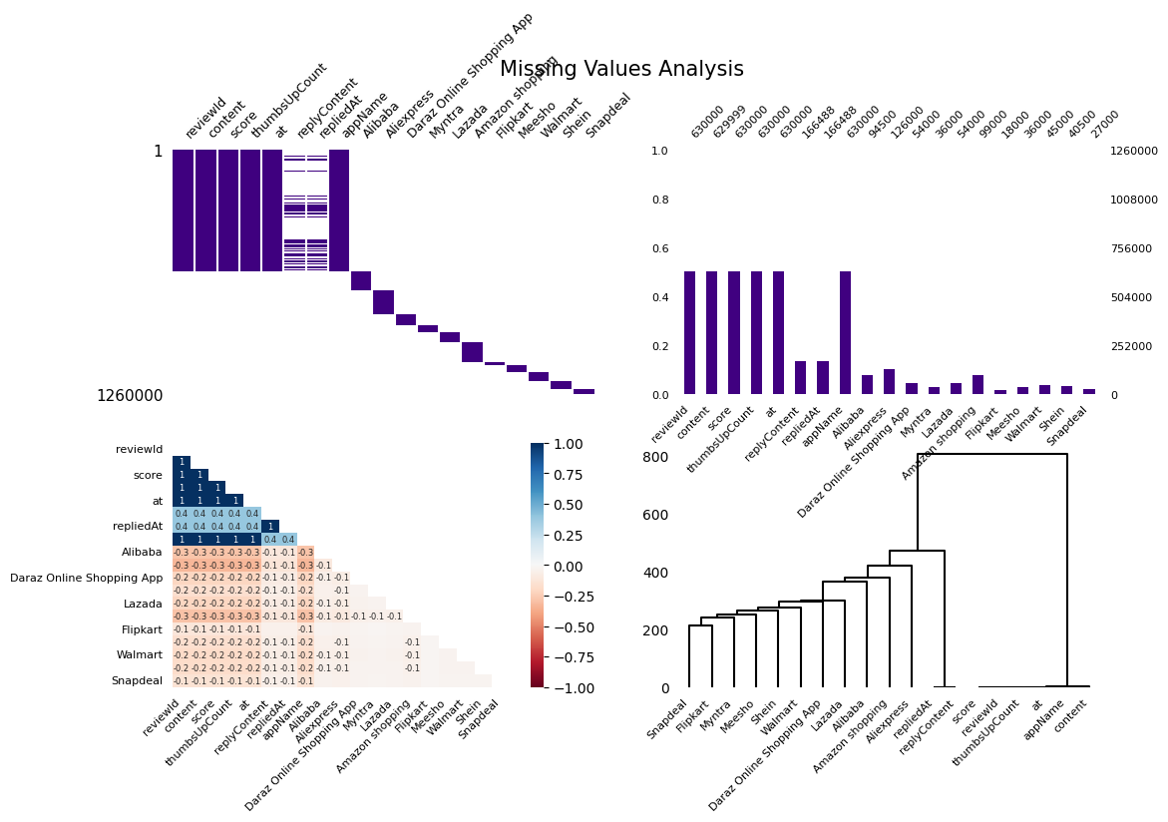
Data Cleaning Process
Preparing review text and rating fields for analysis
Removed rows with missing review content or missing score.
Converted score values to integer categories from 1 to 5.
Reply content was sparse: about 73.6% missing after cleaning.
Created derived columns for sentiment label and review length.
Shopping App Reviews Sentiment Analysis | 4

Slide 5
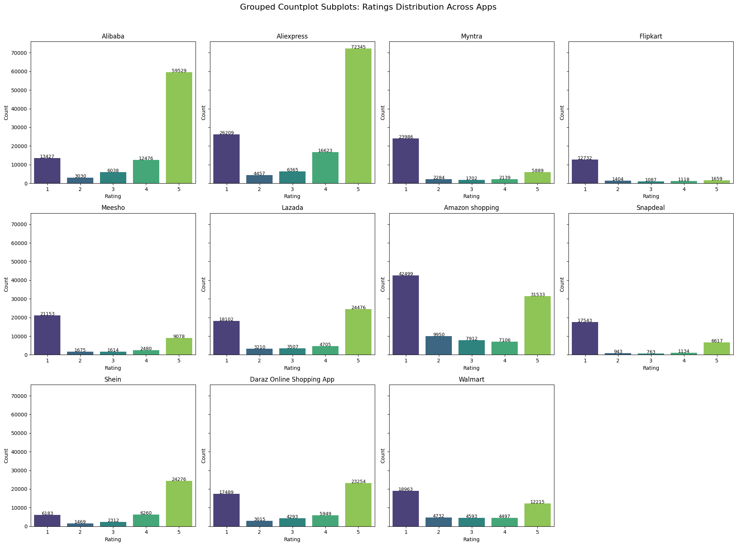
Exploratory Data Analysis
Ratings vary strongly across shopping applications
Shopping App Reviews Sentiment Analysis | 5

Slide 6
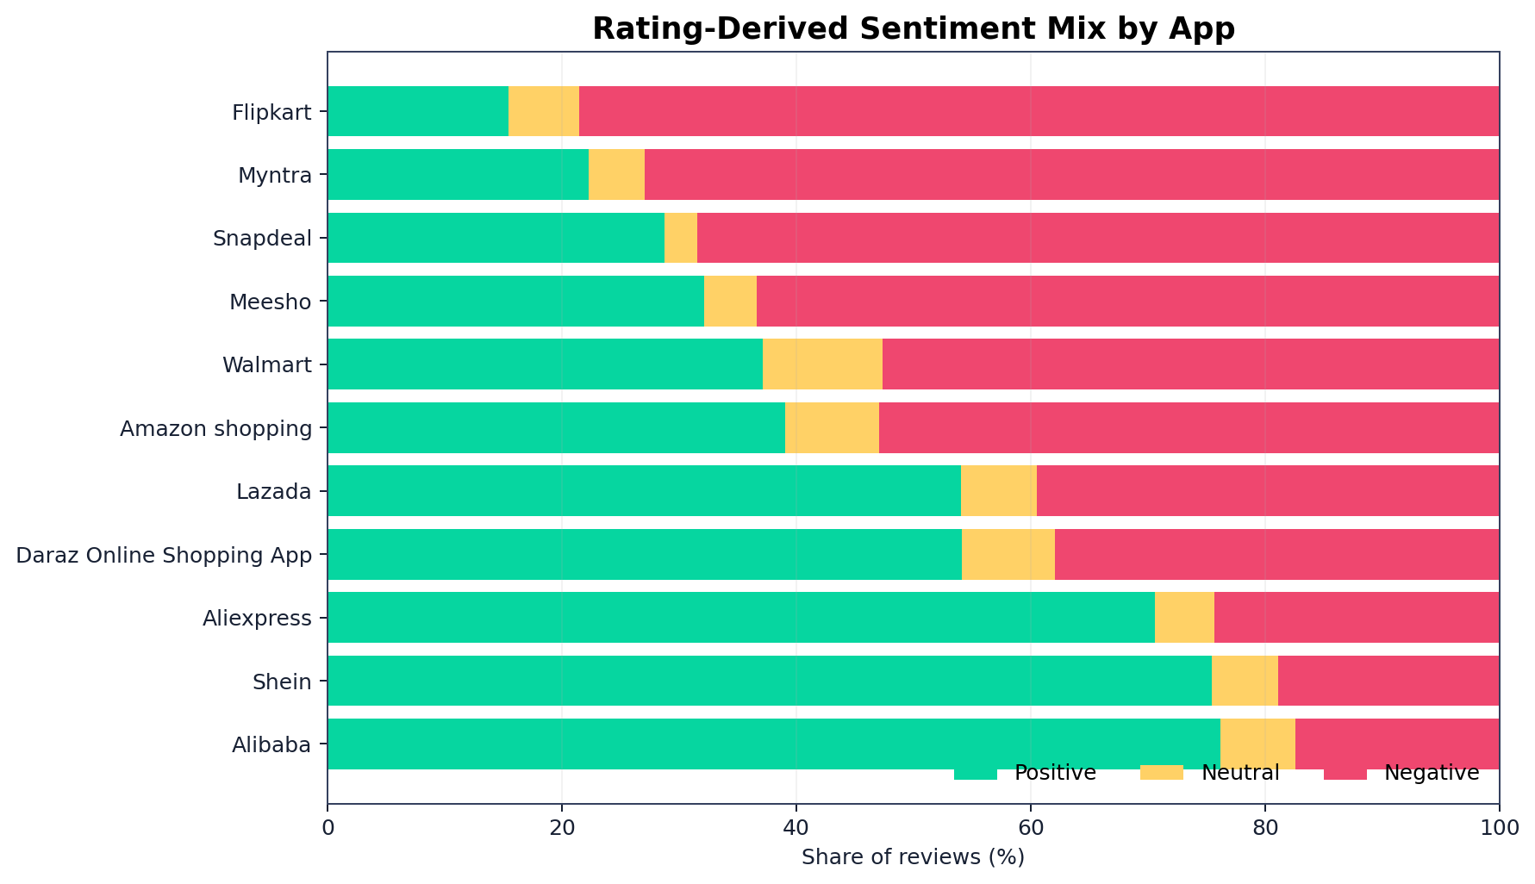
Sentiment Labelling
VADER maps review language into polarity labels
VADER analyzes informal review text using positive, neutral, negative, and compound scores.
Compound score >= 0.05 is classified as Positive.
Compound score <= -0.05 is classified as Negative.
Scores between -0.05 and 0.05 are treated as Neutral.
Shopping App Reviews Sentiment Analysis | 6

Slide 7
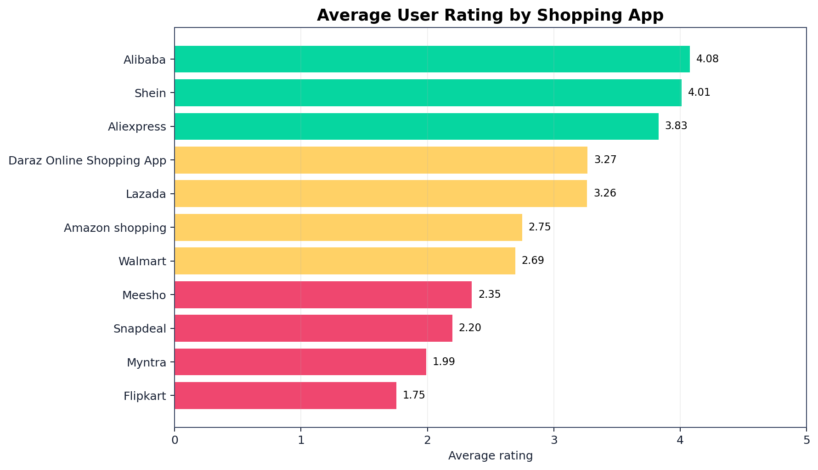
Best-Performing Apps
Average rating gives a quick baseline before text sentiment
Top rating leaders
4.08/5
94,500 reviews
Alibaba
4.01/5
40,500 reviews
Shein
3.83/5
125,999 reviews
Aliexpress
Shopping App Reviews Sentiment Analysis | 7

Slide 8
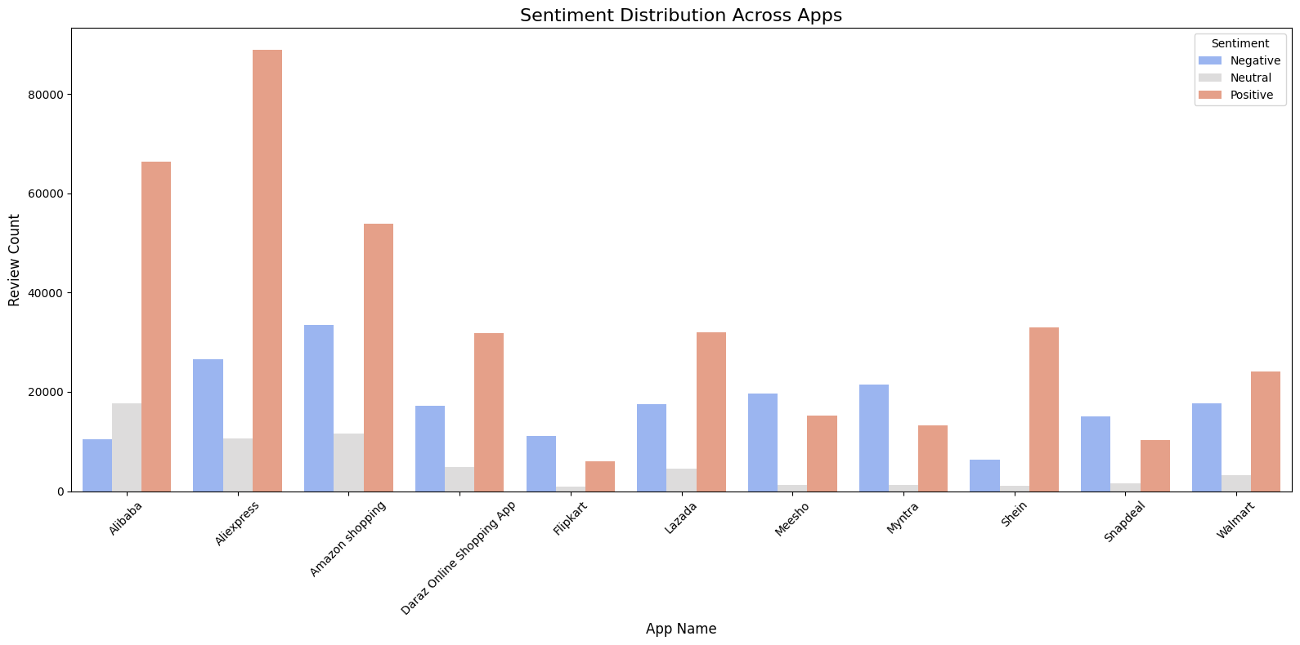
VADER Sentiment Distribution
The notebook compares sentiment counts by application
Shopping App Reviews Sentiment Analysis | 8

Slide 9
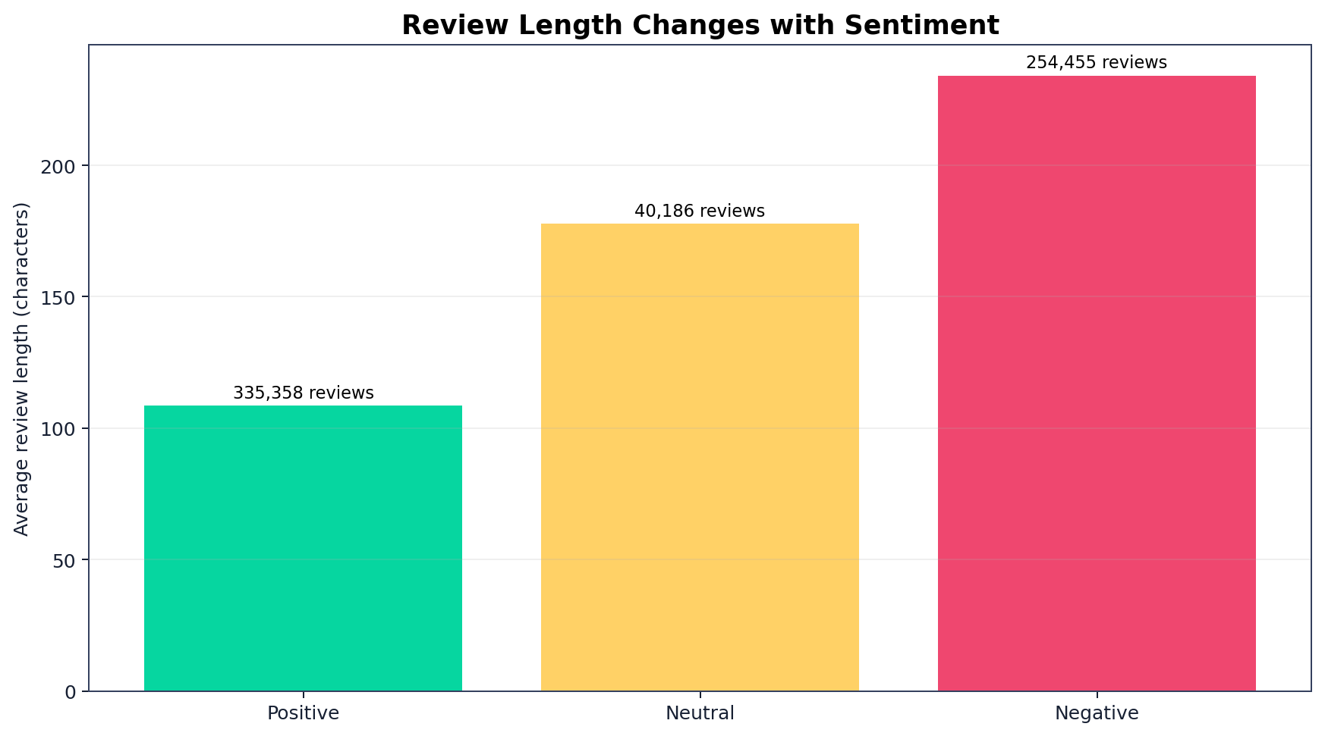
Clustering Review Characteristics
Review length and sentiment can segment user feedback
Created review_length from the character count of each review.
Encoded sentiment numerically: Positive = 1, Neutral = 0, Negative = -1.
Standardization makes both features comparable.
K-Means groups similar review behavior patterns for app-level inspection.
Shopping App Reviews Sentiment Analysis | 9

Slide 10
Key Insights & Conclusion
What the analysis reveals about customer experience
Alibaba, Shein, and Aliexpress show the strongest average rating baselines.
Flipkart, Myntra, Snapdeal, and Meesho need closer attention in this dataset.
Negative reviews are useful because they surface friction: shipping, notifications, quality, trust, and app usability.
Sentiment analysis helps product teams prioritize issues faster than manual review reading.
Shopping App Reviews Sentiment Analysis | 10

Slide 11
Future Scope
How the project can be extended
Use live app-store review streams for real-time monitoring.
Add topic modelling to connect sentiment with product issues.
Build a dashboard for app-wise sentiment trends over time.
Compare VADER against transformer models for higher accuracy.
Add multilingual sentiment support for regional shopping apps.
Shopping App Reviews Sentiment Analysis | 11

