Slide 1

SURE ProEd
A UNIT OF SURE TRUST
SKILL UPGRADATION FOR RURAL-YOUTH EMPOWERMENT – TRUST
INTERNSHIP PROJECT ON:-
SOLAR PANEL CLEANING SYSTEM
Presented by:
VINAYAK VIJAYMAHANTESH KUBAKADDI
G14 AUTOCAD
Under the Guidance of:
YALLASIRI SHANMUKH RAVITEJA

Slide 2
INTRODUCTION OF THE MODEL
Solar panels need to be clean to work efficiently and produce maximum electricity.
Dust, dirt, bird droppings, and leaves reduce the power output of solar panels.
Manual cleaning is time-consuming, costly, and not practical for large systems.
An automatic cleaning system helps keep panels clean without human effort.
This project uses a camera sensor to detect dirt on the solar panel.
When the camera detects dirt, the system automatically starts cleaning (e.g., with a wiper or brush).
It saves time, reduces labor cost, and improves solar panel performance.
The system is smart, efficient, and suitable for homes, buildings, and solar farms.

Slide 3
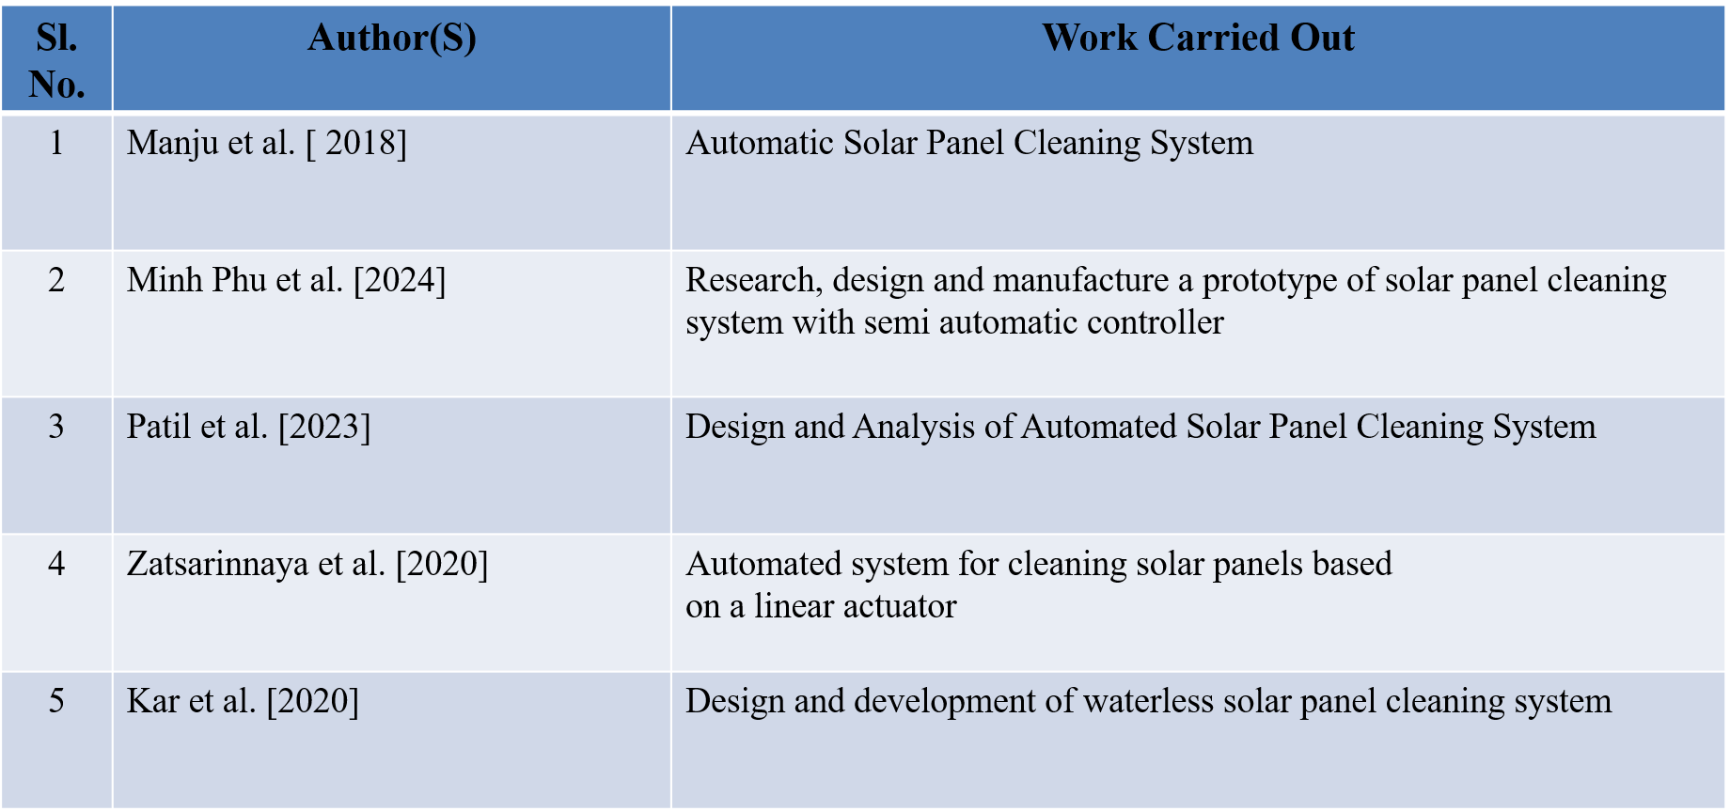
LITERATURE REVIEW

Slide 4
PROBLEM STATEMENT
Solar panels are widely used to generate clean and renewable electricity. However, dust, dirt, bird droppings, and other particles accumulate on the surface of solar panels over time. This reduces the amount of sunlight reaching the photovoltaic cells and consequently decreases the efficiency and power output of the solar panel.
Manual cleaning requires significant time, labour, and water, especially in large solar installations. Therefore, there is a need for an efficient, economical, and automated solar panel cleaning system that can regularly remove dust and dirt from the panel surface with minimum human intervention. The proposed system aims to improve solar panel performance, reduce maintenance effort, and maintain maximum power generation through an effective cleaning mechanism.

Slide 5
OBJECTIVES
To design and develop an automated solar panel cleaning system to remove dust, dirt, and other particles from the panel surface.
To improve the efficiency of solar panels by maintaining a clean surface for maximum absorption of sunlight.
To reduce manual labour and maintenance time required for cleaning solar panels.
To develop a cost-effective cleaning mechanism suitable for domestic as well as large-scale solar installations.
To minimize water consumption during the cleaning process.
To ensure safe and effective cleaning without causing damage to the solar panel surface.
To improve the overall power generation and performance of the solar energy system.
To create a reliable system with minimum human intervention for regular solar panel maintenance.

Slide 6
METHODOLOGY
Problem Identification
Need & Objective Definition
Literature Review & Research
Requirement Analysis
Concept Development
CAD Modelling
Analysis & Validation
Final Design Output

Slide 7
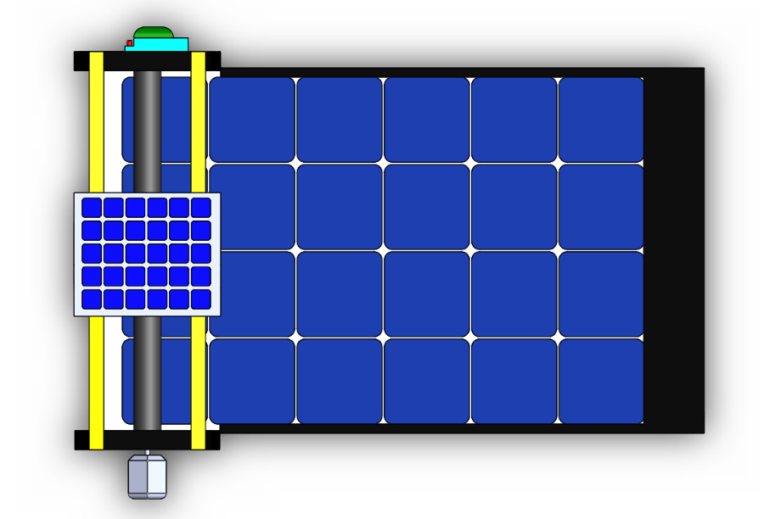
3D DESIGN
SOLAR MODEL FOR POWER SUPPLY
MOTOR
RELAY MODEL
BRUSH
ROTATING SYSTEM OF CLEANING SYSTEM
CLEANING PLATFROM FOR SOLAR PANEL
SOLAR PANEL

Slide 8
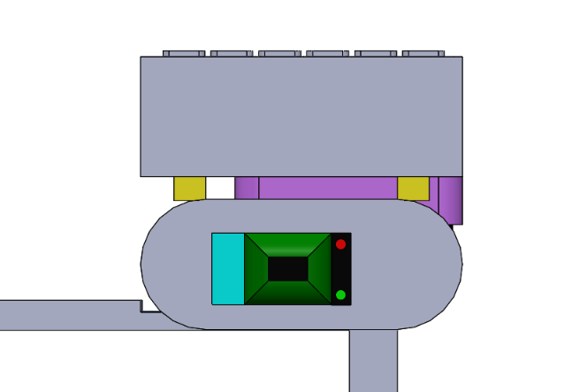
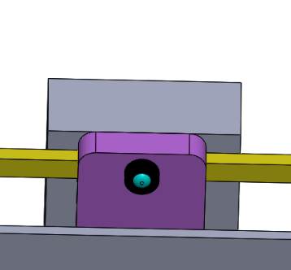
RELAY MODEL
FUNCTIONS OF COMPONENTS
Turn electrical devices ON/OFF
Control high-power devices using a low-power signal
Provide electrical isolation between control and power circuits
Work automatically with sensors and programmed systems
Control devices such as motors, pumps, lights, and other electrical equipment
Capture photos
Stream live video over Wi-Fi
Detect/monitor objects (with programming)
Send images and data through Wi-Fi
Work with sensors and automation systems
CAMERA SENSOR

Slide 9
FUNCTIONS OF COMPONENTS
SOLAR MODEL FOR POWER SUPPLY
Convert sunlight into electrical energy
Supply electrical power to the system
Charge the battery for energy storage
Provide power to electronic components and motors
Enable the system to operate using renewable solar energy
MOTOR
Convert electrical energy into mechanical motion
Provide rotational or linear movement for the cleaning mechanism
Drive the brush or cleaning mechanism across the solar panel
Work automatically based on the control system signals
Enable efficient movement and operation of the solar panel
cleaning system

Slide 10
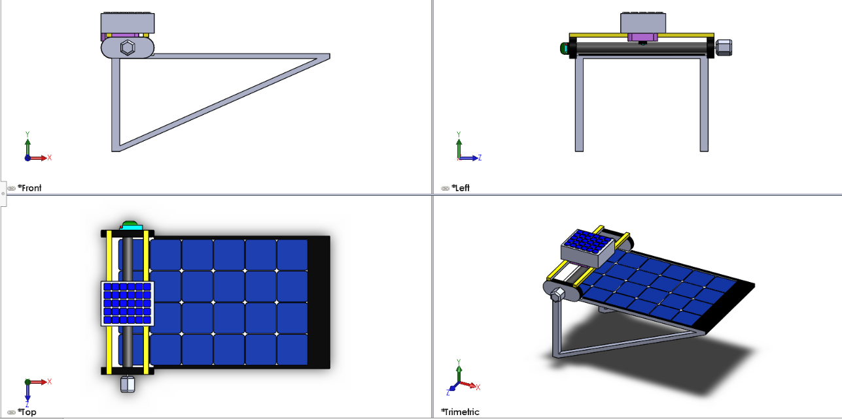
ALL VIEWS OF THE MODEL

Slide 11
FUTURE WORK
  The future work of the solar panel cleaning system can focus on improving its automation, efficiency, and reliability. Dust and environmental sensors can be integrated to automatically detect dirt accumulation and initiate the cleaning process when required. IoT-based monitoring can allow users to control and monitor the system remotely through a mobile application. The system can also be powered using solar energy generated by the panel itself, making it more energy-efficient and sustainable. Future developments may include waterless cleaning mechanisms, weather-based control, AI-based cleaning schedules, and improved robotic movement for different sizes and orientations of solar panels. The system can also be further developed for large-scale solar power plants to clean multiple panels automatically while reducing maintenance cost and improving overall power generation efficiency.

Slide 12
CONCLUSION
The solar panel cleaning system is designed to provide an effective and efficient solution for removing dust, dirt, and other particles accumulated on the surface of solar panels. Regular cleaning helps maintain maximum sunlight absorption and improves the overall power generation efficiency of the solar panel. The proposed system reduces manual effort, saves time, and provides a safer and more convenient cleaning method. By using an automated mechanism, the system can perform cleaning operations efficiently and consistently. Overall, the solar panel cleaning system is a practical, cost-effective, and sustainable solution that can help improve the performance and lifespan of solar power systems.

Slide 13
THANK YOU

