Slide 1
Simply Explained
If you can’t explain it simply, you don’t understand it well enough.
– Albert Einstein

Slide 2
BLOCKCHAIN
Goal
Simply Explain it to have common understanding across group

Slide 3





CURRENT
$100
$85

Slide 5
PROBLEM/SOLUTION - Elevator Pitch
1. Thirdparty - Trusted middleman
2. Fee - sizeable cut of the transaction
3. Time - often days
For <Individuals>
WHO <want to transfer money>
THE <COINER>
IS A <DISTRIBUTED, COST EFFECTIVE, REALTIME Money TRANSFER>
THAT <allows individuals>
UNLIKE <the current third-parties acting as middleman which is expensive and slow>
OUR PRODUCT <provides individuals with quick, cost effective transfer without any third-party>
BLCOCKCHAIN ATTEMPTS TO SOLVE MONEY TRANSFER

Slide 6
TWO BASIC TERMS
BITCOIN
MONEY WHICH IS DIGITAL
BLOCKCHAIN
TECHNOLOGY
THAT ENABLES
MOVING
DIGITAL ASSESTS
FROM ONE ENTITY
TO ANOTHER

Slide 7
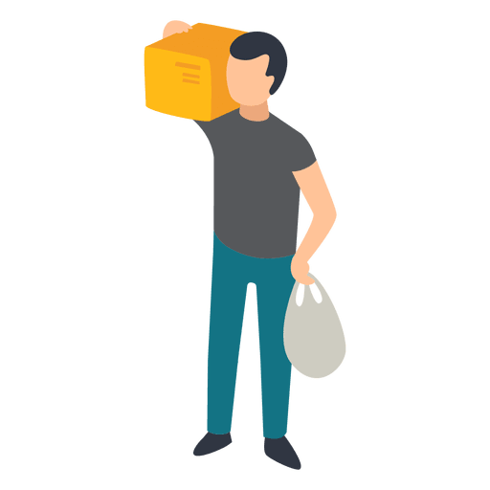

OPEN LEDGER 1st principle (Chain of transactions - public)
$50
J: $100
Inception/Genesis
J->D: $50
1 -> How much money
everyone has
2 -> Everyone can validate
a transaction
$150
D->S: $30
$30
S->V: $10
$10

Slide 8
DISTRIBUTED OPEN LEDGER 2nd principle
$50
J: $100
J->D: $50
$150
D->S: $30
$30
S->V: $10
$10

Slide 9
MINER’s 3rd principle
$50
J: $100
J->D: $50
D->S: $30
D->V: $10
D->V: $10
$30
Miner
Special node
Compete for unvalidated transaction
1. Validate the transaction
2. Key to put into the ledger (SHA256)
First one will get financial reward
Publish Validated transaction and its Key to lock
J: $100
J->D: $50
D->S: $30
D->V: $10

Slide 10
Key Takeaway:
ANY process that relies on trusting a middleman, regardless of industry, can potentially be improved with blockchain

Slide 11
Demo
Hash
Block
Blockchain
Distributed
Token
Coinbase

