Slide 1
Chicago Car Crashes
A guide for Vehicle Safety Board to reduce car crashes

Slide 2
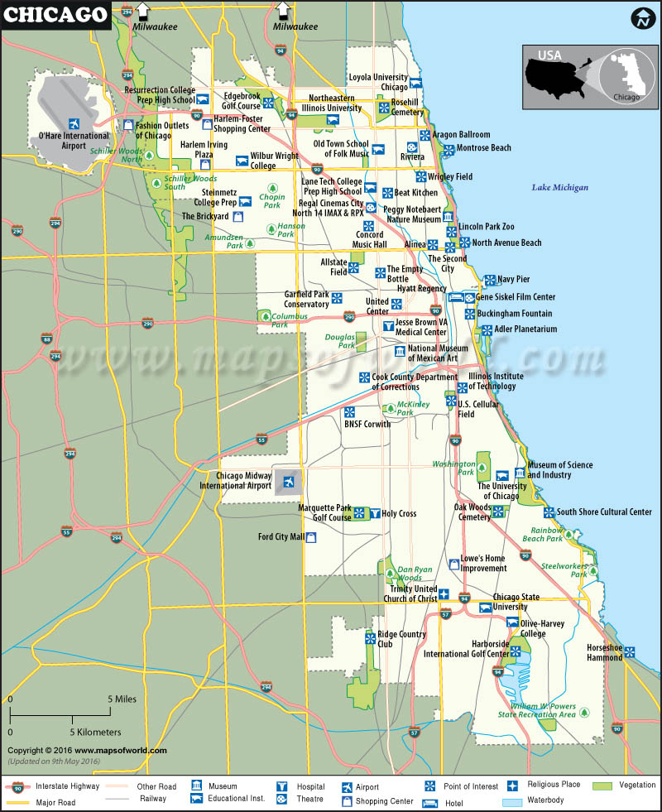
Predicting Types of Car Crashes Can Save Lives
There are almost 118,000 car crashes in Chicago with known cause and known history.
Chicago is the 3rd largest city in the USA
Chicago is the eighth worst city for drivers out of the 100 most populated cities.

Slide 3
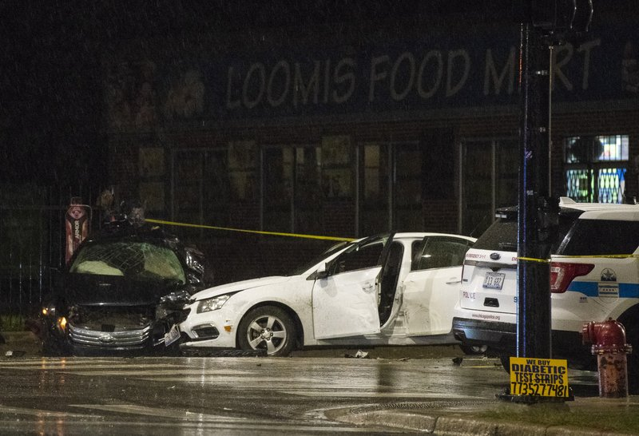
Data Quality: a Potential Issue
Out of about 520,000 car crashes, we only have quality data for about 118,000 for the same.
Recommendation: Improving data quality to improve model performance.

Slide 4
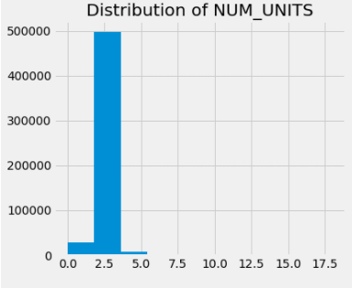
Overview of Analysis
Of about 65% of car crashes, a civilian gets injured.
There is a high chance of at least two units of vehicles to get into an accident.

Slide 5
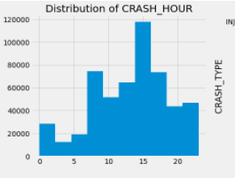
Afternoon crashes
Crashes hit the peak in the afternoon.

Slide 6
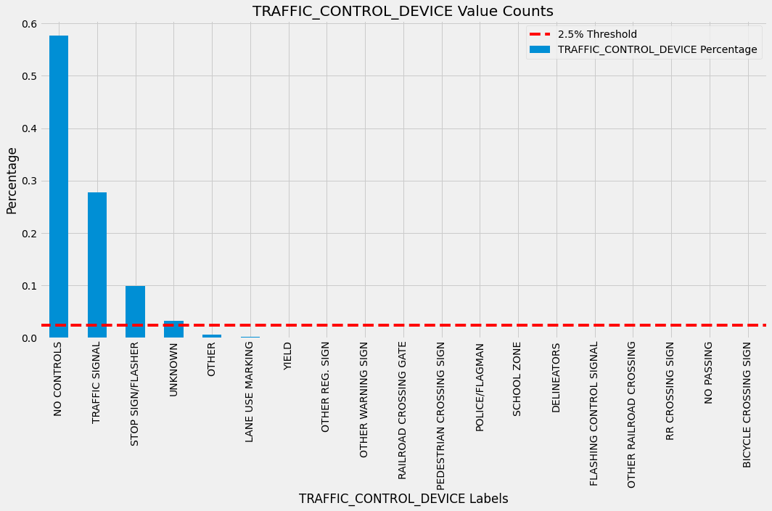
Usually Civilians have no control over the vehicle

Slide 7
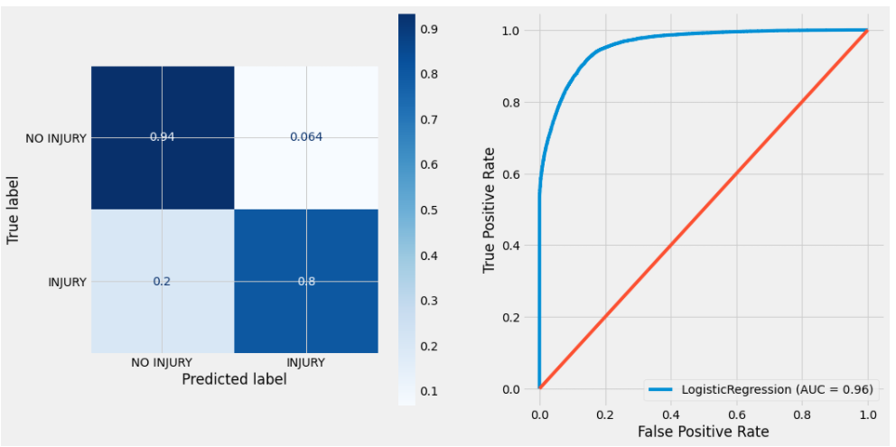
Best Classification Modeling of Crash Injury
1. Random Forest Performance
2. Logistic Regression
Logistic Regression Performance

Slide 8
Thank you!
Questions?

Slide 9
Appendix

Slide 10
Add a Slide Title - 4

Slide 11
Add a Slide Title - 5

