Slide 1
Pneumonia Detection
A Deep learning project by Vinayak And ABDULLAH

Slide 2
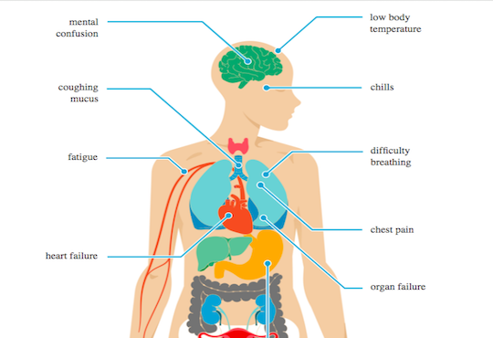
Business Problem
Pneumonia is an inflammatory disease caused by infection with viruses or bacteria in the lungs.
Affects about 445 million (about 7% of the total population) and results in about 4.3 million deaths
Can be lethal if not treated – Can be treated if diagnosed during the early onset
Can we use Deep Learning to detect Pneumonia?
Can we use Deep learning to making informed medical decisions on other diseases?

Slide 3
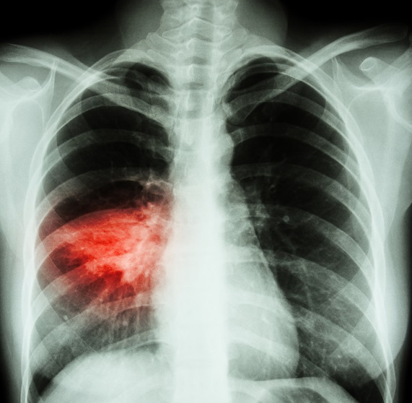
Diagnosing Pneumonia
Doctor’s Expertise based on evaluating the patient and symptoms.
X-ray imaging (The red portion in the image) – A Radiologist or a Physician.

Slide 4
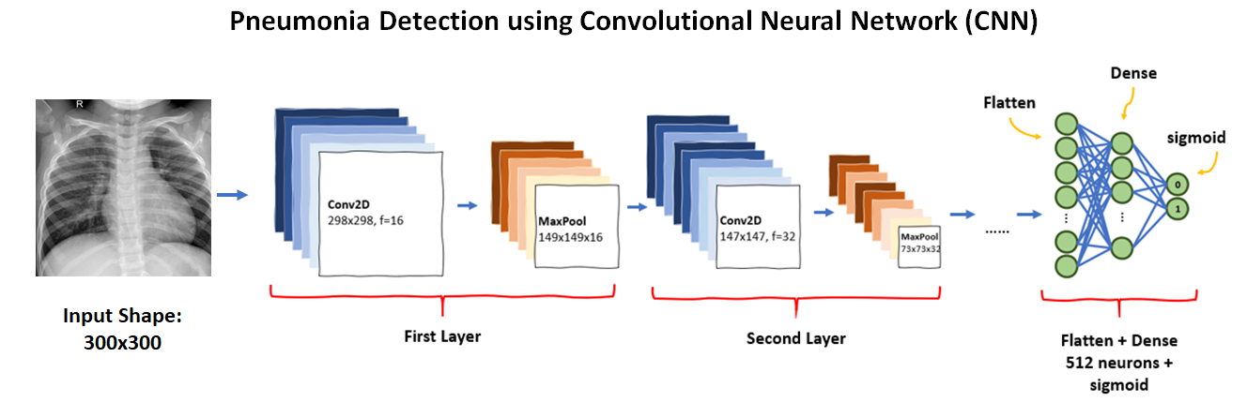
Convolutional Neural Networks –The Solution
“Convolutional neural networks (CNNs) are effective tools for image understanding. They have outperformed human experts in many image understanding tasks” (Sarvamangala & Kulkarni, 2021).

Slide 5
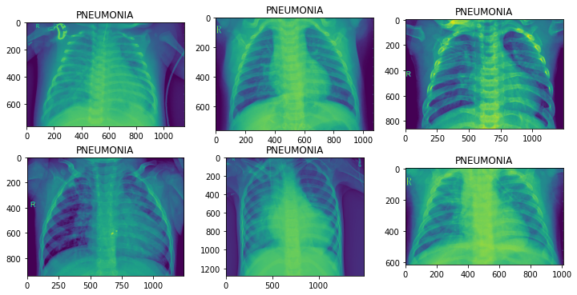
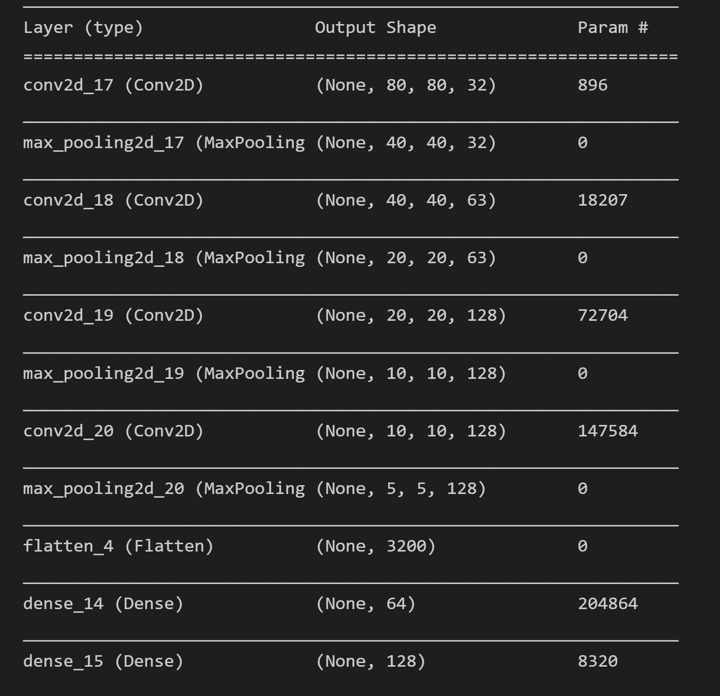
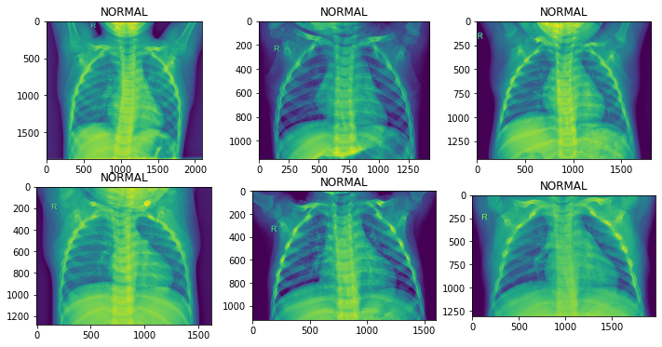
CNN Working
CNN

Slide 6
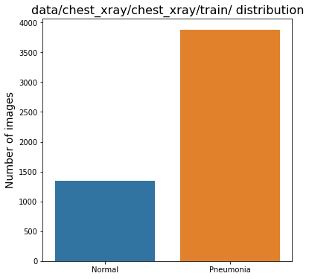
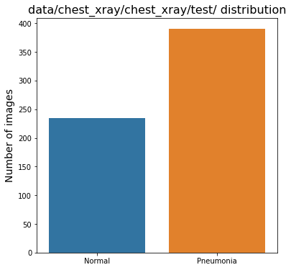
The data we trained the NN model on contain normal and pneumonia X-rays as the 2 class
Exploratory Data Analysis
Test data balance: Normal = 37.4% Pneumonia=62.3%
Train data balance: Normal = 25.7% Pneumonia=74.2%

Slide 7
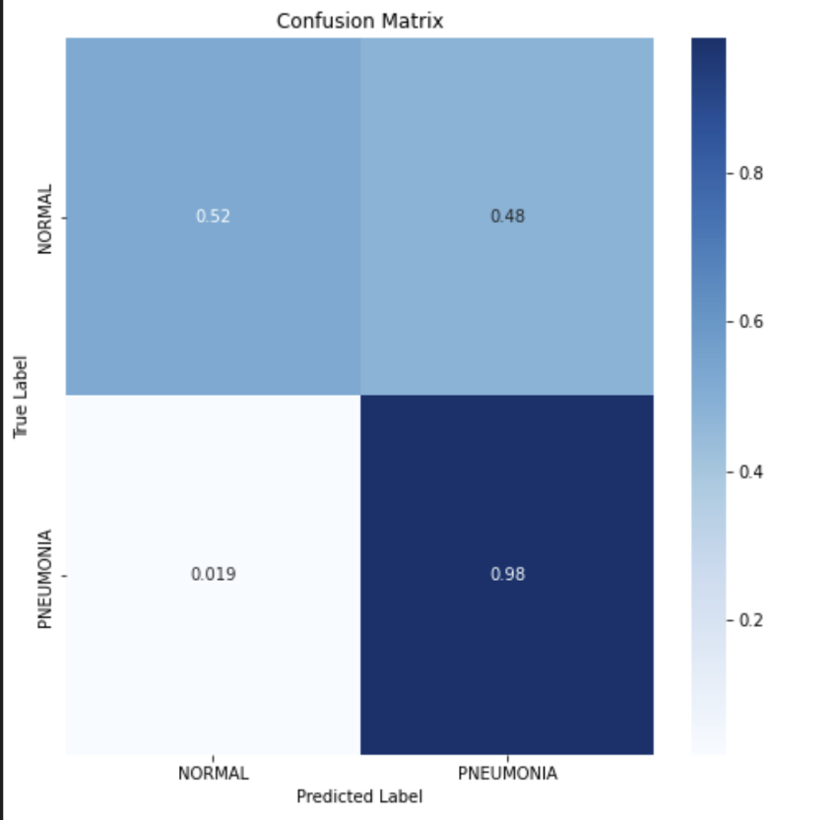
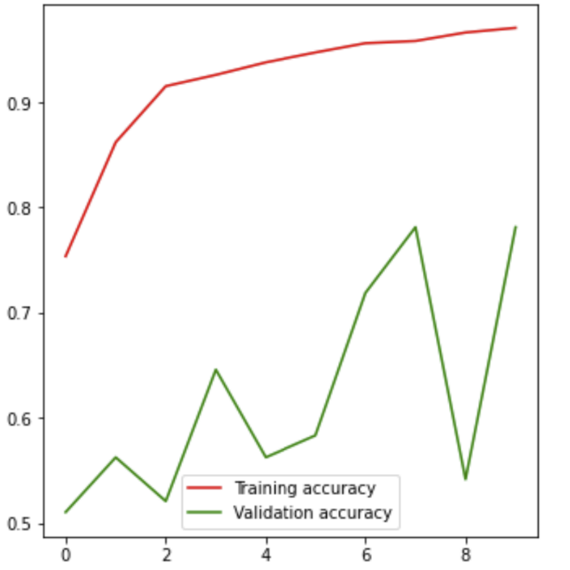
Modelling
Baseline Model
Model structure (2 CNN layers, 2 Max Pool layers and 2 Dense layers
Training Accuracy = 97%, val accuracy = 78.12& (Overfitting)
Confusion Matrix - The model does extremely well with detecting pneumonia but has limited functionality because of high false positive rate.

Slide 8
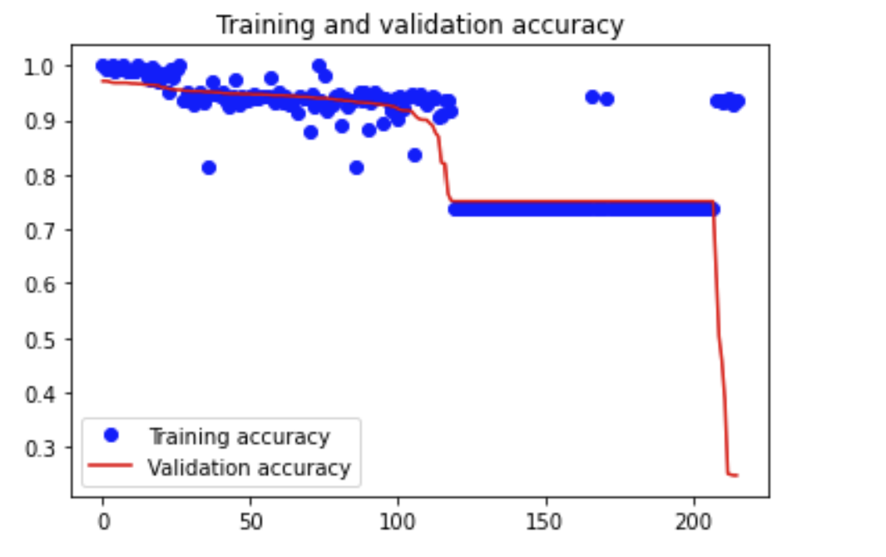
Best Model
Model Structure: 1 CNN layer, 1 MaxPool layer, 2 Dense layers, Dropout layer.
Talos for the params
Talos ran 216 models and the best model parameters were:
Activation-fnc (CNN and dense): relu, Dropout:0.25, Nodes(CNN):128, Nodes(Dense), Optimizer:adam
loss | accuracy | val_loss | val_accuracy
0.007022 | 0.999726 | 0.097082 | 0.971246

Slide 9
Further Studies
“A recent publication estimated that by 2020, there will be 200 times more medical information than what a single individual would be able to read in his/her entire life” (Chumbita et al., 2020)
The goal of the model was achieved with over 95% validation accuracy
However, the accuracy could be further increased by adding additional CNN and dense layers to the model structure, and then using the best parameters from Talos

Slide 10
Thank You

