Slide 1


Microsoft Movie Studio
Microsoft enters the movie market

Slide 2



Summary
Long gone has the time when IMAX, PVR dominated the screening of movies. Genres of various kinds can be found on streaming services as part of the monthly subscription business. Streaming originals has been the go-to in the recent movie trends. Movie reviewing websites help tons in selecting the genres and trends.
Streaming giants have taken over the throne. Netflix, Hulu, HBO Max are dominating the industry. Enter the market with guns blazing

Slide 3

Outline
This presentation consists of 5 parts:
Business Problem
Data
Methods
Results
Conclusions

Slide 4

Business Problem
Venturing into the movie market, Microsoft has a choice of making original video content just like Netflix and Hulu does. As a beginner in this industry, Microsoft needs to find out the recent trends in the movie industry, and the popularity of movies as seen on IMDB, Rotten Tomatoes and TMDB. The solution is to analyse the data and help the head of Microsoft’s new movie studio to make business decisions..

Slide 5

Methods
In this presentation, we will use descriptive analysis to find out which movies are the most profitable in the recent trends.

Slide 6
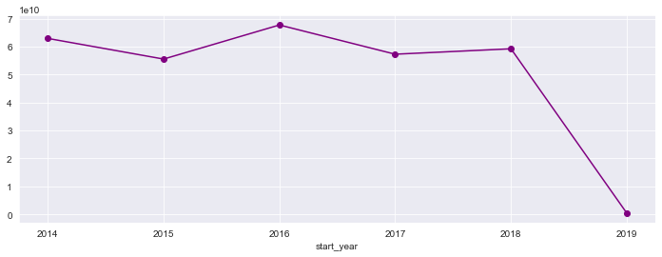
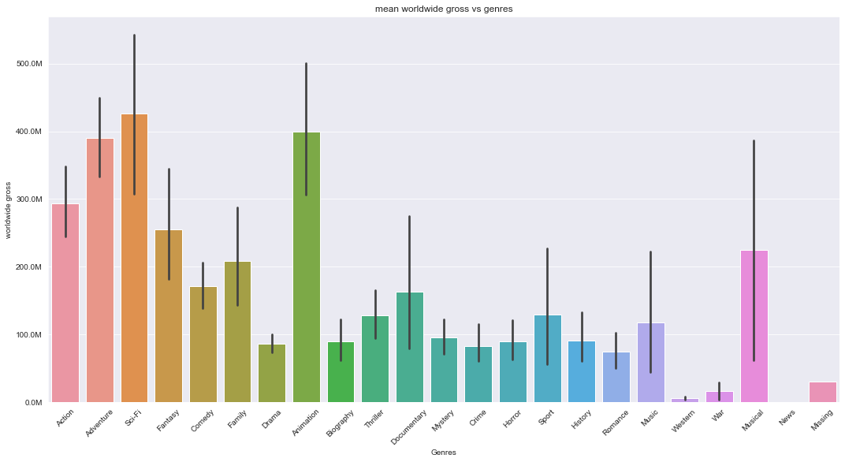
Data
Data for about 600 movies from 2014 to 2019.
Includes movies from different data
The graph above shows the total profit worldwide of all the movies from year 2014 to year 2019
According to the graph beside, Sci-Fi makes the most profit globally followed by Animation and Adventure respectively. (domestically as well as internationally)

Slide 7
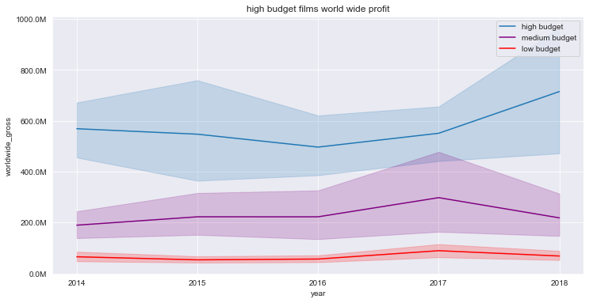
Recent trends in profits for different budget movies
Gross profit max in 2018 for high budget films
Gross profit max in 2017 for medium and low budget films

Slide 8
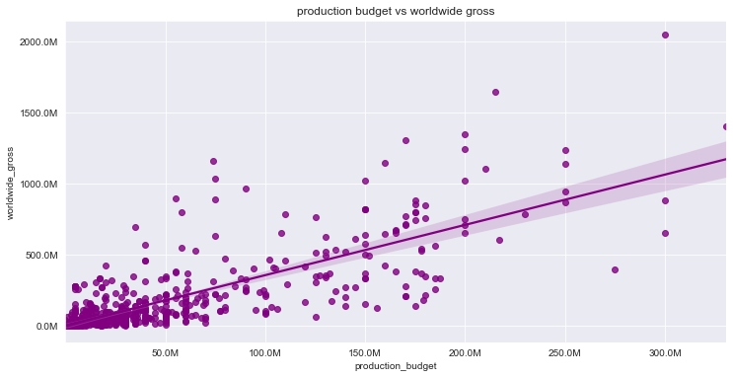
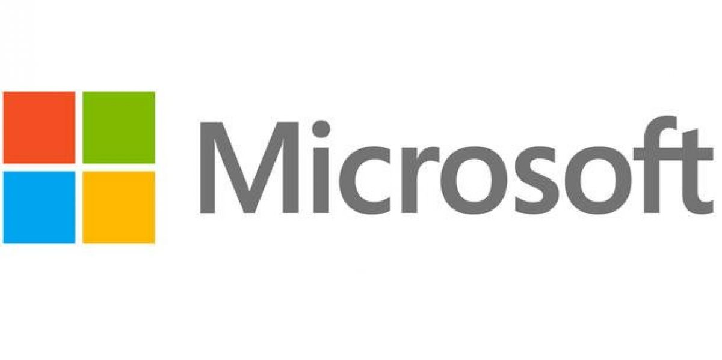
Results
Large image
Linear relationship between production budget and worldwide gross
Higher the production budget better is the worldwide gross

Slide 9
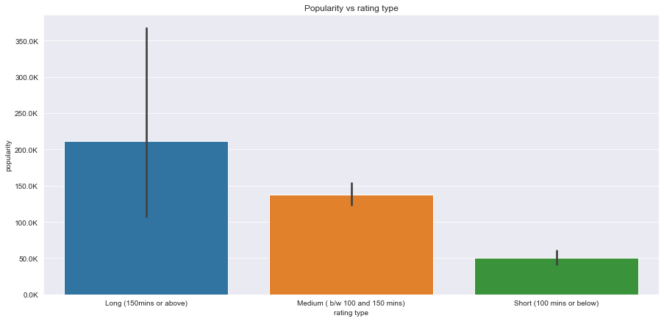
Popularity vs Rating
Movies running over 150 minutes turn out to be more popular than medium movies as well as short movies.

Slide 10
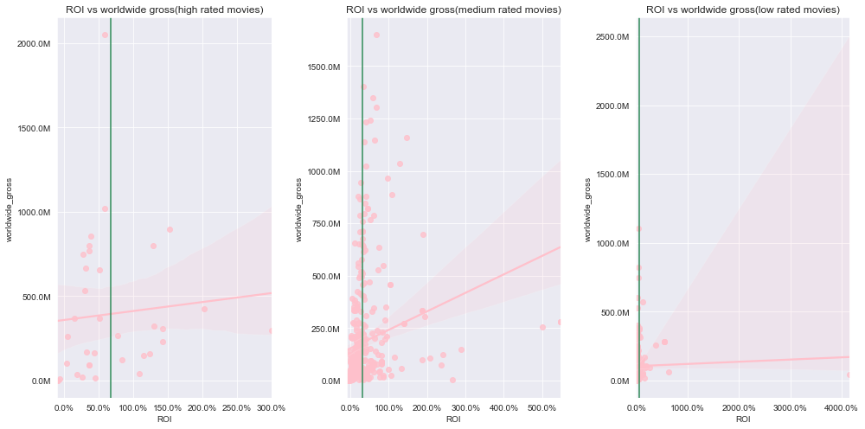
ROI vs worldwide gross profit
No relationship but as we can see, highly profitable films do not amount to maximum ROI

Slide 11
Conclusion/Recommendation
This analysis leads to three recommendations for producing original video content:¶
Microsoft needs to invest in media companies that make content in Sci-Fi, Animation and Adventure.
As seen from the trends, usually long movies are more popular and therefore Microsoft should focus on the same.
Movies with high rating doesn't necessarily amount to the return on investment being high. As we can see, medium rated films perform better than others in terms of ROI.
Next Steps:
The following steps that can be taken by Microsoft are:
Improve production speed by investing more in genre-specific studios.
Aim for high return on investment which is usually seen from medium rated movies.
Allocate high budgets to movies

Slide 12





Thank You
Vinayak Modgil
8968021470
vinayak.modgil@gmail.com
github.com/vinayakmodgil

Slide 13
Questions?

