Slide 1

ParkGrid
A1
A2
A3
A4
A5
Smart Parking Allocation System
B1
B2
B3
B4
B5
IoT / IoE project | QR gate access | ML peak alerts
C1
C2
C3
C4
C5
Team
D1
D2
D3
D4
D5
Reg No - Name
Reg No - Name
Reg No - Name
Live slot map: free / booked / occupied
Reg No - Name
Notes:
Title slide. Fill in the four Reg No - Name entries before presenting.

Slide 2






Problem and goal
The problem
Our goal
Drivers circle the lot hunting for a free spot
Book a specific slot in advance
Attendants check tickets and lift barriers
Contactless QR entry and exit, no attendant
No warning before the lot fills up
Live occupancy plus ML peak alerts
ParkGrid
2
Notes:
Frame the problem in one sentence, then the goal. Keep it short.

Slide 3
What ParkGrid does
Four capabilities, two dashboards
Pre-book a slot
Walk-in booking
QR gate access
ML peak alerts
Pick a slot and time; get a signed QR code
Guest kiosk, no account, nearest free slot
Scan to enter and exit; gate opens by itself
Forecast when the lot will cross 85%
User dashboard
Monitor
Admin
book, QR, history
3D lot + live activity log
free slots for demo resets
ParkGrid
3
Notes:
Two dashboards: one for users, one (Monitor) that shows how the system works. Admin is an operator tool.

Slide 4
System architecture
Hardware is simulated; everything downstream is real
EDGE (simulated)
BACKEND (FastAPI)
FRONTEND (React)
Sensor simulator
ESP32 + HC-SR04 x20
MQTT
broker
(Mosquitto)
MQTT worker
User dashboard
REST API + JWT
Monitor (3D + logs)
Gate simulator
servo boom gate
WebSocket hub
Admin
ML predictor
Guest kiosk / Gate
Key idea
PostgreSQL
The backend only sees MQTT messages, so real ESP32 devices can replace the simulators with no backend change.
ParkGrid
4
Notes:
Walk left to right. The MQTT broker is what decouples hardware from software.

Slide 5


How the IoT layer is simulated
Two Python programs publish real MQTT messages
MQTT topics
Sensor simulator
Topic | Direction | Carries
parking/sensor/{n}/status | device to backend | distance_cm, occupied
parking/gate/command | backend to gate | open, entry or exit
parking/gate/ack | gate to backend | cycle completed
ESP32 + HC-SR04 for each of 20 slots
Simulated clock at 60x speed
Day curve: about 3% at night up to 92% at noon
Raw distance + 30 cm occupied threshold
Gate simulator
Design choice
Servo boom sweep 0 to 90 degrees and back
Receives open command, sends acknowledgement
Local event log, like device serial output
Gate-controlled slots are held occupied so the random simulation never overwrites a real gate scan.
ParkGrid
5
Notes:
Emphasise: no real hardware, but the messages are real MQTT, so the backend cannot tell the difference.

Slide 6










IoT components for a real deployment
Hardware that would replace the simulators (12 components)
ESP32 DevKit
Arduino Uno / Nano
Raspberry Pi 4
HC-SR04 ultrasonic
Wi-Fi MCU, one per 4 slots
Simple sensor-node option
Gate gateway, camera, broker
Slot occupancy, x20
IR obstacle sensor
RGB / R-G-Y LEDs
SG90 / MG996R servo
Pi Camera / webcam
Vehicle at gate lane, x2
Per-slot status, x20
Boom barrier motor
Reads the QR at the gate
OLED / 16x2 LCD
Active buzzer
5 V relay module
PSU + buck converter
Gate message display
Accept / reject tone
Switches barrier power
5 V / 12 V power rails
Also: 220 ohm resistors, logic-level shifter (5 V echo to 3.3 V), Wi-Fi router, enclosures and cabling
ParkGrid
6
Notes:
Full table with quantities and wiring notes is in the documentation, section 4.3.

Slide 7
From sensor to LED
How one slot's state is decided
1
2
3
4
5
HC-SR04
ESP32
MQTT
Backend
LED + UI
measures distance to the car
distance < 30 cm means occupied
JSON status message, QoS 1
applies state rules, saves to DB
slot colour updates live
LED colours
Free
Booked
Occupied
green LED
red + green mix
red LED
ParkGrid
7
Notes:
A booked-but-empty slot is expected to look empty to the sensor, so the backend keeps it BOOKED until the car arrives.

Slide 8



Working: booking to exit
The same QR code opens the gate twice
Book
Get QR
Scan
Validate
Gate opens
Pre-book or guest kiosk
Signed token on phone
Gate camera reads QR
Signature + booking state
Slot turns red, event logged
Slot state machine
FREE
booking created
BOOKED
scan: entry
OCCUPIED
scan again: exit
FREE
Admin can free any slot; unused bookings expire when their window ends.
ParkGrid
8
Notes:
Entry and exit use the same QR. The first scan is entry, the next scan is exit.

Slide 9
QR code and gate validation
Signed tokens, checked on the server
Checks at POST /gate/scan
Token anatomy
payload
booking_id, slot_id
+
HMAC signature
(secret key)
Signature valid?
else 400
eyJib29raW5nX2lkIjoxNH0.zK3...
Booking found, token matches?
else 404
Why it is safe
Not completed, cancelled, expired?
Guessing a booking id fails: signature mismatch
Token must equal the one stored for the booking
Validity comes from booking status and time window
else 409
Pending: entry. Active: exit.
gate command sent
Camera re-reads are ignored for 12 s so one QR is not scanned twice by accident.
ParkGrid
9
Notes:
The QR is signed, not encrypted. The scanner ignores the same code for 12 seconds so a lingering QR does not toggle entry into exit.

Slide 10

Machine learning: data and target
UCI Parking Birmingham dataset (id 482)
35,717
30
11
30 min
readings
car parks
weeks, Oct-Dec 2016
sampling interval
What it predicts
Regression
Classification
Occupancy percentage of the lot (0-100%) at a given hour
Will the next reading reach 85% or more? Drives the peak alert banner
ParkGrid
10
Notes:
The dataset has capacity, occupancy and timestamp per car park. We derive percentage occupancy and a next-reading threshold flag.

Slide 11
ML training pipeline and factors
Dataset
Feature engineering
Time-ordered split
80% / 20%
Random Forest
regressor + classifier
joblib models
/predictions/peak
Factors used (features)
Feature importance
hour
time of day
rolling avg
78.7%
day_of_week
weekday pattern
hour
17.1%
is_weekend
weekend flag
capacity ratio
3.0%
capacity_ratio
lot size
day of week
0.9%
rolling_avg_occupancy
mean of last 3 readings
is weekend
0.3%
ParkGrid
11
Notes:
Chronological split so the test set is genuinely future data. The rolling average dominates: recent occupancy is the strongest predictor of near-term occupancy.

Slide 12
Machine learning results
Held-out later period (5-19 Dec 2016), 7,142 readings
Error, lower is better (occupancy %)
0.948
R², Random Forest
13.41
baseline linear model: 0.759
9.31
0.987
ROC-AUC, peak classifier
6.23
accuracy 0.94, F1 0.84
3.71
0.95
recall on peak class
misses few real peaks
Linear Regression
Random Forest
RMSE
MAE
ParkGrid
12
Notes:
Random Forest halves the error of the linear baseline. Limitation: the model learned from large lots; retrain.py adapts it to our 20-slot lot using our own logs. The LSTM in the notebook was not run.

Slide 13

Technology stack
Backend
Frontend
Infrastructure
FastAPI + Uvicorn
React 18 + Vite
Docker + Docker Compose
SQLAlchemy 2 + Alembic
Tailwind CSS (dark theme)
Mosquitto MQTT broker
PostgreSQL 16
Recharts
7 services, one command
JWT + bcrypt
Three.js + react-three-fiber
Proposed: AWS IoT Core,
paho-mqtt, WebSockets
qrcode.react, html5-qrcode
ECS Fargate, RDS, S3,
scikit-learn, pandas, joblib
React Router, Axios
CloudFront, ElastiCache
ParkGrid
13
Notes:
Everything runs from one docker compose command. The cloud items are the proposed deployment, not deployed.

Slide 14
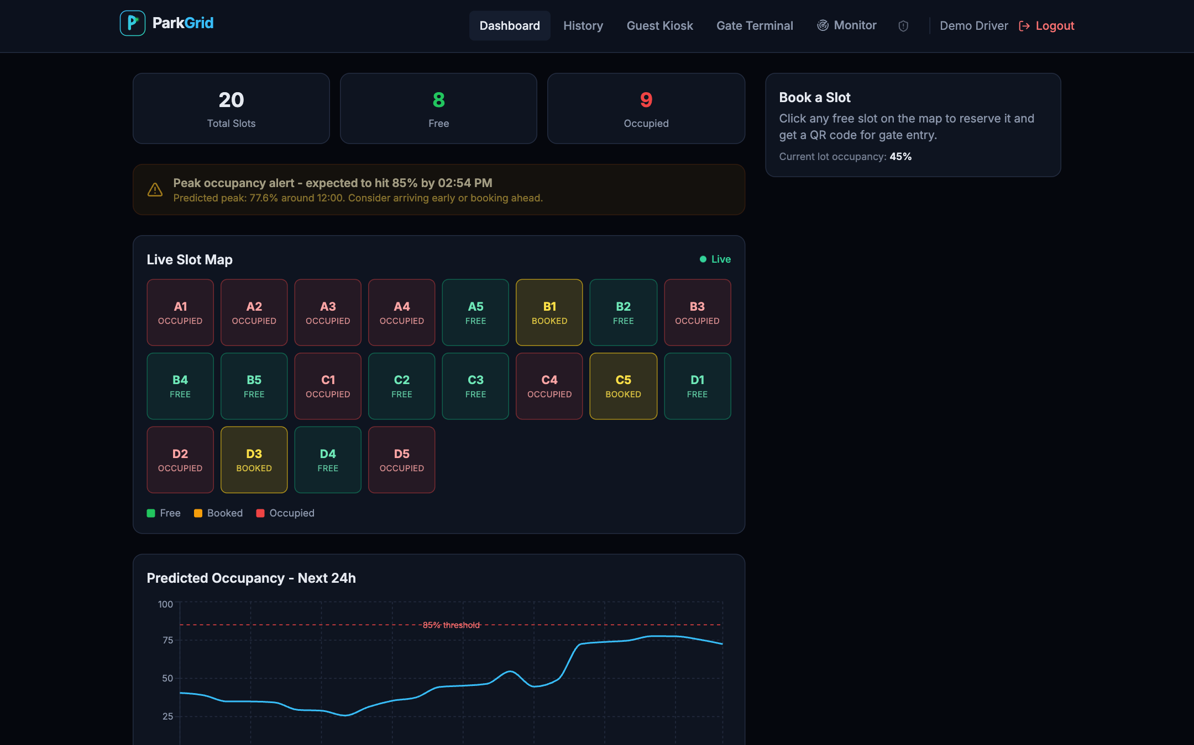

User dashboard
Live slot map, ML alert and booking
Live slot map over WebSocket
Green free, yellow booked, red occupied
24 h forecast and peak alert
Click a free slot to book it
ParkGrid
14
Notes:
Real screenshot of the dashboard with a mix of free, booked and occupied slots.

Slide 15
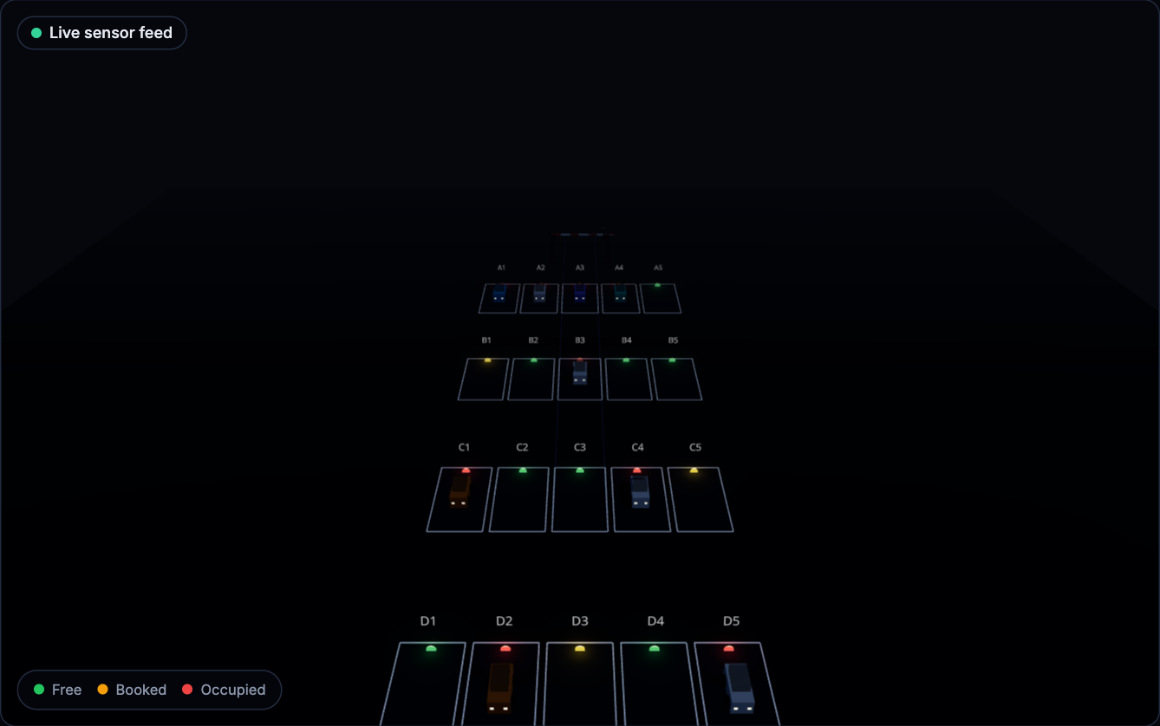
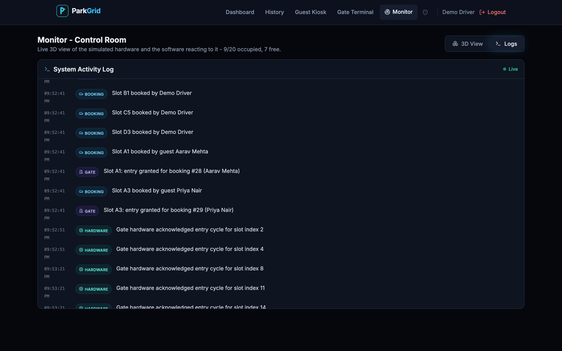
Monitor dashboard
3D control room and live activity log
3D view: LED per slot, parked cars, animated gate
Logs: bookings, gate actions, hardware acknowledgements
Present a booking QR to the webcam: the boom lifts and a car drives to its slot
Every event reads as a sentence, not raw telemetry
ParkGrid
15
Notes:
Show the 3D scene and the log side by side; both are driven by the same live state.

Slide 16
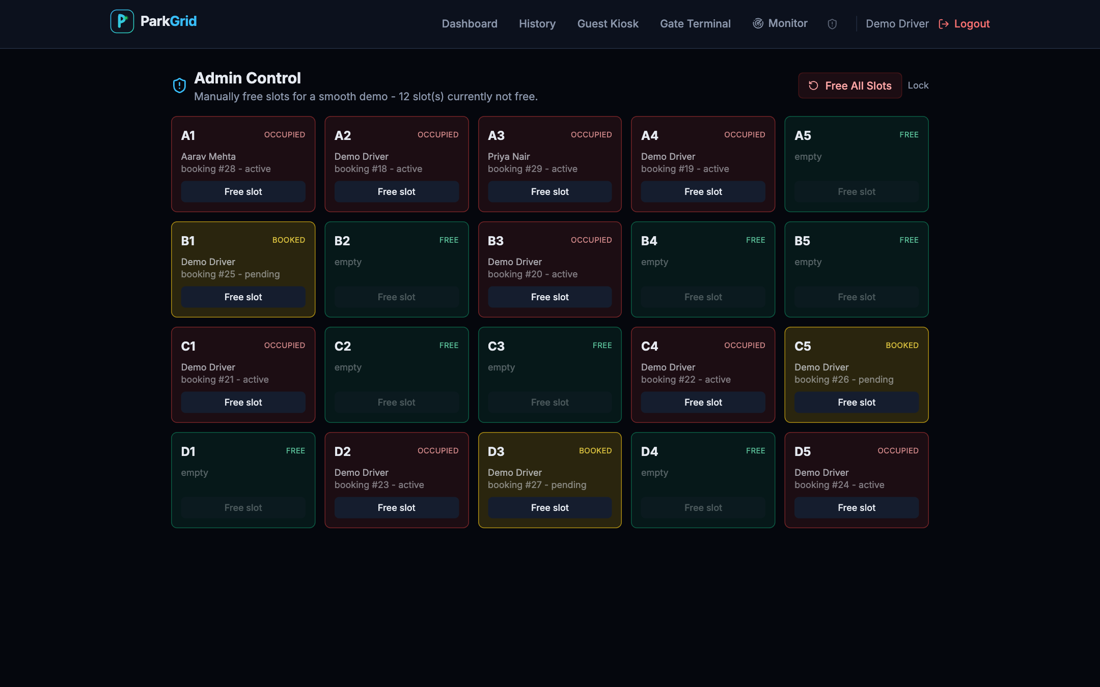
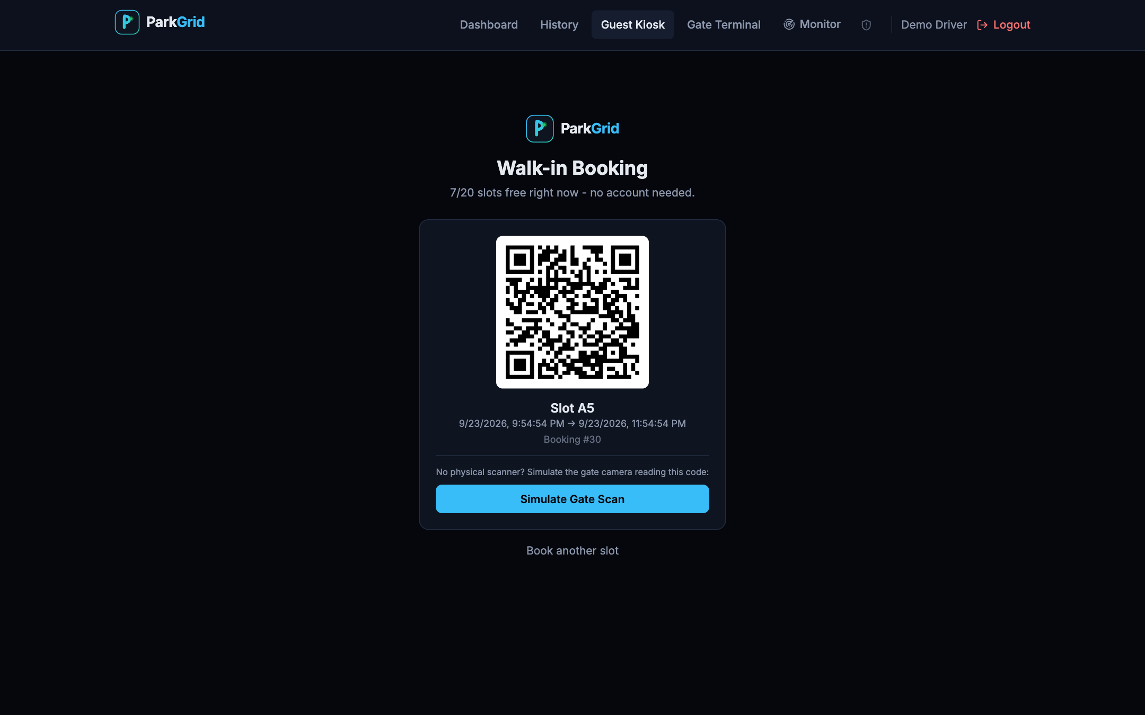
Admin control and guest kiosk
Demo resets and walk-in booking
Admin: free one slot or all, with occupant details
Guest kiosk: booking ticket with signed QR
Admin is protected by a shared token; freeing a slot also closes its booking and logs the action
A phone can open the kiosk over the same Wi-Fi, generate a QR, and the laptop webcam scans it
ParkGrid
16
Notes:
The kiosk works from a phone on the same network by opening the laptop's IP address.

Slide 17
Cloud implementation (proposed)
Designed for AWS; not deployed
ESP32 / Pi devices
X.509 certificate each
AWS IoT Core
MQTT over TLS
Backend on ECS Fargate
behind load balancer
Amazon RDS
PostgreSQL
Scheduled
retraining job
S3
model artifacts
ElastiCache Redis
WebSocket pub/sub
CloudFront + S3
React static site
Users: browsers and phones
HTTPS + WSS
CloudWatch
logs + alarms
Why move: managed MQTT and per-device certificates, scaling, backups, HTTPS (browsers need it for camera access off localhost)
ParkGrid
17
Notes:
Direct mapping: Mosquitto to IoT Core, Postgres to RDS, backend container to Fargate, in-process WebSocket fan-out to Redis. Secrets move to Secrets Manager.

Slide 18
Results
Measured on the development laptop (local Docker, median of 8 runs)
13 ms
23 ms
~21 ms
0.948
guest booking request
gate scan (entry)
live update reaches browser
forecast R² (held-out)
Pre-book, scan, enter, scan again, exit: slot green, yellow, red, green
Guest walk-in gets the nearest free slot and a QR
Forged, expired or reused QR is rejected with a reason
Phone generates the QR; laptop webcam scans it on the same Wi-Fi
2D map, 3D LEDs and activity log always agree (one shared state)
ParkGrid
18
Notes:
Latency numbers are local loopback figures, so they show the server work is small, not real-network performance.

Slide 19
Challenges and fixes
Real bugs found while integrating
Symptom
Cause
Fix
Gate scans undone within seconds
Random sensor simulation overwrote real bookings
Gate-controlled slots are held
Slot stayed green after scanning
Camera re-read the QR; 2nd scan meant exit
12 s same-code cooldown
Phone could not open the app
API address hard-coded to localhost
Derive backend host from page host
Database enum errors
SQLAlchemy created enum twice / used names
Explicit enum handling in migration
ParkGrid
19
Notes:
The first two are the most instructive: both are interactions between independent parts (simulator vs booking, camera vs scan logic).

Slide 20

Limitations and future work
Limitations
Future work
No physical hardware built
Model trained on large lots; retrain on own logs
LSTM comparison not run (no TensorFlow)
Single backend process, shared admin token
Slots held from booking time, no time-window scheduling
Build one real ESP32 + HC-SR04 + LED node
Retrain on accumulated entry logs
Cloud deployment with IoT Core and RDS
Payments and dynamic pricing
Licence-plate recognition, mobile app alerts
ParkGrid
20
Notes:
Be upfront about what is simulated and what is real.

Slide 21
Thank you
Questions?
Notes:
Open for questions.

