Slide 1
What is the best answer to queries on search engines?
Which packages forms the foundation of R ?

Slide 2

Shivaji University, Kolhapur
Department of Statistics
Seminar on
“Google Matrix and PageRank Algorithm”
Presented by
Sable Vinayak Machhindra
MSc.I Statistics Sem(I)
Under the Guidance of
Dr. S.B.Mahadik
2017-2018

Slide 3
Introduction
We live in a computer era. Internet is part of our everyday lives and information is only a click away. Just open your favorite search engine, like google, altavista, yahoo, type in the key words, and the search engine will display the pages relevant for your search. But how does a search engine really work? It's answer is google 's PageRank algorithm
PageRank works by counting the number and quality of links to a page to determine a rough estimate of how important the website is. The underlying assumption is that more important websites are likely to receive more links from other websites.It's find by using google 's matrix
A google matrix is a particular stochastic matrix that is used by google 's PageRank algorithm. The matrix represents a graph with edges representing links between pages. The rank of each page can be generated iteratively from the google matrix using the power method. However, in order for the power method to converge, the matrix must be stochastic, irreducible and aperiodic

Slide 4
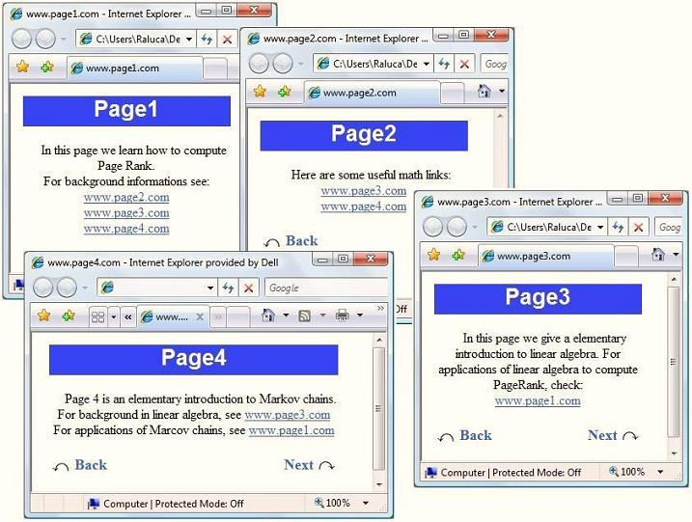
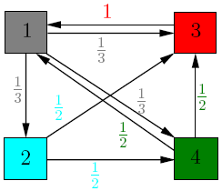
An Artificial Web World
Imagine a web which has only 4 web pages, which are linked to each other. Each of the box below represents a web page.
In our model, each page should transfer evenly its importance to the pages that it links to. After analyzing each web page, we get the following graph

Slide 5
What is PageRank?
PageRank is a link analysis algorithm which assigns weight to each page with the purpose of measuring the relative importance of the page.
The heart of Google’s searching software is PageRank, a system for ranking web pages developed by Larry Page, one of the founder of the Google and Sergey Brin at Stanford University.
PAGE RANK determines the importance of WebPages based on link structure.
PageRank (PR) is an algorithm used by google search to rank websites in their search engine results. PageRank is a way of measuring the importance of website pages.
PageRank works by counting the number and quality of links to a page to determine a rough estimate of how important the website is.The underlying assumption is that more important websites are likely to receive more links from other websites.

Slide 6

Google's PageRank algorithm
Lets consider how authors of the method, Brin and Page , define PageRank.
Lets P_{i} is a web page and P₁,P_{2,} ..., P_{j} are pages linking to the page P_{i} . Lets O(P_{j}) is the number of outgoing links from the page P_{j} . The parameter d is a damping factor which can be set between 0 and 1 (typically 0.85). Assume that n is the number of pages. Then Let r_{k+1}(Pi) be the PageRank of page Pi at iteration k+ 1.Then,
.
Where
r_{k+1}(Pi) = PageRank of page pi at iteration k+ 1.
d = Damping factor=0.85
r_{k}(P_{j}) = The PageRanks of pages inlinking to page P_{i}
n = The number of WebPages
O(P_{j}) = No. Of out bounding links of page (p_{j})
B_{pj} = The set of all pages linking to p_{i}
This process is initiated with r₀(P_{i})=1/n for all pages P_{i} and repeated with the hope that the PageRank scores will eventually converge to some final stable values

Slide 7
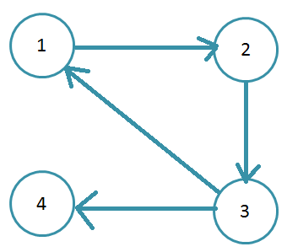
Mathematical Formulation of Google Page PageRank
To facilitate our discussion of PageRank, we apply the PageRank algorithm to the directed graph with 4 nodes shown inbelow

Slide 8
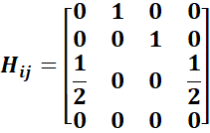
Web Hyperlink Matrix
The process for determining PageRank begins by expressing the directed Web graph as the n × n “Hyperlink Matrix(H)” where n is the number of WebPages
If webpage i has l_{i} ≥ 1 links to other WebPages and webpage i links to webpage j, then the element in row i and column j of H is H_{ij} =1/l_{i} Otherwise, H_{ij} = 0
Thus, H_{ij} represents the likelihood that a random surfer selects a link from webpage i to webpage j. For the directed graph in above figure
Node 4 is a Dangling Node because it does not link to other nodes. As a result, all entries in row 4 of the example matrix are zero. This means the probability is zero that a random surfer moves from node 4 to any other node in the directed graph

Slide 9

Stochastic Matrix
When a Web surfer lands on dangling node WebPages, the surfer can either stop surfing or move to another webpage, perhaps by entering the Uniform Resource Locator (URL) of a different webpage in the address line of a Web browser.
To solve this problem, Brin and Page define their first adjustment, which we call the Stochasticity Adjustment because the 0^{t} rows of H are replaced with 1/n e^{T} , thereby making H stochastic. As a result, the random surfer, after entering a dangling node, can now hyperlink to any page at random. For the tiny 4-node web of Figure, the Stochastic Matrix called S is
Where,
H = web hyperlink matrix,
n = no. Of WebPages
e = the column vector of all 1s
a = Dangling node vector
a_{i} =1, if page i is a dangling node and 0 otherwise

Slide 10
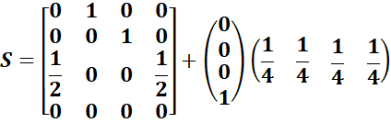
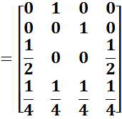
Stochastic Matrix for given problem is
The model is not yet complete. Even when WebPages have links to other WebPages, a random web surfer might grow tired of continually selecting links and decide to move to a diﬀerent webpage some other way
Like for the graph in figure, there is no directed edge from node 2 to node 1. On the web, though, a surfer can move directly from node 2 to node 1 by entering the URL for node 1 in the address line of a web browser. like a Star Trek character, “teleports” to the new page The matrix S does not consider this possibility.

Slide 11

Google Matrix
To model the overall behaviour of a random Web surfer Brin and Page invented a new matrix is called Google Matrix (G), such that
Where,
S= Stochastic Matrix ,
n = no. Of WebPages
e = the column vector of all 1s
d = damping factor
More About Damping Factor
The damping factor, d, in the Google matrix indicates that random web surfers move to a diﬀerent webpage by some means other than selecting a link with probability 1−d. The majority of experiments performed by brin and page during the development of the PageRank algorithm used
d = 0.85

Slide 12
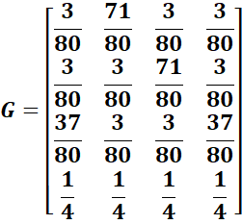
Google Matrix for given problem :

Slide 13
Properties of Google Matrix (G)
G is Stochastic. It is the convex combination of the two stochastic matrices S and (1/n)ee^{t}.
G is Irreducible. Every page is directly connected to every other page, so irreducibility is trivially enforced.
G is Aperiodic. The self-loops (G_{ii} > 0 for all i) create aperiodicity.
G is Primitive. because G^{k} > 0 for some k. (In fact, this holds for k =1.) This implies that a unique positive π^{T} exists, and the Power Method applied to G is guaranteed to converge to this vector.
G is Completely Dense.
G is Artiﬁcial in the sense that the raw hyperlink matrix H has been twice modiﬁed in order to produce desirable convergence properties. A stationary vector (thus, a PageRank vector) does not exist for H, so Brin and Page creatively cheated to achieve their desired result. For the twice-modiﬁed G, a unique PageRank vector exists, and as it turns out, this vector is remarkably good at giving a global importance value to WebPages.

Slide 14
Computation Of The PageRank Vector
For small Google matrices , we can quickly ﬁnd exact solutions to the eigensystem, πG = π. The Google matrix for the entire Web has more than 25 billion rows and columns, so computing the exact solution requires extensive time and computing resources. The oldest and easiest technique for approximating a dominant eigenvector of a matrix is the Power Method. The power method converges when the dominant eigenvalue is not a repeated eigenvalue for most starting vectors . Since λ = 1 is the dominant eigenvalue of G and π is the dominant left eigenvector, the power method applied to G converges to the PageRank vector. This method was the original choice for computing the PageRank vector.
Given a starting vector π⁽⁰⁾, e.g. π⁽⁰⁾= (1/n)e^{T}, the power method calculates successive iterates
.
π^{(k)} = π^{(k-1)}G where k = 1,2,...,
Minimum iteration are depends upon value of damping factor(d). It's given below:
d | 0.5 | 0.75 | 0.8 | 0.85 | 0.9 | 0.95 | 0.99 | 0.999
no, of Iterations | 34 | 81 | 104 | 142 | 219 | 449 | 2292 | 23015

Slide 15
Google’s PageRank vector is the stationary vector of G and is given by :
.
π^{T} = ( 0.21 0.26 0.31 0.21 )
The interpretation of π₁ = 0.21 is that 21% of the time the random surfer visits page 1, Therefore, the pages in this tiny web can be ranked by their importance as (3 2 1 3), meaning page 3 is the most important page and page 1 & 4 is the least important page, according to the PageRank deﬁnition of importance.

Slide 16
Application of PageRank algorithm
We will use PageRank algorithm to find the most important packages in R software. The simple philosophy being, the packages which are referred by many different packages on R are the ones forming the foundation of R
The relative importance-measuring property of the PageRank link analysis algorithm could be used to identify new possible drug targets in proteins. A PageRank-based algorithm could identify important protein targets in the pathogen organism better than a method considering only the number of incoming edges (in-degree) of a node in the metabolic network. The reason for this is that some already known, important protein targets do not have a high degree (are not hubs) and also, perturbing some hubs could result in unwanted physiological effects.
PageRank is now regularly used in bibliometrics, social and information network analysis, and for link prediction and recommendation. It's even used for systems analysis of road networks, as well as biology, chemistry, neuroscience, and physics
Personalized PageRank is used by Twitter to present users with other accounts they may wish to follow.

Slide 17


Now let's see how we can actually obtain the PageRank of web pages
see more…..

Slide 18
References:
Google’s PageRank and Beyond: The Science of Search Engine Rankings, Amy N. Langville and Carl D. Meyer

Slide 19
Thank you......

