Slide 1
POLLUTION
Pollution is the introduction of harmful materials into the environment. These harmful materials are called pollutants. Pollutants can be natural, such as volcanic ash. They can also be created by human activity, such as trash or runoff produced by factories.

Slide 2
TYPES OF POLLUTION:
Air pollution.
Water pollution.
Soil pollution.
Radioactive pollution.
Noise pollution

Slide 3
AIR POLLUTION
Air pollution is contamination of the indoor or outdoor environment by any chemical, physical or biological agent that modifies the natural characteristics of the atmosphere.
Household combustion devices, motor vehicles, industrial facilities and forest fires are common sources of air pollution. Pollutants of major public health concern include particulate matter, carbon monoxide, ozone, nitrogen dioxide and sulfur dioxide. Outdoor and indoor air pollution cause respiratory and other diseases and are important sources of morbidity and mortality.
WHO data show that almost all of the global population (99%) breathe air that exceeds WHO guideline limits and contains high levels of pollutants, with low- and middle-income countries suffering from the highest exposures.
Air quality is closely linked to the earth’s climate and ecosystems globally. Many of the drivers of air pollution (i.e. combustion of fossil fuels) are also sources of greenhouse gas emissions. Policies to reduce air pollution, therefore, offer a win-win strategy for both climate and health, lowering the burden of disease attributable to air pollution, as well as contributing to the near- and long-term mitigation of climate change.

Slide 4
WATER POLLUTION
Water pollution occurs when harmful substances—often chemicals or microorganisms—contaminate a stream, river, lake, ocean, aquifer, or other body of water, degrading water quality and rendering it toxic to humans or the environment.
This widespread problem of water pollution is jeopardizing our health. Unsafe water kills more people each year than war and all other forms of violence combined. Meanwhile, our drinkable water sources are finite: Less than 1 percent of the earth’s freshwater is actually accessible to us. Without action, the challenges will only increase by 2050, when global demand for freshwater is expected to be one-third greater than it is now.

Slide 5
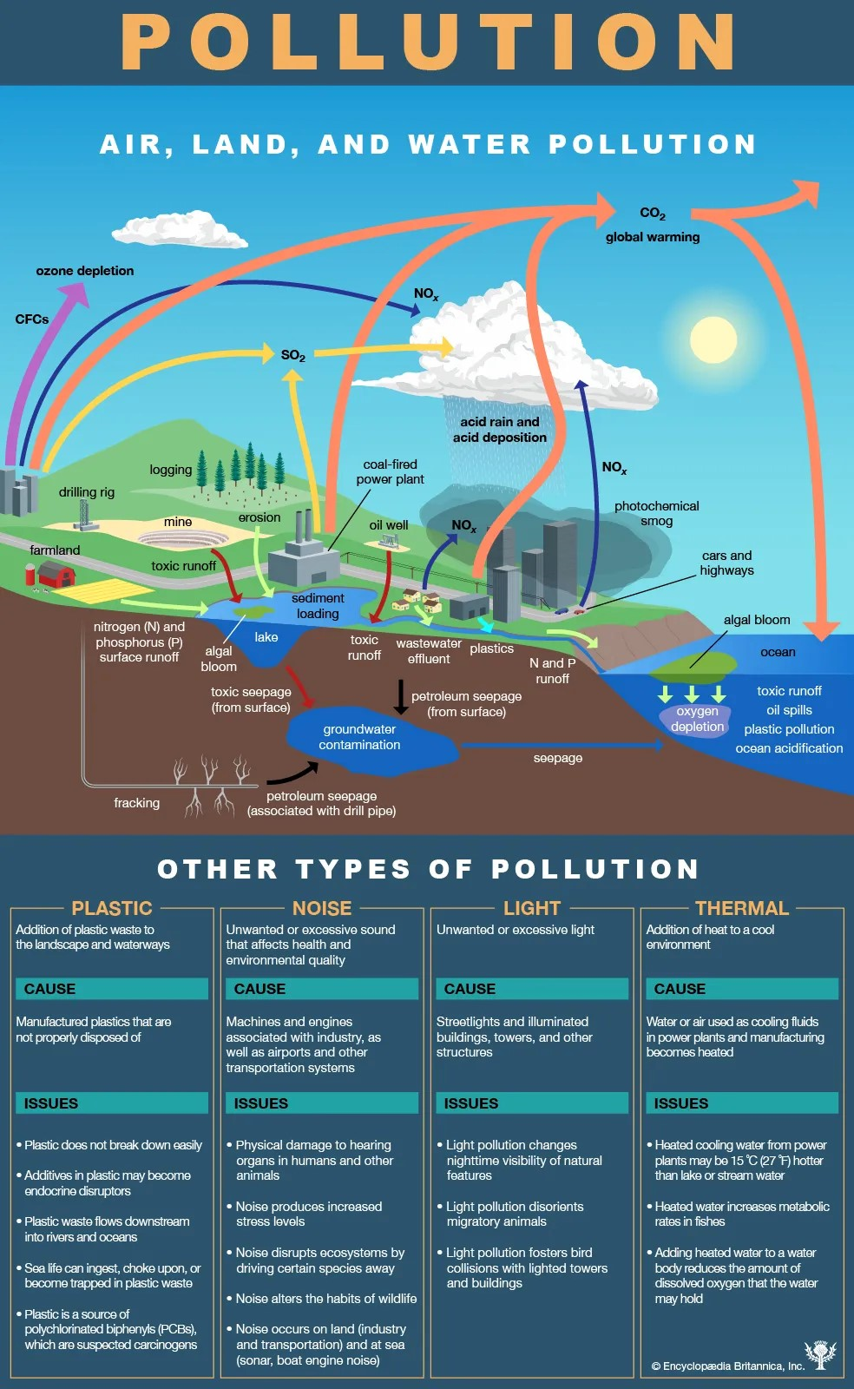

Slide 6
SOIL POLLUTION
It is a serious environmental concern since it harbours many health hazards. For example, exposure to soil containing high concentrations of benzene increases the risk of contracting leukaemia. An image detailing the discolouration of soil due to soil pollution is provided below.
It is important to understand that all soils contain compounds that are harmful/toxic to human beings and other living organisms. However, the concentration of such substances in unpolluted soil is low enough that they do not pose any threat to the surrounding ecosystem. When the concentration of one or more such toxic substances is high enough to cause damage to living organisms, the soil is said to be contaminated.

Slide 7
RADIOACTIVE POLLUTION
Natural radioactivity, as the name suggests, occurs naturally in our environment. Some radioactive elements such as uranium and thorium are present in rocks and soil, albeit in trace quantities. Interestingly, humans and all other living organisms contain nuclides such as carbon-14, which are created by cosmic rays.
Man-made radioactivity is the result of nuclear weapon discharge or a nuclear reactor containment breach. In such scenarios, all living organisms in the vicinity of the nuclear event will become contaminated by fission products and remnants of nuclear fuel. This can be in the form of radioactive dust or even particles that are found on various surfaces.

Slide 8
NOISE POLLUTION
Noise pollution can cause health problems for people and wildlife, both on land and in the sea. From traffic noise to rock concerts, loud or inescapable sounds can cause hearing loss, stress, and high blood pressure. Noise from ships and human activities in the ocean is harmful to whales and dolphins that depend on echolocation to survive.

Slide 9
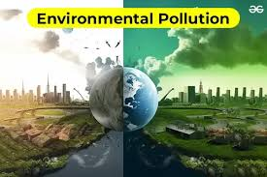
ENVIRONMENTAL POLLUTION
Pollution is the introduction of contaminants into the natural environment that cause adverse change. Pollution can take the form of any substance or energy. Pollutants, the components of pollution, can be either foreign substances/energies or naturally occurring contaminants

Slide 10
THANK YOU

