Slide 1
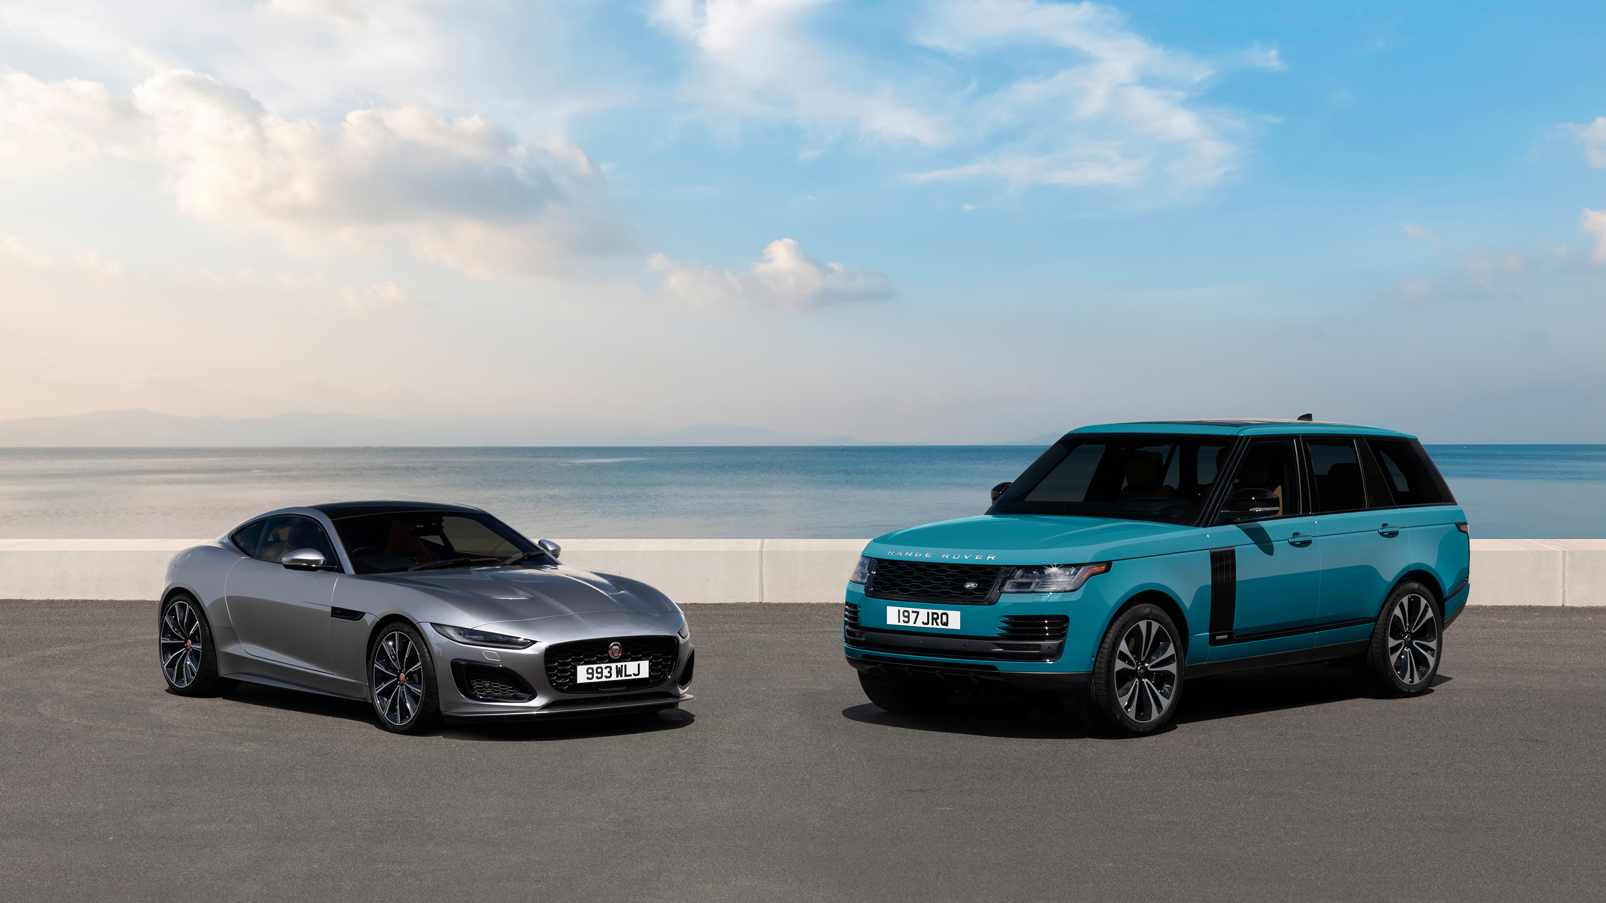

TATA GROUP
" We innovate mobility solutions with passion to enhance the quality of life "
Strategy & Business Modeling By Vinayak Singh

Slide 2






























Tata Group, a multinational conglomerate
Founded by Jamsetji Tata in 1868,
the Tata group is a global enterprise, headquartered in India, comprising
30 companies across ten verticals. Tata Motors, the group's flagship automotive company, manufactures and markets automobiles for every need and segment.
In a Nutshell
Key Group Companies
>$180 billion
Combined Group Revenue
1 million+
Collective Workforce Strength
TECHNOLOGY
MATERIALS
AUTOMOTIVE
TOURISM AND TRAVEL
>$328 billion
Combined Market Cap of
26 publicly listed Tata enterprises¹
$31.6 billion
Brand Valuation, making it India’s most valuable brand²
CONSUMER AND RETAIL
INFRASTRUCTURE
FINANCIAL SERVICES
150+ countries
across 6 continents
TELECOM AND MEDIA
TRADING AND INVESTMENTS
AEROSPACE AND DEFENSE
Strategy & Business Modeling Presentation 2025
1

Slide 3

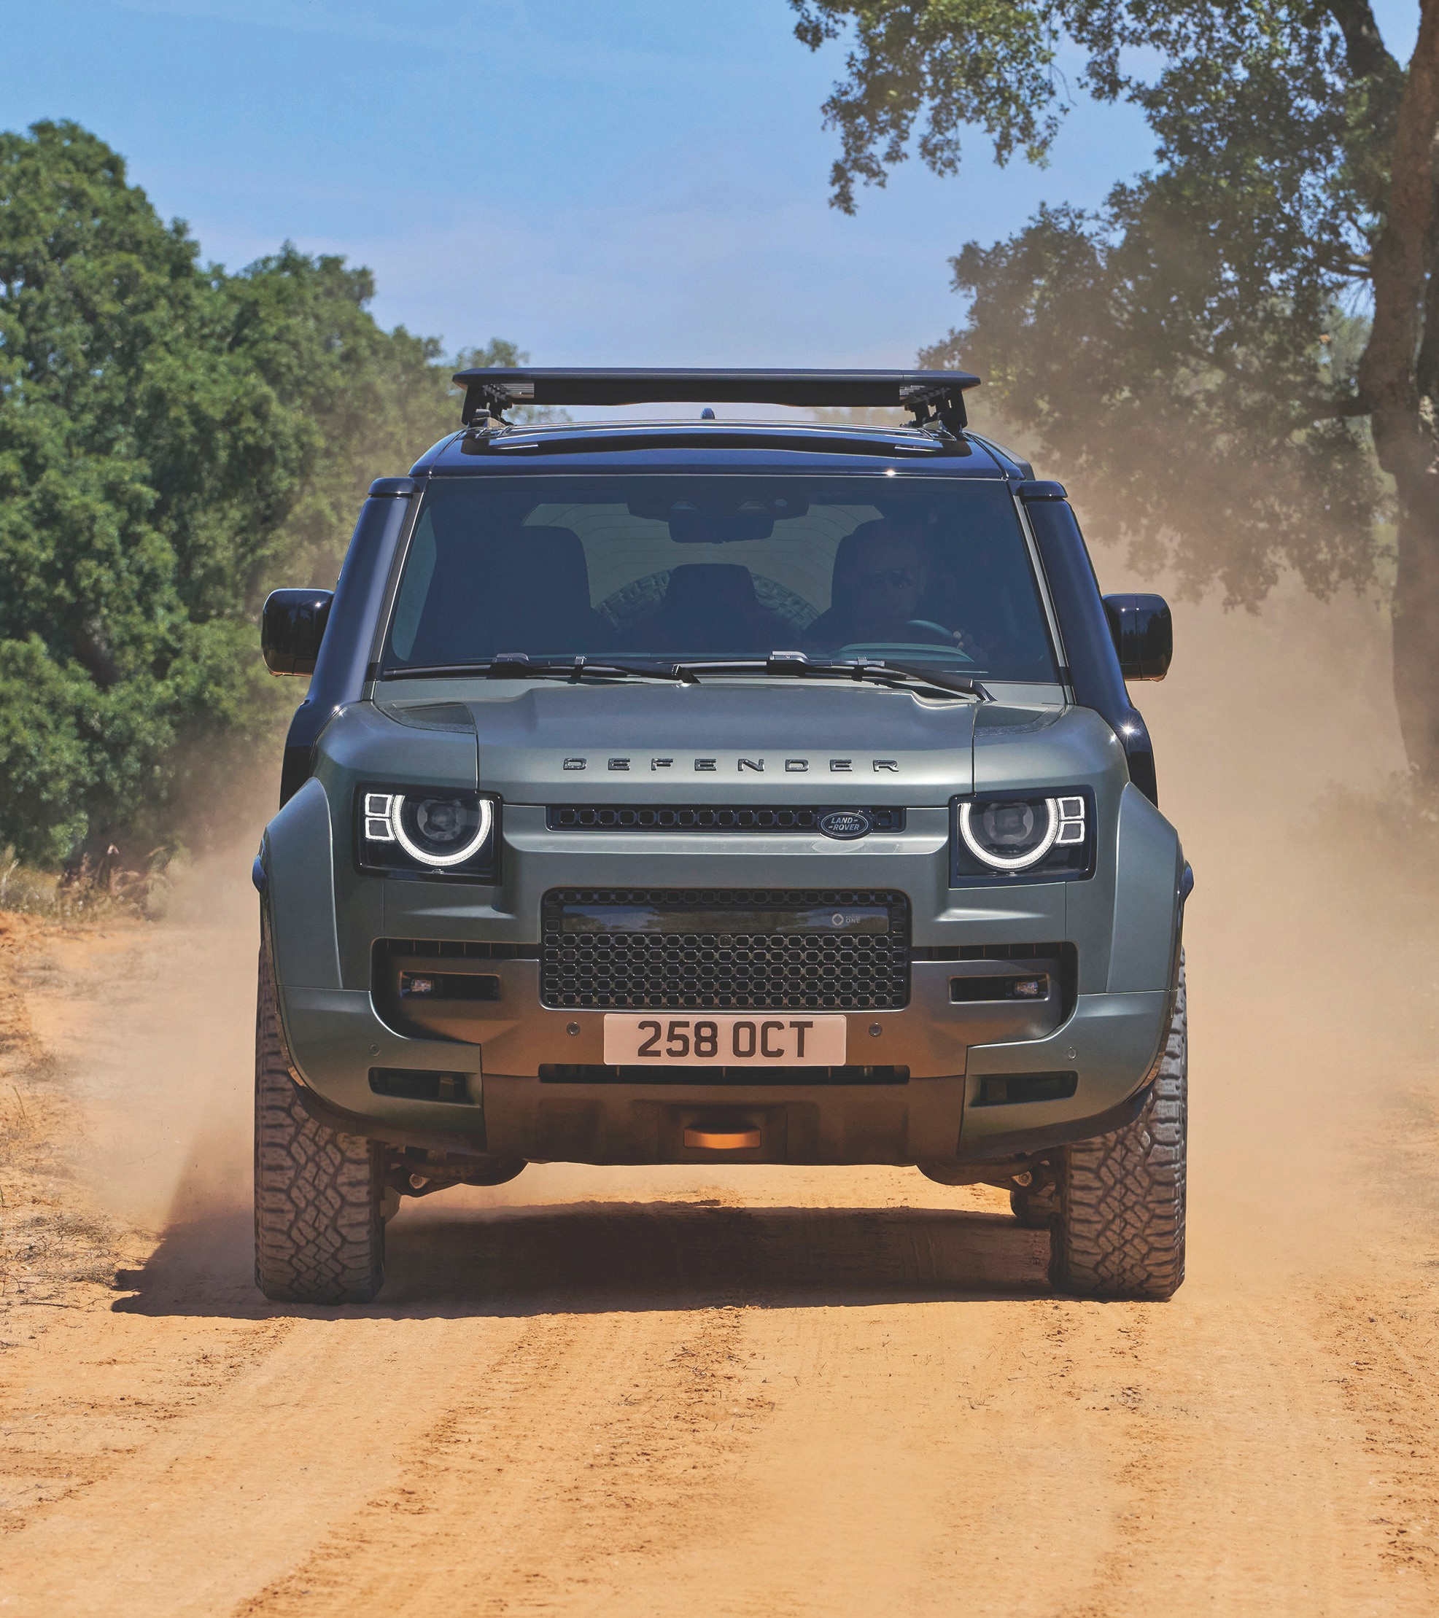


Jaguar Land Rover
JLR

Slide 4




















JLR Timeline
J
1938
The first ever Jaguar car to be produced
1990
Jaguar XJ220 becomes the world’s fastest production car
2013
Jaguar F-Type is revealed
2021
Reimagine Strategy Launched Jaguar to become all electric brand by 2025; First all-electric Land Rover vehicle in 2024
1948
The debut of Land Rover;
To showcase the new XK DOHC ‘six’ engine, the Jaguar XK120 is launched
1996
Jaguar XK is launched
2015
The first Jaguar SUV, the F-Pace is announced
2022
New RR, New RR Sport, Defender 130
2005
Range Rover Sport is revealed
2017
Range Rover Velar is launched
1961
Jaguar E-Type is introduced
2023
Reaffirms Reimagine Strategy Announces investment plans over five years in industrial footprint, vehicle programmes, AI and digital tech, etc.
2008
Jaguar Land Rover is founded as Tata Motors completes acquisition of the brands
2018
The world’s first all-electric SUV, Jaguar I-Pace is revealed
1970
Birth of British Rover
2025
Set to launch first pure electric Range Rover Electric with waitlisting
exceeding 59,000; Jaguar unveiled its new brand and the exuberant Type 00 design vision concept
1989
All-new Discovery Rover is launched
2011
Range Rover Evoque brings the LRX concept car to life
2019
All-new Land Rover Defender makes its world debut
Strategy & Business Modeling Presentation 2025

Slide 5


Slide 6









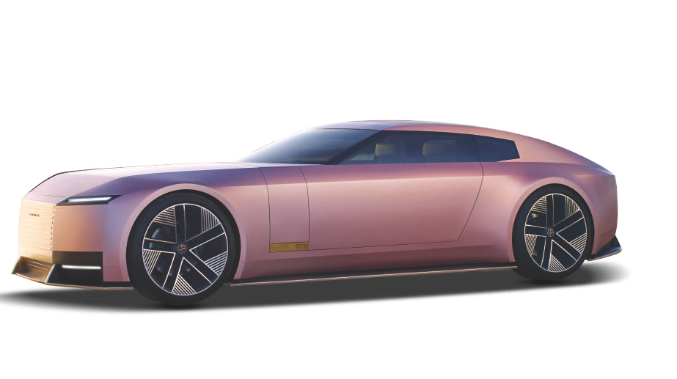
The Jaguar Challenge
From glory to uncertainity: the Jaguar story
Acquisition
2008: Tata Motors acquires Jaguar Land Rover from Ford for $2.3B.
Decline
Identity Crisis
Sales ↓ 70% since 2018
Core issue: Blurred brand positioning, neither true luxury nor pure performance.
Early boom: new models, surging China sales, global prestige comeback.
Luxury EV market +25%/year, Jaguar has only one EV (I-Pace)
Mixed messages: sporty classics (F-Type, XE) vs futuristic “modern luxury” (I-Pace)
Pricing: too high for BMW M / Porsche competitors
Jaguar vision:
• “Live the exceptional with soul”
• “Creators of modern luxury, all-electric, sustainable future.”
<20% of JLR sales → lowest profitability in Tata motors portfolio
Brand message “Modern Luxury” feels vague and hollow
Once a rising star, now fighting to stay relevant.
Because a brand without a clear position loses both differentiation and emotional connection
Strategy & Business Modeling Presentation 2025

Slide 7
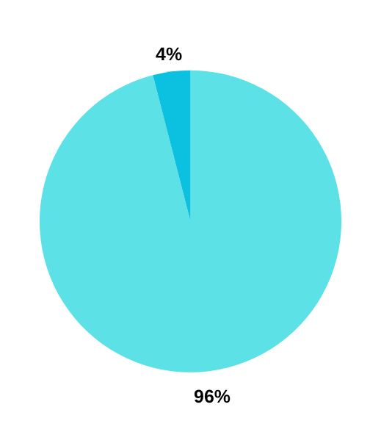
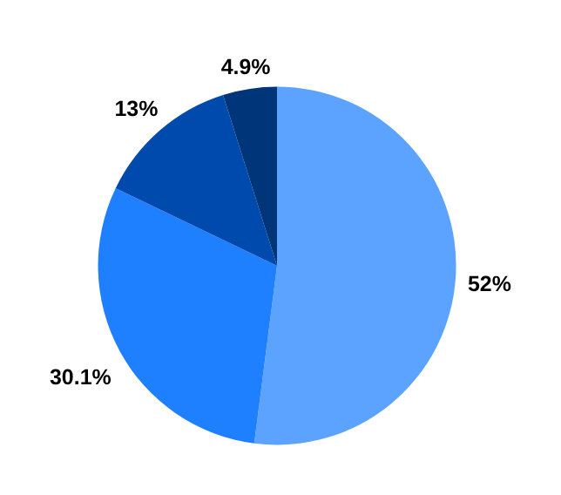
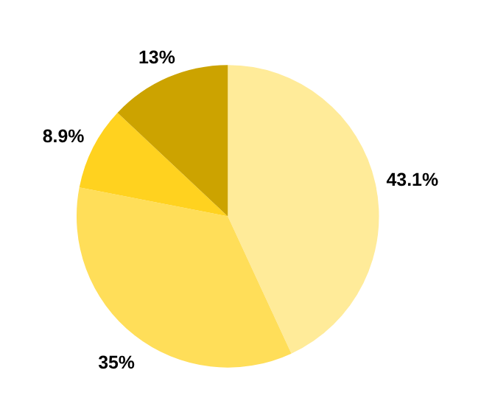

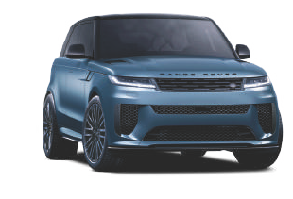

Survey Methodology: Sample size: 123 respondents Age: 20–50 years
Survey results confirm Jaguar’s grey zone – A brand In need of specialization
1.
2.
3.
Which of the following best describes Jaguar in your opinion?
How clear do you think Jaguar’s brand identity is compared to other premium brands?
If Jaguar were to focus more on one direction, which would you prefer?
4% A luxury brand(Bently, Rolls Royace)
4.9% Very Clear
35% Ultra Luxury( Bently, Rolls Royace)
0% A performance brand (Porche, BMW)
13% Somewhat Clear
43% Performance and Sports ( BMW)
96% A brand somewhere in between both
52% Not Very Clear
13% Sustainability and EV
0% A mass-market brand
30.1% Not Clear at all
8.9% Keep a balance of both
Geography: international (mainly Europe & India) Method: online questionnaire, distributed via social media Question type: closed multiple-choice questions
OUR JAGUAR BRAND PERCEPTION SURVEY
Strategy & Business Modeling Presentation 2025

Slide 8
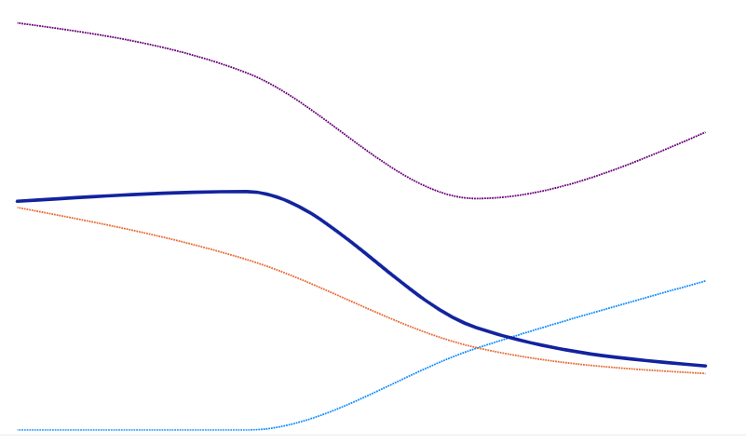
Jaguar Land Rover : Financial situation
While JLR’s financials appear stable at first glance, a closer look reveals that Jaguar’s sales have been in a steep decline, offering little to no meaningful contribution to the group’s overall performance. This underscores a structural imbalance within JLR’s brand portfolio.
JLR is operationally solid, not underperforming, but Still has room to improve efficiency & pricing power compared to top-tier luxury peers
It’s not at the level of BMW or Mercedes yet, but it’s clearly closing the gap in profitability and improving its cash flow conversion efficiency — a sign of operational maturity and financial discipline.
Sales Mix Over The Years
300K
Sales Volume*
Units (Wholesale)
EBITDA Margin
%
150K
173K
4,00,898
FY25
FY24
14.3
FY25
4,00,898
4,01,303
50K
48K
14.3
FY24
15.9
FY23
3,21,362
FY17
FY19
FY22
FY25
FY23
11.6
EBIT
%
Revenue
£ million
PBT (BEI)
£ million
324
Free Cash Flow
£ million
8.5
FY25
28,961
FY25
FY24
2,489
1,478
FY25
8.5
28,961
28,995
FY25
2,489
1,478
FY24
8.5
FY24
2,165
FY24
2,269
FY23
2.4
FY23
22,809
FY23
(64)
FY23
521
Strategy & Business Modeling Presentation 2025
7

Slide 9
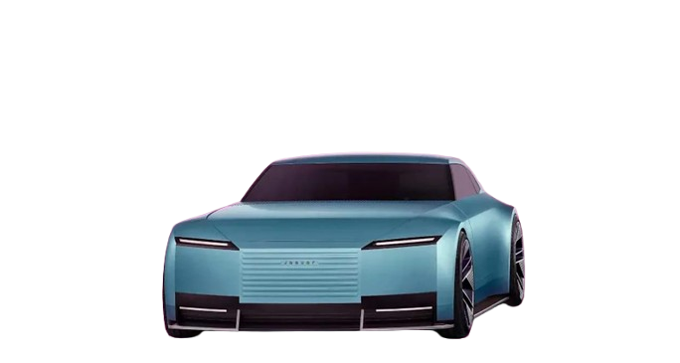


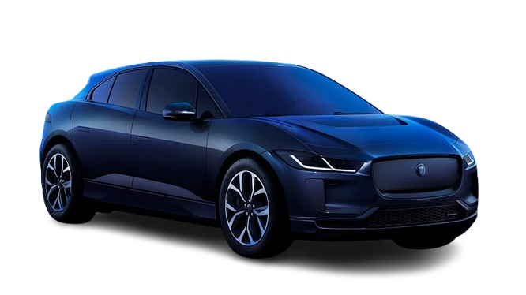
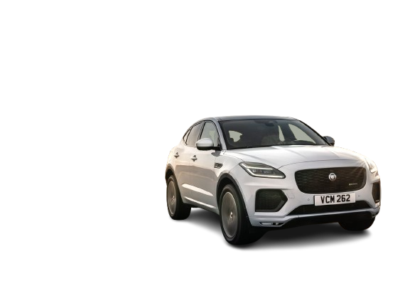


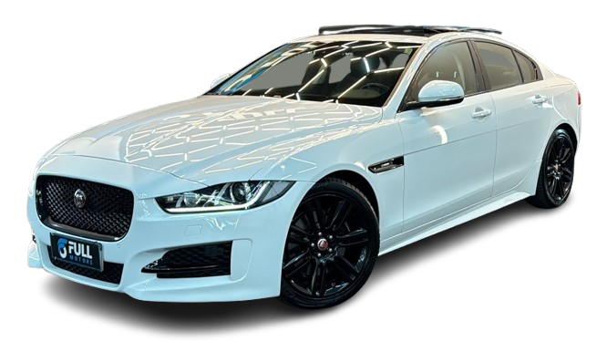
BCG Matrix in play
By prioritizing the Question Mark segment and neglecting existing Stars and Cash Cows, Jaguar risks creating an unbalanced JLR portfolio. This overreliance on uncertain EV ventures could jeopardize brand stability and long-term profitability.
Relative Market Share
🌟 Stars
❓ Question Marks
Competes in the rapidly growing EV market.- Jaguar was one of the first luxury automakers to introduce a fully electric SUV.- Faces tough competition from Tesla, Mercedes EQ series, BMW iX, etc. Jaguar I-PACE (Electric SUV
Jaguar plans to become an all-electric luxury brand by 2025.- High potential market growth but uncertain market share and profitability Future All-Electric Lineup (Post-2025 Vision)
Market Growth
🐄 Cash Cows
🐶 Dogs
Established models with decent brand recognition.- Market for internal combustion luxury vehicles is mature or declining.- Still contributes steady cash flow due to loyal customers Jaguar XF and Jaguar F-PACE (Luxury Sedan & SUV)
Competes with BMW 3-Series, Audi A4, Mercedes C-Class.- Sales performance has been weak globally.- Market share declining as consumers shift to SUVs and Evs Jaguar XE (Entry-level sedan)
Strategy & Business Modeling Presentation 2025

Slide 10
Jaguar’s unique value proposition
Target customer profile
Value Proposition
I want a car that blends luxury + performance + sustainability
For modern drivers seeking performance with purpose, Jaguar combines British luxury and electric innovation for a timeless & emotional driving experience
I need confidence in a future-proof brand
Pain relievers
Bring back emotion to EVs
Preserve brand DNA in electrification
Differentiate through luxury & performance
Reinforce brand distinctiveness
Gain Creators
Heritage meets innovation
Advanced tech and credibility
Premium customer experience
Consistent brand integrity across all touchpoints
I want a brand with a clear identity and a sense of belonging
I take pride in British heritage
Demographics
30-50 years old, upper-income, urban professionals or entrepreneurs
Pain points
Most EV’s (e.g. Tesla) feel uniform and emotionless
Traditional luxury brands (e.g. Bentley) seem old-fashioned
Desired Gain
Distinct identity & exclusivity
Premium service, high resale value
Recognition through subtle distinction
Effortless ownership experience
Offering
Luxury cars with design focus and electrification
Hand crafted interiors and premium materials
Storytelling rooted in British heritage and elegance
Fusion of craftmanship and technology
Strategy & Business Modeling Presentation 2025

Slide 11
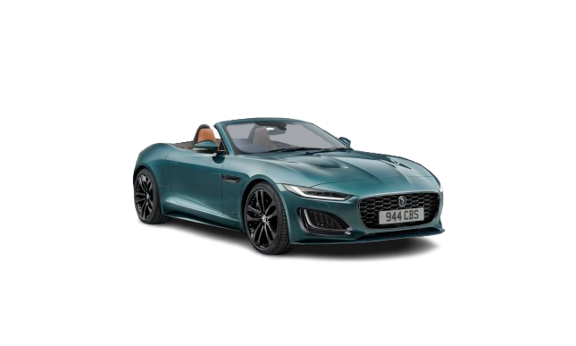
Jaguar’s unique value proposition
For modern drivers seeking performance with purpose, Jaguar combines British luxury and electric innovation for a timeless & emotional driving experience
Target customer profile
Value Proposition​
CUSTOMER ASPIRATION:
I want a car that blends luxury + performance + sustainability
I need confidence in a future-proof brand
I want a brand with a clear identity and a sense of belonging
I take pride in British heritage
Offering
Pain relievers
DESIRED POINTS:
Distinct identity & exclusivity
Premium service, high resale value
Recognition through subtle distinction
Effortless ownership experience
Bring back emotion to EVs
Preserve brand DNA in electrification​
Differentiate through luxury & performance​
Reinforce brand distinctiveness​
PAINS POINTS:
Most EV’s (e.g. Tesla) feel uniform and emotionless
Traditional luxury brands (e.g. Bentley) seem old-fashioned
Luxury cars with design focus and electrification​
Hand crafted interiors and premium materials
​
Storytelling rooted in British heritage and elegance​
Fusion of craftmanship and technology​
Gain Creators​
Heritage meets innovation​
Advanced tech and credibility
​
Premium customer experience​
Consistent brand integrity across all touchpoints​
Strategy & Business Modeling Presentation 2025
9

Slide 12



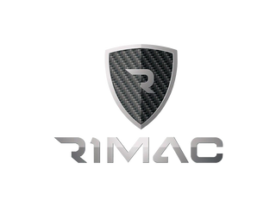

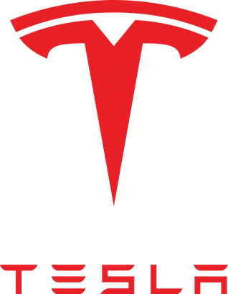




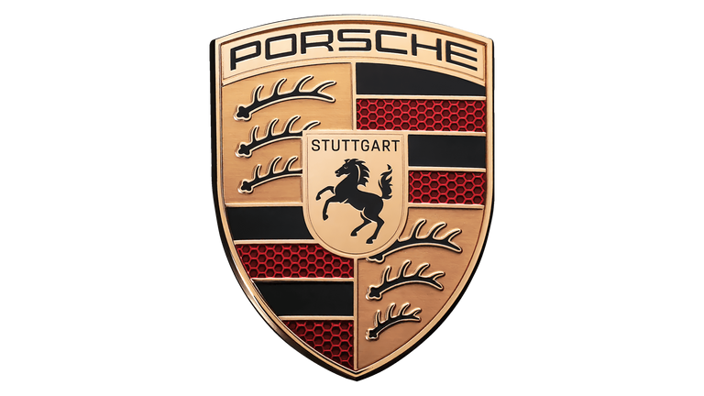




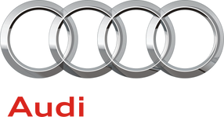


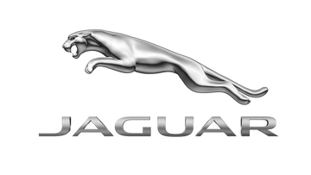
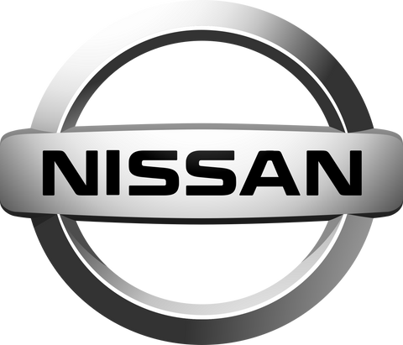

Jaguar’s current market reality: Premium but not distinct
Market Price Segmentation
Market Mapping in 2025
Electric
The industry is undergoing major transformations : electrification has become the main strategic priority for all brands.
Competition is fierce, making differentiation a key challenge.
Price
Jaguar is positioned in the middle of the premium market, alongside Audi, BMW, and Mercedes
Jaguar’s price and performance levels remain similar to those of its main competitors.
To stand out, Jaguar must choose between:
Focusing on petrol and electric performance,
Entering the ultra-luxury electric niche.
Thermic
Performance
Performance
Luxury
Strategy & Business Modeling Presentation 2025
7

Slide 13


OUR RECOMMENDATION : SPLIT JAGUAR IN 2 DIVISIONS
Reimagine Jaguar as a dual-brand powerhouse, combining ultra-luxury and performance
1. Jaguar Ultra-Luxury division
2. Jaguar Performance division
Positioning: Electric British Elegance Target: Younger global elite Focus: Craftsmanship, sustainability, serenity
Positioning: Emotion through performance and exclusivity Target: Younger performance enthusiasts Focus: Design, driver connection, sportiness
Strategy & Business Modeling Presentation 2025

Slide 14





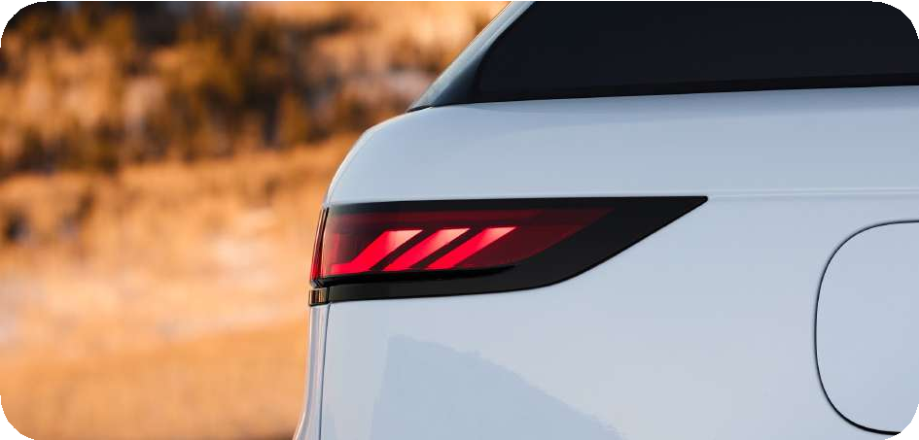
The Spheres of Shange (Oliver Wyman)
Objective 1 : Rebuild Jaguar as an ultra-luxury electric brand competing with Rolls-Royce and Bentley
Expand into luxury services (chauffeur, bespoke charging, lifetime care) leveraging SV division
Ensure cost efficiency via shared EV knowledge from the group
Use agile project management to speed concept-to-market
Hybrid agency model preserving heritage dealer exclusivity
Collaborate with British luxury houses (Burberry, Connolly, Bremont)
ACCELERATE PORTFOLIO UPGRADE
PLAY AS TECHNOLOGY PIONEER
BUILD ORGANIZATIONAL COMPETENCIES
GO TO MARKET WITH DTC MODEL
REPOSITION THE BRAND
Full EV lineup by 2030: reposition Jaguar as an ultra-luxury electric brand
2 handcrafted EV flagships (GT Sedan & SUV) priced at $300–500K
Leverage Tata’s EV & battery R&D (Pune, Coventry) for proprietary tech
Partner with British AI & interior tech firms for smart, customizable experiences
Train teams in digital craftsmanship & luxury service
Focus on sustainability, serenity, and design purity
Target younger global elite seeking “silent luxury”
Create a Jaguar Excellence Unit (design, software, sustainability
Invitation-only boutiques in key cities (London, Paris, Dubai, Shanghai)
Immersive 3D online configurators & virtual delivery tracking
From Performance Luxury to Electric British Elegance
Expected Outcomes
Stronger profitability: moving from a volume-driven to a value-driven model reinforces margins and financial resilience.
Revitalized brand image: Jaguar re-establishes itself as a benchmark of “Electric British Elegance,” recognized alongside the world’s top luxury marques.
Enhanced group positioning: the brand becomes Tata’s technological and symbolic showcase in the luxury EV space, strengthening group synergies and innovation capacity.
Strategy & Business Modeling Presentation 2025

Slide 15
Objective 2 : Reinforce Jaguar’s performance DNA, emotional and sporty, while accelerating portfolio renewal
EXISTING SPECIAL BUILDS DEPARTMENT
TRANSITION TO EVS
An electric, emotional and inclusive future
Skills, culture and precision that defines « The Art of Performance »
3 fully electric models in 2026
Aims to generate 36.4% of its global energy consumption through self-generated renewable sources by 2030
Rebranding focus: attract younger and wealthier buyers seeking modern luxury, sustainability, and individuality
Deep expertise in bespoke craftsmanship (use of sustainable, premium and customized materials)
Performance engineering expertise (performance tuning, lightweight materials).
Heritage of excellence and exclusivity
Metric | 2025 | 2030
Share of EV sales | 20% | 75%
Average transaction price | $85K | $130K
New-customer share | 15% | 45-50%
Expected outcomes :
Brand repositioning: from traditional luxury to modern electrified performance
Customer expansion: new generation of design-minded, tech-savvy, affluent consumers
Sustainability & Emotion: deliver clean energy mobility without losing Jaguar’s signature driving feel
Strategy & Business Modeling Presentation 2025
13
Notes:
Short term (2025–2028): Maintain a balanced portfolio (≈60% ICE / 40% EVs) to ensure strong margins and fund R&D
Mid term (2028–2032): Transition to a majority-EV lineup (≈75% EVs) while using SB’s expertise to sustain emotional performance and premium craftsmanship.

Slide 16
The Pyramid of Excellence (Keller’s model)
Objective 2 : Reinforce Jaguar’s performance DNA, emotional and sporty, while accelerating portfolio renewal
Relationship What about you and me?
Brand repositioning (sustainable and emotional), community engagement, customer expansion
Response What about you?
True performance reimagined for the electric age
Inspire deep emotional connection, modern relevance without losing authenticity
Meaning What are you?
Functional meaning – The technical expression of performance
Emotional meaning - Reflect contemporary British craftsmanship and performance lifestyle.
Lightweighted, agile architecture from SB expertise
Adaptive dynamics & torque vectoring derived from motorsport technology, ensuring precision and control.
High performance and durability: Advanced battery cooling systems
Emotional Aesthetic: Quiet power, timeless elegance, and futuristic design.
Exclusivity and personalization: customizable interiors, collector pieces
Rebranding focus: attract younger and wealthier buyers seeking modern luxury, sustainability, and individuality
Identity Who are you?
From heritage luxury to modern, electrified performance.
SB expertise in bespoke craftsmanship, defining the « art of performance » of Jaguar
Transitioning to a modern, sustainable luxury identity (transition to EVs : 3 fully electric models in 2026)
Clear positioning: British design and emotional aesthetic
Strategy & Business Modeling Presentation 2025
13

Slide 17

THANK YOU!
Strategy & Business Modeling Presentation 2025
15

Slide 18


Jaguar Land Rover journey: from ford ownership to Tata’s early success
1990s
2008
2009 - 2015
Ford Era (1990-2008)
Ford owns Jaguar and Land Rover under the Premier Automotive Group.
Limited success due to brand overlap and lack of clear direction.
Financial crisis pushes Ford to sell premium assets.
TATA ACQUISITION
Deal: Tata Motors acquired Jaguar & Land Rover from Ford for $2.3B (Ford added ~$600M to pension funds).
Why Tata:
﻿﻿Quick entry into global luxury market with strong British brands.
﻿﻿Diversification beyond India's domestic segment.
﻿﻿Access to advanced design and R&D capabilities.
﻿﻿Opportunity to buy at crisis-level pricing.
﻿﻿Commitment to preserve British heritage and autonomy.
EARLY BOOM
New models: Range Rover Evoque, Jaguar F-Type → strong global demand.
Autonomy under Tata boosted innovation and brand revival.
Sales tripled between 2009-2015, led by China growth.
=> JLR became Tata's most profitable unit, restoring global prestige.
Strategy & Business Modeling Presentation 2025
Source: Jaguar Land Rover Press Release, 2008
Ford sells Jaguar & Land Rover, 2008
(Eurofound, 2008)

Slide 19
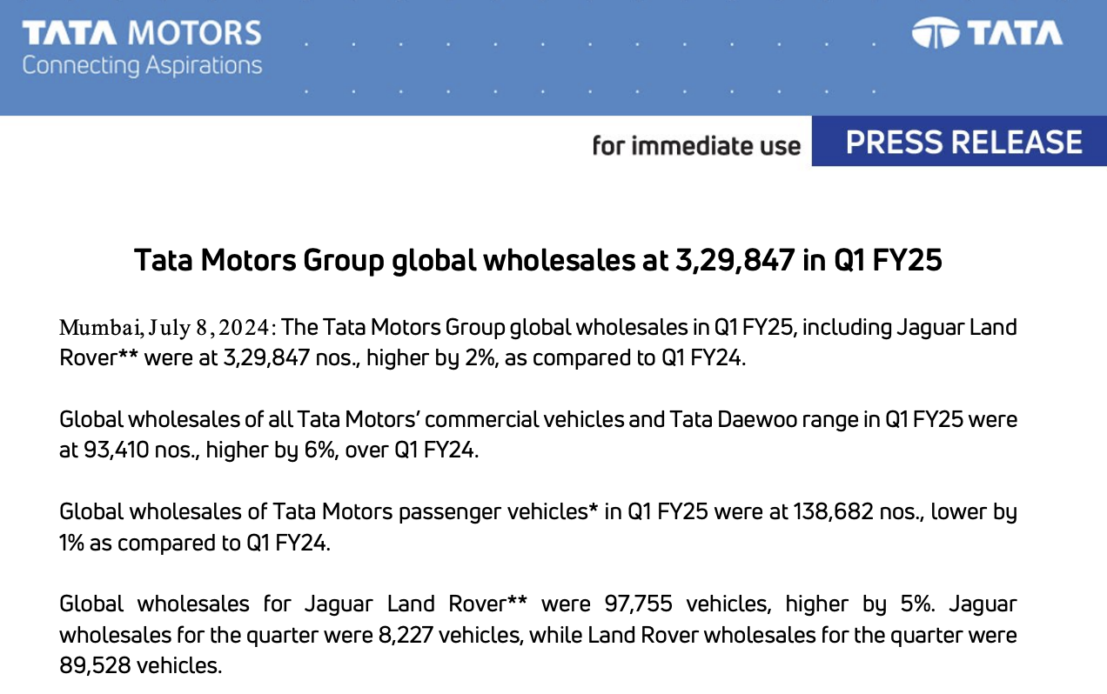
DECLINE OF JAGUAR
Tata Motors Press Release – Q1 FY25 (July 8, 2024)
Tata Motors Group’s total global wholesales: 329,847 units
Jaguar Land Rover (JLR) sales: 97,755 units in total, of which:
8,227 units for Jaguar=> accounts for only ~8.4% of JLR’s total sales.
This confirms that Jaguar is the smallest contributor within Tata Motors’ portfolio, both in volume and strategic weight
Strategy & Business Modeling Presentation 2025

Slide 20
SWOT ANALYSIS
STRENGTHS
WEAKNESSES
OPPORTUNITIES
THREATS
Brand restructuring into Luxury and Performance lines -> clear positioning and market segmentation
Luxury division can capture the ultra-premium market (Bentley, Rolls-Royce) -> higher margins
Performance division can reconnect with Jaguar’s heritage and compete with Porshe, Aston Martin
EV expansion: new electric models under both sub-brands could leverage Tata’s EV expertise + Growing global demand for sustainable premium vehicles
Backing from Tata Motors, ensuring financial stability and access to advanced R&D
Established global network
Flexibility to reposition : Jaguar has existing credibility in both luxury and performance, making brand split feasible
Strong design identity and craftsmanship associated with British luxury
Blurred brand identity: unclear market position (neither pure luxury nor performance
Limited EV portfolio : lagging competitors in electrification
Low profitability within Tata’s portfolio
Aging lineup and lack of product differentiation across models
Intense competition in both luxury (Rolls-Royce, Bentley) and performance (Porsche, BMW M, Tesla)
High R&D and marketing costs to launch two distinct brand identities
EV transition pressure from regulations and market expectation segments
Strategy & Business Modeling Presentation 2025

Slide 21
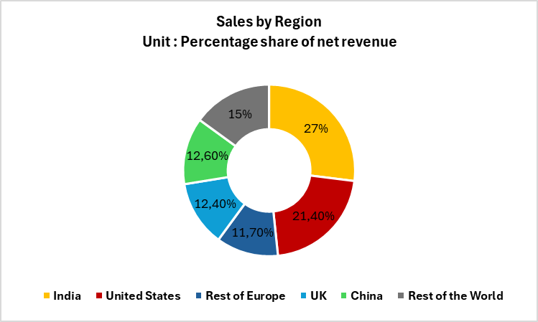
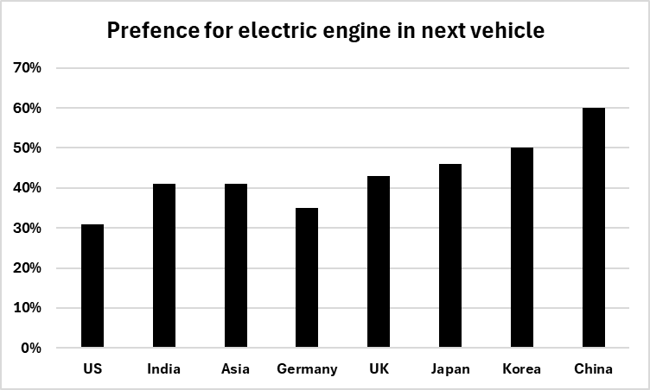
SUPPORTING MARKET DATA
The Market Today :
Splited in 3 parts : Premium / Luxury / Ultra Luxury
Multiple options : sportiness, luxurious, both...
Very wide price range
Big group of brands (Audi, BMW, Mercedes...) with the same proposition / target customers
The Market Tomorrow :
Becoming more and more electric : Customers will buy even more electrified cars tomorrow
Two very important things for customers: sportiness and luxury at this price point.
References :
MarketLine. (2023, August 31). Jaguar Land Rover Automotive Plc – Strategy, SWOT and Corporate
Finance Report. Xerfi (2025, November) Group Report : Tata Motors.
Deloitte (2025, January). 2025 Global Automotive Consumer Study. Deloitte Insights.
Strategy & Business Modeling Presentation 2025

Slide 22
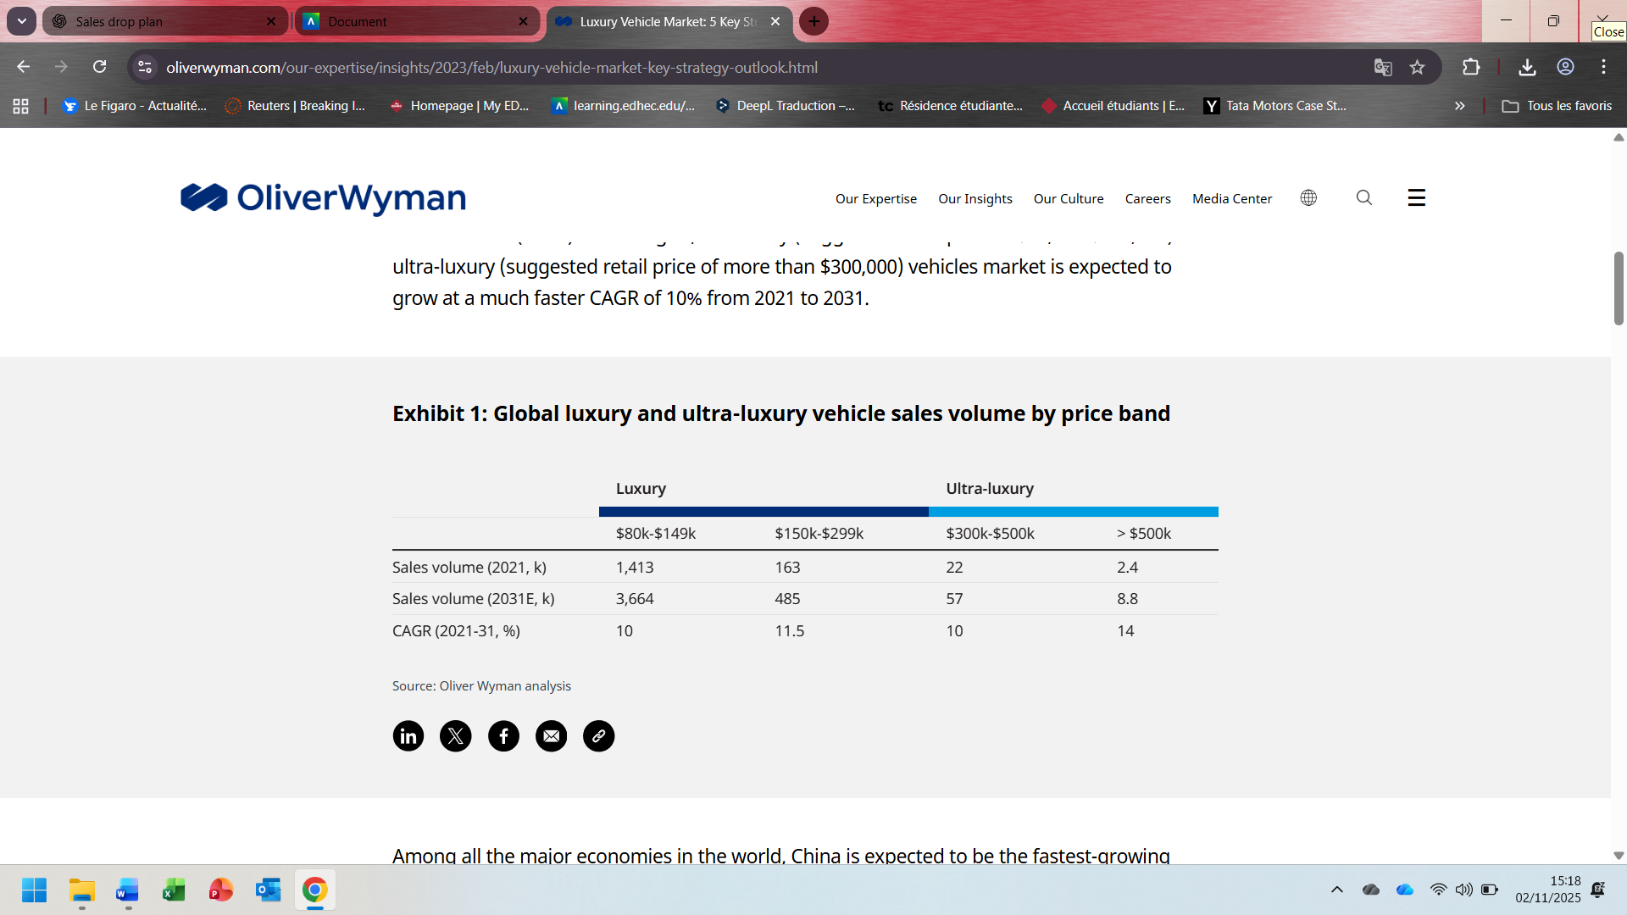
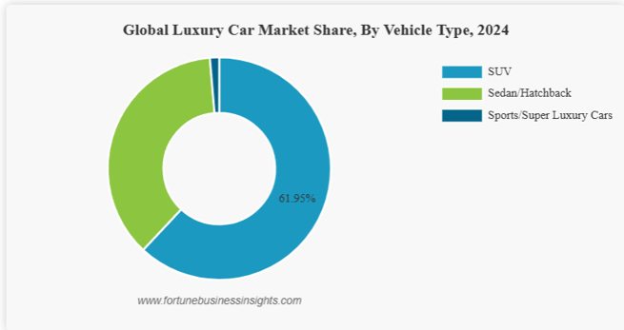
FOCUS : GLOBAL LUXURY AND ULTRA-LUXURY VEHICLE SALES VOLUME BY PRICE BAND
Jaguar’s fearless strategy comes with significant challenges:
Customer retention: Jaguar predicts retaining only 15% of its current customer base, a dramatic shift from its traditional loyalists.
Market demand: Questions remain about whether the ultra-luxury EV segment can sustain the aggressive pricing strategy.
Production gap: The company will have no new luxury vehicles until the electric lineup launches in late 2025 or early 2026, risking a loss of market relevance.
Brand identity: Alienating long-time enthusiasts in favour of a new, younger demographic may come at a cost.
Key Supporting Facts
Sales collapse: –77.6 % (Jan–May 2025) to only 2 776 cars sold; production paused.
Market shift: Luxury EV segment = $35 bn (+10 % CAG).
Trade deal (US–UK 2025): tariffs cut from 27.5 % to 10 %, quota 100 000 cars/year.
Strategic logic: Differentiation → exclusivity over volume + “Electric British Elegance.”
SOURCES
Mikulic, M. (2025, 28 octobre). The most profitable luxury car brand isn’t Porsche or BMW. SlashGear.
Fiches-Auto. (n.d.). Nombre de ventes dans le monde – Jaguar. Retrieved [date you accessed the site],
Pannaud, Q. (2025, 4 juillet). Jaguar : comment le géant anglais du luxe est devenu un nain européen. Auto Journal.
Le Monde. (2025, May 8). Trump, Starmer announce US-UK trade agreement. Le Monde.
Laia. (2025, 3 octobre). Luxury Car Market Projections 2025-2034 by Global Market Insights. WLCC
Strategy & Business Modeling Presentation 202

Slide 23
HOW TO LEAD IN THE LUXURY AUTOMOTIVE FUTURE
5 Strategies to Get Ahead in the Luxury Vehicle Market (by OliverWyman)
Accelerate portfolio upgrade Transition rapidly from internal combustion engines (ICE) to electric vehicles (EVs). Go beyond the product itself and build new mobility services and experiences, shifting from a manufacturer to a service provider mindset.
Play as technology pioneers Lead innovation through R&D and strategic partnerships. Balance technological advancement (AI, connectivity, battery systems) with cost control to sustain profitability.
Build organizational competencies Foster a culture of innovation, agility, and openness. Invest in digital transformation, customer experience, and cross-border collaboration to strengthen competitiveness.
Go to market with direct-to-consumer (DTC) Deliver personalized, high-end buying experiences. Combine direct sales with reimagined dealership roles (agency or hybrid models) to maintain exclusivity and customer intimacy.
Reposition the luxury brand Refresh brand identity by blending heritage with modern values, sustainability, innovation, and digital lifestyle, to appeal to younger, tech-savvy, and environmentally conscious luxury buyers.
Strategy & Business Modeling Presentation 2025
Schnurrer, S. (s. d.). Luxury Vehicle market : 5 Key Strategies to Get ahead. Oliver Wyman.

Slide 24
FOCUS - Keller’s model
Brand Salience (Who are you?)
Objective: Make Jaguar instantly recognized as the world’s most refined high-performance electric marque.
Core Identity: Ultra-luxury electric performance brand with British soul.
Tagline Essence: “Power. Poise. Pure Electricity.”
Distinctive Elements: Leaping cat emblem, sleek silhouette design, illuminated signature grill, cutting-edge EV acoustics.
Brand Performance (What are you?)
Objective: Deliver uncompromising performance through electrified innovation.
Functional Drivers:
0–100 km/h under 3 seconds benchmark.
Advanced battery technology with high torque and long range.
Lightweight aluminum and sustainable luxury materials.
Intelligent drive systems emphasizing agility, silence, and control.
Benchmark: Rivals Porsche Taycan, Aston Martin Valhalla EV, and Lucid Air Sapphire
Brand Imagery (How do you look and feel?)
Objective: Reflect contemporary British craftsmanship and performance lifestyle.
Emotional Aesthetic: Quiet power, timeless elegance, and futuristic design.
Target Persona: The “modern connoisseur” — affluent, sustainability-minded, driven by taste and individuality, not status.
Design Codes: Sleek minimal interiors, ambient lighting, sustainable leathers, artisan detailing.
Brand Universe: Exclusive lounges, curated experiences, and high-end design partnerships (e.g., with Burberry or Bang & Olufsen).
Brand Judgments (What do consumers think?)
Objective: Reestablish credibility as a performance pioneer and luxury innovator.
Perceived Quality: Cutting-edge tech meets handcrafted artistry.
Credibility Pillars:
Proven EV performance through motorsport innovation.
World-class design and build integrity.
Seamless digital and ownership experience.
Superiority Perception: “The art of performance, electrified and elevated
Brand Feelings (How do consumers feel?)
Objective: Inspire deep emotional connection built on exhilaration and prestige.
Key Feelings:
Thrill: instant electric acceleration.
Pride: owning a symbol of rare craftsmanship.
Serenity: silent, immersive drive experience.
Strategy & Business Modeling Presentation 2025

Slide 25
Why Do I Think The Strategy Will Work
Splitting Jaguar into two distinct sub-brands—one dedicated to ultra-luxury electric vehicles and the other focused on high-performance models—offers both strategic and practical merit.
This dual-brand architecture would allow Jaguar to preserve and amplify its performance DNA, while simultaneously ascending into the ultra-luxury EV segment, positioning itself as a true competitor to marques like Bentley, Aston Martin, and Porsche.
The approach is not merely theoretical; it has proven feasibility within the group itself. Land Rover’s successful multi-brand strategy—operating Range Rover, Discovery, and Defender as differentiated sub-brands under one umbrella—demonstrates JLR’s capability to manage diverse brand identities that serve distinct customer bases without diluting parent equity.
By leveraging this internal precedent, Jaguar can:
Differentiate Target Segments: Position one line as a high-performance electric sports range (reviving the spirit of F-Type and racing heritage) and the other as a pure ultra-luxury electric portfolio (representing sophistication, craftsmanship, and serenity).
Optimize Brand Architecture: Maintain a unified master brand identity (“Jaguar”) while developing strong emotional sub-brand narratives.
Capitalize on Shared Expertise: Use common technological platforms, R&D infrastructure, and sustainability goals to ensure efficiency without compromising brand individuality.
Ultimately, this strategic bifurcation would enable Jaguar to become the best of both worlds—a symbol of performance purity and electric luxury excellence, aligned with evolving consumer expectations and JLR’s long-term electrification vision.
Strategy & Business Modeling Presentation 2025

Slide 26
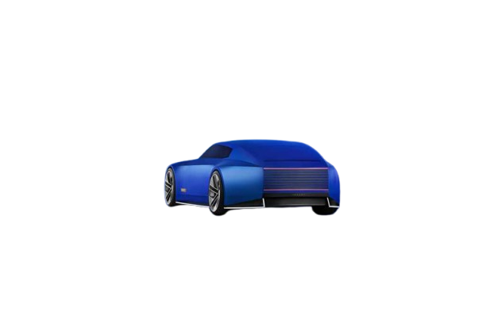
OTHER SOURCES
“Jaguar Land Rover | Business | Tata group” – tata.com
“Introducing Jaguar Land Rover” – Tata Motors investor presentation (PDF, June 2008)
Press release “Jaguar Land Rover reimagines the future of modern luxury…” – Tata Motors / JLR (PDF)
Infinium Global Research. (2023, agosto). Luxury Electric Vehicles Market
Schnurrer, S. (s. d.). Luxury Vehicle market : 5 Key Strategies to Get ahead. Oliver Wyman.
Danziger, Pamela N. How Jaguar is abandoning the Language of Luxury in his rebrand. Forbes
EV magazine – Jaguar’s Bold Rebrand : Electric Future with Modern Luxury (2024)
Strategy & Business Modeling Presentation 2025

