Slide 1

PipedPeer: Zero-Configuration Distributed Computing via Recursive, Decentralised Coordination
Yateen Vaviya (UCID 2023300251)
Vinayak Yadav (UCID 2023300264)
Sahil Gupta (UCID 2023300072)
Guide: Dr. Rupali Sawant
Department of Computer Engineering, Sardar Patel Institute of Technology, Mumbai
Main Project Stage-II, End Semester Examination, November 2026
Notes:
Good morning. We are Yateen, Vinayak and Sahil. Our guide is Dr. Rupali Sawant. Our project is PipedPeer: it runs an ordinary Python script on the other machines around you, without setting up a cluster, without changing the script, and across different home or college networks.

Slide 2
Introduction
Idle computers are everywhere: college labs, friends' laptops, phones.
Using them for a Python script normally needs three things first:
a configured cluster with a head node and matching software on every machine,
a program rewritten against a framework's API (Spark, Ray, Dask),
machines that can reach one another, which home and campus routers prevent.
Remote execution over ssh avoids setup but gives no environment management, placement, isolation or fault tolerance.
PipedPeer: pipedpeer run script.py runs the unchanged script on other machines, and spreads the parallel work inside it when that is faster.
Department of Computer Engineering, Sardar Patel Institute of Technology
2
Notes:
Every lab and every home has machines sitting idle. A student with a slow script cannot easily use them. Spark, Ray and Dask need a cluster that someone set up, a program rewritten against their API, and machines that can reach each other. ssh avoids setup but gives no environment, no placement and no failure handling. So we asked: can python script.py simply use the machines around it?

Slide 3
Problem Statement
Given an unmodified Python script and a small group's machines, possibly on different networks behind NAT routers, run the script and its parallel work on those machines:
with no cluster to configure and no head node or scheduler process,
with no change to the script,
reproducing the script's environment exactly on every machine,
joining machines across networks without relaying job data through a third machine,
never changing the result, and declining to distribute when it would be slower.
Department of Computer Engineering, Sardar Patel Institute of Technology
3
Notes:
Formally: given an unmodified Python script and a few machines owned by one group, possibly behind different routers, run the script and its parallel work on those machines with no cluster setup and no code change, without ever changing the result, and without being slower than staying local.

Slide 4
Objectives
One binary per machine; joining takes one setup command and, across networks, one invite code.
Build the script's environment as a pinned Nix closure; send a peer only the store paths it lacks.
Substitute the parallel primitives the script already uses (Pool, joblib, pandas, NumPy, PyTorch training) at import time.
Divide work by measured machine speed; keep work local when a cost model predicts no gain.
Connect machines behind different routers directly: introducer, port mapping, hole punching; no relay.
Train PyTorch models data-parallel across machines, with accuracy held within 1% of one device.
Survive a worker, link or rank failing without changing the result; sandbox every job.
Use an Android phone's CPU as a worker.
Department of Computer Engineering, Sardar Patel Institute of Technology
4
Notes:
These are the objectives we set. Each one maps to a part of the system and a measurement in the report.

Slide 5
Literature Survey
System / paper | What it does | Limitation for our problem
Spark (Zaharia et al., 2010) | Cluster computing on resilient datasets | Configured cluster, Spark API, JVM
Ray (Moritz et al., OSDI 2018) | Tasks and actors; drop-in Pool and joblib | Head node, changed import, reachable machines
Dask (Rocklin, 2015) | Parallel NumPy/pandas, task scheduler | Scheduler process, changed code
Arjona et al., FGCS 2023 (Lithops) | Unmodified multiprocessing on serverless functions | Needs a cloud back end; no peers, no NAT
HTCondor / BOINC | Harvest idle machines for jobs | Central manager; project-specific
Nix (Dolstra et al., 2004) | Content-addressed, reproducible builds | Single machine; no peer-to-peer push
Ford et al., 2005; STUN/ICE | UDP hole punching across NATs | Building blocks, not an executor
DiLoCo (2023); local SGD (2020) | Train with infrequent synchronisation | Datacentre scale; need a framework
Department of Computer Engineering, Sardar Patel Institute of Technology
5
Notes:
We compared the existing ways to use more than one machine from Python. Each solves part of the problem. The closest is Arjona et al. 2023, which runs unmodified multiprocessing code, but on serverless cloud functions that someone must provision and pay for. The full survey is chapter 2 of the report.

Slide 6
Research Gap
Cluster frameworks remove the code change only partly and always need a configured cluster.
Drop-in multiprocessing systems (Fiber, Lithops, Arjona et al.) need a provisioned back end: a cluster manager or a cloud account.
None ships the script's exact environment to ordinary peer machines.
None connects machines behind different home routers without a VPN or a relay.
None decides per call whether distributing is worth it, and stays local when it is not.
Gap: run unmodified Python across a small group's own machines, on any network, with no setup beyond one command, and never slower or different than running it locally by design.
Department of Computer Engineering, Sardar Patel Institute of Technology
6
Notes:
No system we surveyed covers the three obstacles together for a small group. The frameworks assume a cluster; the drop-in ones assume a cloud back end; the networking tools are pieces, not an executor.

Slide 7
Proposed System: PipedPeer
Each machine runs one daemon from a single Go binary; any machine submits and works.
pipedpeer setup installs everything; pipedpeer invite / connect joins another machine.
pipedpeer run script.py:
scans imports and builds a pinned Nix closure,
places the job by live capacity under a lease,
sends only the missing store paths and the workspace,
runs it in a crun sandbox with a memory ceiling,
streams output back; changed files return.
Inside the job, a shim spreads Pool, joblib, pandas, NumPy and torch work over the cluster.
Command | What it does
setup | Install, open ports, start daemon
invite / connect | Join a machine with one code
run script.py | Run, spreading the work
status / dashboard | Machines and their work
doctor | Diagnose, with the fix
jobs / attach | History; reattach to a run
ui | Cluster web page
uninstall | Remove everything it added
Department of Computer Engineering, Sardar Patel Institute of Technology
7
Notes:
This is what the user sees. Every machine runs the same daemon. The user types pipedpeer run. The client builds the environment, picks a machine, ships what is missing, and runs the job in a sandbox. Inside the job, a Python shim spreads the parallel calls across machines when the model says it pays.

Slide 8
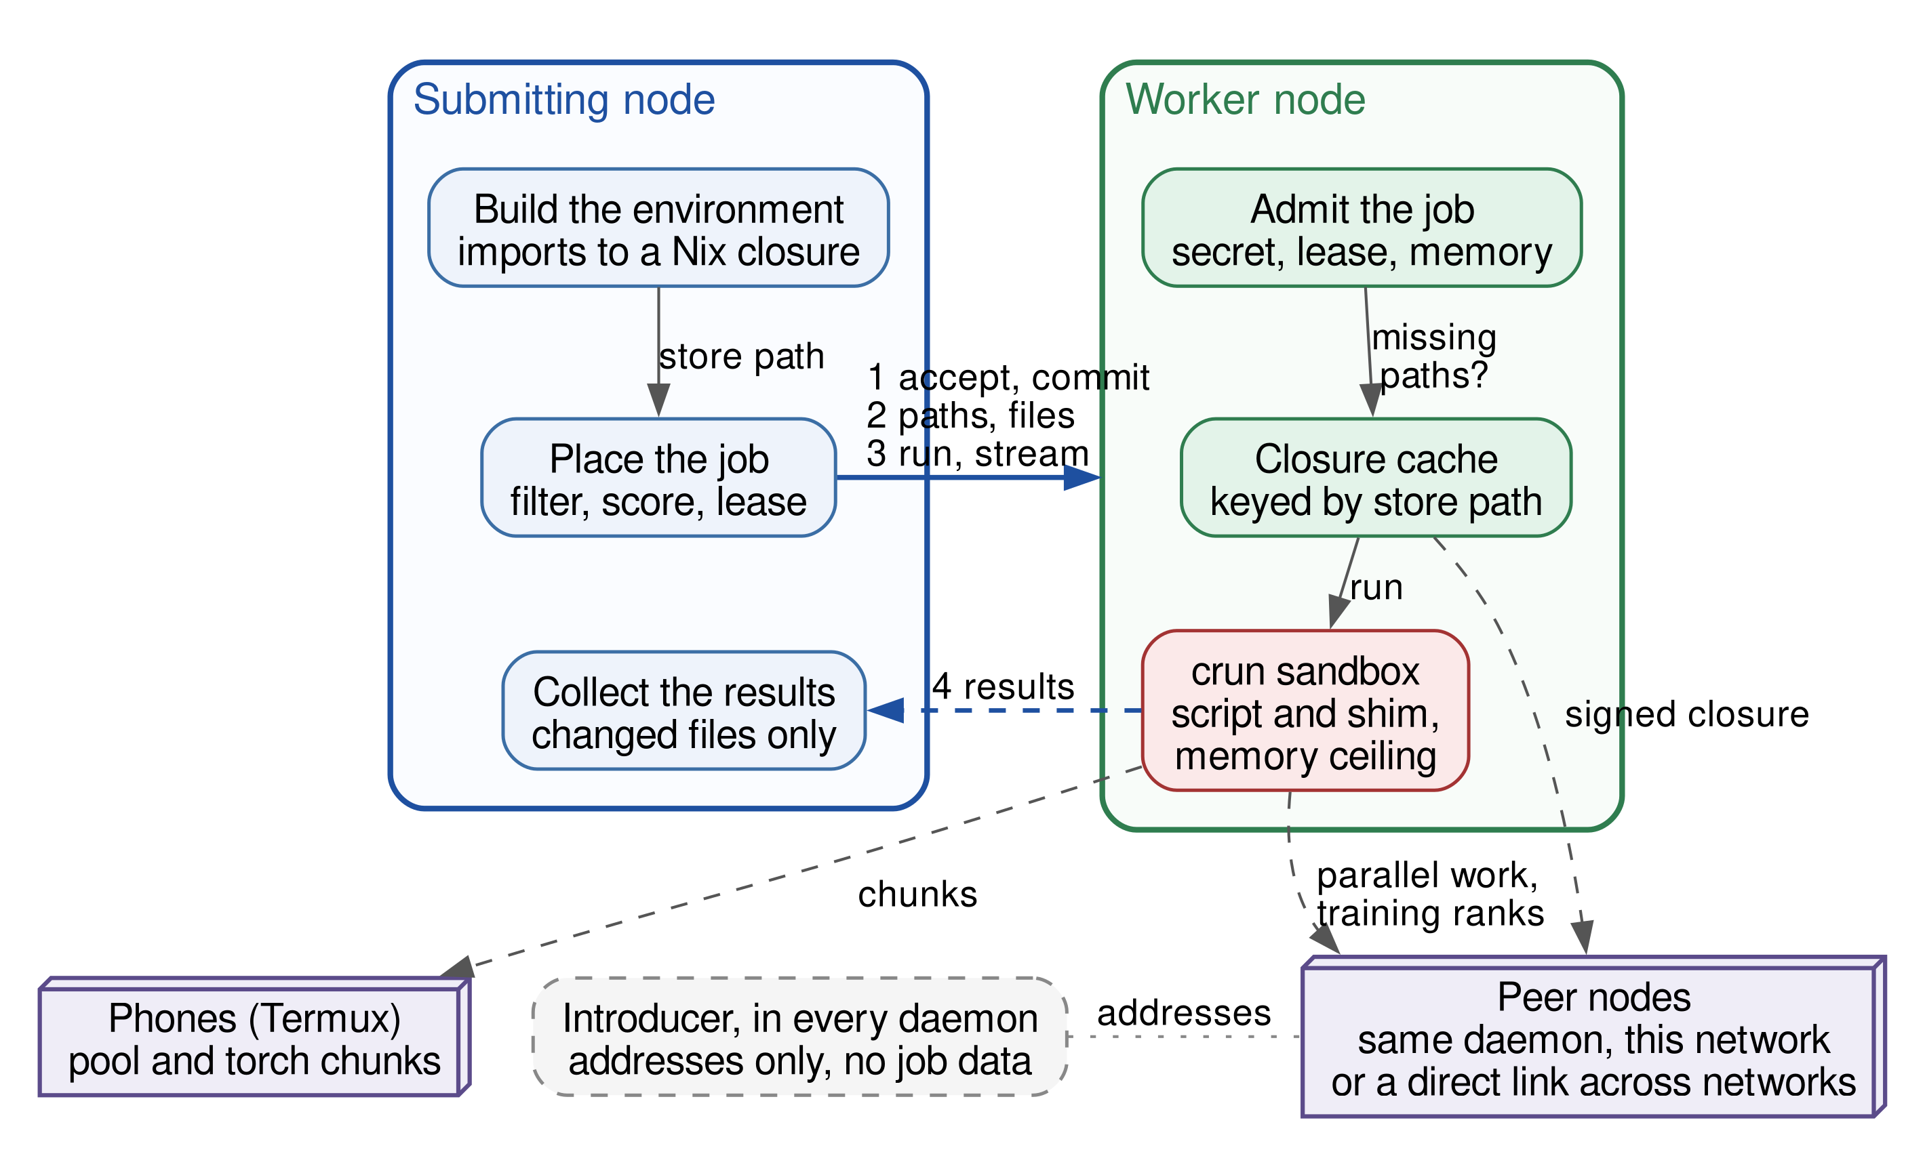
System Architecture
No head node: placement runs in the submitting client.
Worker: admit, cache by store path, sandbox.
Peers take parallel work and training ranks.
Phones take chunks only.
Introducer in every daemon: addresses only.
Department of Computer Engineering, Sardar Patel Institute of Technology
8
Notes:
The submitting node and the worker are the same binary. The submitter builds the closure and places the job: accept, commit, then the missing paths and files, then run and stream. The worker admits the job, fills its closure cache, and runs the script with the shim in a crun sandbox. Parallel work and training ranks go to peer nodes, chunks also to phones. The introducer lives in every daemon and only exchanges addresses; it never carries job data.

Slide 9
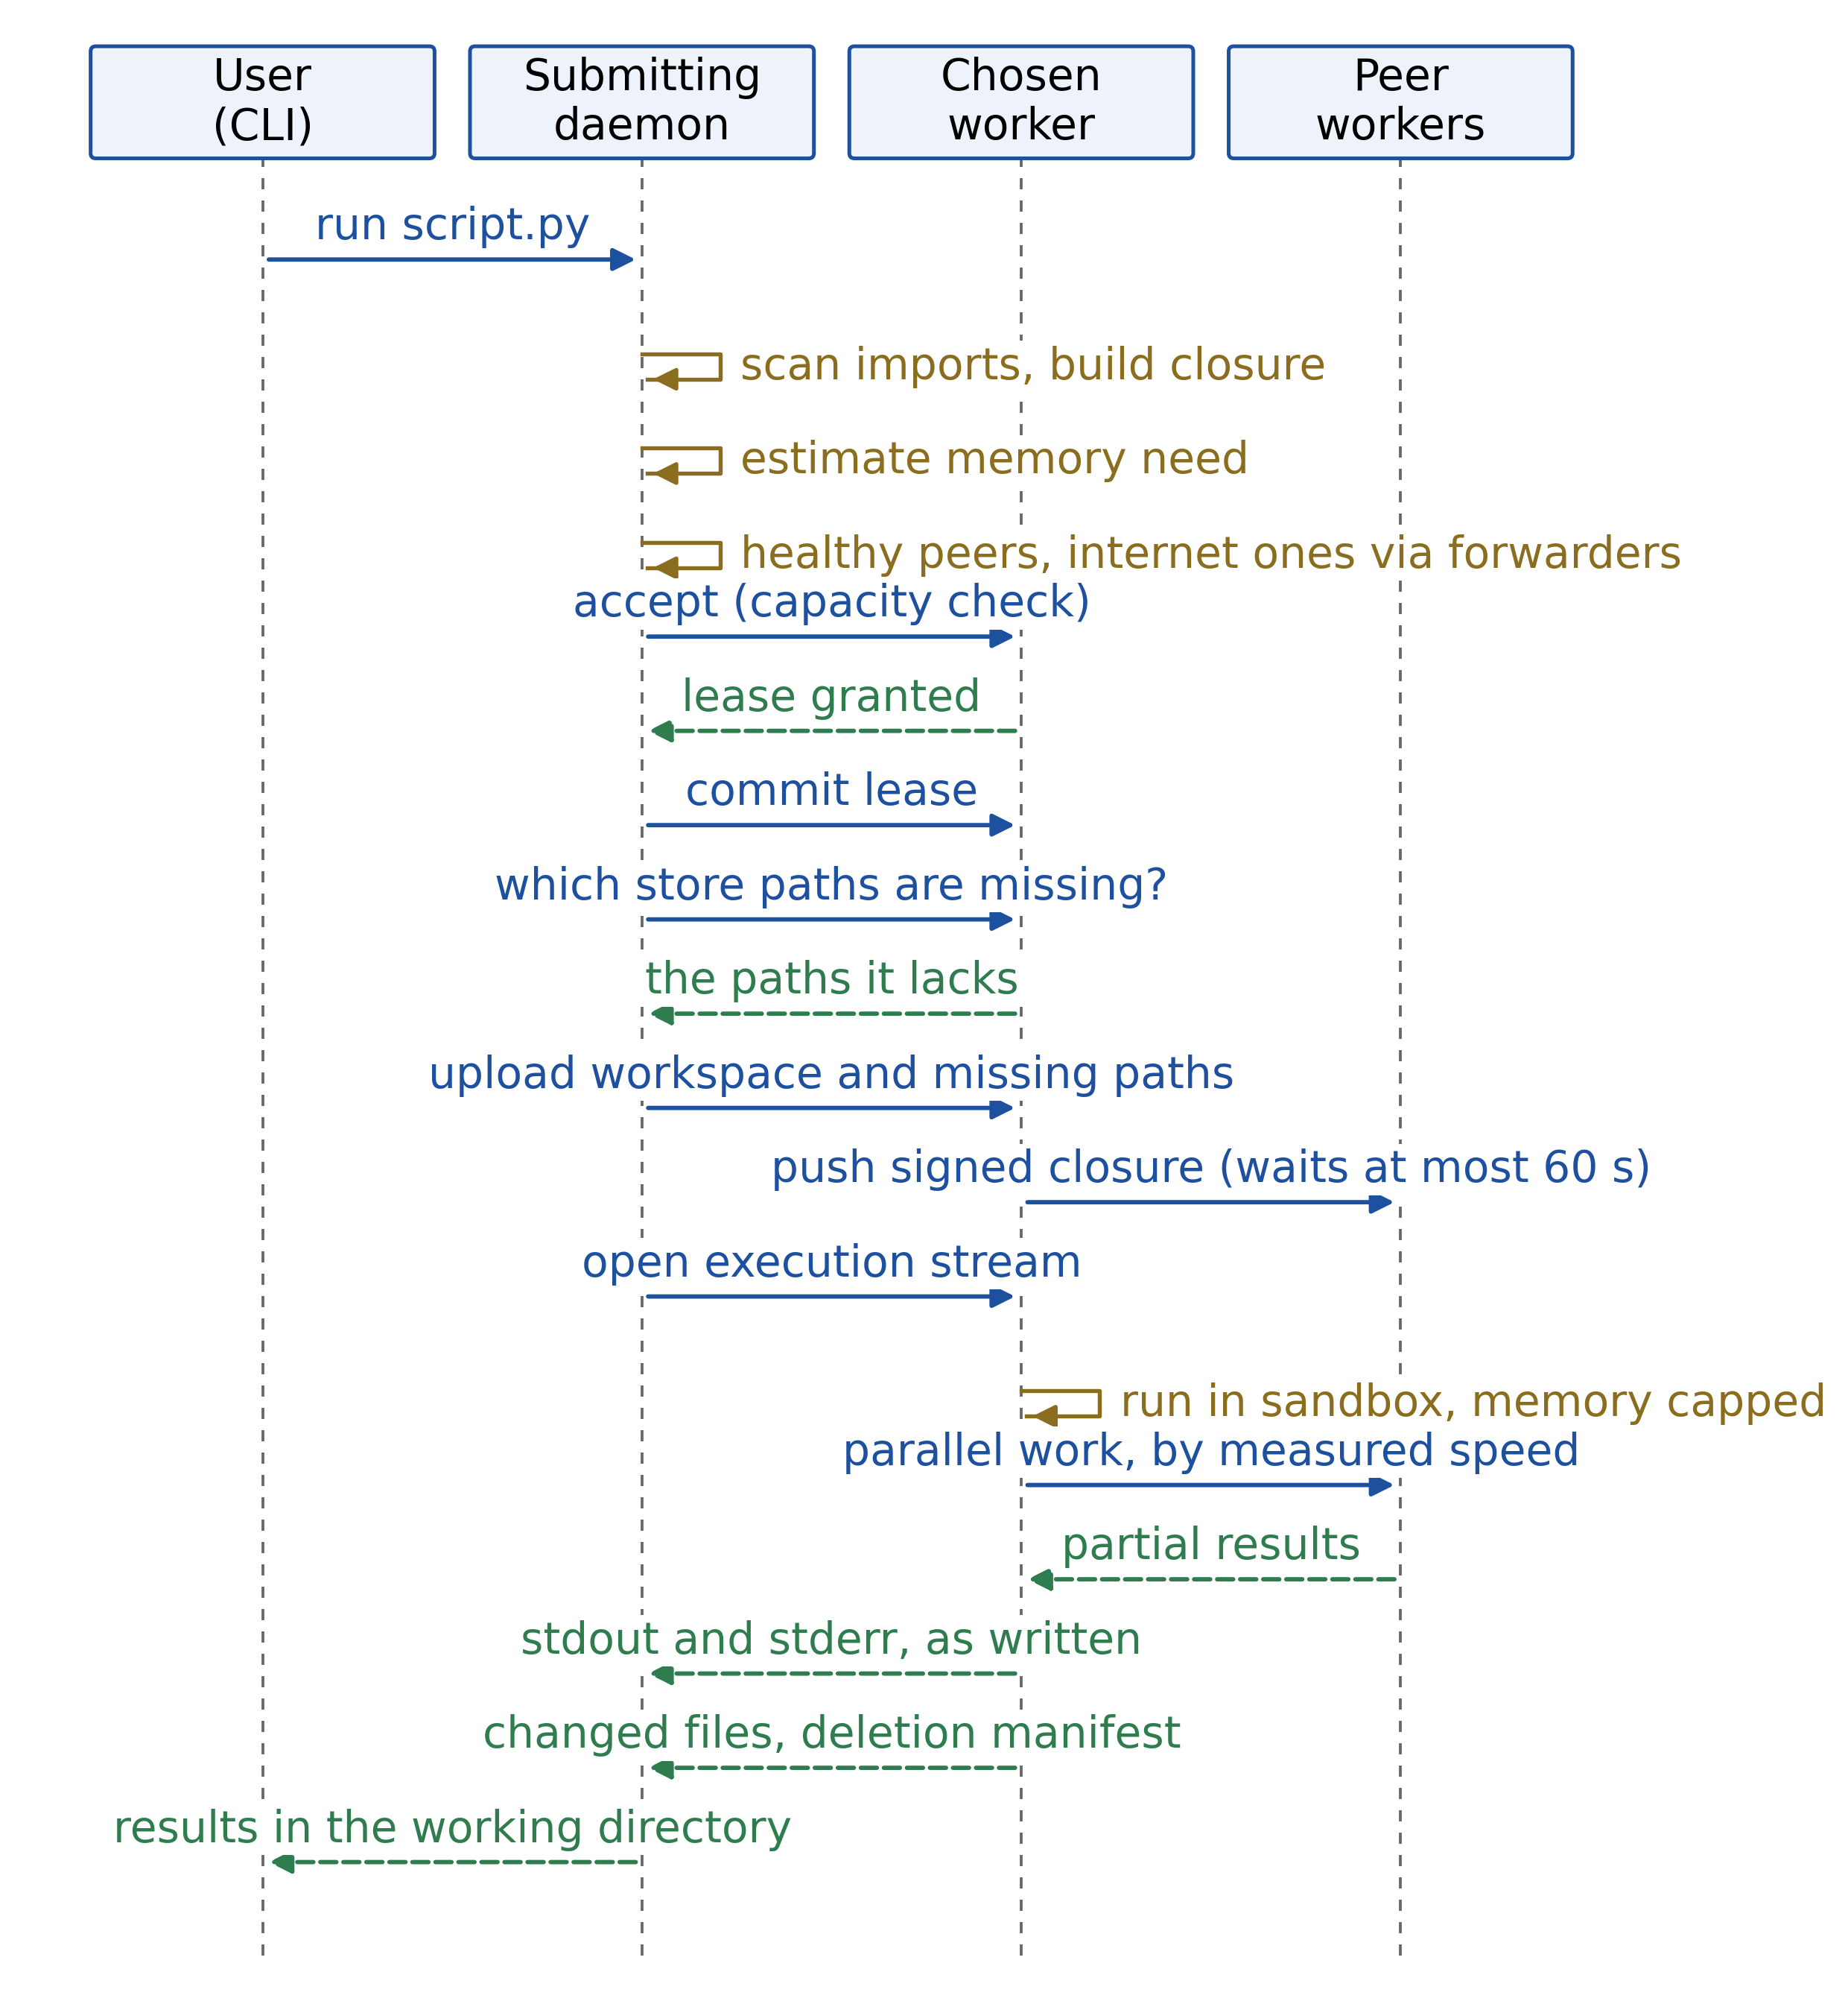
How a Job Runs
1. Scan imports; build or reuse the closure.
2. Filter and score candidates; three-phase lease (accept, commit, complete), renewed every 30 s.
3. Ask what the worker lacks; send only those store paths, then the workspace.
4. Run in a sandbox with the shim on the interpreter's path.
5. Parallel calls may go to peers that can run the same closure.
6. Stream output; return changed files; print where the time went.
Ctrl+C stops the job on every machine; a dropped connection never kills it (reattach).
Department of Computer Engineering, Sardar Patel Institute of Technology
9
Notes:
This is the sequence of one run. The lease has three phases so a dead submitter's slot is reclaimed and a dead worker's job is rescheduled. Only missing paths are sent. Output streams back live, and a dropped connection never kills the job: you can reattach.

Slide 10
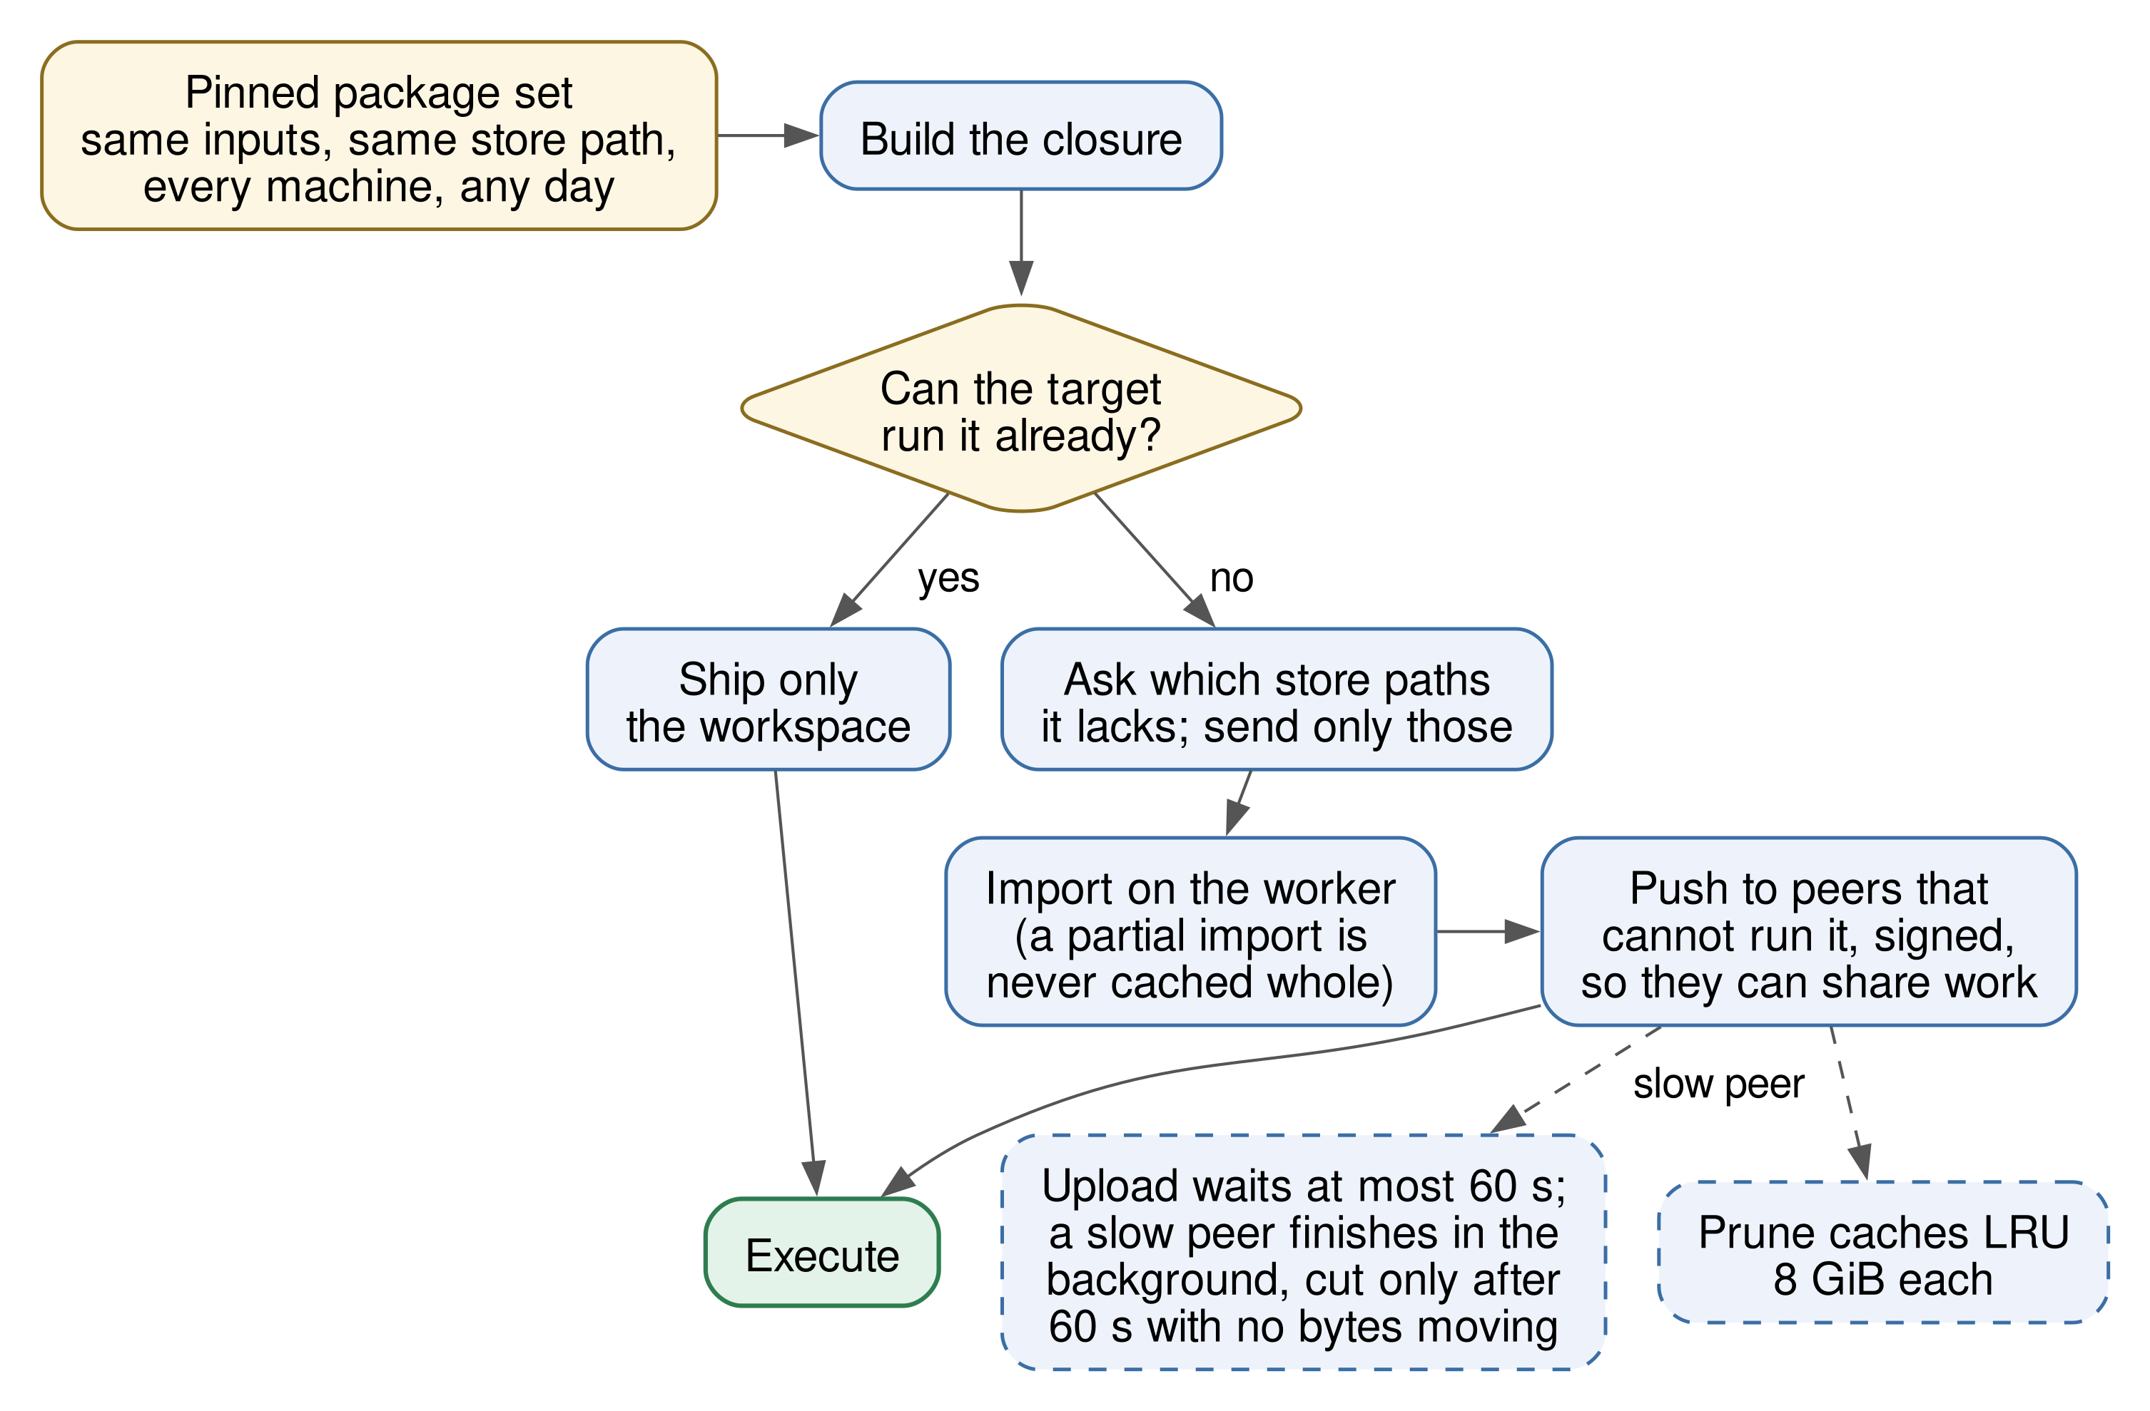
Environment Reproduction: Nix Closures
Closure diff (one package added) | Sent
Whole closure | 206.0 MB
Only missing paths (7 of 43) | 28.6 MB (-86%)
Pinned package-set revision: same script, same store path, every machine and every day.
Signed closures pushed peer to peer; only peers that can run it get distributed work.
Department of Computer Engineering, Sardar Patel Institute of Technology
10
Notes:
The environment is a Nix closure pinned to one exact package-set revision, so the same script has the same store path on every machine. A worker that holds it receives nothing; one that holds part of it receives only the missing paths. Measured: first submission 23.4 seconds, then 0.83 seconds median. Adding one package sent 28.6 MB instead of 206 MB.

Slide 11
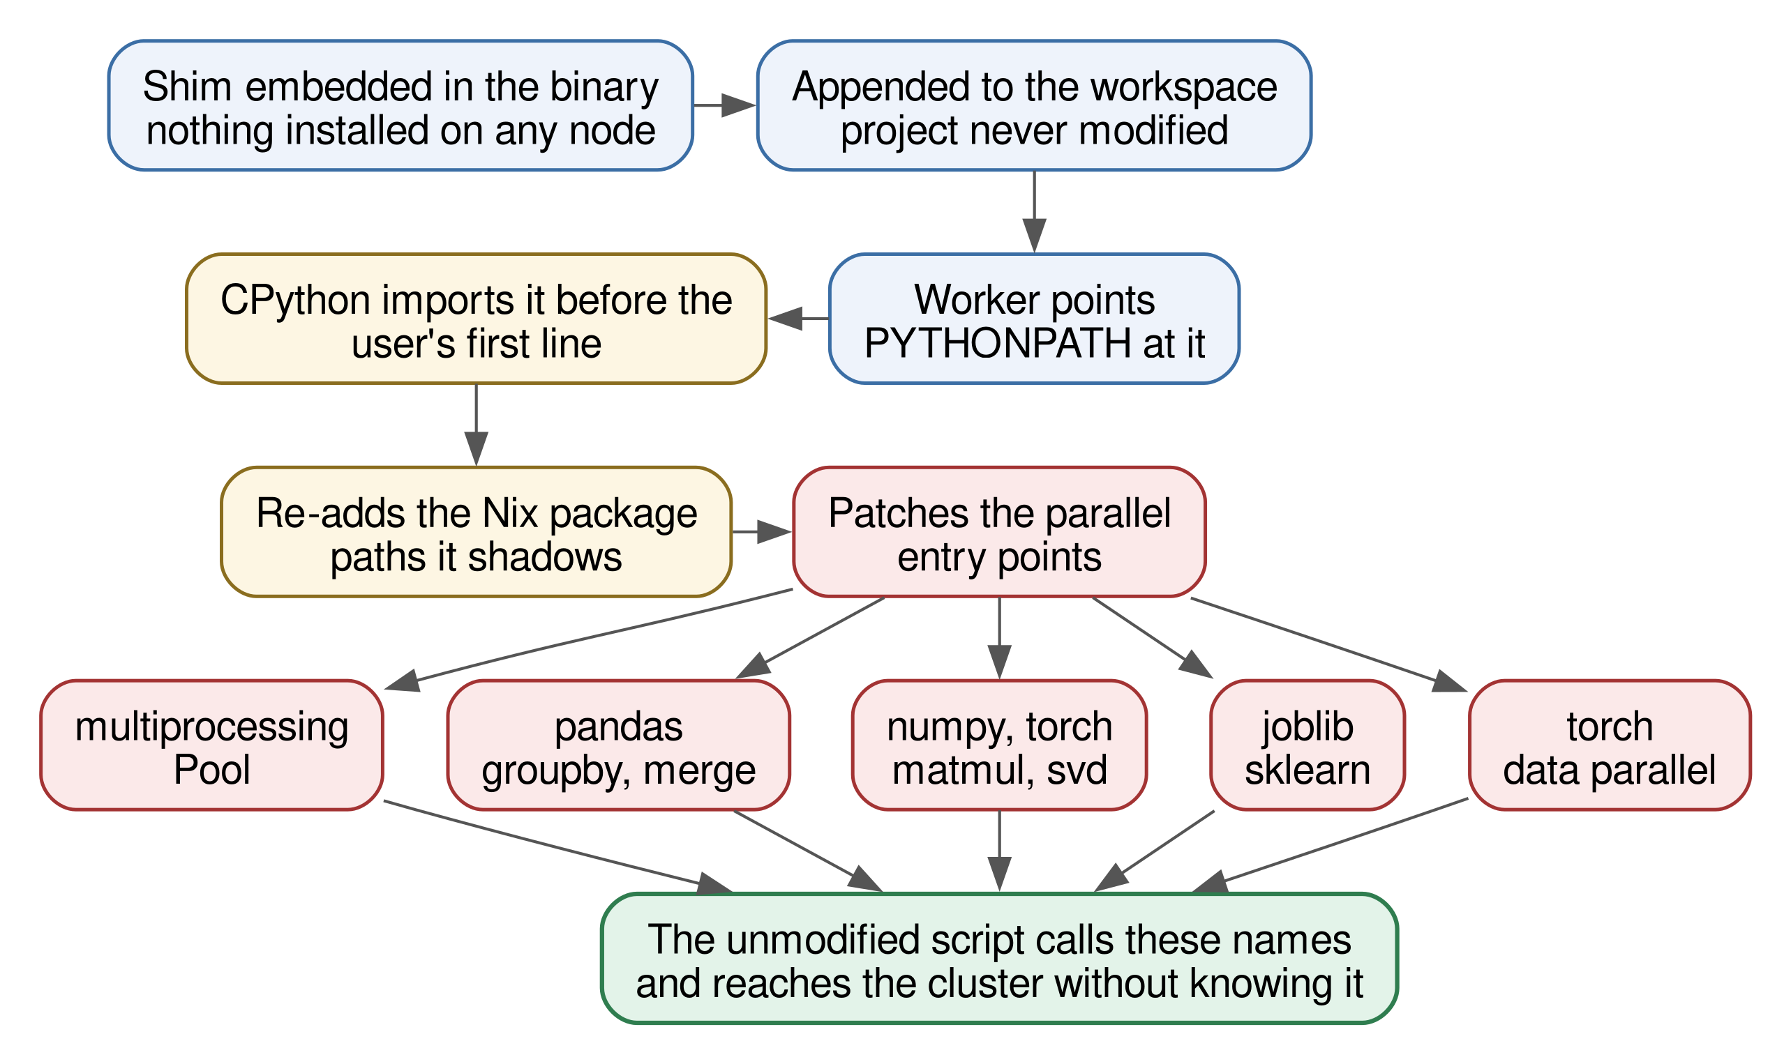
Transparent Interception
Imported before the script's first line; no line of the script changes.
Patched on first import:
multiprocessing / concurrent.futures maps, joblib
pandas groupby, merge, chunked read_csv
NumPy products and decompositions
PyTorch data-parallel training
Any error falls back to the original call.
Startup 1.24× plain Python (eager patching: 20×).
A declined call costs about 0.12 s per job.
Department of Computer Engineering, Sardar Patel Institute of Technology
11
Notes:
A Python package embedded in the binary is imported before the first line of the script. Libraries are patched only when the script imports them, which keeps startup at 1.24 times plain Python; patching eagerly had cost 20 times. Every substituted call falls back to the original on any error.

Slide 12
Dividing Work by Measured Speed
Each device i: setup time oᵢ, effective rate rᵢ (measured, link cost folded in).
Makespan T solves Σ max(0, T − oᵢ)·rᵢ = W (W items).
A device with oᵢ ≥ T cannot start in time and is dropped; repeat until the set settles.
Rates are refitted from every part a device returns.
Late parts are copied to a free device; first result wins (backup tasks).
Idle local cores re-run unfinished parts, so a dead cluster degrades to a local pool.
Lab of 8, 2 and 1 CPUs | Time
Local only (derived) | ≈ 2.3 s
Split by headcount | 3.6 s (1.6× slower)
Split by measured speed | 2.9 s (1-CPU node declined)
Measured split beat headcount but was still ~1.3× slower than local at this size.
A peer at 1/10 CPU: slowdown fell from 1.6× to 1.08× over four runs as rates converged.
Department of Computer Engineering, Sardar Patel Institute of Technology
12
Notes:
Each machine is modelled by a setup time and a measured rate. We find the finish time T at which the machines together absorb all the items, and drop any machine that cannot even start before T. So a machine three times faster gets three times the work, and a very slow one is left out. Late parts get a backup copy; the first to finish wins. Honest result: on an 8, 2 and 1 CPU lab, splitting by speed beat splitting by headcount, but was still 1.3 times slower than staying local at that small size.

Slide 13
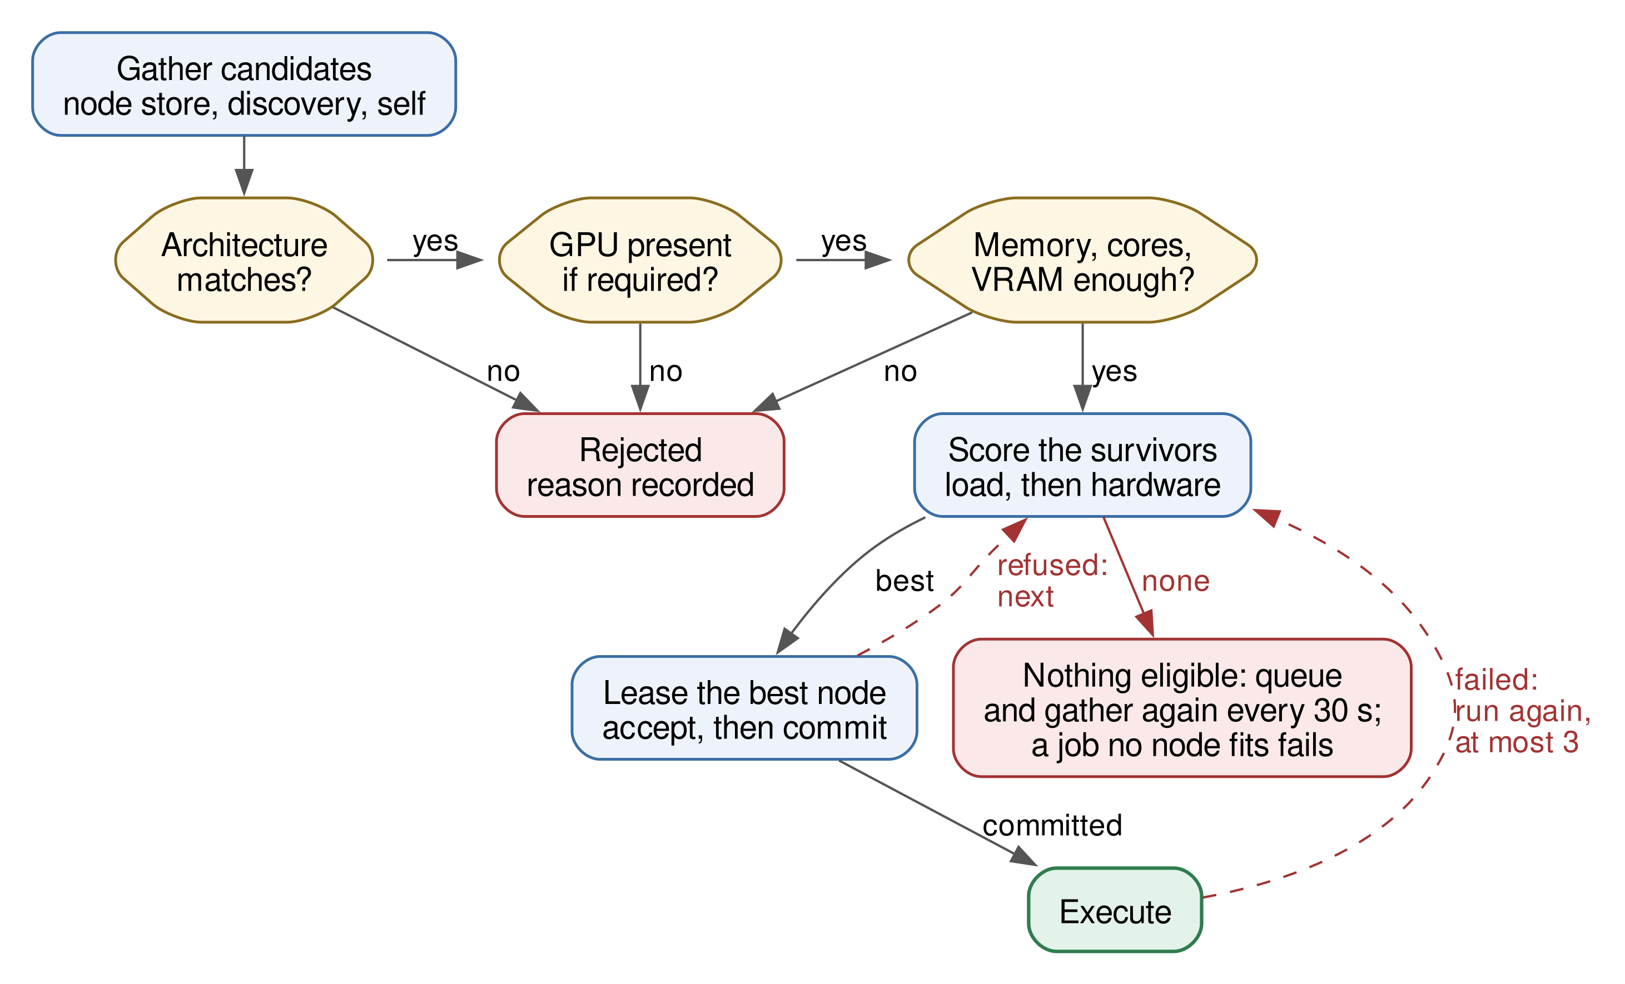
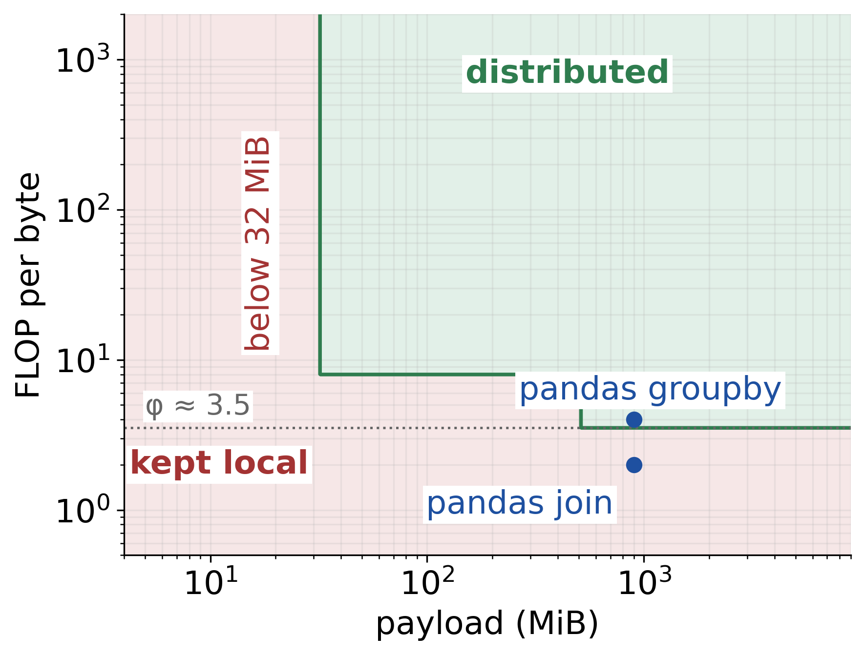
Placement and the Cost Model
Filters: architecture, GPU, free memory, cores, VRAM.
Score: load terms subtract up to 1.0; hardware terms move it ±0.18.
× health factor: halves when a node fails, regains 0.1 per healthy poll.
Move work only if φ/R > ρ/B + 1.3·φ/(R′K).
Bandwidth measured only when offloading could win.
Department of Computer Engineering, Sardar Patel Institute of Technology
13
Notes:
Placement is computed in the client: hard filters first, then a bounded score where current load dominates hardware. For numerical work the cost model compares time per byte locally against transfer plus remote compute; on our machines local BLAS is faster than any CPU cluster's transport, so dense matrix products stay local.

Slide 14
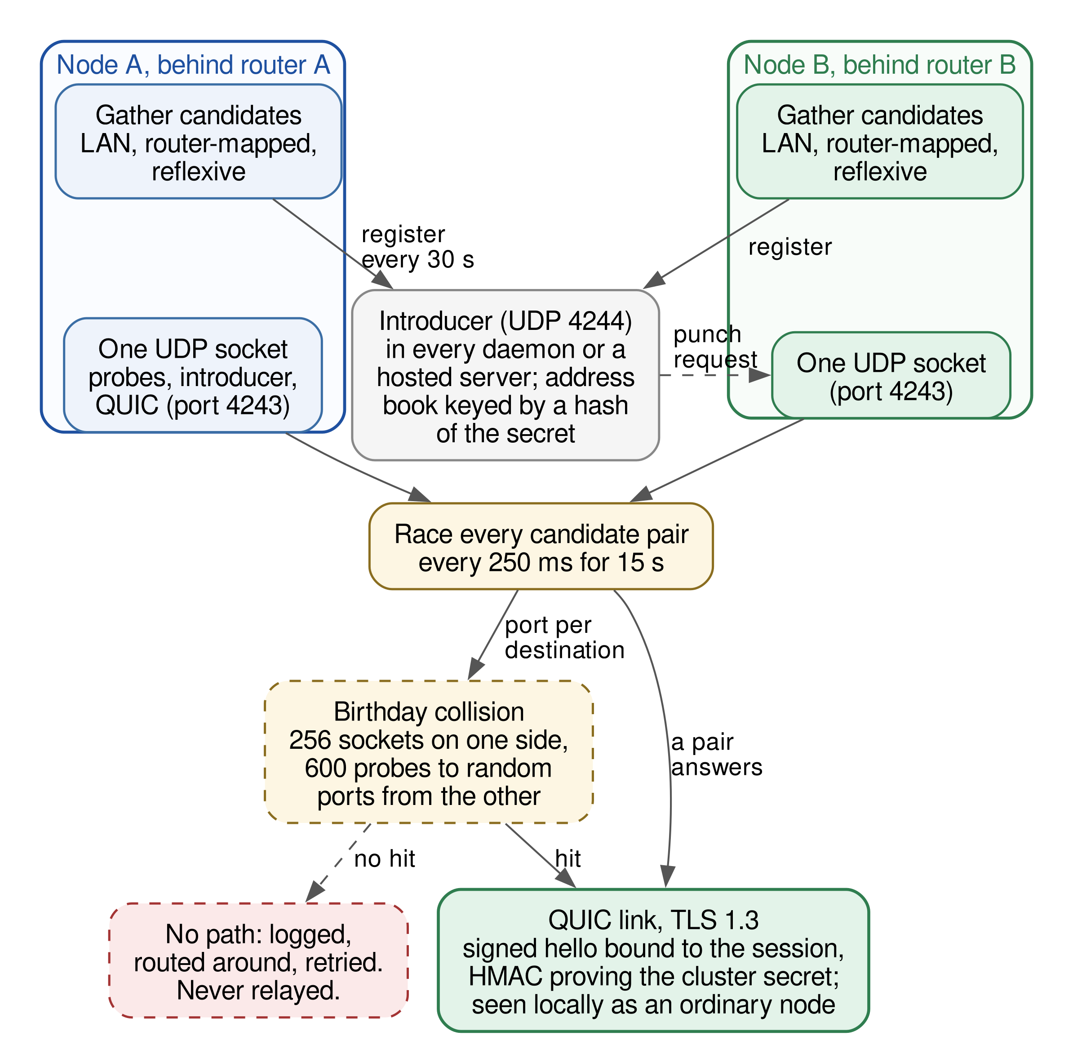
Joining Across Networks (NAT Traversal)
Introducer in every daemon: address book + punch request; no job data.
Candidates: LAN addresses, router port mapping (PCP, NAT-PMP, UPnP), reflexive address.
Probes, introducer traffic and QUIC share one UDP socket; every pair probed every 250 ms for 15 s.
Port-randomising NAT: 256 sockets vs 600 probes — ≈91% per round, computed, not measured.
QUIC link, hello signed with each node's Ed25519 key + HMAC of the cluster secret.
A node is its key, not its address: a machine that changes network rejoins on its own.
No path? Reported with the reason and routed around — never relayed.
Department of Computer Engineering, Sardar Patel Institute of Technology
14
Notes:
Machines behind different routers accept no inbound connections. Every daemon is an introducer for its own cluster: it keeps an address book and forwards one punch request, and never carries job data. Both sides race every candidate pair over one UDP socket. When one router changes port per destination, we use a birthday collision: 256 sockets against 600 probes, about 91 percent per round by calculation; we did not measure that rate. Links are QUIC, signed by each node's key and bound to the cluster secret.

Slide 15
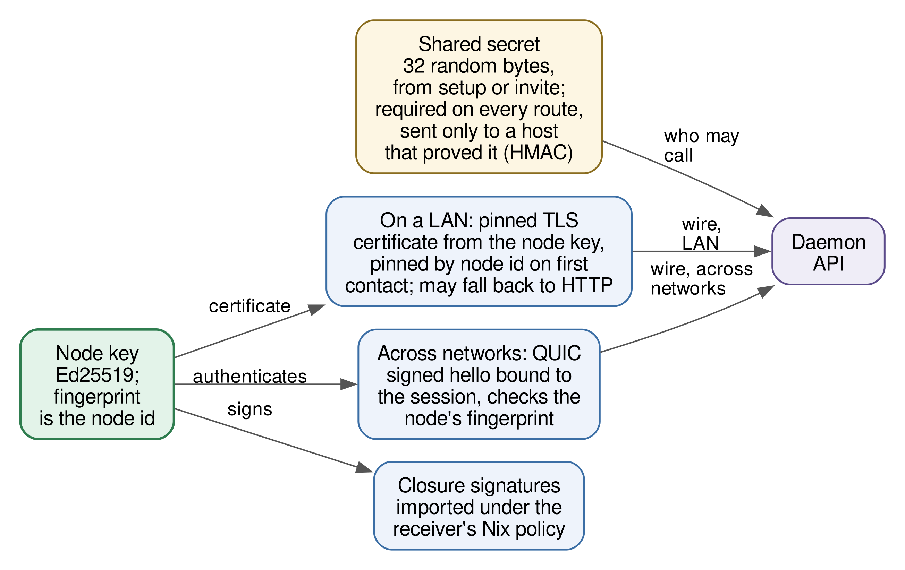
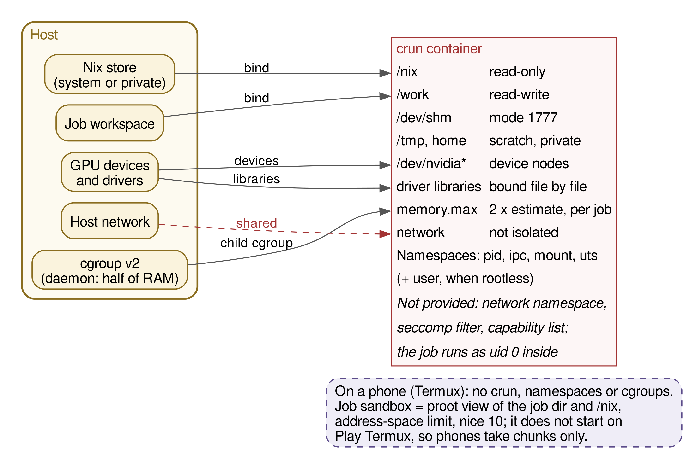
Trust and Sandboxing
Closures signed by the sender; key checked before import.
crun container per job: memory ceiling, GPU bound in.
Gaps: TLS trust-on-first-use; one shared secret; signing keys not yet bound to identity.
Department of Computer Engineering, Sardar Patel Institute of Technology
15
Notes:
Closures are signed by the sending node and checked against its published identity before import. Each job runs in an unprivileged crun container with a memory ceiling; GPU driver files are bound in one by one. We are honest about the gaps: TLS is trust on first use, signing keys are not yet bound to an authenticated identity, and one shared secret is the only authorisation, so this is for machines whose owners trust each other.

Slide 16
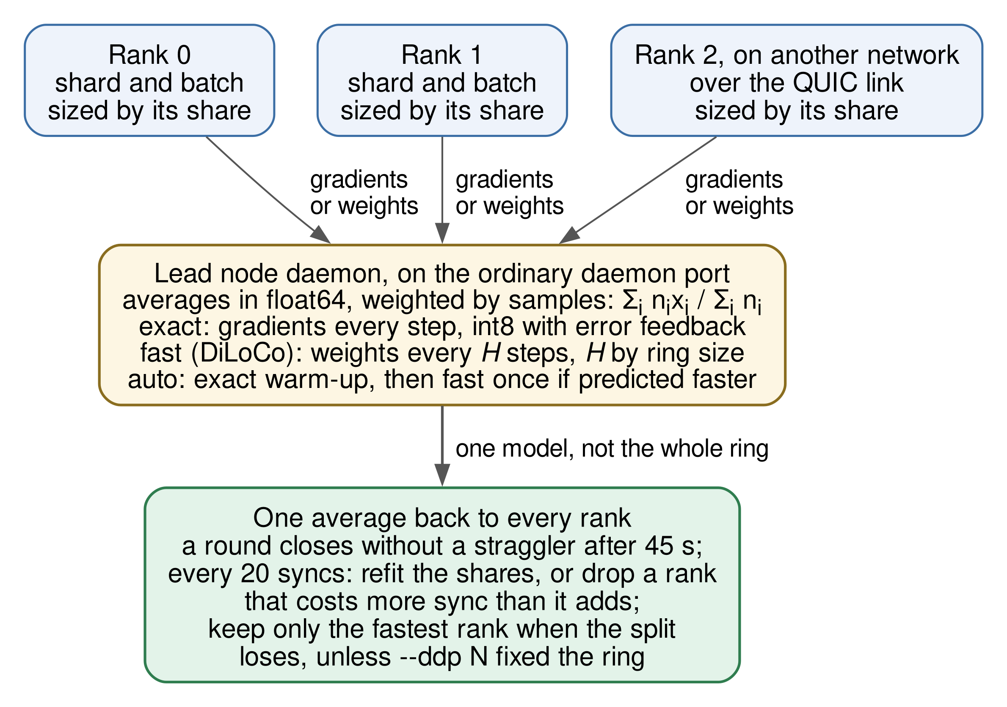
Data-Parallel Training Through the Daemons
Ranks post gradients to daemons — no rank-to-rank mesh needed.
One sample-weighted average, sent as 8-bit with error feedback.
Global batch split by measured speed; learning rate preserved.
Exact sync every step, or fast sync (average weights every H steps).
H chosen per ring size from accuracy runs: 32 (2 ranks), 16 (3), 4 (4); none for 5+.
After warm-up, the ring is released if one machine alone is faster.
A rank that dies: others take its share at the next epoch; a returning rank rejoins.
Department of Computer Engineering, Sardar Patel Institute of Technology
16
Notes:
Ranks send gradients to daemons, not to each other, so they do not need to reach one another directly. Each rank gets one sample-weighted average, sent as 8-bit values with error feedback. Batches are split by measured speed. Fast mode averages weights every H steps; at H = 32 on two ranks validation loss stayed within 1 percent of one device on all three test models, with 7.6 to 9.2 times fewer bytes. If one machine is faster alone, the ring is released.

Slide 17
Phones as Workers
Android phone joins from Termux, no root: pipedpeer connect <code>.
Debian under proot-distro with single-user Nix; environment built for aarch64 from the public cache.
Takes Pool / joblib and torch chunks only (chunks-only role).
Whole jobs need a nested proot sandbox that Play-Store Termux cannot start.
Sandbox is weaker than crun: proot view, memory limit, low priority.
Keep it charging and run termux-wake-lock.
Samsung Galaxy S20 FE (Android 13) | Result
CPU script on 2 laptops + phone | phone took 8 of 192 items; same checksum
Environment built on the phone | 27 s, from the cache
160 small torch models | phone trained 6; all converged
32 small torch models | phone took none
CPU script on the phone alone | 62.4–66.0 s (Nix Python)
Department of Computer Engineering, Sardar Patel Institute of Technology
17
Notes:
An Android phone joins from Termux without root. It runs a Debian under proot with Nix, builds the job's environment for ARM from the public cache, and takes parallel-map and torch chunks. It does not take whole jobs yet: that needs a nested proot sandbox that the Play Store Termux cannot start. On our S20 FE it took 8 of 192 items with the same checksum. It contributes a small share; we did not measure whether it made a run faster.

Slide 18
Fault Tolerance and Recovery
Drill | Result
Node's link cut during a 240-item map (two-site NAT testbed) | its 53 items re-ran on the submitter; checksum unchanged
A worker killed with map chunks in flight (80 items) | 33 items had run on peers; no chunk lost; result correct
A worker killed during a remote job | node reported gone 16 s after the kill
A training rank killed | remaining rank finished all 80 epochs (90.5 s)
A rank's machine back during training | rejoined at the next epoch, 4 s after its daemon started
Ctrl+C during a parallel map | peers stopped within 2 s
Submitter's network removed for 200 s | job ran once; result back ~15 s after reconnecting
Detach, then attach | followed live; replayed in 1.0 s once finished
Single points of failure remain: the submitter of a parallel script and the machine of a training ring's rank 0.
Department of Computer Engineering, Sardar Patel Institute of Technology
18
Notes:
Using the cluster must never change the result. These are the failure drills we ran. When a node's link was cut during a 240-item map, its 53 items were re-run on the submitter and the checksum was unchanged. Two machines are still single points of failure: the submitter of a parallel script and the machine of a training ring's rank 0.

Slide 19
Implementation
Go 1.25, one binary (client + daemon), 46 packages.
Embedded Python shim; links on quic-go; environments with Nix flakes; jobs in crun.
Web page (pipedpeer ui) and terminal dashboard.
Tests: 1,012 of 1,017 pass, 4 skipped, 1 timing-sensitive failure (fresh run, 2 Nov 2026).
Mutation audit: 95 features disabled one at a time — the tests caught 95 / 95.
CI: formatting, vet, race detector, skip check, never-3×-slower benchmarks.
Area | Technology
Language | Go 1.25 + Python shim
Environments | Nix flakes (pinned nixpkgs)
Sandbox | crun (OCI), cgroup v2
Transport | QUIC (quic-go), TLS 1.3
Identity | Ed25519 node keys, HMAC
Training | PyTorch, 8-bit gradients
Phone | Termux + proot-distro
Department of Computer Engineering, Sardar Patel Institute of Technology
19
Notes:
PipedPeer is one Go binary with 46 packages; the Python shim is embedded in it. Links use quic-go, environments use Nix flakes, jobs run in crun. In a fresh full test run with torch installed, 1,012 of 1,017 tests passed, 4 were skipped and one timing-sensitive test failed. A mutation audit disables 95 features one at a time, and the tests caught every one.

Slide 20
Experiment Setup
Setting | What it is | What it can show
Plain lab | 3 worker containers sharing one laptop | Correctness, overhead, caching — not speedup
Quota lab (emulated) | Fixed CPU/memory per container; LAN / Wi-Fi / 5G shaped with netem | How cost grows; emulated speedup
Two-site testbed | Two private networks behind NAT router containers + introducer | Joining across NATs; failover
Physical set A | Ryzen 7 + RTX 3060 and Core i5 + RTX 3050 in two homes; Galaxy S20 FE | Real distribution (over Tailscale)
Physical set B | 20-core Core i9 + Ryzen laptop; cloud host as introducer | Real pool map; introducer traffic
Lab times: medians of 3–5 runs. Training: one seed (accuracy: mean of 3–6 seeds).
Physical runs: single runs or ranges over 2–3 runs — evidence, not a controlled scaling study.
Department of Computer Engineering, Sardar Patel Institute of Technology
20
Notes:
We keep four kinds of measurement apart and label every result. The plain lab shares one processor, so it shows cost and correctness, never speedup. The quota lab is emulated. The two-site testbed has real NAT routers in containers. The physical runs are two laptops in different homes plus a phone, and a second pair of machines.

Slide 21
Results: Two Laptops in Different Homes
CPU work gained on two machines; the small model was fastest on one GPU — splitting it did not pay.
Fast sync 5.0× faster than exact at about the same loss; s1/s2 = two sessions on different builds.
Department of Computer Engineering, Sardar Patel Institute of Technology
21
Notes:
Between two laptops in different homes, the mixed CPU script took 13.3 to 14.6 seconds against 17.4 to 18.1 on one laptop, about half the items on each. The small training model did not gain: one GPU took 4.2 seconds, faster than every split. Fast sync was 5 times faster than exact at the same loss. We show both because the system's job is to choose correctly.

Slide 22
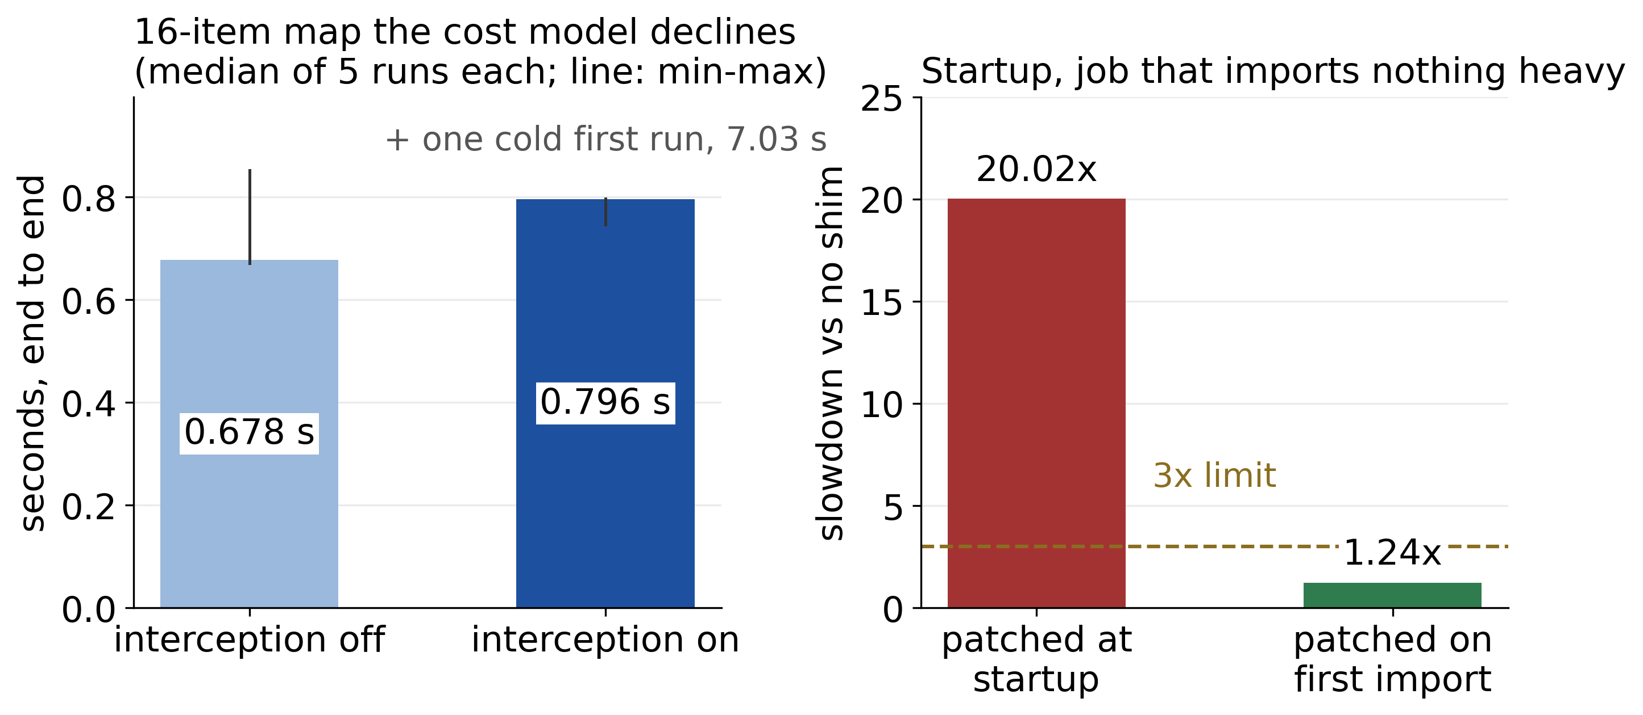
Results: Overheads and Other Measurements
Measurement | Result
Startup with interception | 1.24× plain Python
Declined map (16 items) | +0.12 s per job
crun vs bubblewrap start | +15–21 ms
Pool map, Core i9 alone vs + peer | 5.8–6.4 vs 4.9–5.4 s
Training over 54 Mbit/s: 1 machine / 2 ranks fp16 / int8 | 54.9 / 69.4 / 56.1 s
Introducer traffic vs peer traffic | 0.2 MB vs ~30 MB
Emulated nodes (2 CPU each) | 1 | 2 | 3 | 4
Wall time, s (loaded host) | 2.37 | 1.15 | 0.95 | 0.81
Emulated quotas on one host: shows growth, not a physical-machine speedup. No CPU step grew faster than its expected order.
Department of Computer Engineering, Sardar Patel Institute of Technology
22
Notes:
Interception costs 1.24 times the startup of a trivial job and 0.12 seconds when it declines. On the second pair of machines a parallel map took 4.9 to 5.4 seconds against 5.8 to 6.4 alone. Exact training over a 54 megabit home link was not faster than one machine. The introducer carried 0.2 MB against 30 MB between the peers.

Slide 23
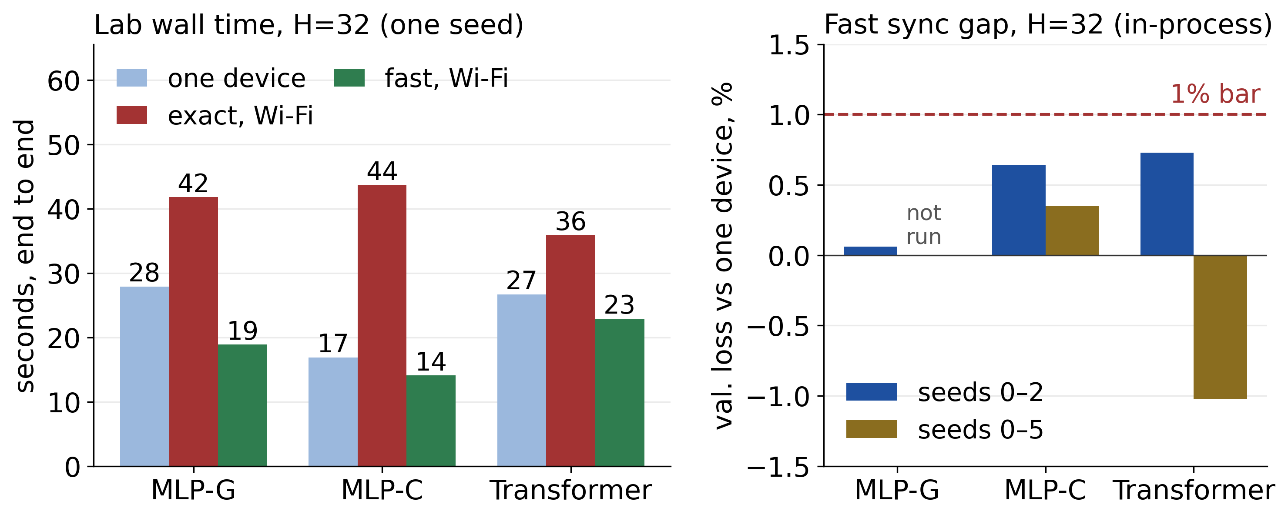
Results: Training Accuracy and Bytes
Model (H = 32, 2 ranks) | Loss gap vs one device | MiB per rank, exact / fast | Lab time LAN: exact / fast / one device
MLP-G (559k params) | +0.06% | 81.1 / 10.7 | 20.0 / 15.2 / 27.9 s
MLP-C (559k params) | +0.64% | 98.9 / 10.7 | 14.6 / 10.4 / 16.9 s
Transformer (70k params) | +0.73% | 21.7 / 2.4 | 22.7 / 19.1 / 26.7 s
Loss gap: mean of seeds 0–2, in-process. Lab times: quota lab, one seed, equal 2-CPU containers.
Department of Computer Engineering, Sardar Patel Institute of Technology
23
Notes:
Fast sync every 32 steps kept validation loss within 1 percent of one device on all three models: plus 0.06, plus 0.64 and plus 0.73 percent. Each rank sent 7.6 to 9.2 times fewer bytes. DiLoCo's outer momentum step failed our bar, so we use plain averaging. At eight ranks no interval kept the transformer within 1 percent, so automatic mode never picks fast sync beyond four ranks.

Slide 24
Comparison with Existing Systems
Property | PipedPeer | Spark | Ray | Dask | Lithops | ssh
Runs unmodified Python | yes | no | partial | partial | partial | yes
No cluster or back end to configure | yes | no | no | no | no | partial
No head or master node | yes | no | no | no | n/a | yes
Reproduces the environment | yes | partial | partial | partial | partial | no
Joins NATed machines, no relay | yes | no | no | no | n/a | no
Survives losing a node | partial | yes | yes | yes | yes | no
Authenticated, encrypted | partial | yes | partial | partial | yes | yes
Runtimes beyond Python | no | yes | partial | no | no | yes
Proven in production | no | yes | yes | yes | yes | yes
Qualitative, from published designs — no wall-time benchmark against Ray, Dask or Lithops was run.
Department of Computer Engineering, Sardar Patel Institute of Technology
24
Notes:
The upper rows are what PipedPeer was designed to do differently; the lower rows are where it is partial or weaker. This comparison is qualitative, from published designs; we did not benchmark against Ray or Dask.

Slide 25
Limitations
Physical evaluation covers two or three machines and one phone, mostly single runs — not a controlled scaling study.
No wall-time comparison with Ray, Dask or torchrun.
Two homes without a reachable introducer need an overlay (e.g. Tailscale); there is no relay by design.
Single points of failure: the submitter of a parallel script, and rank 0's machine.
Python on Linux only; NVIDIA GPUs in practice. Phones take chunks only.
Security: TLS trust-on-first-use, one shared secret, signing keys not bound to identity.
Fast sync validated for 2–4 ranks; the 1% bar holds for the mean over seeds, not every seed.
Cost-model and placement constants are hand-set, not calibrated across hardware.
Department of Computer Engineering, Sardar Patel Institute of Technology
25
Notes:
These are the limits, and they are in the report and the paper too.

Slide 26
Live Demo
$ pipedpeer connect <code> # join with one line
$ pipedpeer status
$ python3 cpu.py # baseline TOTAL
$ pipedpeer run cpu.py # same results, spread
$ pipedpeer run gpu.py # one GPU or a split?
$ pipedpeer run --ddp 2 --ddp-sync fast gpu.py
$ pipedpeer run both.py # CPU phase, then GPU
$ pipedpeer run --remote gpu.py # whole job elsewhere
$ pipedpeer ui # cluster web page
$ pipedpeer run cpu.py --items 600 # cut Wi-Fi mid-run
Join: ✓ connected: N other machine(s).
cpu.py: same checksum lines, lower TOTAL, and ran on <machine> 60%, <machine> 40%.
gpu.py: keeps one GPU when the split would be slower — and says why.
Phone appears in the ran on line for CPU work.
Wi-Fi off mid-run: same checksum; work re-run elsewhere; machine returns by itself.
Department of Computer Engineering, Sardar Patel Institute of Technology
26
Notes:
Now the demo. One machine joins with a single code. Then the CPU script runs plain and through PipedPeer: same result lines, lower total, and the line naming the other machines. Then the GPU script, where the automatic choice keeps one GPU. Then a remote run, the phone taking CPU work, the web page, and finally we switch off a laptop's Wi-Fi mid-run and the checksum stays the same.

Slide 27
Conclusion and Future Scope
Conclusion
Unmodified Python runs across a small group's machines with one command, no cluster and no relay.
Environments are shipped as closures diffed by store path (0.83 s warm vs 23.4 s cold).
CPU-bound work gained on two machines; small GPU models stayed on one GPU — the system measures and declines.
Fast sync kept accuracy within 1% at 7.6–9.2× fewer bytes.
Future scope
Bind signing keys to identities; require TLS; per-user authorisation.
Survive the loss of the submitter and of rank 0.
Whole jobs on phones; AMD GPUs.
Locality- and topology-aware placement.
Controlled, repeated evaluation on more machines against Ray, Dask and Lithops.
Department of Computer Engineering, Sardar Patel Institute of Technology
27
Notes:
To conclude: PipedPeer runs unmodified Python on a small group's machines with no cluster to set up, joining networks over direct links. It gains on CPU-bound work and declines when one machine is faster. Next: close the security gaps, survive the loss of the submitter and rank 0, whole jobs on phones, and a controlled evaluation on more machines.

Slide 28
Execution Plan and Budget
Timeline: 12 April – November 2026 (first to latest commit); each phase on its own branch, merged into dev after review.
Team: all three members worked jointly on design, implementation, evaluation and writing.
Budget: no hardware bought — open-source software, our own laptops and phone, and one rented cloud server as introducer during the cross-network tests (since shut down).
Department of Computer Engineering, Sardar Patel Institute of Technology
28
Notes:
The project ran from April to November 2026 in phases, each on its own branch and merged into dev after review. All three of us worked on every part together. No hardware was bought: the software is open source, and we used our own laptops and a phone, plus one rented cloud server as an introducer during the cross-network tests, since shut down.

Slide 29
Research Publication
"PipedPeer: Running Unmodified Python Across a Small Group's Machines Without a Configured Cluster"
Y. Vaviya, V. Yadav, S. Gupta, R. Sawant.
Submitted to the Journal of Parallel and Distributed Computing (Elsevier), 3 November 2026 (JPDC-D-26-02273); under review.
Shorter IEEE conference-format version (6 pages) with the report; plagiarism report attached.
Every number in the paper and report traces to a recorded measurement in the repository.
Department of Computer Engineering, Sardar Patel Institute of Technology
29
Notes:
Our journal paper was submitted to the Journal of Parallel and Distributed Computing, an Elsevier journal, on 3 November 2026, and is under review. A shorter IEEE conference-format version accompanies the report, with the plagiarism report attached as the evaluation requires. Every number in both comes from a recorded measurement.

Slide 30
References
M. Zaharia et al., Spark: Cluster computing with working sets, HotCloud, 2010.
P. Moritz et al., Ray: A distributed framework for emerging AI applications, OSDI, 2018.
M. Rocklin, Dask: Parallel computation with blocked algorithms and task scheduling, SciPy, 2015.
A. Arjona, G. Finol, P. García-López, Transparent serverless execution of Python multiprocessing applications, Future Gener. Comput. Syst. 140 (2023) 436–449.
E. Dolstra, M. de Jonge, E. Visser, Nix: A safe and policy-free system for software deployment, LISA, 2004.
B. Ford, P. Srisuresh, D. Kegel, Peer-to-peer communication across network address translators, USENIX ATC, 2005.
J. Iyengar, M. Thomson, QUIC: A UDP-based multiplexed and secure transport, RFC 9000, 2021.
S. Li et al., PyTorch distributed: Experiences on accelerating data parallel training, PVLDB 13(12), 2020.
A. Douillard et al., DiLoCo: Distributed low-communication training of language models, arXiv:2311.08105, 2023.
T. Lin et al., Don't use large mini-batches, use local SGD, ICLR, 2020.
Department of Computer Engineering, Sardar Patel Institute of Technology
30
Notes:
These are the main references; the report has the full list.

Slide 31
Thank You
Questions?
Yateen Vaviya, Vinayak Yadav, Sahil Gupta
Guide: Dr. Rupali Sawant
Notes:
Thank you. We are happy to take questions.

