Slide 1
Servlets

Slide 2
What Are Servlets?
Basically, a java program that runs on the server
Creates dynamic web pages

Slide 3
What is a Servlet
A servlet can be thought of as a server-side applet
  Applet: a java program that runs within the web browser
  Servlet: a java program that runs within the web server
  Servlets are loaded and executed by a web server in the same manner that applets are loaded and executed by a web browser

Slide 4
Servlet Architecture
Web
Server
Servlet
Container
Client
(web browser)
HTTP request
Servlet
HTTP response
The client makes a request via HTTP
The web server receives the requests and forwards it to the servlet
  If the servlet has not yet been loaded, the web server loads it into the JVM and executes it
The servlet receives the HTTP request and performs some type of process
The servlet returns a response to the web server
The web server forwards the response to the client

Slide 5
History
Dynamic websites were often created with CGI
CGI: Common Gateway Interface
Poor solution to today’s needs
A better solution was needed

Slide 6

Servlets vs. CGI
CGI
Servlet Advantages
  Efficient
    Single lightweight java thread handles multiple requests
    Optimizations such as computation caching and keeping connections to databases open
  Convenient
    Many programmers today already know java
  Powerful
    Can talk directly to the web server
    Share data with other servlets
    Maintain data from request to request
  Portable
    Java is supported by every major web browser (through plugins)
  Inexpensive
    Adding servlet support to a server is cheap or free
Notes:
Adapted from
http://www.apl.jhu.edu/~hall/java/Servlet-Tutorial/Servlet-Tutorial-Overview.html

Slide 7
Servlets vs. CGI
CGI Advantages
  CGI scripts can be written in any language
  Does not depend on servlet-enabled server

Slide 8
What Servlets Need
JavaServer Web Development Kit (JSWDK)
Servlet capable server
Java Server Pages (JSP)
Servlet code

Slide 9
Java Server Web Development Kit
JSWDK
  Small, stand-alone server for testing servlets and JSP pages
The J2EE SDK
  Includes Java Servlets 2.4

Slide 10
Servlet capable server
Apache
  Popular, open-source server
Tomcat
  A “servlet container” used with Apache
  Other servers are available
Notes:
Adapted from
www.cis.upenn.edu/~matuszek/ cit597-2004/Lectures/21-servlets.ppt

Slide 11
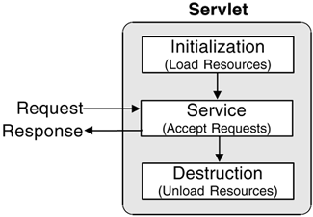
Life Cycle
Initialize
Service
Destroy

Slide 12
Life Cycle: Initialize
Servlet is created when servlet container receives a request from the client
Init() method is called only once

Slide 13
Life Cycle: Service
Any requests will be forwarded to the service() method
  doGet()
  doPost()
  doDelete()
  doOptions()
  doPut()
  doTrace()

Slide 14
Life Cycle: Destroy
destroy() method is called only once
Occurs when
  Application is stopped
  Servlet container shuts down
Allows resources to be freed

Slide 15
Servlet Code
Written in standard Java
Implement the javax.servlet.Servlet interface

Slide 16
The Servlet API
Servlet interface
  Implemented by all servlets
  Many methods invoked automatically by server
    Similar to applets (paint, init, start, etc.)
  abstract classes that implement Servlet
    GenericServlet (javax.servlet)
    HTTPServlet (javax.servlet.http)
  Examples in chapter extend HTTPServlet
Methods
  void init( ServletConfig config )
    Automatically called, argument provided

Slide 17
The Servlet API
Methods
  ServletConfig getServletConfig()
    Returns reference to object, gives access to config info
  void service ( ServletRequest request, ServletResponse response )
    Key method in all servlets
    Provide access to input and output streams
      Read from and send to client
  void destroy()
    Cleanup method, called when servlet exiting

Slide 18
HttpServlet Class
HttpServlet
  Base class for web-based servlets
  Overrides method service
    Request methods:
      GET - retrieve HTML documents or image
      POST - send server data from HTML form
  Methods doGet and doPost respond to GET and POST
    Called by service
    Receive HttpServletRequest and HttpServletResponse (return void) objects

Slide 19
HttpServletRequest Interface
HttpServletRequest interface
  Object passed to doGet and doPost
  Extends ServletRequest
Methods
  String getParameter( String name )
    Returns value of parameter name (part of GET or POST)
  Enumeration getParameterNames()
    Returns names of parameters (POST)
  String[] getParameterValues( String name )
    Returns array of strings containing values of a parameter
  Cookie[] getCookies()
    Returns array of Cookie objects, can be used to identify client

Slide 20
HttpServletResponse Interface
HttpServletResponse
  Object passed to doGet and doPost
  Extends ServletResponse
Methods
  void addCookie( Cookie cookie )
    Add Cookie to header of response to client
  ServletOutputStream getOutputStream()
    Gets byte-based output stream, send binary data to client
  PrintWriter getWriter()
    Gets character-based output stream, send text to client
  void setContentType( String type )
    Specify MIME type of the response (Multipurpose Internet Mail Extensions)
    MIME type “text/html” indicates that response is HTML document.
    Helps display data

Slide 21
Handling HTTP GET Requests
HTTP GET requests
  Usually gets content of specified URL
    Usually HTML document (web page)
Example servlet
  Handles HTTP GET requests
  User clicks Get Page button in HTML document
    GET request sent to servlet HTTPGetServlet
  Servlet dynamically creates HTML document displaying "Welcome to Servlets!"

Slide 22
Handling HTTP GET Requests
3 import javax.servlet.*;
  Use data types from javax.servlet and javax.servlet.http
  HttpServlet has useful methods, inherit from it
  Method doGet
    Responds to GET requests
    Default action: BAD_REQUEST error (file not found)
    Override for custom GET processing
    Arguments represent client request and server response
4 import javax.servlet.http.*;
7 public class HTTPGetServlet extends HttpServlet {
8 public void doGet( HttpServletRequest request,
9 HttpServletResponse response )
10 throws ServletException, IOException

Slide 23
Handling HTTP GET Requests
  setContentType
    Specify content
    text/html for HTML documents
  getWriter
    Returns PrintWriter object, can send text to client
    getOutputStream to send binary data (returns ServletOutputStream object)
14 response.setContentType( "text/html" ); // content type
12 PrintWriter output;
15 output = response.getWriter(); // get writer

Slide 24
Handling HTTP GET Requests
19 buf.append( "<HTML><HEAD><TITLE>\n" );
  Lines 19-23 create HTML document
    println sends response to client
    close terminates output stream
      Flushes buffer, sends info to client
20 buf.append( "A Simple Servlet Example\n" );
21 buf.append( "</TITLE></HEAD><BODY>\n" );
22 buf.append( "<H1>Welcome to Servlets!</H1>\n" );
23 buf.append( "</BODY></HTML>" );
24 output.println( buf.toString() );
25 output.close(); // close PrintWriter stream

Slide 25
Handling HTTP GET Requests
Running servlets
  Must be running on a server
    Check documentation for how to install servlets
    Tomcat web server
    Apache Tomcat

Slide 26
Handling HTTP GET Requests
Port number
  Where server waits for client (handshake point)
  Client must specify proper port number
    Integers 1 - 65535, 1024 and below usually reserved
  Well-known port numbers
    Web servers - port 80 default
    JSDK/Apache Tomcat 4.0 Webserver- port 8080
      Change in default.cfg (server.port=8080)

Slide 27
Handling HTTP GET Requests
HTML documents
  Comments: <!-- text -->
  Tags: <TAG> ... </TAG>
    <HTML> ... <HTML> tags enclose document
    <HEAD> ... </HEAD> - enclose header
      Includes <TITLE> Title </TITLE> tags
      Sets title of document
1 <!-- Fig. 19.6: HTTPGetServlet.html -->
2 <HTML>
3 <HEAD>
4 <TITLE>
5 Servlet HTTP GET Example
6 </TITLE>
7 </HEAD>

Slide 28
Handling HTTP GET Requests
9 <FORM
  Document body (<BODY> tags)
    Has literal text and tags for formatting
  Form (<FORM> tags )
    ACTION - server-side form handler
    METHOD - request type
10 ACTION="http://lab.cs.siu.edu:8080/rahimi/HTTPGetServlet"
11 METHOD="GET">
12 <P>Click the button to have the servlet send
13 an HTML document</P>
14 <INPUT TYPE="submit" VALUE="Get HTML Document">
15 </FORM>
16 </BODY>

Slide 29
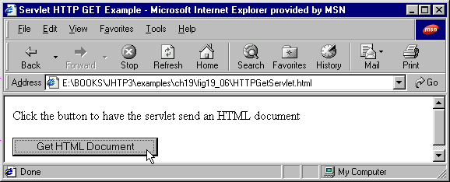
Handling HTTP GET Requests
  ACTION
    localhost - your computer
    :8080 - port
    /servlet - directory
  GUI component
    INPUT element
    TYPE - "submit" (button)
    VALUE - label
    When pressed, performs ACTION
    If parameters passed, separated by ? in URL
10 ACTION="http://localhost:8080/servlet/HTTPGetServlet"
14 <INPUT TYPE="submit" VALUE="Get HTML Document">

Slide 30
1 // Fig. 19.5: HTTPGetServlet.java
2 // Creating and sending a page to the client
3 import javax.servlet.*;
1. import
1.1 extends HttpServlet
2. doGet
2.1 setContentType
2.2 getWriter
2.3 println
4 import javax.servlet.http.*;
Import necessary classes and inherit methods from HttpServlet.
5 import java.io.*;
6
7 public class HTTPGetServlet extends HttpServlet {
8 public void doGet( HttpServletRequest request,
9 HttpServletResponse response )
10 throws ServletException, IOException
11 {
12 PrintWriter output;
13
14 response.setContentType( "text/html" ); // content type
15 output = response.getWriter(); // get writer
16
17 // create and send HTML page to client
Create PrintWriter object. Create HTML file and send to client.
18 StringBuffer buf = new StringBuffer();
19 buf.append( "<HTML><HEAD><TITLE>\n" );
20 buf.append( "A Simple Servlet Example\n" );
21 buf.append( "</TITLE></HEAD><BODY>\n" );
22 buf.append( "<H1>Welcome to Servlets!</H1>\n" );
23 buf.append( "</BODY></HTML>" );
24 output.println( buf.toString() );
25 output.close(); // close PrintWriter stream
26 }
27 }

Slide 31
1 <!-- Fig. 19.6: HTTPGetServlet.html -->
2 <HTML>
3 <HEAD>
HTML document
1. <TITLE>
2. <FORM>
2.1 ACTION
2.2 METHOD
3. INPUT TYPE
4 <TITLE>
5 Servlet HTTP GET Example
ACTION specifies form handler, METHOD specifies request type.
6 </TITLE>
7 </HEAD>
8 <BODY>
9 <FORM
10 ACTION="http://lab.cs.siu.edu:8080/rahimi/HTTPGetServlet"
11 METHOD="GET">
12 <P>Click the button to have the servlet send
13 an HTML document</P>
14 <INPUT TYPE="submit" VALUE="Get HTML Document">
15 </FORM>
16 </BODY>
Creates submit button, performs ACTION when clicked.
17 </HTML>

Slide 32
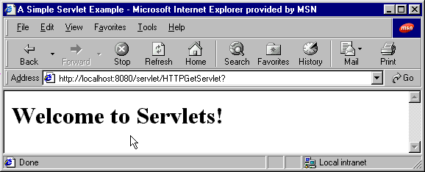
Program Output

Slide 33
Handling HTTP POST Requests
HTTP POST
  Used to post data to server-side form handler (i.e. surveys)
  Both GET and POST can supply parameters
Example servlet
  Survey
    Store results in file on server
  User selects radio button, presses Submit
    Browser sends POST request to servlet
  Servlet updates responses
    Displays cumulative results

Slide 34
Handling HTTP POST Requests
9 public class HTTPPostServlet extends HttpServlet {
  Extend HttpServlet
    Handle GET and POST
  Array for animal names
  doPost
    Responds to POST requests (default BAD_REQUEST)
    Same arguments as doGet (client request, server response)
10 private String animalNames[] =
11 { "dog", "cat", "bird", "snake", "none" };
13 public void doPost( HttpServletRequest request,
14 HttpServletResponse response )
15 throws ServletException, IOException

Slide 35
Handling HTTP POST Requests
18 File f = new File( "survey.txt" );
  Open survey.txt, load animals array
  Method getParameter( name )
    Returns value of parameter as a string
  Content type
23 ObjectInputStream input = new ObjectInputStream(
24 new FileInputStream( f ) );
26 animals = (int []) input.readObject();
40 String value =
41 request.getParameter( "animal" );
64 response.setContentType( "text/html" ); // content type

Slide 36
Handling HTTP POST Requests
67 StringBuffer buf = new StringBuffer();
  Return HTML document as before
  <PRE> tag
    Preformatted text, fixed-width
  <BR> tag - line break
68 buf.append( "<html>\n" );
69 buf.append( "<title>Thank you!</title>\n" );
70 buf.append( "Thank you for participating.\n" );
71 buf.append( "<BR>Results:\n<PRE>" );
73 DecimalFormat twoDigits = new DecimalFormat( "#0.00" );
74 for ( int i = 0; i < percentages.length; ++i ) {
75 buf.append( "<BR>" );
76 buf.append( animalNames[ i ] );
88 responseOutput.println( buf.toString() );

Slide 37
Handling HTTP POST Requests
8 <FORM METHOD="POST" ACTION=
  METHOD="POST"
  Radio buttons (only one may be selected)
    TYPE - radio
    NAME - parameter name
    VALUE - parameter value
    CHECKED - initially selected
9 "http://lab.cs.siu.edu:8080/rahimi/HTTPPostServlet">
10 What is your favorite pet?<BR><BR>
11 <INPUT TYPE=radio NAME=animal VALUE=dog>Dog<BR>
12 <INPUT TYPE=radio NAME=animal VALUE=cat>Cat<BR>
13 <INPUT TYPE=radio NAME=animal VALUE=bird>Bird<BR>
14 <INPUT TYPE=radio NAME=animal VALUE=snake>Snake<BR>
15 <INPUT TYPE=radio NAME=animal VALUE=none CHECKED>None
16 <BR><BR><INPUT TYPE=submit VALUE="Submit">
17 <INPUT TYPE=reset>
18 </FORM>

Slide 38
Handling HTTP POST Requests
8 <FORM METHOD="POST" ACTION=
  Submit button (executes ACTION)
  Reset button - browser resets form, with None selected
9 "http://lab.cs.siu.edu:8080/rahimi/HTTPPostServlet">
10 What is your favorite pet?<BR><BR>
11 <INPUT TYPE=radio NAME=animal VALUE=dog>Dog<BR>
12 <INPUT TYPE=radio NAME=animal VALUE=cat>Cat<BR>
13 <INPUT TYPE=radio NAME=animal VALUE=bird>Bird<BR>
14 <INPUT TYPE=radio NAME=animal VALUE=snake>Snake<BR>
15 <INPUT TYPE=radio NAME=animal VALUE=none CHECKED>None
16 <BR><BR><INPUT TYPE=submit VALUE="Submit">
17 <INPUT TYPE=reset>
18 </FORM>

Slide 39
1 // Fig. 19.7: HTTPPostServlet.java
2 // A simple survey servlet
3 import javax.servlet.*;
Extending HttpServlet allows processing of GET and POST requests.
4 import javax.servlet.http.*;
1. import
1.1 extends HttpServlet
1.2 animalNames
2. doPost
2.1 Open file
5 import java.text.*;
6 import java.io.*;
7 import java.util.*;
8
9 public class HTTPPostServlet extends HttpServlet {
10 private String animalNames[] =
11 { "dog", "cat", "bird", "snake", "none" };
12
13 public void doPost( HttpServletRequest request,
14 HttpServletResponse response )
15 throws ServletException, IOException
16 {
17 int animals[] = null, total = 0;
18 File f = new File( "survey.txt" );
19
20 if ( f.exists() ) {
21 // Determine # of survey responses so far
22 try {
23 ObjectInputStream input = new ObjectInputStream(
24 new FileInputStream( f ) );
25
26 animals = (int []) input.readObject();
27 input.close(); // close stream
28
29 for ( int i = 0; i < animals.length; ++i )
30 total += animals[ i ];
31 }

Slide 40
32 catch( ClassNotFoundException cnfe ) {
33 cnfe.printStackTrace();
34 }
Use request (HttpServletRequest) method getParameter to get value of animal.
35 }
2.2 getParameter
2.3 Write to file
36 else
37 animals = new int[ 5 ];
38
39 // read current survey response
40 String value =
41 request.getParameter( "animal" );
42 ++total; // update total of all responses
43
44 // determine which was selected and update its total
45 for ( int i = 0; i < animalNames.length; ++i )
46 if ( value.equals( animalNames[ i ] ) )
47 ++animals[ i ];
48
49 // write updated totals out to disk
50 ObjectOutputStream output = new ObjectOutputStream(
51 new FileOutputStream( f ) );
52
53 output.writeObject( animals );
54 output.flush();
55 output.close();
56
57 // Calculate percentages
58 double percentages[] = new double[ animals.length ];
59
60 for ( int i = 0; i < percentages.length; ++i )
61 percentages[ i ] = 100.0 * animals[ i ] / total;
62

Slide 41
63 // send a thank you message to client
64 response.setContentType( "text/html" ); // content type
65
2.4 getWriter
2.5 Create HTML code
2.6 println
66 PrintWriter responseOutput = response.getWriter();
67 StringBuffer buf = new StringBuffer();
68 buf.append( "<html>\n" );
69 buf.append( "<title>Thank you!</title>\n" );
70 buf.append( "Thank you for participating.\n" );
71 buf.append( "<BR>Results:\n<PRE>" );
72
73 DecimalFormat twoDigits = new DecimalFormat( "#0.00" );
74 for ( int i = 0; i < percentages.length; ++i ) {
75 buf.append( "<BR>" );
76 buf.append( animalNames[ i ] );
77 buf.append( ": " );
78 buf.append( twoDigits.format( percentages[ i ] ) );
79 buf.append( "% responses: " );
80 buf.append( animals[ i ] );
81 buf.append( "\n" );
82 }
83
84 buf.append( "\n<BR><BR>Total responses: " );
85 buf.append( total );
86 buf.append( "</PRE>\n</html>" );
87
88 responseOutput.println( buf.toString() );
89 responseOutput.close();
90 }
91 }

Slide 42
1 <!-- Fig. 19.8: HTTPPostServlet.html -->
2 <HTML>
3 <HEAD>
HTML file
1. <FORM>
1.1 METHOD="POST"
2. <INPUT>
4 <TITLE>Servlet HTTP Post Example</TITLE>
5 </HEAD>
Use a POST request type.
6
7 <BODY>
8 <FORM METHOD="POST" ACTION=
9 "http://lab.cs.siu.edu:8080/rahimi/HTTPPostServlet">
10 What is your favorite pet?<BR><BR>
11 <INPUT TYPE=radio NAME=animal VALUE=dog>Dog<BR>
12 <INPUT TYPE=radio NAME=animal VALUE=cat>Cat<BR>
13 <INPUT TYPE=radio NAME=animal VALUE=bird>Bird<BR>
14 <INPUT TYPE=radio NAME=animal VALUE=snake>Snake<BR>
15 <INPUT TYPE=radio NAME=animal VALUE=none CHECKED>None
16 <BR><BR><INPUT TYPE=submit VALUE="Submit">
17 <INPUT TYPE=reset>
18 </FORM>
19 </BODY>
Create radio buttons. Specify parameter name and value. None is initially selected (CHECKED).
20 </HTML>
Returns form to original state (None selected).

Slide 43
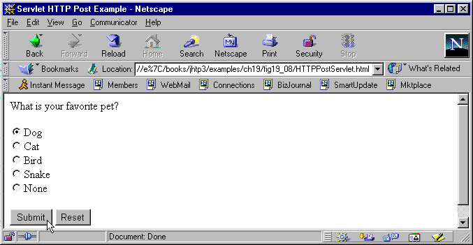
Program Output

Slide 44
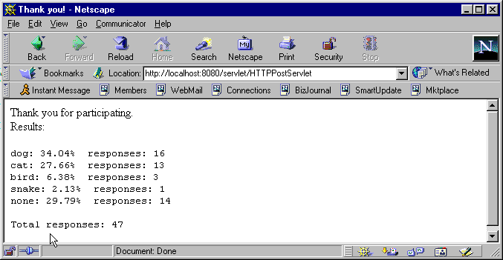
Program Output

Slide 45
Session Tracking
Web sites
  Many have custom web pages/functionality
    Custom home pages - http://my.yahoo.com/
    Shopping carts
    Marketing
  HTTP protocol does not support persistent information
    Cannot distinguish clients
Distinguishing clients
  Cookies
  Session Tracking

Slide 46
Cookies
Cookies
  Small files that store information on client's computer
  Servlet can check previous cookies for information
Header
  In every HTTP client-server interaction
  Contains information about request (GET or POST) and cookies stored on client machine
  Response header includes cookies servers wants to store
Age
  Cookies have a lifespan
  Can set maximum age
    Cookies can expire and are deleted

Slide 47
Cookies
Example
  Demonstrate cookies
  Servlet handles both POST and GET requests
  User selects programming language (radio buttons)
    POST - Add cookie containing language, return HTML page
    GET - Browser sends cookies to servlet
      Servlet returns HTML document with recommended books
  Two separate HTML files
    One invokes POST, the other GET
    Same ACTION - invoke same servlet

Slide 48
Cookies
  Method doPost
    Get language selection
  Cookie constructor
    Cookie ( name, value )
    getISBN is utility method
    setMaxAge( seconds ) - deleted when expire
14 public void doPost( HttpServletRequest request,
15 HttpServletResponse response )
19 String language = request.getParameter( "lang" );
21 Cookie c = new Cookie( language, getISBN( language ) );
22 c.setMaxAge( 120 ); // seconds until cookie removed

Slide 49
Cookies
  Add cookie to client response
    Part of HTTP header, must come first
    Then HTML document sent to client
  Method doGet
  getCookies
    Returns array of Cookies
23 response.addCookie( c ); // must precede getWriter
41 public void doGet( HttpServletRequest request,
42 HttpServletResponse response )
46 Cookie cookies[];
48 cookies = request.getCookies(); // get client's cookies

Slide 50
Cookies
57 if ( cookies != null ) {
  Cookie methods
    getName, getValue
    Used to determine recommended book
    If cookie has expired, does not execute
62 output.println(
63 cookies[ i ].getName() + " How to Program. " +
64 "ISBN#: " + cookies[ i ].getValue() + "<BR>" );

Slide 51
1 // Fig. 19.9: CookieExample.java
Allows class to handle GET and POST.
2 // Using cookies.
3 import javax.servlet.*;
1. import
1.1 extends HttpServlet
2. doPost
2.1 getParameter
2.2 Cookie
2.3 setMaxAge
2.4 addCookie
4 import javax.servlet.http.*;
5 import java.io.*;
6
7 public class CookieExample extends HttpServlet {
8 private String names[] = { "C", "C++", "Java",
9 "Visual Basic 6" };
10 private String isbn[] = {
11 "0-13-226119-7", "0-13-528910-6",
12 "0-13-012507-5", "0-13-528910-6" };
13
14 public void doPost( HttpServletRequest request,
Create a new Cookie, initialized with language parameter.
15 HttpServletResponse response )
16 throws ServletException, IOException
17 {
18 PrintWriter output;
19 String language = request.getParameter( "lang" );
20
21 Cookie c = new Cookie( language, getISBN( language ) );
22 c.setMaxAge( 120 ); // seconds until cookie removed
23 response.addCookie( c ); // must precede getWriter
24
Set maximum age of cookie, add to header.
25 response.setContentType( "text/html" );
26 output = response.getWriter();
27

Slide 52
28 // send HTML page to client
29 output.println( "<HTML><HEAD><TITLE>" );
30 output.println( "Cookies" );
3. doGet
3.1 getCookies
31 output.println( "</TITLE></HEAD><BODY>" );
32 output.println( "<P>Welcome to Cookies!<BR>" );
33 output.println( "<P>" );
34 output.println( language );
35 output.println( " is a great language." );
36 output.println( "</BODY></HTML>" );
37
38 output.close(); // close stream
39 }
40
41 public void doGet( HttpServletRequest request,
42 HttpServletResponse response )
43 throws ServletException, IOException
44 {
Returns array of Cookies.
45 PrintWriter output;
46 Cookie cookies[];
47
48 cookies = request.getCookies(); // get client's cookies
49
50 response.setContentType( "text/html" );
51 output = response.getWriter();
52
53 output.println( "<HTML><HEAD><TITLE>" );
54 output.println( "Cookies II" );
55 output.println( "</TITLE></HEAD><BODY>" );
56

Slide 53
57 if ( cookies != null ) {
58 output.println( "<H1>Recommendations</H1>" );
59
3.2 getName, getValue
4. Method getISBN
60 // get the name of each cookie
61 for ( int i = 0; i < cookies.length; i++ )
62 output.println(
63 cookies[ i ].getName() + " How to Program. " +
64 "ISBN#: " + cookies[ i ].getValue() + "<BR>" );
65 }
66 else {
Use cookies to determine recommended book and ISBN.
67 output.println( "<H1>No Recommendations</H1>" );
68 output.println( "You did not select a language or" );
69 output.println( "the cookies have expired." );
70 }
71
72 output.println( "</BODY></HTML>" );
If cookies have expired, no recommendations.
73 output.close(); // close stream
74 }
75
76 private String getISBN( String lang )
77 {
78 for ( int i = 0; i < names.length; ++i )
79 if ( lang.equals( names[ i ] ) )
80 return isbn[ i ];
81
82 return ""; // no matching string found
83 }
84 }

Slide 54
1 <!-- Fig. 19.10: SelectLanguage.html -->
2 <HTML>
3 <HEAD>
HTML file
1. POST
2. Radio buttons
4 <TITLE>Cookies</TITLE>
5 </HEAD>
6 <BODY>
7 <FORM ACTION="http://lab.cs.siu.edu:8080/rahimi/CookieExample"
8 METHOD="POST">
9 <STRONG>Select a programming language:<br>
10 </STRONG><BR>
11 <PRE>
12 <INPUT TYPE="radio" NAME="lang" VALUE="C">C<BR>
13 <INPUT TYPE="radio" NAME="lang" VALUE="C++">C++<BR>
14 <INPUT TYPE="radio" NAME="lang" VALUE="Java"
15 CHECKED>Java<BR>
16 <INPUT TYPE="radio" NAME="lang"
17 VALUE="Visual Basic 6">Visual Basic 6
18 </PRE>
19 <INPUT TYPE="submit" VALUE="Submit">
20 <INPUT TYPE="reset"> </P>
21 </FORM>
22 </BODY>
23 </HTML>

Slide 55
1 <!-- Fig. 19.11: BookRecommendation.html -->
2 <HTML>
3 <HEAD>
HTML file
1. GET
2. Submit
4 <TITLE>Cookies</TITLE>
5 </HEAD>
6 <BODY>
7 <FORM ACTION="http://lab.cs.siu.edu:8080/rahimi/CookieExample"
8 METHOD="GET">
9 Press "Recommend books" for a list of books.
10 <INPUT TYPE=submit VALUE="Recommend books">
11 </FORM>
12 </BODY>
13 </HTML>

Slide 56
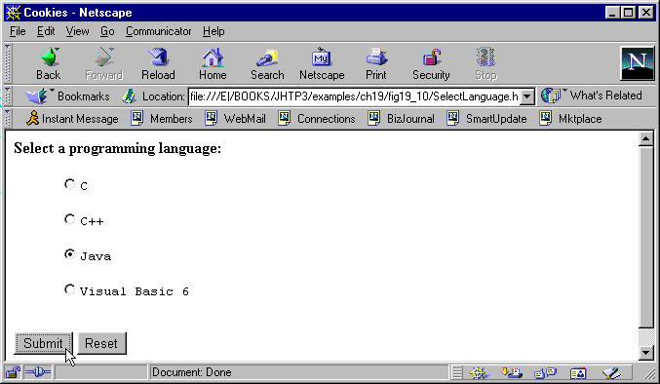
Program Output

Slide 57
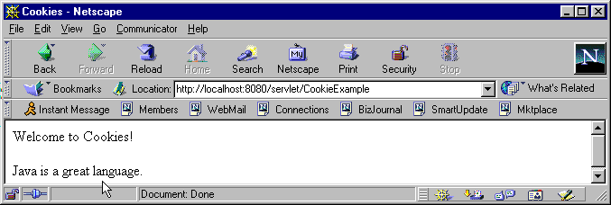
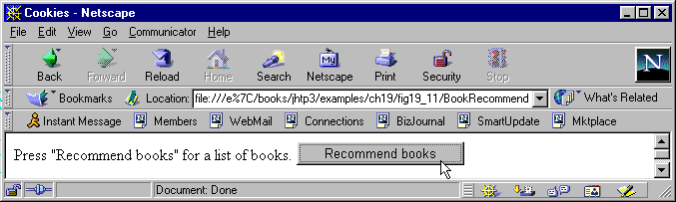

Slide 58
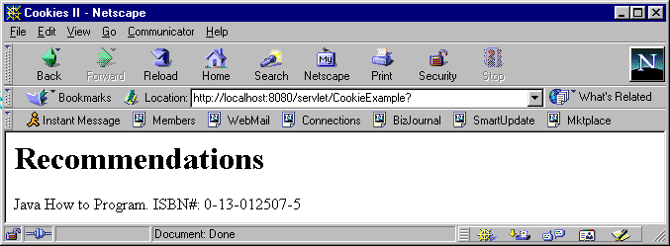
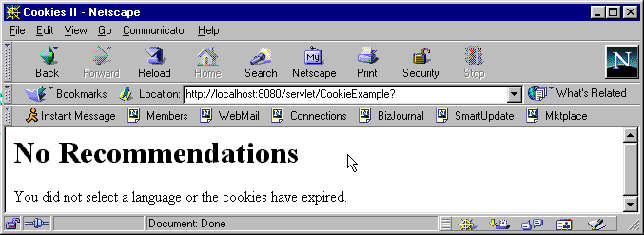

Slide 59
Session Tracking with HttpSession
HttpSession (javax.servlet.http)
  Alternative to cookies
  Data available until browsing ends
Methods
  Creation
  getSession( createNew )
    Class HttpServletRequest
    Returns client's previous HttpSession object
    createNew - if true, creates new HttpSession object if does not exist
23 HttpSession session = request.getSession( true );

Slide 60
Session Tracking with HttpSession
  putvalue( name, value )
    Adds a name/value pair to object
  getValueNames()
    Returns array of Strings with names
  getValue( name )
    Returns value of name as an Object
    Cast to proper type
26 session.putValue( language, getISBN( language ) );
58 valueNames = session.getValueNames();
73 for ( int i = 0; i < valueNames.length; i++ ) {
74 String value =
75 (String) session.getValue( valueNames[ i ] );

Slide 61
Session Tracking with HttpSession
Redo previous example
  Use HttpSession instead of cookies
  Use same HTML files as before
    Change ACTION URL to new servlet

Slide 62
1 // Fig. 19.13: SessionExample.java
2 // Using sessions.
3 import javax.servlet.*;
1. import
2. doPost
2.1 getSession
2.2 putValue
4 import javax.servlet.http.*;
5 import java.io.*;
6
7 public class SessionExample extends HttpServlet {
8 private final static String names[] =
9 { "C", "C++", "Java", "Visual Basic 6" };
10 private final static String isbn[] = {
11 "0-13-226119-7", "0-13-528910-6",
12 "0-13-012507-5", "0-13-528910-6" };
13
14 public void doPost( HttpServletRequest request,
15 HttpServletResponse response )
16 throws ServletException, IOException
17 {
18 PrintWriter output;
Load HttpSession if exists, create if does not.
19 String language = request.getParameter( "lang" );
20
21 // Get the user's session object.
22 // Create a session (true) if one does not exist.
23 HttpSession session = request.getSession( true );
24
Set name/value pair.
25 // add a value for user's choice to session
26 session.putValue( language, getISBN( language ) );
27

Slide 63
28 response.setContentType( "text/html" );
29 output = response.getWriter();
30
3. doGet
3.1 getSession
31 // send HTML page to client
32 output.println( "<HTML><HEAD><TITLE>" );
33 output.println( "Sessions" );
34 output.println( "</TITLE></HEAD><BODY>" );
35 output.println( "<P>Welcome to Sessions!<BR>" );
36 output.println( "<P>" );
37 output.println( language );
38 output.println( " is a great language." );
39 output.println( "</BODY></HTML>" );
40
41 output.close(); // close stream
42 }
43
44 public void doGet( HttpServletRequest request,
45 HttpServletResponse response )
46 throws ServletException, IOException
Do not create object if does not exist. session set to null.
47 {
48 PrintWriter output;
49
50 // Get the user's session object.
51 // Don't create a session (false) if one does not exist.
52 HttpSession session = request.getSession( false );
53
54 // get names of session object's values
55 String valueNames[];
56

Slide 64
57 if ( session != null )
58 valueNames = session.getValueNames();
59 else
3.2 getValueNames
3.3 getValue
60 valueNames = null;
Put names into array.
61
62 response.setContentType( "text/html" );
63 output = response.getWriter();
64
65 output.println( "<HTML><HEAD><TITLE>" );
66 output.println( "Sessions II" );
67 output.println( "</TITLE></HEAD><BODY>" );
68
69 if ( valueNames != null && valueNames.length != 0 ) {
70 output.println( "<H1>Recommendations</H1>" );
71
72 // get value for each name in valueNames
73 for ( int i = 0; i < valueNames.length; i++ ) {
74 String value =
75 (String) session.getValue( valueNames[ i ] );
76
77 output.println(
78 valueNames[ i ] + " How to Program. " +
Get value associated with name.
79 "ISBN#: " + value + "<BR>" );
80 }
81 }
82 else {
83 output.println( "<H1>No Recommendations</H1>" );
84 output.println( "You did not select a language or" );
85 output.println( "the session has expired." );
86 }

Slide 65
87
88 output.println( "</BODY></HTML>" );
89 output.close(); // close stream
90 }
91
92 private String getISBN( String lang )
93 {
94 for ( int i = 0; i < names.length; ++i )
95 if ( lang.equals( names[ i ] ) )
96 return isbn[ i ];
97
98 return ""; // no matching string found
99 }
100 }

Slide 66
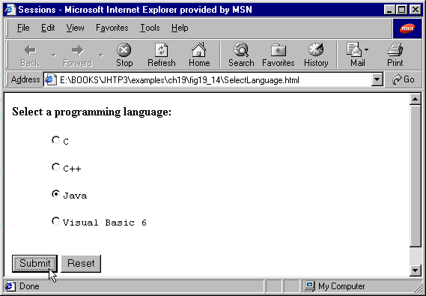
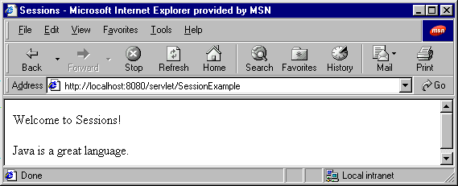
Program Output

Slide 67
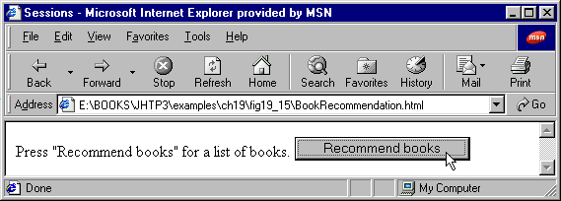
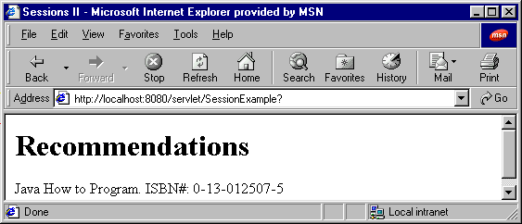
Program Output

Slide 68
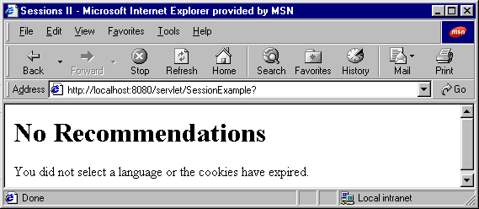
Program Output

Slide 69
Multitier Applications: Using JDBC from a Servlet
Servlets and databases
  Communicate via JDBC
    Connect to databases in general manner
    Use SQL-based queries
Three tier distributed applications
  User interface
    Often in HTML, sometimes applets
    HTML preferred, more portable
  Business logic (middle tier)
    Accesses database
  Database access
  Three tiers may be on separate computers
    Web servers for middle tier

Slide 70
Multitier Applications: Using JDBC from a Servlet
Servlets
  Method init
    Called exactly once, before client requests
    Initialization parameters
  Method destroy
    Called automatically, cleanup method
    Close files, connections to databases, etc.

Slide 71
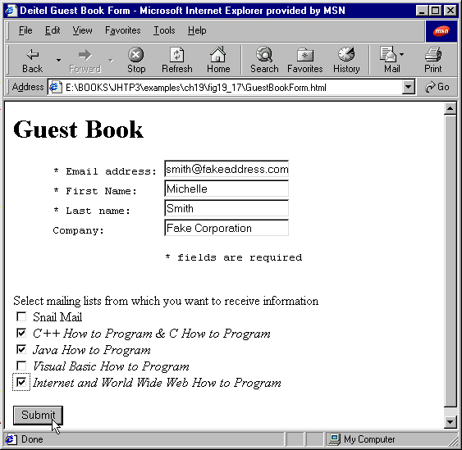
Multitier Applications: Using JDBC from a Servlet
HTML files
  <INPUT TYPE=CHECKBOX NAME=name VALUE=value>
    Creates checkbox, any number can be selected
  <INPUT TYPE=TEXT NAME=name>
    Creates text field, user can input data

Slide 72
Multitier Applications: Using JDBC from a Servlet
Example servlet
  Guest book to register for mailing lists
  HTML document first tier
    Get data from user
  Use servlet as middle tier
    Provides access to database
    Set up connection in init
  Microsoft Access database (third tier)

Slide 73
1 // Fig. 19.16: GuestBookServlet.java
2 // Three-Tier Example
3 import java.io.*;
1. import
1.1 URL
2. init
2.1 Connect to database
4 import javax.servlet.*;
5 import javax.servlet.http.*;
6 import java.util.*;
7 import java.sql.*;
8
9 public class GuestBookServlet extends HttpServlet {
10 private Statement statement = null;
11 private Connection connection = null;
12 private String URL = "jdbc:odbc:GuestBook";
13
14 public void init( ServletConfig config )
15 throws ServletException
16 {
init called exactly once, before client requests are processed. Note the first line format.
17 super.init( config );
18
19 try {
20 Class.forName( "sun.jdbc.odbc.JdbcOdbcDriver" );
21 connection =
22 DriverManager.getConnection( URL, "", "" );
23 }
24 catch ( Exception e ) {
25 e.printStackTrace();
Get connection to database (no name/password).
26 connection = null;
27 }
28 }
29

Slide 74
30 public void doPost( HttpServletRequest req,
31 HttpServletResponse res )
32 throws ServletException, IOException
3. doPost
3.1 getParameter
3.2 getWriter
3.3 println
33 {
34 String email, firstName, lastName, company,
35 snailmailList, cppList, javaList, vbList,
36 iwwwList;
37
38 email = req.getParameter( "Email" );
39 firstName = req.getParameter( "FirstName" );
40 lastName = req.getParameter( "LastName" );
41 company = req.getParameter( "Company" );
42 snailmailList = req.getParameter( "mail" );
43 cppList = req.getParameter( "c_cpp" );
44 javaList = req.getParameter( "java" );
45 vbList = req.getParameter( "vb" );
46 iwwwList = req.getParameter( "iwww" );
47
48 PrintWriter output = res.getWriter();
49 res.setContentType( "text/html" );
50
51 if ( email.equals( "" ) ||
52 firstName.equals( "" ) ||
53 lastName.equals( "" ) ) {
54 output.println( "<H3> Please click the back " +
55 "button and fill in all " +
56 "fields.</H3>" );
57 output.close();
58 return;
59 }

Slide 75
60
61 /* Note: The GuestBook database actually contains fields
62 * Address1, Address2, City, State and Zip that are not
4. insertIntoDB
4.1 createStatement
63 * used in this example. However, the insert into the
64 * database must still account for these fields. */
65 boolean success = insertIntoDB(
66 "'" + email + "','" + firstName + "','" + lastName +
67 "','" + company + "',' ',' ',' ',' ',' ','" +
68 ( snailmailList != null ? "yes" : "no" ) + "','" +
69 ( cppList != null ? "yes" : "no" ) + "','" +
70 ( javaList != null ? "yes" : "no" ) + "','" +
71 ( vbList != null ? "yes" : "no" ) + "','" +
72 ( iwwwList != null ? "yes" : "no" ) + "'" );
73
74 if ( success )
75 output.print( "<H2>Thank you " + firstName +
76 " for registering.</H2>" );
77 else
78 output.print( "<H2>An error occurred. " +
79 "Please try again later.</H2>" );
80
81 output.close();
82 }
83
84 private boolean insertIntoDB( String stringtoinsert )
85 {
86 try {
87 statement = connection.createStatement();

Slide 76
88 statement.execute(
89 "INSERT INTO GuestBook values (" +
90 stringtoinsert + ");" );
4.2 INSERT INTO
5. destroy
5.1 close
Insert data into database.
91 statement.close();
92 }
93 catch ( Exception e ) {
94 System.err.println(
95 "ERROR: Problems with adding new entry" );
96 e.printStackTrace();
97 return false;
98 }
99
100 return true;
101 }
destroy called automatically, closes connection to database.
102
103 public void destroy()
104 {
105 try {
106 connection.close();
107 }
108 catch( Exception e ) {
109 System.err.println( "Problem closing the database" );
110 }
111 }
112 }

Slide 77
1 <!-- Fig. 19.17: GuestBookForm.html -->
2 <HTML>
3 <HEAD>
HTML file
1. <FORM>
1.1 TYPE=text
2. TYPE=CHECKBOX
4 <TITLE>Deitel Guest Book Form</TITLE>
5 </HEAD>
6
7 <BODY>
8 <H1>Guest Book</H1>
9 <FORM
10 ACTION=http://lab.cs.siu.edu:8080/rahimi/GuestBookServlet
11 METHOD=POST><PRE>
12 * Email address: <INPUT TYPE=text NAME=Email>
13 * First Name: <INPUT TYPE=text NAME=FirstName>
14 * Last name: <INPUT TYPE=text NAME=LastName>
15 Company: <INPUT TYPE=text NAME=Company>
16
17 * fields are required
18 </PRE>
Create text fields and checkboxes for user input.
19
20 <P>Select mailing lists from which you want
21 to receive information<BR>
22 <INPUT TYPE=CHECKBOX NAME=mail VALUE=mail>
23 Snail Mail<BR>
24 <INPUT TYPE=CHECKBOX NAME=c_cpp VALUE=c_cpp>
25 <I>C++ How to Program & C How to Program</I><BR>
26 <INPUT TYPE=CHECKBOX NAME=java VALUE=java>
27 <I>Java How to Program</I><BR>
28 <INPUT TYPE=CHECKBOX NAME=vb VALUE=vb>
29 <I>Visual Basic How to Program</I><BR>

Slide 78
30
31 <INPUT TYPE=CHECKBOX NAME=iwww VALUE=iwww>
32 <I>Internet and World Wide Web How to Program</I><BR>
33 </P>
34 <INPUT TYPE=SUBMIT Value="Submit">
35 </FORM>
36 </BODY>
37 </HTML>

Slide 79
Program Output

Slide 80
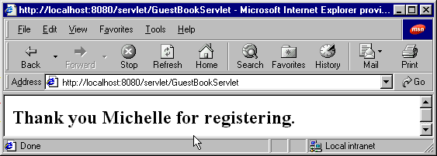
Program Output

Slide 81
Electronic Commerce
Revolution in electronic commerce
  2/3 of stock transactions by 2007
  amazon.com, ebay.com, huge volumes of sales
  Business to business transactions
  Servlet technology
    Help companies get into e-commerce
  Client-server systems
    Many developers use all Java
    Applets for client, servlets for server

