Slide 1

LANGUAGE LEARNING APP
LuxLingo
App for learning Luxembourgish
May 2026

Slide 2
Today's Presentation
01
01
The Opportunity
The gap in Luxembourgish language learning
02
02
The App
Features, exercises and learning system
03
03
Luxembourg Technology
Government & university APIs powering LuxLingo
04
04
How It Was Built
Content pipeline, architecture and data quality
05
05
Impact & The Ask
Potential reach and how ZLS can help
CONTENTS

Slide 3

THE OPPORTUNITY
A language spoken by 400,000 people — with no modern learning app.
400K
0
12,000+
native speakers
Duolingo-level apps
newcomers/year
Luxembourg's integration policy requires newcomers to learn Lëtzebuergesch
Existing tools are textbook-heavy, expensive or aimed at German speakers
No app comparable to Duolingo or Babbel exists for Luxembourgish

Slide 4
THE APP
Everything a learner needs. Built for Luxembourg.
🧠
🎮
🇱🇺
Science-Backed
Genuinely Engaging
Authentically Luxembourgish
— Spaced repetition surfaces words just before you forget them
— 10 distinct exercise types — variety prevents boredom
— Powered exclusively by Luxembourg government & uni APIs
— Zipf's Law ensures the 700 most-used words come first
— XP points, streaks and lesson celebrations reward progress
— Native speaker audio from LOD.lu for every word
— Mastery score (0–20) determines which exercise fires next
— Consistent story characters make sentences memorable
— Neural TTS from Sproochmaschinn.lu for all sentences
— Progress chart shows real coverage of everyday speech
— Lessons average 5–7 minutes — fits any schedule
— Pronunciation scored by LuxASR (Uni Luxembourg)

Slide 5
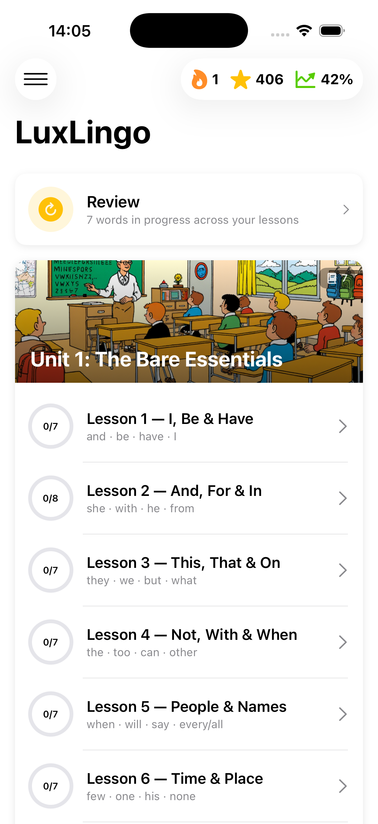
THE APP
Clean, structured, motivating.
XP · Streak · Coverage
Progress at a glance — always visible at the top of the home screen.
Smart Review Card
Surfaces words approaching forgetting before the next session begins.
Unit Scene Banners
Each unit opens with an illustrated Luxembourgish scene as visual context.
Situational Bonus Lessons
Market, café, doctor's — unlocked after completing each unit.
Lesson Mastery Rings
Shows how many of the 7 core words per lesson have been mastered.

Slide 6

EXERCISE TYPES
10 ways to learn. Every word, every angle.
🃏 Flashcard
Introduction with image, audio, sentence
📝 Fill in the Blank
Cloze — type the missing word
🔤 Multiple Choice
Choose from 4 options
🔀 Word Jumble
Rearrange tokens in LB or EN
🧩 Matching Pairs
Drag LB words to EN translations
🏃 Speed Run
True / false rapid-fire drill
🎧 Listen & Write
Hear and transcribe a word
🔡 Conjugation
Pick the correct verb form
📖 Article Choice
de · den · dem · d'
🎤 Pronunciation
Record & score via LuxASR
Exercise type scales with mastery level — harder exercises unlock as the learner improves.

Slide 7
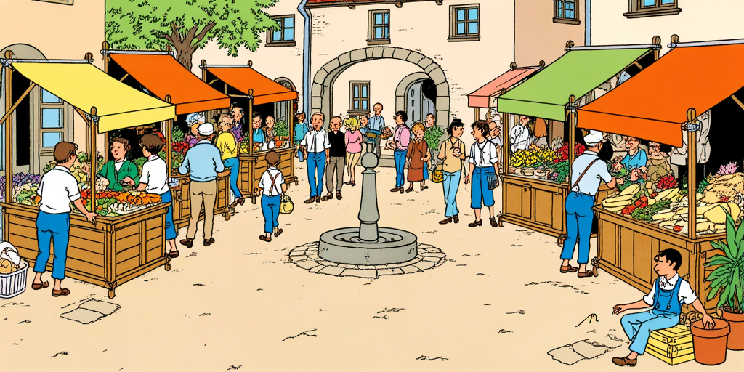

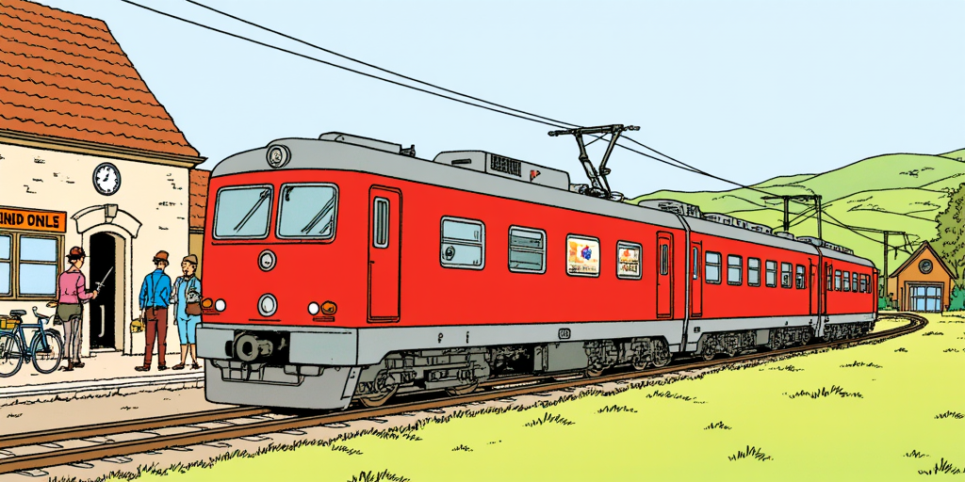
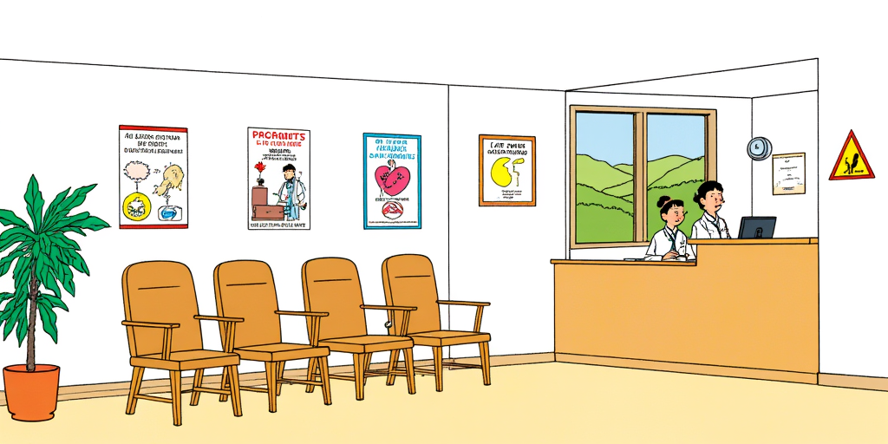
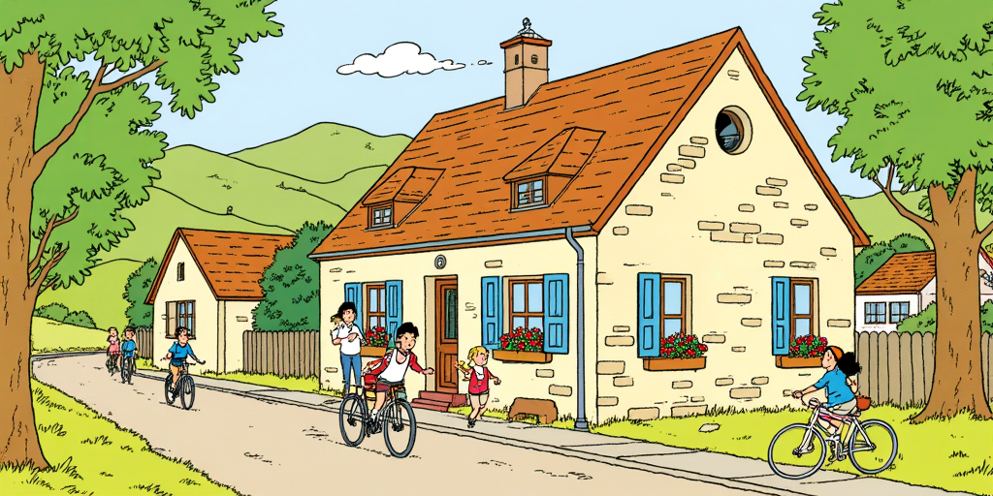

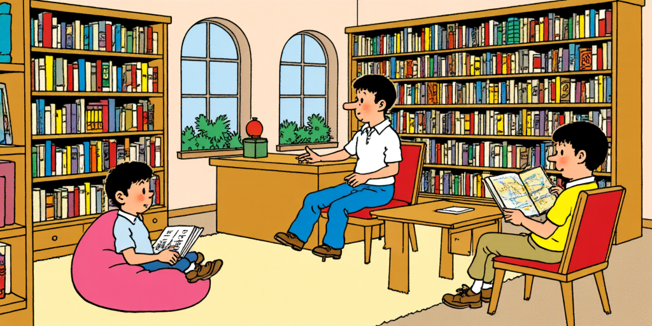

Set across Luxembourg.
Every unit illustrated with a hand-crafted scene from a real Luxembourgish setting.
Village Market
Café & Bakery
Train Station
Doctor's Office
School Morning
Village Centre
Library
Cycling Path

Slide 8








THE APP
A cast of characters that bring Luxembourg to life.
Marc
Anna
Paul
Lena
Teenager
Animal lover
Schoolboy
Marc's friend
Every example sentence features these characters — making vocabulary feel contextual and memorable across all 140+ lessons.
Claire
Natali
Mr Weiss
Bello
Bookworm
Curious toddler
The teacher
The dog

Slide 9
GRAMMAR
Grammar built into every lesson.
N-Rule Detection
Detects when 'den→de' applies before consonants. Teaches the rule in live context — never as isolated memorisation.
Article System
de / den / dem / d' — a dedicated exercise type with a grammar-rule hint revealed after each answer.
Verb Conjugation
Paradigm picker covers all 6 persons. A built-in Grammar Guide covers irregular & suppletive verbs.
Contextual Chips
When a word changes form in a sentence, a small chip explains why — without interrupting the exercise flow.

Slide 10
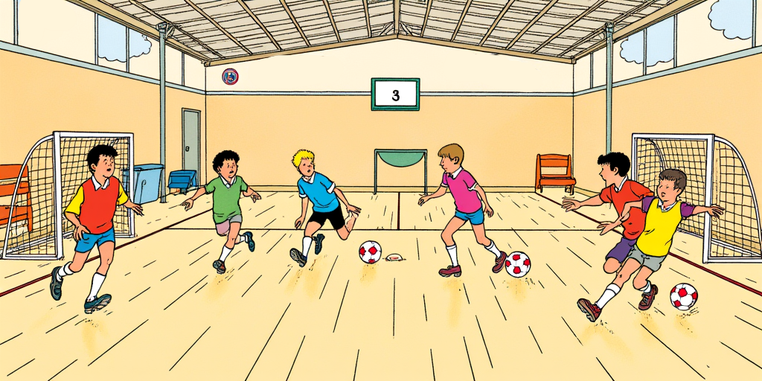
PRONUNCIATION
Hear it. Say it. Get scored.
Powered by LuxASR — University of Luxembourg's speech recognition engine.
Hear it
Tap speaker button → native reference audio from LOD.lu plays back
Say it
Record yourself — animated amplitude bars give live visual feedback
Compare
Play your recording next to the reference before submitting
Get scored
LuxASR transcribes audio → Levenshtein distance → 0–100% score
See results
Lesson summary shows all scores: green ≥80% amber ≥50% red <50%

Slide 11
LUXEMBOURG TECHNOLOGY
Built on Luxembourg's own digital infrastructure.
Every language technology component is Luxembourgish-built — not a single generic cloud service.
🎤
🌐
📖
🔊
LuxASR
LuxMT
LOD.lu
Sproochmaschinn.lu
Uni Luxembourg · luxasr.uni.lu
Uni Luxembourg · luxasr.uni.lu/luxmt
Lëtzebuerger Online Dictionnaire
Luxembourg Government · SCRIPT
Automatic Speech Recognition
Machine Translation EN ↔ LB
Official Luxembourg Dictionary API
Neural Text-to-Speech
Scores every pronunciation exercise. Trained on native Luxembourgish speech corpora.
Translated 3,000+ example sentences from English to Luxembourgish during content creation.
In-app word lookup on tap. Native speaker AAC audio for every vocabulary word.
High-quality Luxembourgish voice for every sentence read aloud during exercises.

Slide 12
HOW IT WAS BUILT
3,000+ sentences. Built with care.
01
02
03
04
05
Frequency Analysis
Curriculum Design
AI Sentence Generation
LuxMT Translation
Human Review & Package
Luxembourgish corpus frequency ranking → 700 words by Zipf score
Words grouped into 140+ thematic lessons across 20 units by frequency band
Claude generates English sentences with consistent story characters
EN→LB via LuxMT (uni.lu) · Batch processed across 93+ API jobs
Grammar checks Cloze index tagging N-rule annotation → initial_seed.json
→
→
→
→
Data quality: 118 cloze-index fixes · 21 translation corrections · 19 n-rule article fixes · 120 verb normalisations — all scripted & version-controlled.

Slide 13
ARCHITECTURE
Offline-first. Privacy by design. Zero third-party dependencies.
Views — SwiftUI
ExerciseScreen · HomeScreen · LessonSummaryScreen · GrammarGuide 60fps animations · safeAreaInset footers · declarative state
ViewModels — @Observable
ExerciseViewModel (10 exercise types, mastery, XP) · MainViewModel (lesson flow)
Services
PronunciationService · TTSService · WordLookupService · AudioFeedbackService
ContentRepository + SwiftData
Sentence selection · distractor pools · 6 SwiftData entity types · automatic migrations
Data Layer — Bundled JSON
initial_seed.json seeded once on first launch · version-checked on every update
Five decisions that shaped the architecture:
@Observable not ObservableObject — prevents full-screen re-render during 16fps amplitude updates
LazyVGrid not GeometryReader — GeometryReader reports minHeight inside ScrollView, hiding content
.overlay not ZStack — ZStack breaks UIKit responder chain for UIViewRepresentable text fields
activeRecordingURL stored at start — temp directory cleanup makes post-stop URL retrieval unreliable
No backend server — all progress on-device, never at risk from outages

Slide 14
IMPACT & THE ASK
What ZLS support would make possible.
The Opportunity
How ZLS Can Help
12,000+
newcomers receive residency per year — all required to learn Lëtzebuergesch
Language Validation
Expert review of vocabulary, sentences and grammar exercises to ensure correctness and natural usage.
400,000
Luxembourg residents — many seeking practical everyday language skills
Content Partnership
Official endorsement and collaborative content expansion — culture tips, idiomatic expressions, regional variation.
0
comparable mobile apps exist for Luxembourgish today
Funding Support
App Store launch costs, infrastructure, and continued content development.
Institutional Reach
Distribution through ZLS networks, integration courses and language promotion channels.

Slide 15
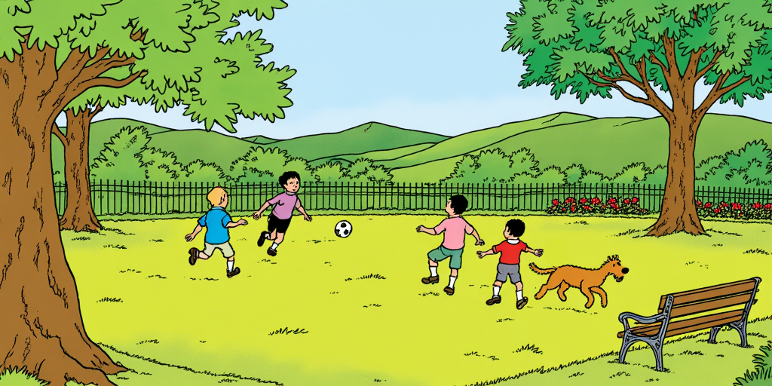
LuxLingo
Making Lëtzebuergesch accessible to everyone.
vinayarun@gmail.com
Thank you — Questions?
May 2026

