Slide 1
Platinum Jubilee Innovation Challenge 2026 | IIT Kharagpur
SHEETAL
Sustainable Hydrogel-Enabled Energy Efficient Thermal Augmentation for Air-conditioning Load Reduction
Indian innovation for energy-efficient cooling.
Team MEGHDOOT
Vinay Arya · Vikash Chandra · Aman Kumar · Shivam Kumar
School of Energy Science and Engineering, IIT Kharagpur
Mentor: Dr. Chirodeep Bakli | Associate Professor, SESE, IIT Kharagpur

Slide 2
CRITERION 1 | Problem Significance & Clarity
The Cooling Problem at IIT Kharagpur
1000+
15-25%
45 °C
Rs. Crores
Split AC units across IIT KGP campus
Efficiency drop in peak summer
Peak ambient temperature (KGP)
Annual campus cooling cost
Faculty, labs, hostels
When demand is highest
May-June every year
And growing every year
Why this problem matters:
• IIT KGP's cooling is largely served by distributed split ACs — not centralised chilled water.
• Split AC efficiency degrades in hot weather: the outdoor condenser must reject heat to increasingly hot ambient air,
forcing the compressor to work harder — and consume more electricity — precisely when cooling demand is highest.
• Replacing units is capital-intensive; most efficiency upgrades need extra energy, water, or maintenance.
• Even a 5-10% improvement across 1000+ units yields substantial cumulative savings and meaningful carbon reduction.
SHEETAL | Team MEGHDOOT | IIT Kharagpur | PJIC 2026

Slide 3
CRITERION 1 | Problem Significance
Why Existing Approaches Fall Short
The gap that SHEETAL fills
Replace With New Units
Continuous Water Spray
Shade Structures / Films
SHEETAL (Our Innovation)
✗ Rs. 30-60K per unit
✗ Major campus disruption
✗ Creates e-waste
✗ Not scalable
✗ Needs pump + piping
✗ Legionella / scaling risk
✗ High water demand
✗ Ongoing maintenance
✗ Marginal gain (< 3%)
✗ Can block airflow
✗ Structural load on wall
✗ No active cooling
✓ Completely passive
✓ No pump / no power
✓ Retrofit in < 30 min
✓ Est. 15-20% COP gain
SHEETAL | Team MEGHDOOT | IIT Kharagpur | PJIC 2026

Slide 4
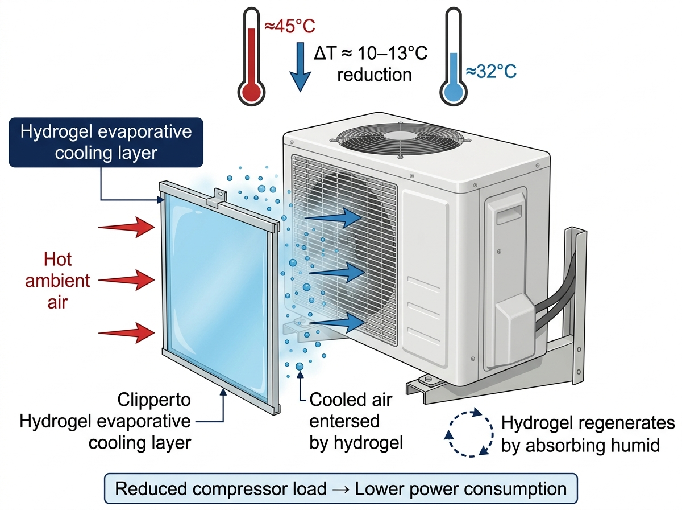
CRITERION 2 | Originality & Creativity
SHEETAL: The Proposed Innovation
What is SHEETAL?
A PAM-LiCl hydrogel panel retrofitted onto the air intake of any split AC outdoor condenser unit.
Core mechanism:
The hygroscopic hydrogel absorbs atmospheric moisture at night and releases it via evaporation during hot daytime periods, cooling the condenser inlet air by 4-10 °C.
What makes it novel:
Applies atmospheric water harvesting + desiccant cooling principles as a zero-energy AC retrofit. No prior commercial product combines these into a passive condenser pre-cooler.
Key advantage:
Completely passive. No pump, no water supply, no external power, no structural change. Clips onto any condenser grille in under 30 minutes.
SHEETAL | Team MEGHDOOT | IIT Kharagpur | PJIC 2026

Slide 5
CRITERION 3 | Technical Feasibility
Working Mechanism: Day & Night Cycle
DAYTIME — Evaporative Cooling Cycle
NIGHT — Autonomous Regeneration Cycle
1. Hot ambient air (40-45 °C, RH 25-40%) sweeps the condenser intake.
1. Temperature drops (25-32 °C), relative humidity rises (60-80%).
2. Air passes through the PAM-LiCl hydrogel panel.
2. Gel equilibrium RH ≈ 80% (for 30 wt% LiCl) → below ambient RH.
3. LiCl lowers the vapour pressure at the gel surface (aᵤ ≈ 0.80).
3. Atmospheric moisture flows into the gel (spontaneous adsorption).
4. Moisture evaporates from gel into the airstream → latent heat absorbed.
4. PAM matrix swells, storing water for the next day's cycle.
5. Condenser inlet air temperature drops 4-10 °C.
5. No pump, no valve, no active control — fully autonomous.
6. Cooler air → better heat rejection → lower compressor head pressure.
6. Hydrogel is fully recharged by morning.
7. Compressor power reduces → lower electricity draw → higher COP.
7. Cycle repeats: like a desert beetle, every single day.
SHEETAL | Team MEGHDOOT | IIT Kharagpur | PJIC 2026

Slide 6
CRITERION 3 | Scientific Soundness
PAM-LiCl Hydrogel: Material Selection Rationale
Water Activity (aᵤ)
Water Uptake
Evaporation Rate
0.75-0.85 at 30 wt% LiCl (Conde 2004) Equilibrium RH = 75-85% Enables evaporation when ambient RH < 80%
> 5 g water / g polymer (PAM hydrogel) Thin 3 mm panel holds enough water for 15-50 h of continuous cooling
j ≈ 50 μg/(m²·s) (Analytical, 45°C, RH 30%) Surface cooling: 4-10 K COP improvement: ~15-20%
Self-Regeneration
Synthesis & Cost
Absorbs moisture from humid night air passively Cycle life: > 500 cycles (Li et al. 2018 ref.) No cartridge replacement
Free-radical polymerisation Low-cost: AAm + MBA + LiCl LiCl impregnation post-gelation Scalable to sheet format Est. material: Rs. 200-400/unit
References: Conde (2004), Int. J. Refrig.; Li et al. (2018), Nat. Commun.; Zhao et al. (2019), Sci. Adv.
SHEETAL | Team MEGHDOOT | IIT Kharagpur | PJIC 2026

Slide 7
CRITERION 3 | Technical Feasibility & Scientific Soundness
Analytical Model (NTU-Effectiveness + Chilton-Colburn)
SHEETAL | Team MEGHDOOT | IIT Kharagpur | PJIC 2026

Slide 8
CRITERION 3 | Technical Feasibility
Key Model Predictions
Condenser Inlet Temp. Drop
COP Improvement (Estimated)
Nu / Sh (Graetz Corr.)
Panel Endurance
4.4 K
~20%
6.2 / 6.0
15-50 h
Bulk air: 45 °C → 40.6 °C (40 cm panel, u=0.35 m/s)
Carnot-based, T_cond drop of ~5 K
Entry-length correction Re = 413, Pr = 0.69
3-10 mm PAM-LiCl before night recharge
Governing equations (base case: L=40 cm, H=20 mm, u=0.35 m/s, T_in=45°C, RH=30%, PAM-LiCl 30 wt%)
h_conv = Nu * k_air / H = 8.42 W/(m²K) NTU_T = h_conv * L / (G * c_p) = 0.42 T_out = T_gel + (T_in - T_gel) * exp(-NTU_T)
h_mass = Sh * D_vap / H = 9.05 mm/s NTU_m = h_mass * L / (u * H) = 0.52 omega_out = omega_gel + (omega_in - omega_gel) * exp(-NTU_m)
omega_gel = a_w(w_LiCl) * omega_sat(T_gel) j_evap = rho * h_mass * (omega_gel - omega_air) Endurance = m_water / j_evap
SHEETAL | Team MEGHDOOT | IIT Kharagpur | PJIC 2026

Slide 9
CRITERION 5 | Prototype Quality & Development Stage
Prototype Design & Experimental Validation Plan
Technology Readiness Level
Prototype & Validation Plan
DONE Basic principles observed
Phase 1 — Hydrogel Synthesis
Synthesise PAM-LiCl sheets (30 wt% LiCl). Measure water uptake, a_w, evaporation rate at 35-45 °C in lab.
DONE Technology concept formulated
Phase 2 — Bench Channel Test
TRL 3 Experimental PoC (next 2 weeks)
Lab-scale air channel (40x20 mm). Heater + hygrometer. Measure DeltaT and j_evap. Validate vs. analytical model.
TRL 4 Lab-scale validation
Phase 3 — Condenser Mockup
TRL 5 Relevant environment test
Aluminium frame + gel panel for standard 1.5T split AC (800x550 mm face). Test fit and pressure drop.
TRL 6 Prototype demo in situ
Phase 4 — Field Trial (SESE Building)
TRL 7 System prototype operational
Install on 2-3 AC units. Log compressor current, power, indoor T over 2-4 weeks. Compare with controls.
TRL 8 System complete & qualified
Key Metrics
DeltaT_condenser, DeltaW_compressor, COP_before vs COP_after, gel recharge time, daily water balance.
TRL 9 Deployment proven
SHEETAL | Team MEGHDOOT | IIT Kharagpur | PJIC 2026

Slide 10
CRITERION 4 | Impact Potential: Scale, Depth & Reach
How Big Can This Get?
IIT KGP Campus
Indian Campuses
Indian Residential
Global South
~1000 split AC units
>1000 universities / IITs / NITs
300 million+ AC units in India
Hot & humid tropical climates
• 20% COP improvement
• 15-25% electricity saving on AC
• Meaningful carbon reduction
• Visible net-zero contribution
• Millions of split AC units
• Procurement via sustainability MoU
• Replicable IIT Kharagpur model
• Central govt. green campus push
• World's fastest-growing AC market
• No infrastructure change needed
• Works on any split AC brand
• Affordable retrofit for all
• Maximum benefit in hot countries
• No grid power required
• Climate adaptation technology
• Aligns with SDG 7 & SDG 13
SHEETAL | Team MEGHDOOT | IIT Kharagpur | PJIC 2026

Slide 11
CRITERION 6 | Business & Implementation Viability
Path to Deployment
Unit Economics (Estimated)
Go-to-Market Strategy
Material cost (per unit):
~Rs. 200-400
Phase 1 (0-6 months) — Campus Pilot
Install on 50 AC units at IIT KGP. Publish performance data. Build credibility with real numbers.
Frame + fitting hardware:
~Rs. 300-500
Total manufacturing cost:
~Rs. 500-900
Phase 2 (6-18 months) — Institute Network
Retail price (2x markup):
~Rs. 1,000-1,800
License to 10 IITs / NITs via campus sustainability procurement MoU.
Annual electricity saving:
~Rs. 1,500-4,000
Phase 3 (18-36 months) — B2B Channel
Simple payback period:
< 6 months
Partner with AC service companies (Daikin, Voltas, Blue Star dealers) as an add-on retrofit product.
Panel lifespan:
> 3 years (est.)
ROI over 3 years:
4-10x investment
Phase 4 (3+ years) — Consumer Retail
D2C via Amazon / Flipkart. Self-install kit format. Refill cartridge subscription (~Rs. 200/year).
Revenue model
Product sale + annual refill subscription. Institutional bulk pricing for colleges and housing societies.
SHEETAL | Team MEGHDOOT | IIT Kharagpur | PJIC 2026

Slide 12
Team MEGHDOOT
School of Energy Science and Engineering | IIT Kharagpur
Vinay Arya
Vikash Chandra
Aman Kumar
Shivam Kumar
20ES91R07
22ES92R03
25ES60R03
25ES60R11
Institute Post-Doctoral Fellow
PhD Scholar, SESE
M.Tech Student, SESE
M.Tech Student, SESE
vinayarya@kgpian.iitkgp.ac.in
vikash.es@kgpian.iitkgp.ac.in
aman1825@kgpian.iitkgp.ac.in
kshivam511725@kgpian.iitkgp.ac.in
Mentor
Dr. Chirodeep Bakli | Associate Professor, SESE, IIT Kharagpur | cbakli@iitkgp.ac.in
SHEETAL is not just an idea — it is a thermodynamically grounded, low-cost, and passively scalable solution ready to begin deployment within IIT Kharagpur this academic year.

