Slide 1
ENTERPRISE PLATFORM
PiOne Testmate
Autonomous Enterprise Web QA & Low-Impact DAST Security Platform
⚡ Zero-Script Setup
Autonomous SPA & SSR route discovery without writing fragile manual selector scripts. Cut test authoring cycles from weeks to minutes.
🛡️ Production-Safe DAST
Passive OWASP Top 10 security auditing across discovered routes. Detects CSP, HSTS, cookie flag, and unauth access flaws without destructive payloads.
🎯 Enterprise Resilience
SQLite / PostgreSQL relational persistence, safe checkpoint resume, visual regression baselines, and multi-provider AI model freedom.
CONFIDENTIAL & PROPRIETARY — PIONE TECHNOLOGIES LLP — PLATFORM RELEASE V2.1 (OCTOBER 2026)

Slide 2
MARKET ANALYSIS & PROBLEM STATEMENT
The Enterprise Web QA Dilemma
⏳ Fragile Script Maintenance
✖ Teams spend 40% to 60% of test engineering sprints repairing broken XPath and CSS locators.
✖ Minor UI redesigns silently break test suites, leading to release delays and QA friction.
✖ High barrier to entry: requires dedicated automation engineers to maintain large repositories.
✖ Result: Test coverage stagnates while applications rapidly evolve.
💣 Destructive Autonomous Bots
✖ Unbounded AI agents inadvertently click delete buttons, cancel accounts, or submit orders.
✖ Black-box crawlers execute arbitrary external links, leading to SSRF and security alerts.
✖ Non-deterministic execution: LLM hallucinations generate tests for elements that don't exist.
✖ Result: Enterprise security teams ban autonomous AI tools from staging and production.
🚀 The PiOne Testmate Solution
✔ Deterministic Playwright Scanner First: The browser is strictly driven by deterministic code.
✔ Grounded AI Second: LLMs only generate tests bounded to elements in the discovered DOM registry.
✔ Safety Parking Lot: Destructive actions quarantined for explicit human operator confirmation.
✔ Zero Lock-in: Emits pure standard pytest code with full relational checkpoint persistence.

Slide 3
SYSTEM ARCHITECTURE & DESIGN PRINCIPLES
Core Philosophy & Enterprise Value Pillars
GUIDING PRINCIPLE: DETERMINISTIC SCANNER FIRST, GROUNDED AI INTELLIGENCE SECOND
Playwright deterministically owns browser exploration, DOM extraction, and execution. Artificial Intelligence models (Gemini, Claude, GPT, Ollama) are strictly restricted to synthesizing structured test scenarios from registered elements. AI never directly touches the browser.
🛡️ SSRF Guardrails
Target origin allowlisting and strict network blocking of private IP ranges (10.0.0.0/8, 127.0.0.1, 169.254.169.254).
🎯 12-Attr Fingerprint
Multi-attribute selector scoring (Role > ARIA > ID > Text > CSS > XPath) guaranteeing self-healing locator resilience.
🛑 Safety Parking Lot
Dangerous keywords (delete, cancel, reset, buy) quarantined into a governance review list requiring human sign-off.
🔄 In-Place Session Refresh
Expired sessions are renewed via /session/refresh without dropping discovered route graphs, checkpoints, or active runs.

Slide 4
4-TIER TECHNICAL OVERVIEW
Unified System Architecture Blueprint
Tier 1: Presentation & UI
Tailwind CSS SPA
• 8-Step Responsive Stepper Interface
• Persistent Active-Run HUD Bar
• Dual-Transport WebSocket / Polling Telemetry
• Interactive Element & Security Dossier Viewers
• Saved Runs, Regression Suites & Baseline Hubs
Tier 2: API Gateway
FastAPI Asynchronous Engine
• /scan & /discover-modules Orchestration
• /scan/control Live Pause / Resume / Cancel
• /runs/{id}/security Passive DAST Scanner
• /generate-tests Multi-Provider AI Gateway
• /execute-tests High-Speed Controlled Runner
Tier 3: Core Engine
Playwright Automation Core
• SecurityGuard (SSRF & Boundary Containment)
• ViewportDeepScanner & 12-Attr Fingerprinting
• ActionClassifier (Safe vs. Parking-Lot)
• AuthLifecycleService & Session Key Storage
• Browser Session Recovery & Reconnect Engine
Tier 4: Durable Persistence
Relational Repository
• SQLAlchemy ORM (SQLite / PostgreSQL Support)
• RunContext JSON & Memory State Synchronizer
• 10-Sheet Standardized Excel Audit Workbooks
• JUnit XML, JSON Metrics, & HTML Report Store
• Perceptual Visual Regression Baseline Archive

Slide 5
OPERATIONAL PIPELINE & GOVERNANCE GATES
The End-to-End 8-Step Testing Lifecycle
1. Scan App
Target specification, credentials containment, and initial SPA/SSR probe.
Gate: Explicit Confirmation
2. Choose Modules
Semantic clustering of discovered paths into testable functional domains.
Gate: Explicit Confirmation
3. Manual Review
Human-in-the-loop governance isolating destructive verbs in Parking Lot.
Gate: Explicit Confirmation
4. Crawl Telemetry
Deep sequential traversal with sub-second WebSocket telemetry HUD.
Gate: Explicit Confirmation
5. Analyze Routes
Route health classification (Working/Partial/Non-Working) & element map.
Gate: Explicit Confirmation
6. Security DAST
Passive OWASP Top 10 auditing (CSP, HSTS, cookie flags, unauth access).
Gate: Explicit Confirmation
7. Generate Tests
Multi-provider AI planning gateway emitting clean standalone pytest code.
Gate: Explicit Confirmation
8. Execute Tests
Controlled headless/headed runner with per-step live assertion streaming.
Gate: Explicit Confirmation

Slide 6
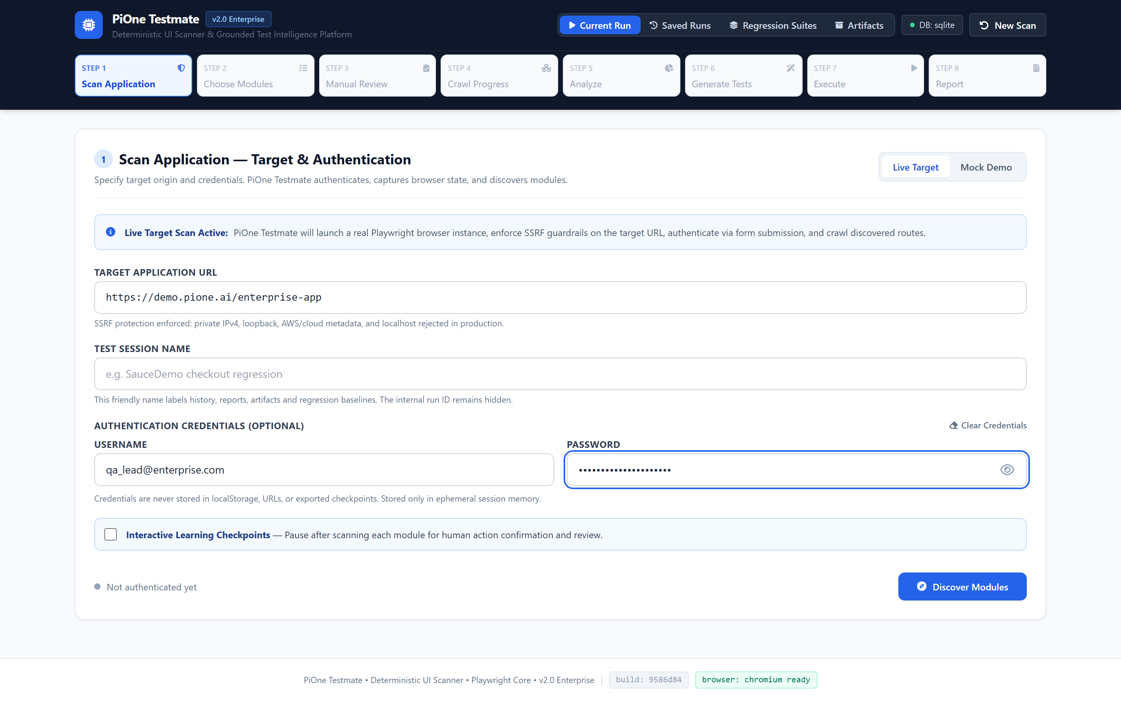
STEP 1 — INITIATION & TARGET SPECIFICATION
Step 1: Scan Application & Session Lifecycle
Target Configuration with Strict Session Containment
🎯 Executive Value:
✔ Single entry point supporting both public applications and authenticated enterprise portals.
✔ Opaque Session Storage: Browser cookies and storage states saved under reports/auth_sessions/<uuid>.json.
✔ Deterministic Mock/Demo Mode enables 100% offline, air-gapped evaluation without network dependencies.
✔ Target Origin Boundary: Enforces strict host validation to prevent inadvertent off-site exploration.
🛡 Enterprise Guarantee: Passwords, session tokens, and local storage keys are never logged in plaintext or exposed to telemetry.
LIVE PLATFORM CAPTURE: TARGET URL SPECIFICATION, AUTH CREDENTIALS, AND OFFLINE DEMO CONTROLS [1440x900 @ 2x HI-DPI]

Slide 7
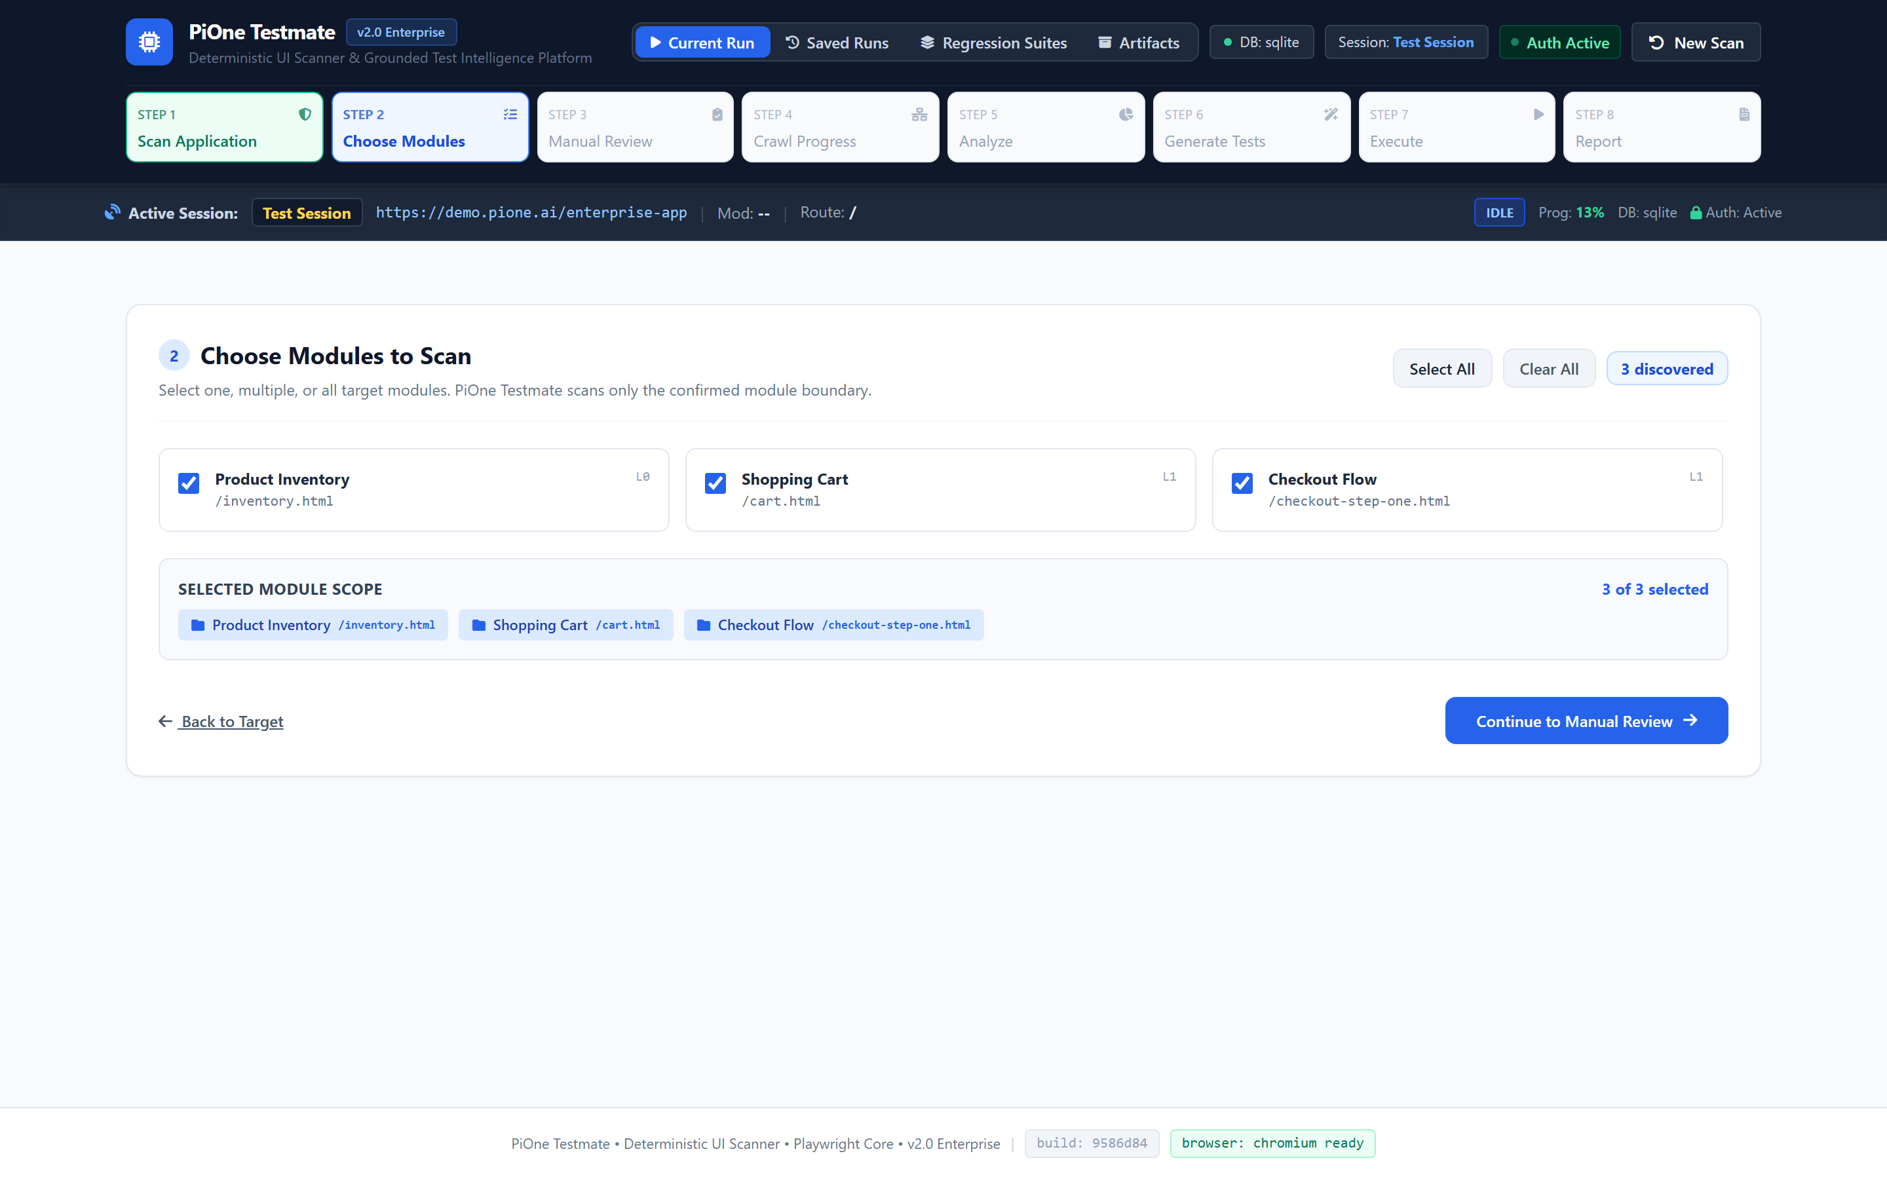
STEP 2 — SCOPING & SUBDOMAIN ISOLATION
Step 2: Intelligent Module Discovery & Boundary Locking
Semantic Route Clustering & Selective Test Scoping
🎯 Executive Value:
✔ Autonomous Route Clustering: Discovered URLs grouped into logical domains (e.g. Auth, Inventory, Cart, Settings).
✔ Granular Selection: Operators select only the modules affected by recent commits, cutting crawl time by up to 85%.
✔ Dynamic Stale Run Invalidation: Changing module selection transparently flags downstream test suites as needing regeneration.
✔ Boundary Locking: Prevents crawlers from expanding into unwanted subdomains or external OAuth redirect targets.
🛡 Enterprise Guarantee: Crawling and test generation strictly bounded to selected modules; eliminates redundant enterprise test cycles.
LIVE PLATFORM CAPTURE: MODULE SELECTION CHECKBOXES WITH REAL-TIME ROUTE COUNT INDICATORS [1440x900 @ 2x HI-DPI]

Slide 8
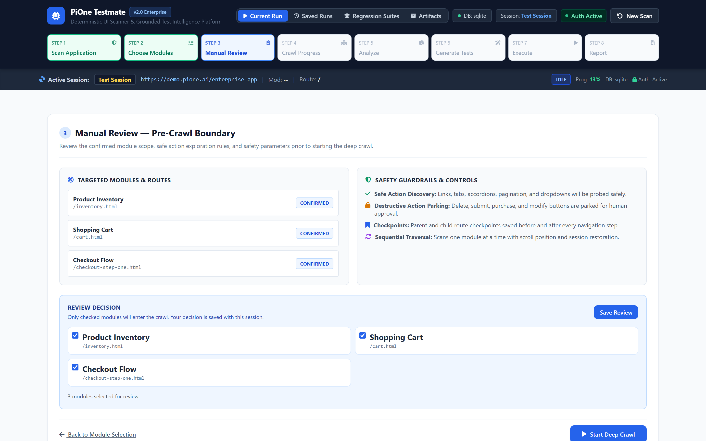
STEP 3 — HUMAN-IN-THE-LOOP GOVERNANCE
Step 3: Interactive Manual Review & Safety Enclaves
Pre-Crawl Risk Triage & Destructive Action Parking Lot
🎯 Executive Value:
✔ Heuristic Classifier: Automatically flags dangerous endpoints containing keywords like delete, cancel, reset, purchase, logout.
✔ Parking-Lot Enclave: Questionable routes quarantined into a dedicated review table requiring explicit operator sign-off.
✔ Deep-Link Ingestion: Operators can manually inject custom deep operational URLs into the queue before crawling.
✔ Zero Surprise Guarantee: Autonomous crawlers are physically blocked from clicking unapproved destructive buttons.
🛡 Enterprise Guarantee: Zero unintentional destructive database mutations or account terminations during autonomous crawling.
LIVE PLATFORM CAPTURE: INTERACTIVE ROUTE CONFIRMATION TABLE WITH PARKING-LOT SAFETY INDICATORS [1440x900 @ 2x HI-DPI]

Slide 9
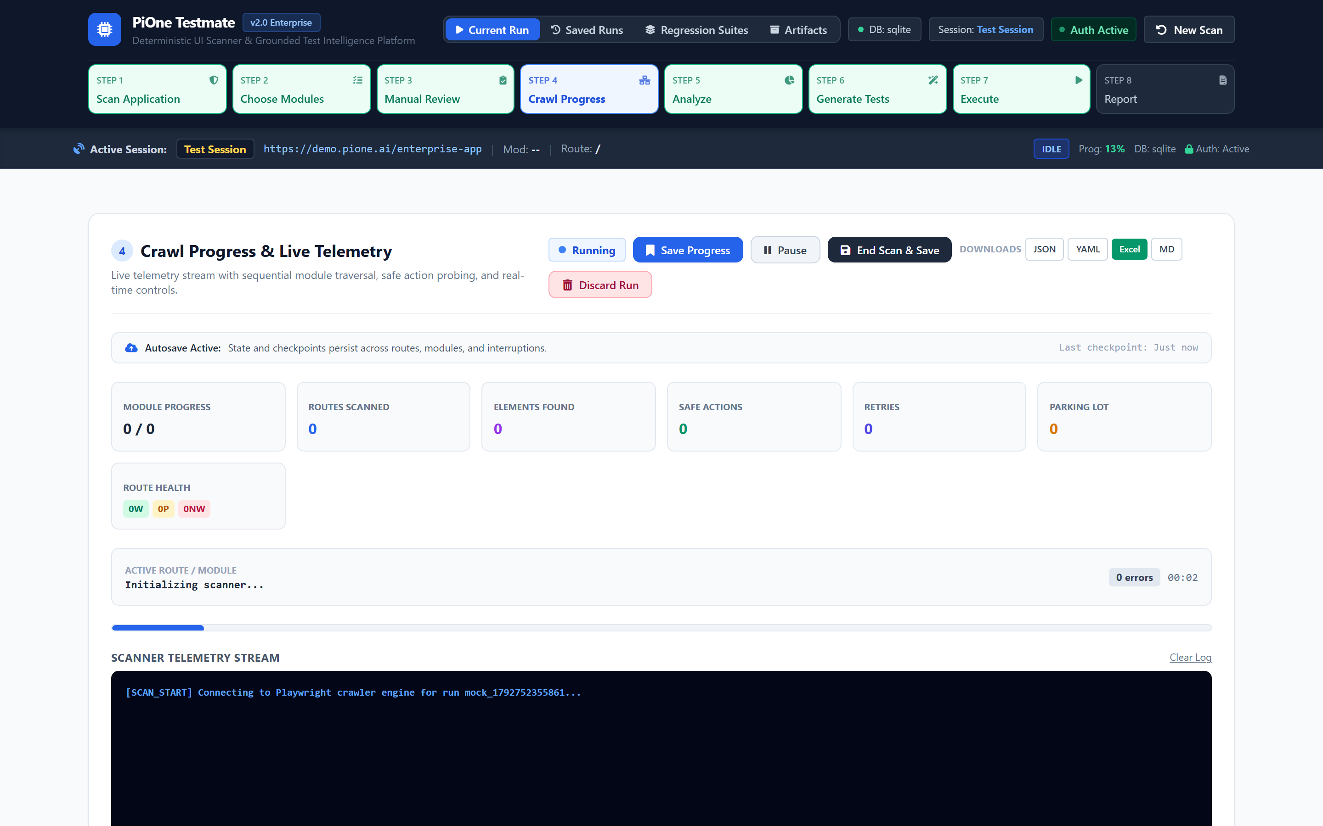
STEP 4 — TRAVERSAL & RESILIENT TELEMETRY
Step 4: Real-Time Crawl Telemetry & Bounded Traversal
Sub-Second Live Streaming & Global Active-Run HUD
🎯 Executive Value:
✔ Dual-Transport Telemetry: High-speed WebSocket streaming with seamless fallback to HTTP polling upon network drops.
✔ Persistent Active-Run HUD: Global top bar displays Target URL, Run ID, Active Module, Current Route, and DB Status.
✔ Operator Controls: Live Pause, Resume, and Graceful End Scan actions available at any moment.
✔ Terminal State Integrity: Completed scans lock controls, stop polling, and cleanly activate 'View Analysis'.
🛡 Enterprise Guarantee: Zero automatic phase transitions; operator retains complete supervisory control throughout exploration.
LIVE PLATFORM CAPTURE: LIVE PROGRESS BAR, ROUTE STREAM, AND ACTIVE-RUN PERSISTENT HUD [1440x900 @ 2x HI-DPI]

Slide 10
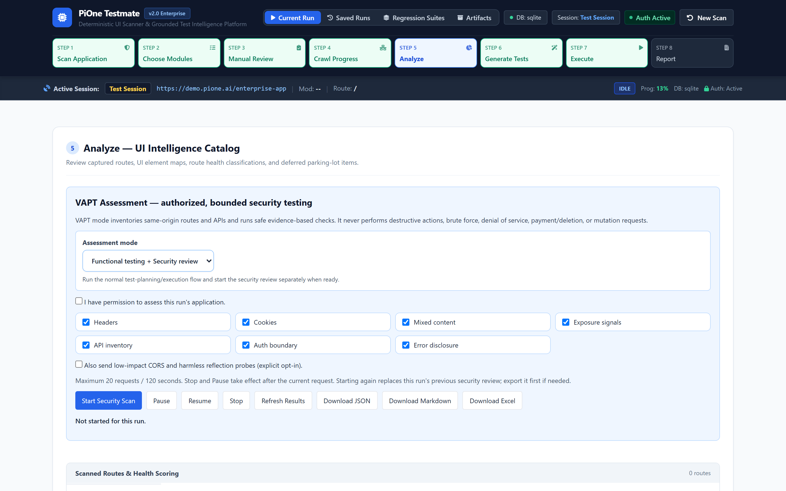
STEP 5 — CATALOGING & ROUTE TAXONOMY
Step 5: Route Health Catalog & UI Intelligence
Automated Health Derivation & 12-Attribute Element Fingerprinting
🎯 Executive Value:
✔ Normalized Route Taxonomy: Every page classified into Working, Partial, or Non-Working based on HTTP and client responses.
✔ 12-Attribute Element Map: Indexes all interactive buttons, inputs, selects, links, forms, and ARIA accessibility roles.
✔ Instant Triage: Detects 404 dead links, 500 server crashes, and client-side rendering failures before writing tests.
✔ Deep Filtering: Filter discovered elements by module, HTTP status code, interactive role, or URL path.
🛡 Enterprise Guarantee: Summary metric cards strictly reconcile with underlying route records; zero false-zero counts.
LIVE PLATFORM CAPTURE: DISCOVERED ROUTE TABLE, HEALTH BADGES, AND ELEMENT DENSITY METRICS [1440x900 @ 2x HI-DPI]

Slide 11
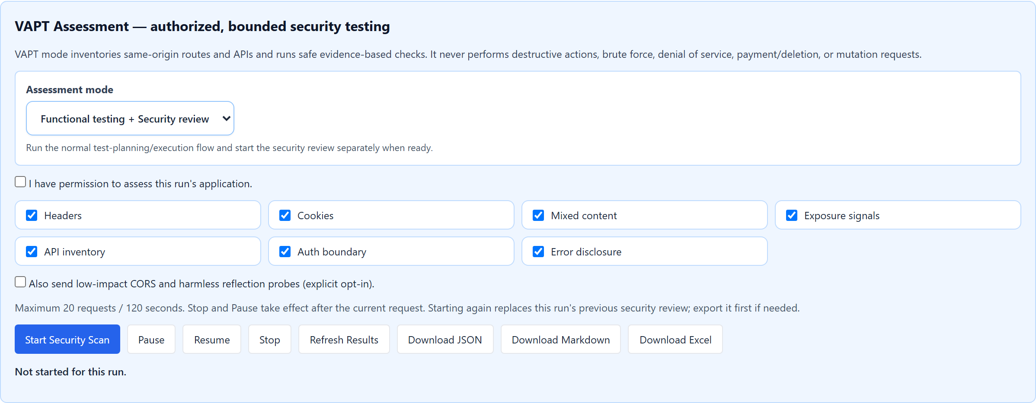
STEP 6 — PASSIVE VULNERABILITY AUDITING
Step 6: Non-Destructive DAST Security Assessment
OWASP Top 10 (2021) Passive Compliance Auditing
🎯 Executive Value:
✔ Security Headers Audit: Evaluates Strict-Transport-Security (HSTS), Content-Security-Policy (CSP), and X-Frame-Options.
✔ Cookie Security Review: Flags missing Secure, HttpOnly, and SameSite flags across all established session cookies.
✔ Unauthenticated Access Probing: Tests discovered internal routes without auth headers to identify broken access controls.
✔ CORS & Secret Leakage: Scans client responses for permissive wildcard origins and accidentally exposed tokens.
🛡 Enterprise Guarantee: Low-impact passive inspection only; zero destructive payloads, injection attacks, or denial-of-service risks.
LIVE PLATFORM CAPTURE: OWASP FINDING CARDS, SEVERITY BADGES, AND REMEDIATION RECOMMENDATIONS [1440x900 @ 2x HI-DPI]

Slide 12
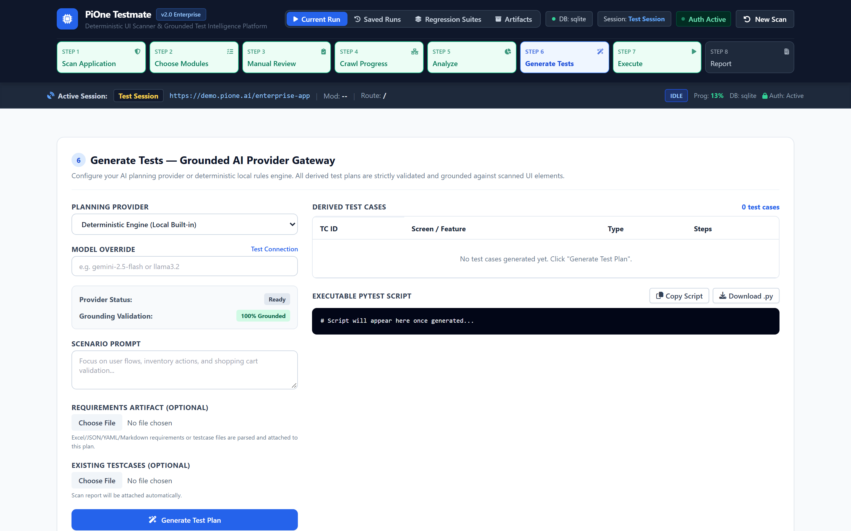
STEP 7 — GROUNDED TEST SYNTHESIS
Step 7: Multi-Provider AI Test Planning Gateway
Vendor-Neutral Test Intelligence Without Hallucinations
🎯 Executive Value:
✔ Model Freedom: Pluggable gateway supports Google Gemini 2.5 Flash, OpenAI GPT-4o, Anthropic Claude 3.5, or Local Ollama.
✔ Zero Hallucination Guarantee: Prompts strictly grounded with elements from the discovered DOM registry.
✔ Clean Code Synthesis: Emits standard Python + Playwright code; no proprietary runtime or vendor lock-in.
✔ Editable Plan Staging: Review, reorder, or customize test scenarios and assertions before generating code.
🛡 Enterprise Guarantee: Generated test files are 100% portable and run in any CI/CD pipeline via standard pytest CLI.
LIVE PLATFORM CAPTURE: LLM PROVIDER SELECTION, SCENARIO GENERATOR, AND EDITABLE TEST PLAN [1440x900 @ 2x HI-DPI]

Slide 13
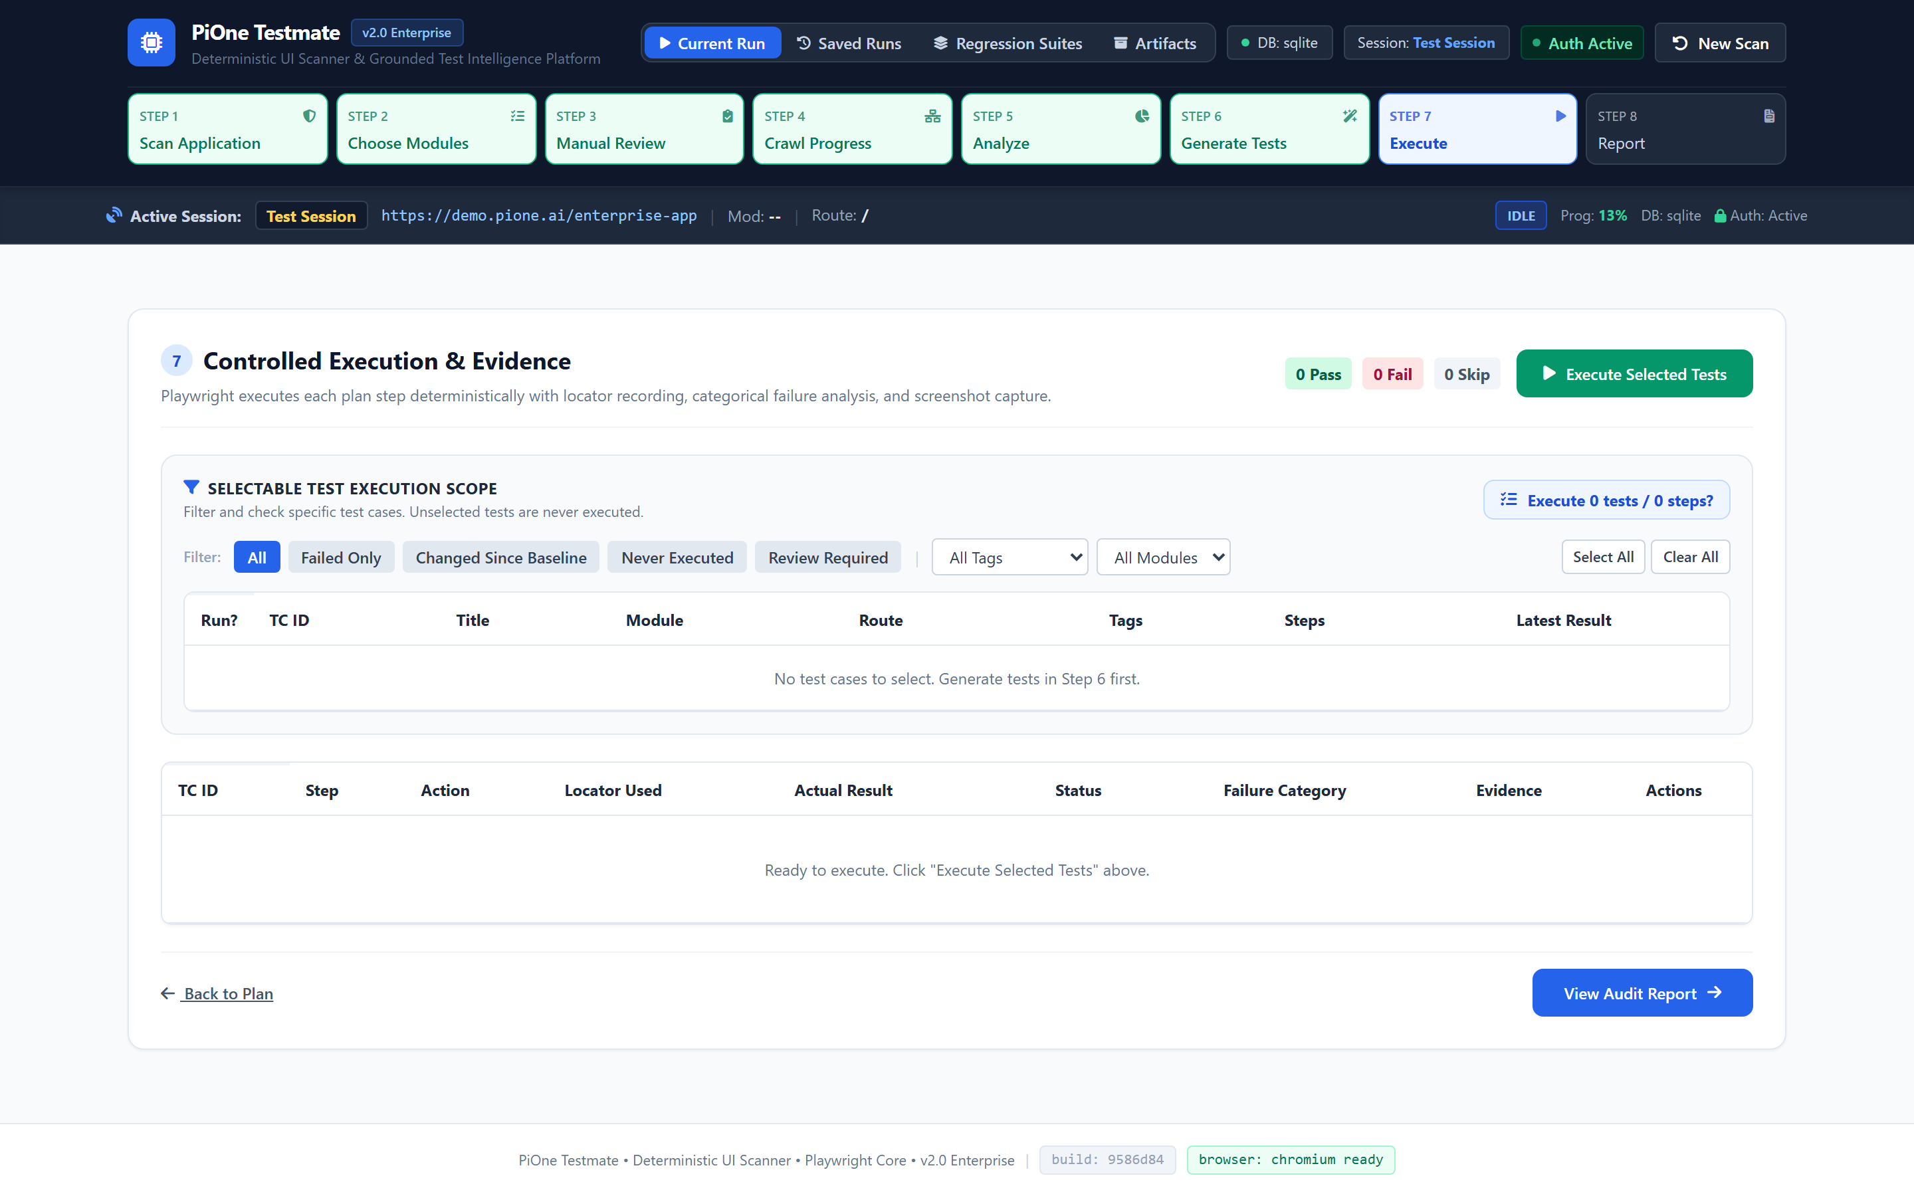
STEP 8 — TEST EXECUTION & LIVE ASSERTIONS
Step 8: Controlled Execution Engine & Step Streaming
High-Speed Runner with Real-Time Assertion Streaming
🎯 Executive Value:
✔ Dual Execution Modes: Interactive headed browser for local visual debugging, or headless runner for CI/CD pipelines.
✔ Live Step Streaming: Displays every action, locator click, text input, and assertion check with millisecond timestamps.
✔ Browser Session Auto-Recovery: Closed browser targets automatically re-instantiate without aborting remaining test cases.
✔ Stop-on-Failure Protection: Automatically pauses or stops execution upon unexpected application crashes.
🛡 Enterprise Guarantee: Native Playwright event dispatching ensures zero timing flakiness and exact assertion reproducibility.
LIVE PLATFORM CAPTURE: LIVE STEP EXECUTION LOG, PASS/FAIL INDICATORS, AND EXECUTION CONTROLS [1440x900 @ 2x HI-DPI]

Slide 14
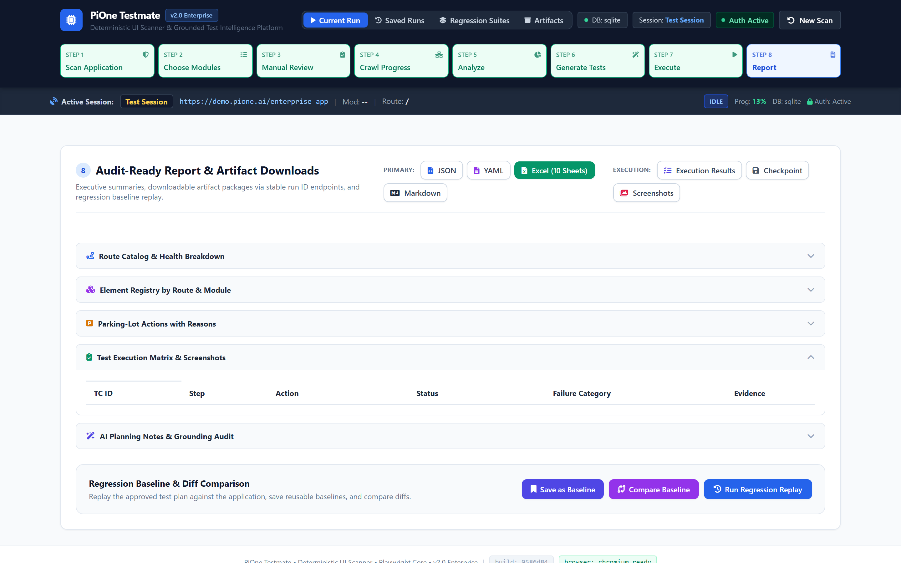
STEP 9 — AUDIT DOSSIERS & COMPLIANCE REPORTING
Step 9: Audit-Ready Test Artifacts & 10-Sheet Workbook
Multi-Format Audit Dossiers & Step-by-Step Screenshot Evidence
🎯 Executive Value:
✔ 10-Sheet Excel Workbook: Complete technical audit artifact detailing execution summary, route inventory, and security findings.
✔ CI/CD Integration: Generates standard JUnit XML and JSON summaries compatible with GitHub Actions, GitLab, and Jenkins.
✔ Executive HTML Dossier: Standalone interactive report shareable with compliance officers and VP Engineering.
✔ Forensic Screenshot Capture: Full-page screen captures recorded for every executed assertion and failure point.
🛡 Enterprise Guarantee: Audit-ready compliance artifacts suitable for SOC2, ISO 27001, and HIPAA enterprise regulatory reviews.
LIVE PLATFORM CAPTURE: EXECUTIVE REPORT SUMMARY CARDS, ARTIFACT DOWNLOAD LINKS, AND METRICS [1440x900 @ 2x HI-DPI]

Slide 15
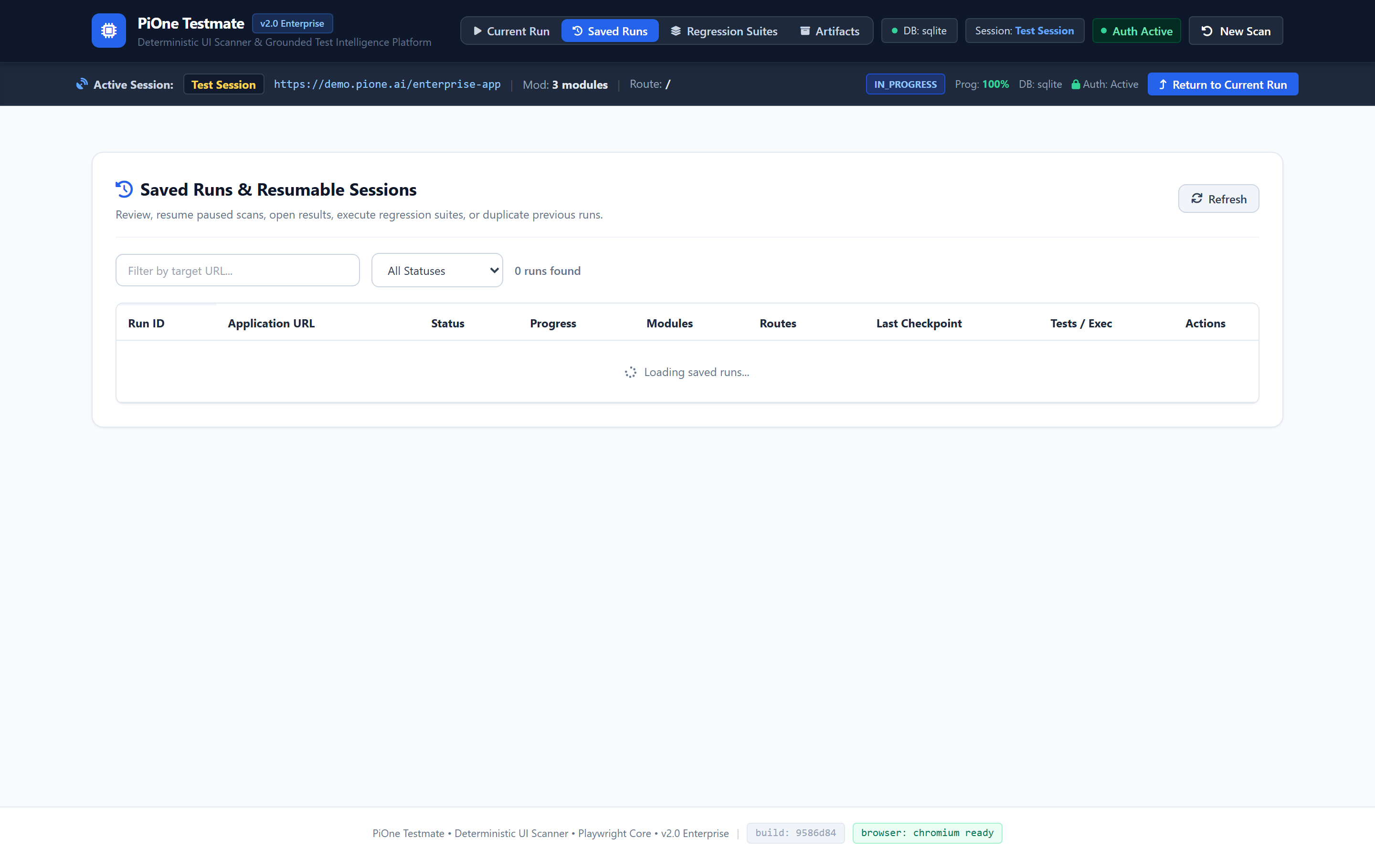
ENTERPRISE PERSISTENCE & FAULT TOLERANCE
Auxiliary Dashboard: Saved Runs & Checkpoint Recovery
Transactional State Persistence on SQLite & PostgreSQL
🎯 Executive Value:
✔ Multi-Engine Relational Storage: Full persistence of all runs, routes, element catalogs, test suites, and audit logs.
✔ One-Click Checkpoint Resume: Resume an interrupted 2-hour scan from its exact recorded state without re-running.
✔ Typed Confirmation Guard: Destructive operations require typing 'DELETE' to prevent accidental test artifact loss.
✔ Multi-Process Database Locking: Safe transactional concurrency prevents run context corruption.
🛡 Enterprise Guarantee: Complete historical scan and test execution audit trail retained indefinitely in enterprise database.
LIVE PLATFORM CAPTURE: SAVED RUNS TABLE, RESUME ACTIONS, AND TYPED DELETE CONFIRMATION MODAL [1440x900 @ 2x HI-DPI]

Slide 16
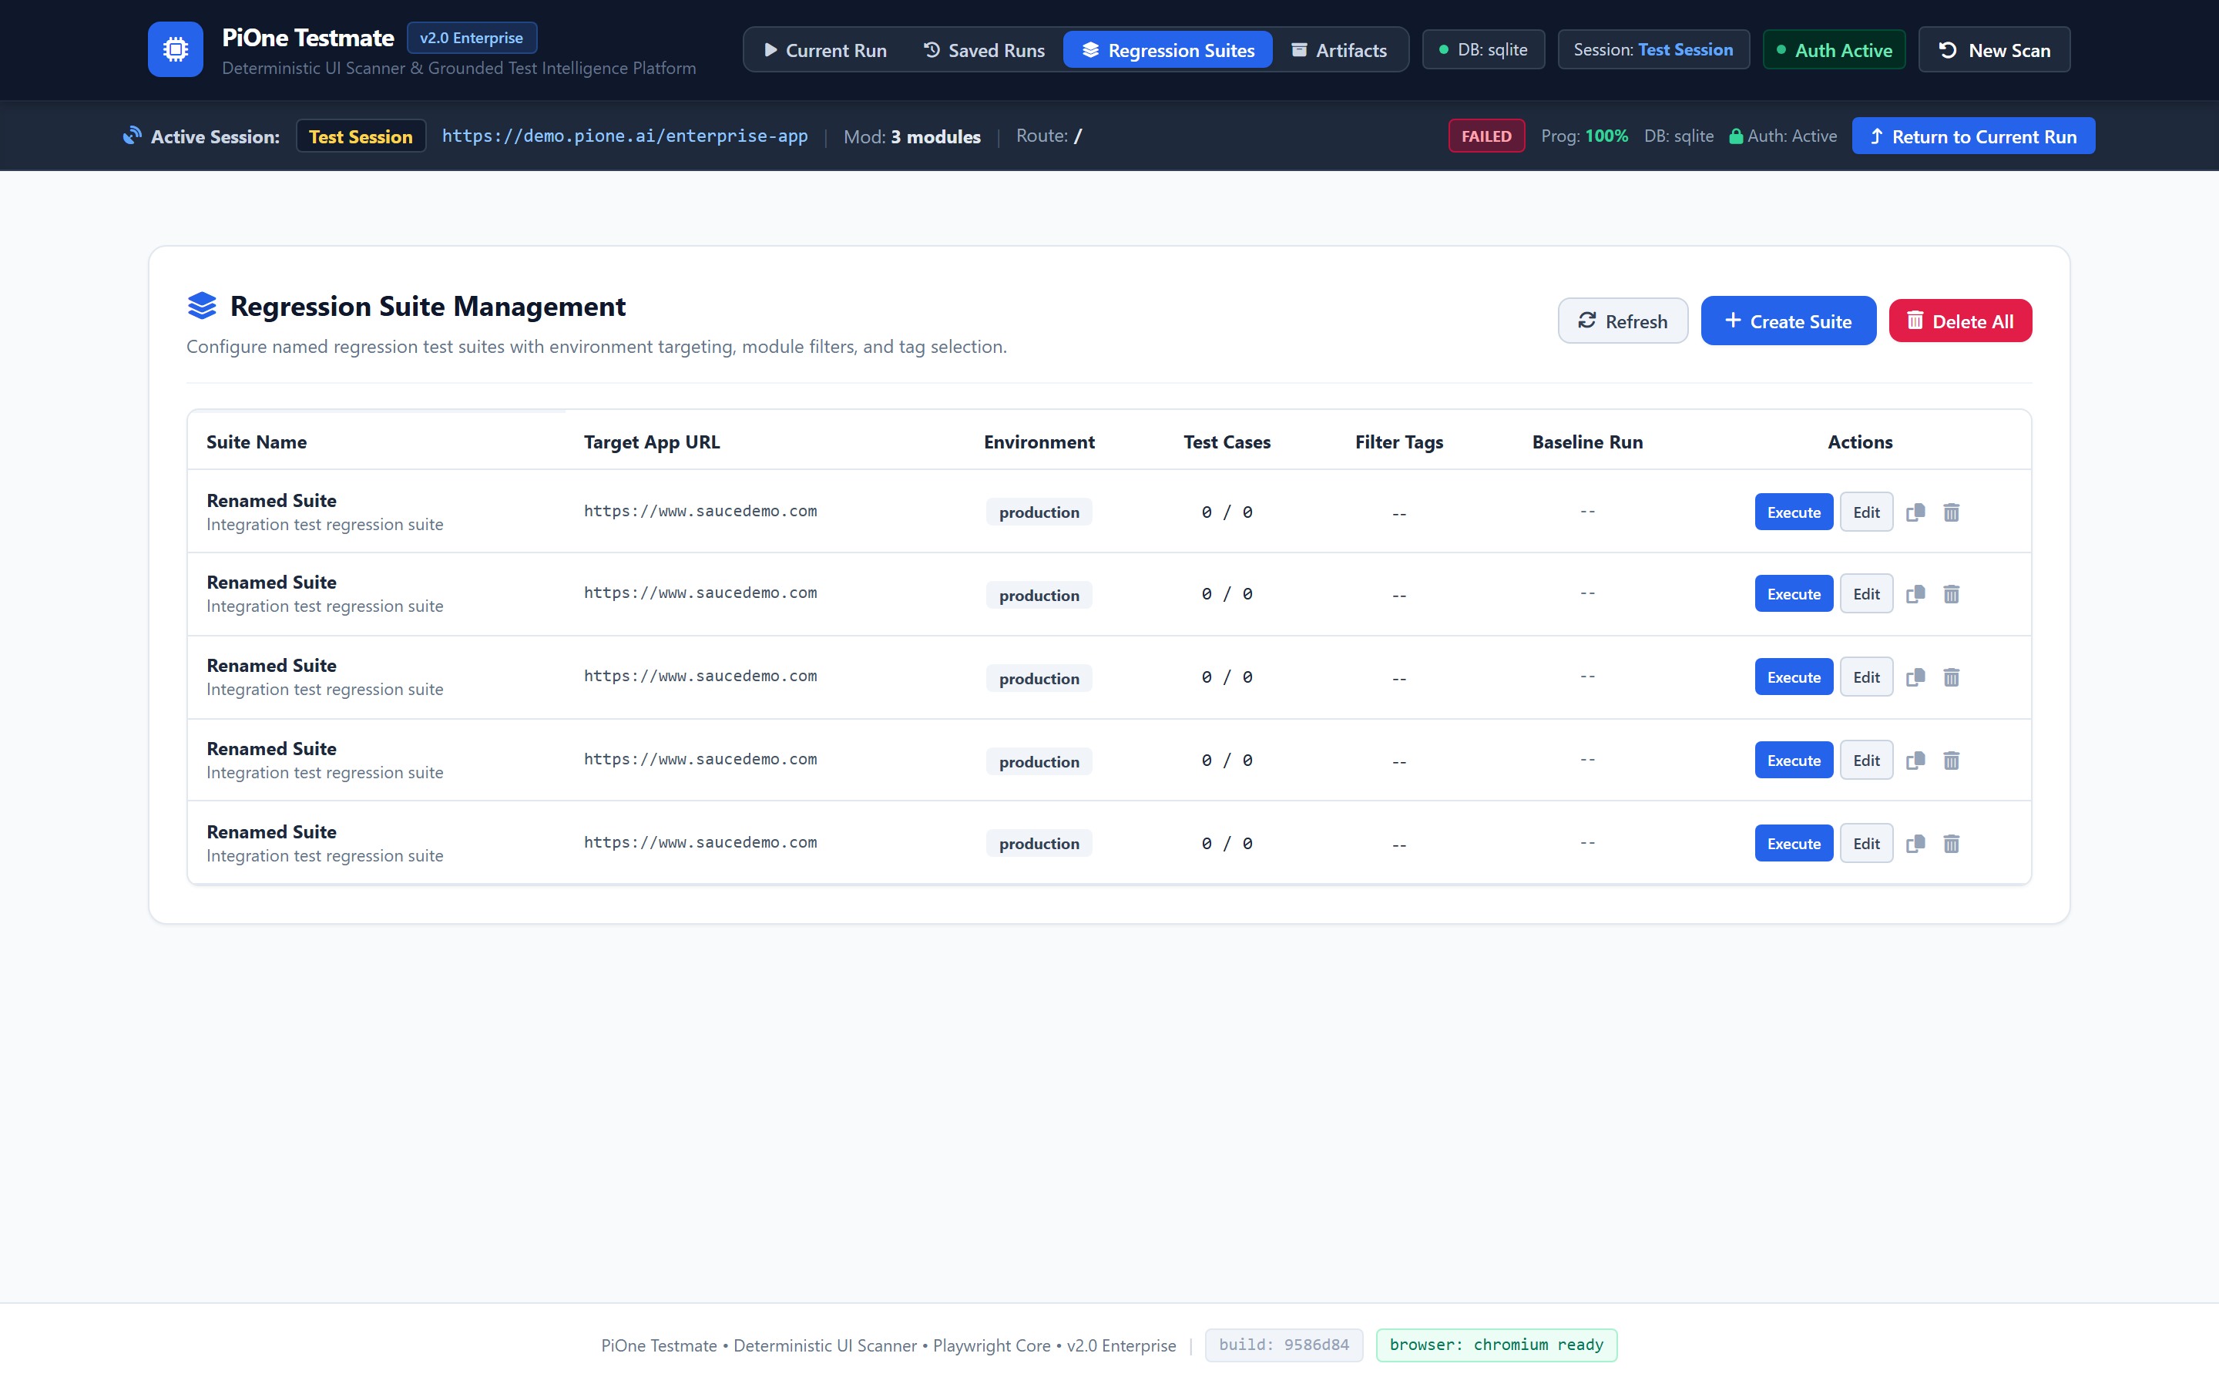
CONTINUOUS TESTING & VISUAL DRIFT DETECTION
Auxiliary Dashboard: Regression Suites & Visual Baselines
Multi-Suite Bundling & Perceptual Diff Baselines
🎯 Executive Value:
✔ Suite Bundling: Group multiple functional test suites into scheduled regression sets (e.g. Daily Smoke, P0 Critical Path).
✔ Visual Perceptual Diffing: Detects subtle CSS shifts, font drops, and visual layout breakage against golden baselines.
✔ Historical Drift Tracking: Compares test timing, memory footprint, and pass rates across sequential software builds.
✔ Baseline Management: Promote approved UI changes to the new golden baseline with single-click operator approval.
🛡 Enterprise Guarantee: Zero undetected visual or functional UI regressions reaching customer-facing production environments.
LIVE PLATFORM CAPTURE: REGRESSION SUITE MANAGER, VISUAL BASELINE COMPARISON, AND DIFF VIEWER [1440x900 @ 2x HI-DPI]

Slide 17
PERSISTENCE LAYER SPECIFICATION (SQLALCHEMY ORM)
Enterprise Data Architecture & Relational Schema
Entity Name | Key Attributes | Relational Mapping | Enterprise Purpose
RunContext | run_id, target_url, status, checkpoint, created_at | 1:N Routes, 1:N Suites | Top-level scan lifecycle & checkpoint pointer
DiscoveredRoute | route_id, run_id, path, http_status, classification | N:1 RunContext, 1:N Elements | Inventory of all crawled application pages
ElementRegistry | element_id, route_id, role, selector_score, bbox | N:1 DiscoveredRoute | 12-attribute self-healing element registry
RegressionSuite | suite_id, name, run_id, test_case_count, status | 1:N TestCases, 1:1 Baseline | Named bundle of test scenarios for CI/CD runs
SecurityFinding | finding_id, run_id, owasp_category, severity, url | N:1 RunContext | Passive DAST vulnerability audit log
ArtifactReference | artifact_id, run_id, file_type, file_path, size_bytes | N:1 RunContext | Tracked Excel workbooks, JUnit XML & reports
ℹ Note: Supports SQLite for zero-config single-node setups and PostgreSQL for multi-user high-concurrency enterprise deployments.

Slide 18
SECURE ARCHITECTURE & RISK MITIGATION
Enterprise Security, Governance & Transport Guardrails
Security Domain | Threat Vector | PiOne Testmate Guardrail | Compliance Mapping
Transport SSRF | Malicious redirects to cloud metadata (169.254.169.254) or VPC | Playwright route interception mathematically drops non-target and private IP ranges | CWE-918, OWASP A10
Destructive Actions | Accidental deletion of database records or billing transactions | Safety Parking-Lot quarantines verbs (delete, cancel, buy) for human approval | SOC2 CC7.2
Credential Leakage | Passwords or session tokens leaking in logs, reports, or CI artifacts | Encrypted storage under reports/auth_sessions/; regex redaction on all logs | ISO 27001 A.9.4
AI Hallucinations | LLM generating non-existent test steps causing pipeline failures | Prompts strictly bounded to elements in the registered DOM catalog | OWASP LLM09
Session Hijacking | Expired or stale session states invalidating long-running tests | In-place /session/refresh preserves run context without re-authenticating | OWASP A07
ℹ Note: All guardrails are strictly enforced at the Python/Playwright transport layer and cannot be bypassed by AI models.

Slide 19
MARKET COMPARISON & ENTERPRISE ADVANTAGE
Competitive Differentiation Matrix
Capability | PiOne Testmate | Selenium / WebDriver | Cypress / Playwright | Black-Box AI Bots
Setup Effort | Zero-Script Autonomous | High (Manual Coding) | Medium (Manual Coding) | Zero-Script
Selector Maintenance | Self-Healing (12 Attr) | High Maintenance (40% time) | High Maintenance | Brittle / Hallucinates
Destructive Protection | Safety Parking Lot Enclave | None (Blind Execution) | None (Blind Execution) | High Risk of Accidental Delete
Security Auditing | Built-in Passive DAST | Requires 3rd-Party Tools | Requires 3rd-Party Tools | None
AI Model Portability | Gemini, OpenAI, Claude, Ollama | None | None | Locked to Single Vendor
State Persistence | Relational Checkpoint Resume | None (Restart from zero) | None (Restart from zero) | None
Test Code Portability | Emits Pure Pytest Code | Custom Java/Python | Custom JS/TS | Proprietary Platform Lock-in
ℹ Note: PiOne Testmate delivers the speed of autonomous AI with the deterministic safety and portability of pure Playwright code.

Slide 20
EXECUTIVE BUSINESS CASE & NEXT STEPS
Economic ROI, Deployment Options & Action Plan
📈 85% Less Maintenance
Reclaim hundreds of engineering hours lost to brittle manual selector updates. Autonomous route discovery adapts dynamically as your UI evolves.
⚡ 10x Test Velocity
Synthesize complete, production-grade Playwright suites in minutes rather than weeks. Cut QA release cycles from 3 days to under 30 minutes.
🔒 Air-Gapped Deployment
Deploy in private cloud VPC, Kubernetes, or fully air-gapped on-premise with local Ollama inference. Zero test data or credentials leave your network.
ACTIONABLE ENTERPRISE PILOT ROADMAP
▶ Phase 1: Day 1 Integration: Deploy PiOne Testmate container in your staging VPC; configure target URLs and verify browser runtime readiness.
▶ Phase 2: Week 1 Pilot Evaluation: Scan 3 representative applications; catalog routes, run passive DAST scans, and generate grounded pytest suites.
▶ Phase 3: Production CI/CD Rollout: Integrate generated JUnit XML and HTML reports into your GitHub Actions / GitLab pipeline for automated gatekeeping.

