Slide 1
ENTERPRISE UI AUTOMATION PLATFORM v2.1
PiOne Testmate
Deterministic UI Scanner, Grounded AI Test Planner & Resilient Regression Engine
• 100% Playwright Synchronous Core Engine (No Flaky Selectors)
• Neutral Multi-Provider AI Gateway (Ollama, Gemini, Claude, OpenAI)
• Passive DAST Assessment Mapped to OWASP Top 10 (2021)
• 10-Sheet Audit-Ready Workbooks & In-Place Session Lifecycle Protection
PiOne Technologies LLP • Production Platform Presentation • Confidential

Slide 2
EXECUTIVE PROBLEM STATEMENT
The $3.6M Problem: The 3 Broken Pillars of UI Automation
1. Brittle Locators & Flakiness
• Traditional suites bind to dynamic CSS or relative XPaths.
• Minor styling, wrapper, or Tailwind updates break 40% of test suites.
• Teams waste hundreds of hours fixing locators instead of testing product features.
2. Ungrounded AI Hallucinations
• Raw AI agents attempting to drive web browsers click destructive actions.
• Accidental checkouts, data deletions, and credential leaks cause business risk.
• AI models hallucinate non-existent element locators, generating false coverage.
3. Session & State Fragility
• In modern SPAs, authentication tokens expire silently during long crawler passes.
• A 2-hour end-to-end regression fails completely when a cookie expires.
• Legacy tools discard all progress and force engineers to restart from scratch.

Slide 3
ARCHITECTURE PARADIGM
Core Philosophy: Deterministic Scanner First, AI Second
“Playwright owns browser discovery, DOM analysis, and execution deterministically.
AI models synthesize test logic based strictly on saved evidence—AI never drives the browser directly.”
Deterministic Crawler Engine
✔ SSRF Guardrails: Rejects RFC 1918, loopbacks, and cloud metadata.
✔ Deep Scrolling: Explores document viewports & nested containers.
✔ Overlay Engine: Probes menus/dropdowns and cleans up via Escape key.
✔ 12-Attribute Fingerprinting: Role > ARIA > Text > CSS > XPath.
✔ Destructive Action Parking Lot: Segregates unsafe mutations.
Neutral Multi-Provider AI Gateway
✔ 100% Grounded Test Synthesis: References verified DOM IDs only.
✔ Multi-Provider Freedom: Ollama, Gemini, Claude, OpenAI, Offline Rules.
✔ Requirement Awareness: Ingests user stories, PRDs, and custom prompts.
✔ Zero Hallucination Tolerance: Rejects unverified target elements.
✔ Controlled Execution: Verifies assertions and captures step screenshots.

Slide 4
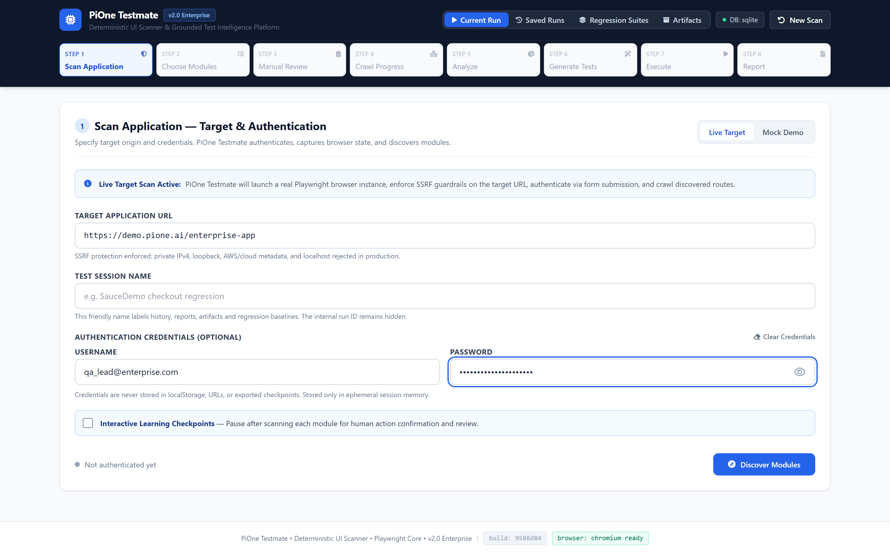
STEP 1: SCAN APPLICATION
Step 1: Zero-Trust Target Setup & SSRF Protection
Target Origin Locking with Kernel-Level SSRF Guardrails
✔ Strict Origin Validation: Locks the crawler to the exact application origin, preventing cross-domain creeping.
✔ SSRF IP-Level Guard: Automatically blocks RFC 1918 private IPs, loopbacks, and cloud metadata (169.254.169.254).
✔ Zero Credential Storage: Passwords and tokens are never stored in localStorage, URLs, or checkpoints.
✔ Segmented Mode Switcher: Toggle between Live Target Scan and 100% Offline Mock/Demo Simulation.
🛡 Enterprise Guarantee: Zero internal network leakage and absolute target isolation.
LIVE PRODUCT CAPTURE: STEP 1 DASHBOARD: TARGET URL, PASSWORD REVEAL & MODE CONFIGURATION

Slide 5
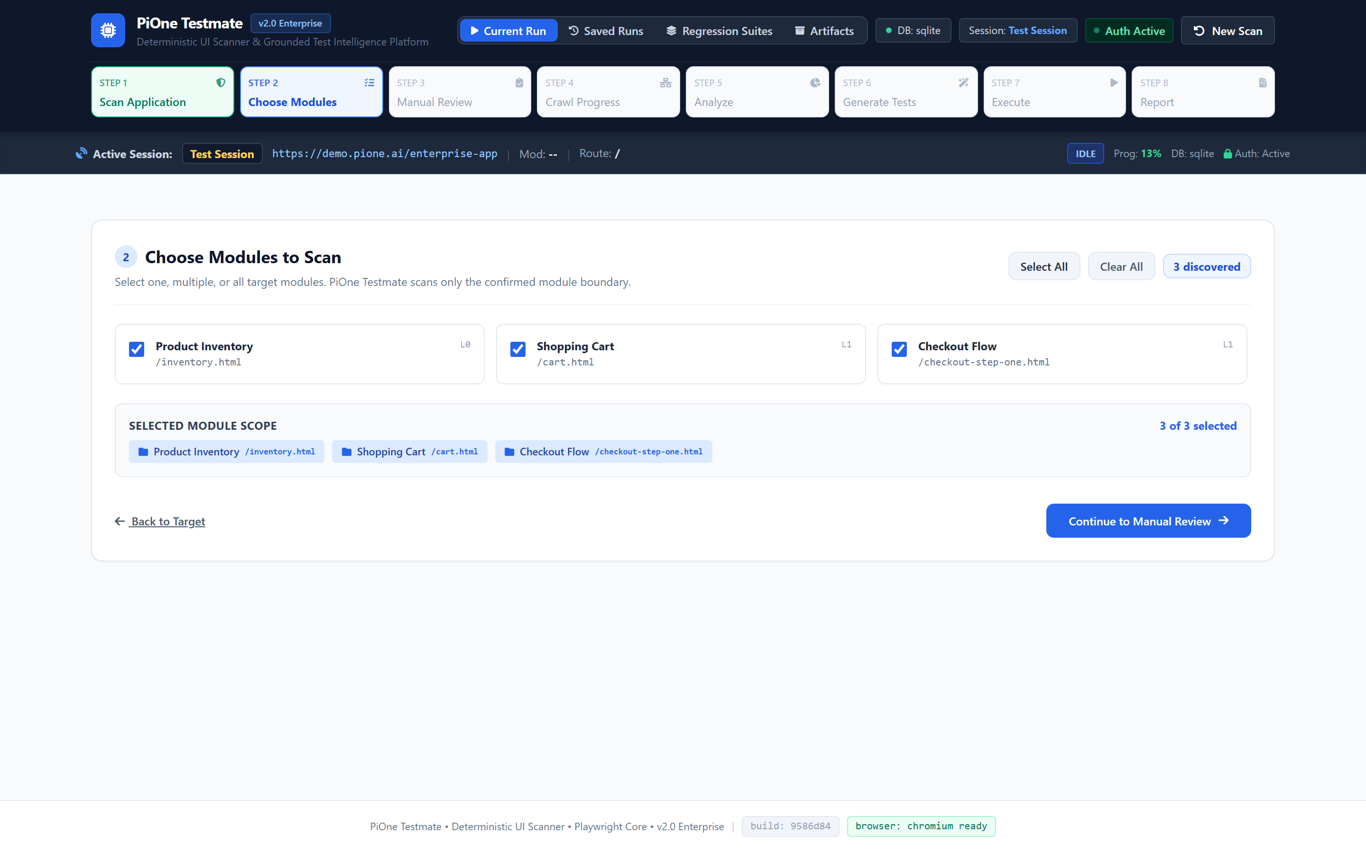
STEP 2: CHOOSE MODULES
Step 2: Autonomous Module Discovery & Boundary Selection
Automatic Navigation Mapping without Crawling Noise
✔ Passive Navigation Detection: Automatically extracts top navigation bars, sidebars, and functional modules.
✔ Granular Scope Selection: Select single, multiple, or all modules (e.g. Inventory and Cart, excluding Admin).
✔ Dynamic Selection Chips: Real-time visual feedback on selected application boundaries with instant removal.
✔ Zero Traversal Overrun: Unselected modules and external links are strictly excluded from subsequent crawling.
🛡 Enterprise Guarantee: Scans only what you select; zero wasted crawling cycles.
LIVE PRODUCT CAPTURE: STEP 2 DASHBOARD: DISCOVERED APPLICATION MODULES & SCOPE CHECKBOXES

Slide 6
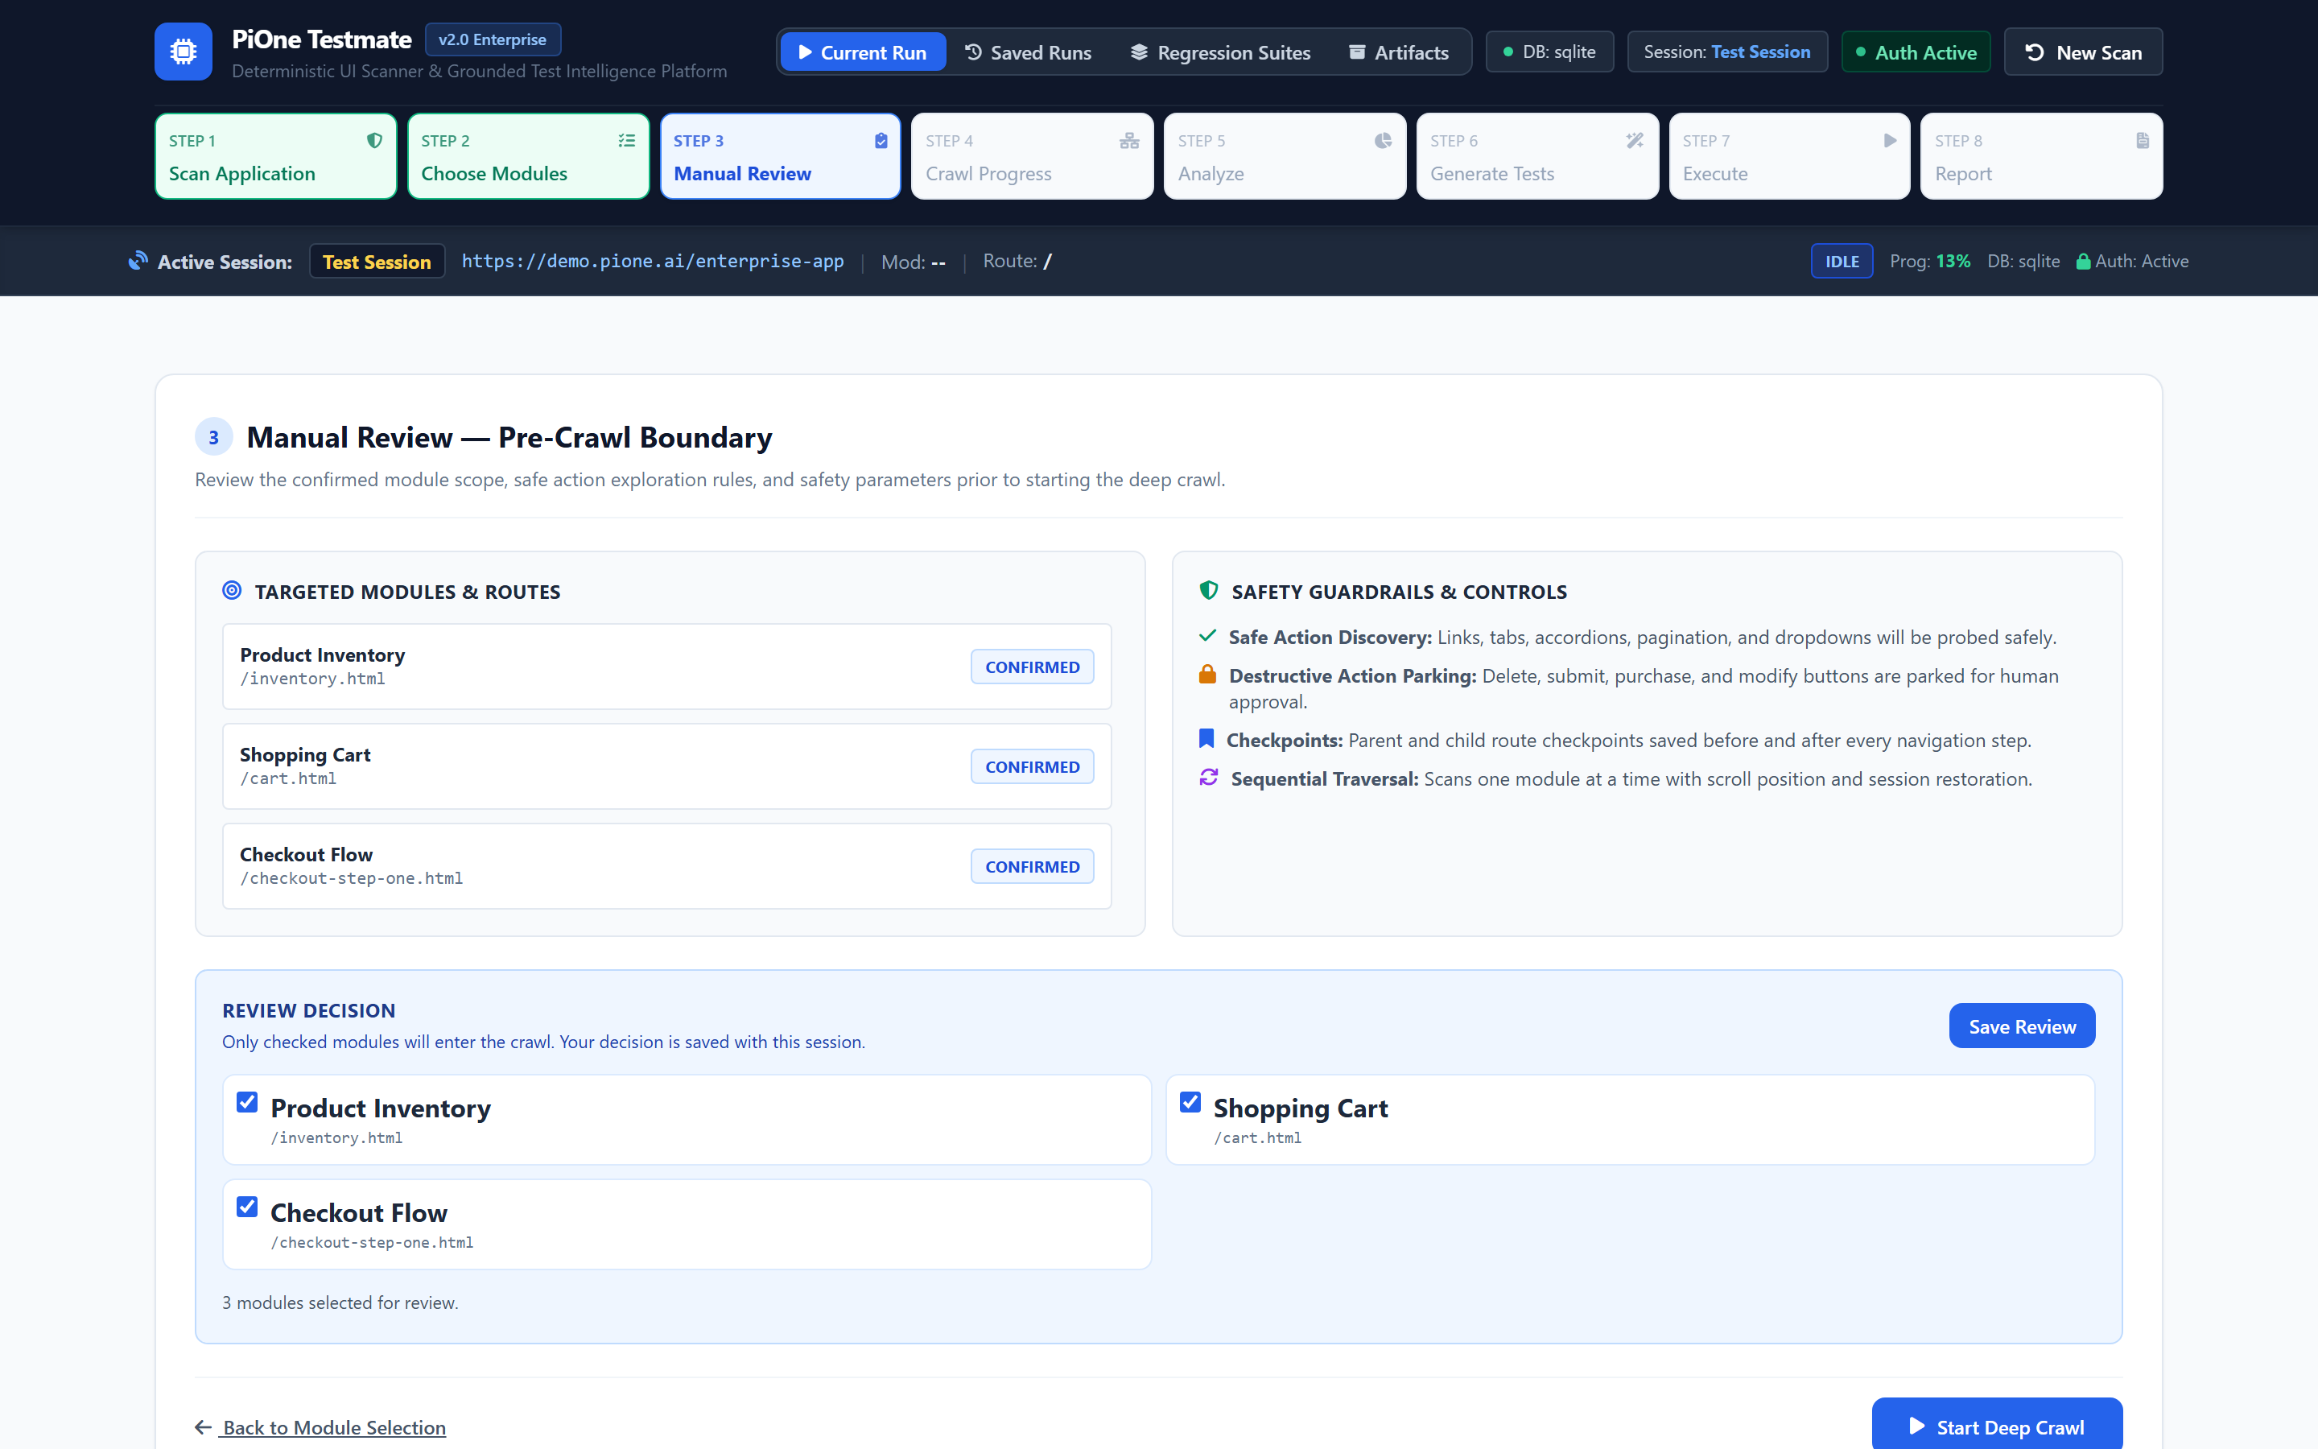
STEP 3: MANUAL REVIEW
Step 3: Human-in-the-Loop Safety Governance
Pre-Crawl Safety Checkpoint & Traversal Verification
✔ Governance Gate: Provides explicit human review of confirmed module scopes prior to launching Playwright.
✔ Destructive Action Policy Preview: Outlines how mutations, deletes, and checkouts will be safely diverted.
✔ Sequential Traversal Assurance: Enforces module-by-module exploration with scroll and state restoration.
✔ Durable Checkpoint Initialization: Initializes atomic on-disk recovery checkpoints before scanning starts.
🛡 Enterprise Guarantee: No automated crawler launches without explicit operator authorization.
LIVE PRODUCT CAPTURE: STEP 3 DASHBOARD: PRE-CRAWL SCOPE CONFIRMATION & SAFETY GUARDRAILS

Slide 7
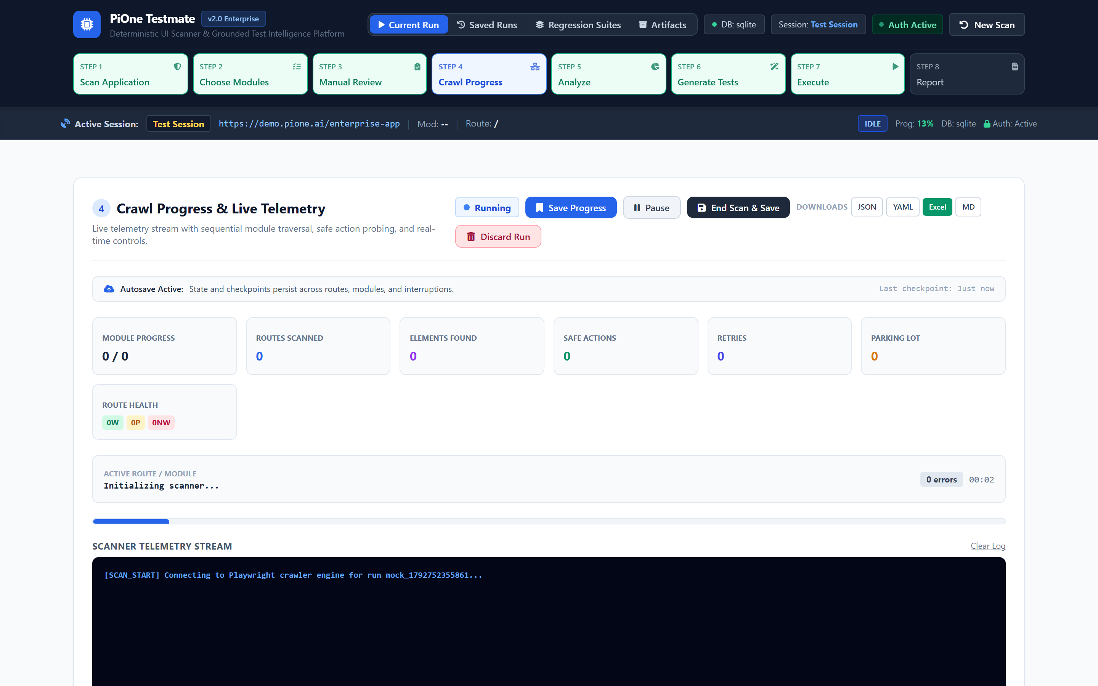
STEP 4: CRAWL PROGRESS
Step 4: Deep Crawling & Live Telemetry Stream
Real-Time Exploration with Deep Scrolling & Full Telemetry
✔ Viewport Deep Scanning: Explores document viewports and nested scrollable containers for lazy-loaded items.
✔ Menu Overlay Probing: Discovers flyouts and dropdowns, restoring page state cleanly via the Escape key.
✔ Live Telemetry Stream: Real-time gauges for module completion, route progression, and discovered elements.
✔ Interactive Scan Controls: Real-time Pause, Resume, End & Save, and Discard controls.
🛡 Enterprise Guarantee: Destructive buttons parked with 100% zero-click safety.
LIVE PRODUCT CAPTURE: STEP 4 DASHBOARD: LIVE MODULE/ROUTE PROGRESS GAUGES & INTERACTIVE CONTROLS

Slide 8
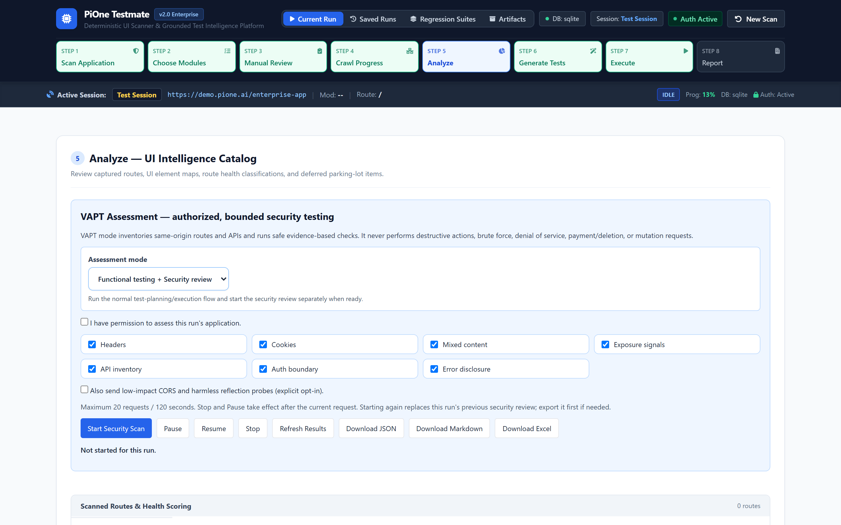
STEP 5: ANALYZE
Step 5: UI Intelligence Catalog & Route Health Scoring
12-Attribute Element Fingerprinting & Route Quality Scoring
✔ Route Health Scoring: Classifies routes as WORKING (>=70), PARTIAL (40-69), or NON-WORKING (<40).
✔ 12-Attribute Fingerprinting: Registers Role, ARIA, Text, ID, Name, TestIDs, CSS, XPath, and Coordinates.
✔ Hierarchical Selector Confidence: Resolves elements using Role > ARIA > ID > Text > CSS > XPath.
✔ Destructive Parking Lot Review: Inspects all blocked actions with screenshot evidence and selector signatures.
🛡 Enterprise Guarantee: Zero flaky locators; tests survive UI redesigns and CSS refactors.
LIVE PRODUCT CAPTURE: STEP 5 DASHBOARD: ROUTE HEALTH SCORING CARDS & SCANNED ROUTES TABLE

Slide 9
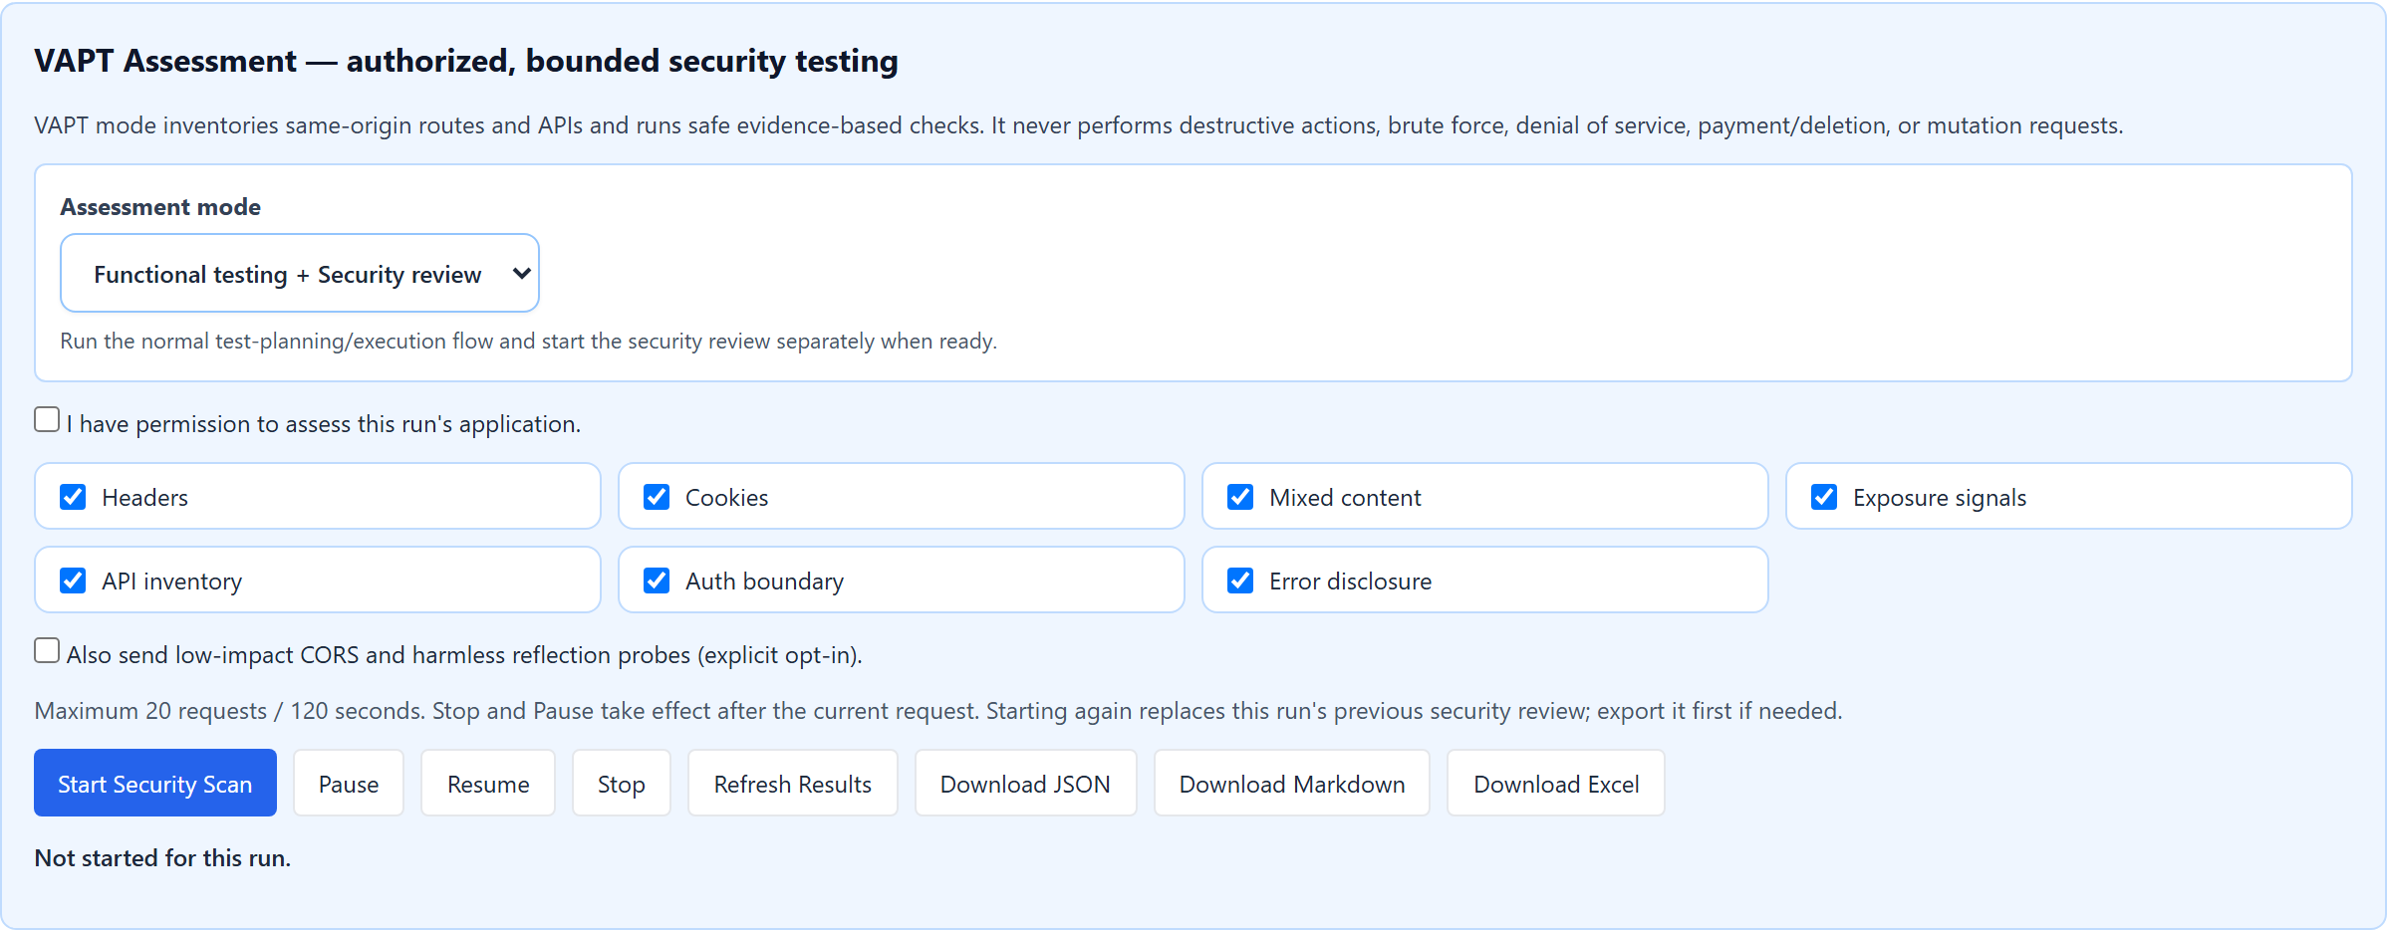
STEP 6: SECURITY REVIEW
Step 6: Safe Passive DAST & OWASP Top 10 (2021) Mapping
Authorized, Passive Security Hygiene Assessment
✔ OWASP Top 10 (2021) Mapping: Categorizes findings into A01 Broken Access, A02 Crypto, A05 Misconfig, etc.
✔ Security Headers & Cookies: Checks CSP, HSTS, nosniff, Referrer-Policy, HttpOnly, Secure, and SameSite.
✔ CORS & Exposure Signals: Flags wildcard CORS with credentials, exposed JWTs, API keys, and DB URIs.
✔ Zero Destructive Actions: Non-intrusive GET requests paced at 1 req/sec; zero brute force or fuzzing.
🛡 Enterprise Guarantee: Multi-format exports in JSON, Markdown, and Excel (.xlsx).
LIVE PRODUCT CAPTURE: STEP 6 SECURITY PANEL: SEVERITY CARDS, FILTERABLE FINDINGS & EXPORT CONTROLS

Slide 10
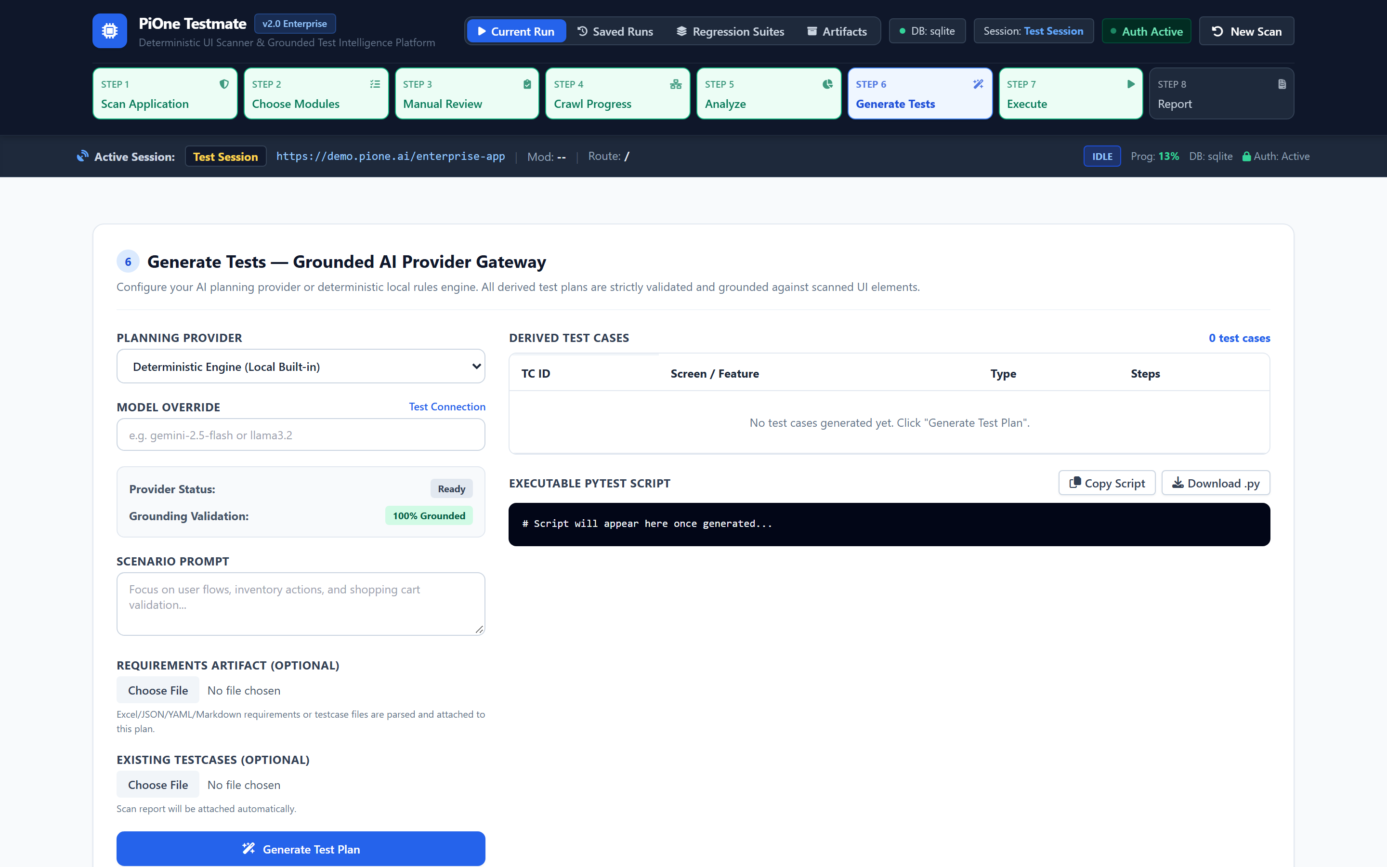
STEP 7: GENERATE TESTS
Step 7: Grounded Multi-Provider AI Test Planning
Neutral AI Gateway with Verified Element Grounding
✔ Multi-Provider Freedom: Choose Offline Deterministic, Ollama (Local), Google Gemini, Claude, or OpenAI.
✔ 100% Grounded Test Steps: Every generated step binds strictly to a verified element ID from Step 5.
✔ Requirement Document Ingestion: Upload PRDs, user stories (.txt, .md, .csv) to guide test scenario generation.
✔ Zero Selector Hallucination: Unverified locators are rejected by the normalizer before execution.
🛡 Enterprise Guarantee: Synthesizes complete, executable Pytest scripts automatically.
LIVE PRODUCT CAPTURE: STEP 7 DASHBOARD: AI PROVIDER SELECTION, CONTEXT INGESTION & GENERATED PLAN

Slide 11
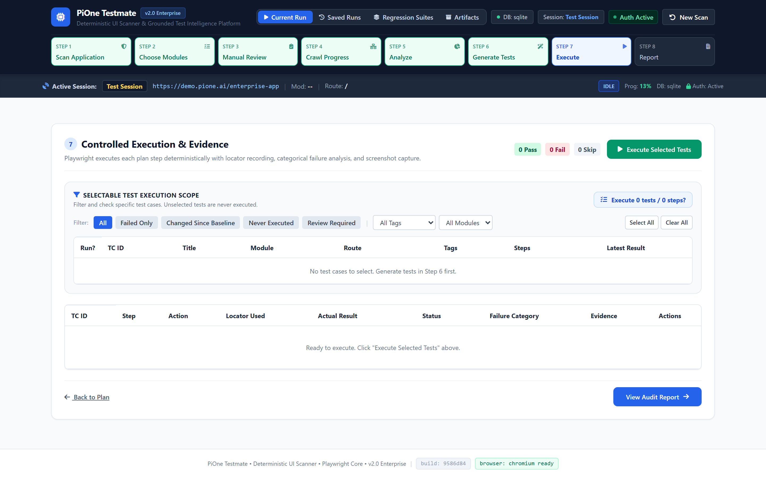
STEP 8: EXECUTE TESTS
Step 8: Controlled Execution & Per-Step Screenshot Evidence
Audit-Grade Test Execution with Full Diagnostic Telemetry
✔ Playwright Test Driver: Executes real browser navigation and assertions with restored authentication state.
✔ Per-Step Screenshots: Automatically captures full-resolution PNG images for every single action.
✔ Inline Lightbox Evidence: Click any test step thumbnail to inspect evidence directly in the dashboard.
✔ Single-Step Rerun: Fast troubleshooting of individual steps without re-executing entire suites.
🛡 Enterprise Guarantee: Exact locator telemetry and console/network failure capture.
LIVE PRODUCT CAPTURE: STEP 8 DASHBOARD: TEST STEP EXECUTION OUTCOMES & EVIDENCE THUMBNAILS

Slide 12
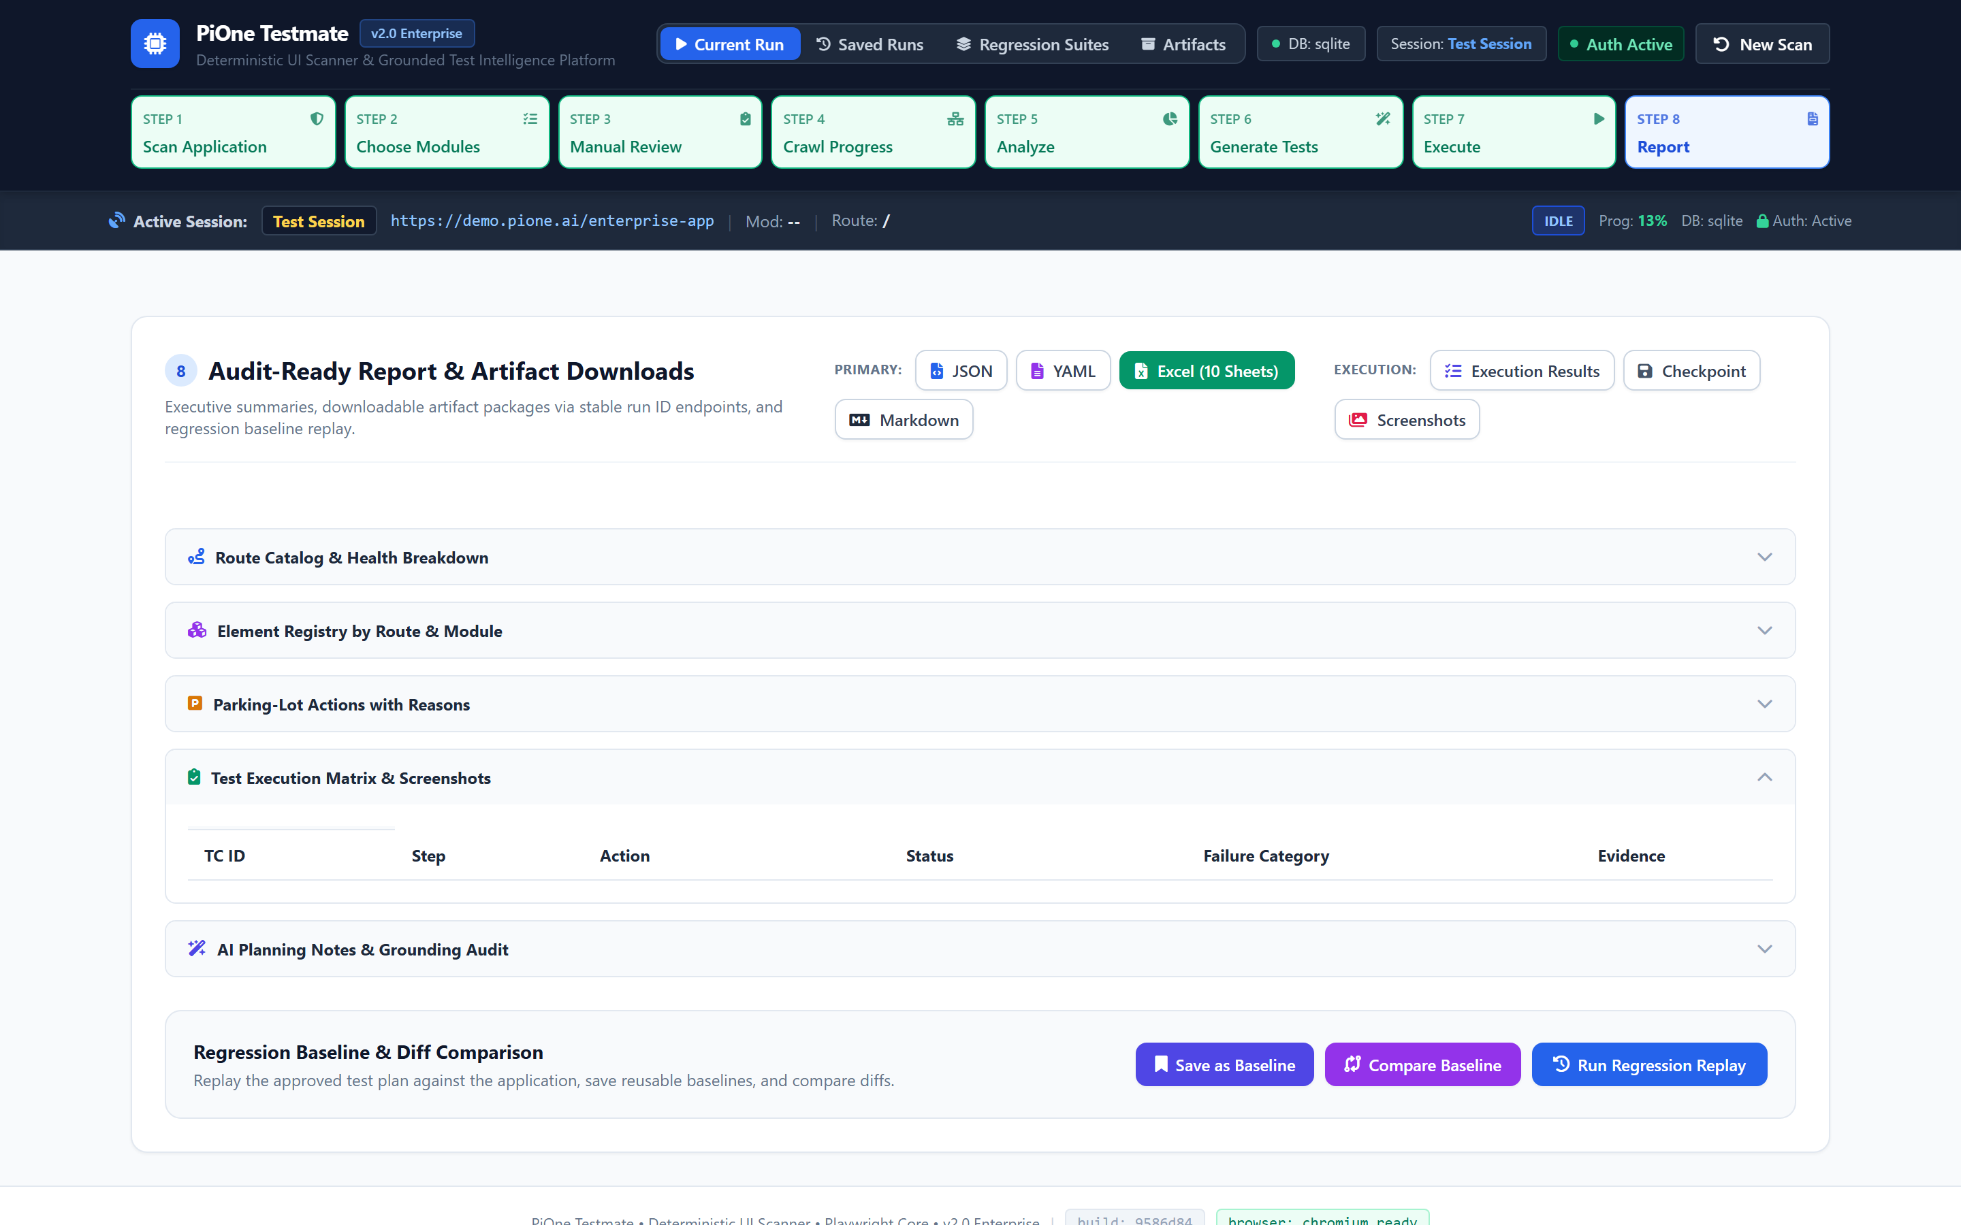
STEP 9: AUDIT REPORTS
Step 9: Standard 10-Sheet Enterprise Audit-Ready Workbook
Complete Transparency & Multi-Format Audit Artifacts
✔ 10-Sheet Excel Architecture: working_routes, partial_routes, non_working_routes, menu_hierarchy, element_map, parking_lot_actions, scan_events, test_cases, execution_results, coverage_gaps.
✔ Formula Injection Sanitization: Cleans cell values to prevent spreadsheet injection vulnerabilities.
✔ Multi-Format Packages: Download JSON catalog, YAML schema, Markdown summary, and Screenshots ZIP.
✔ Reusable Baselines: Save current scan state as a named baseline for regression diff comparisons.
🛡 Enterprise Guarantee: Satisfies both technical QA and enterprise regulatory compliance.
LIVE PRODUCT CAPTURE: STEP 9 DASHBOARD: GROUPED REPORT DOWNLOADS & BASELINE MANAGEMENT

Slide 13
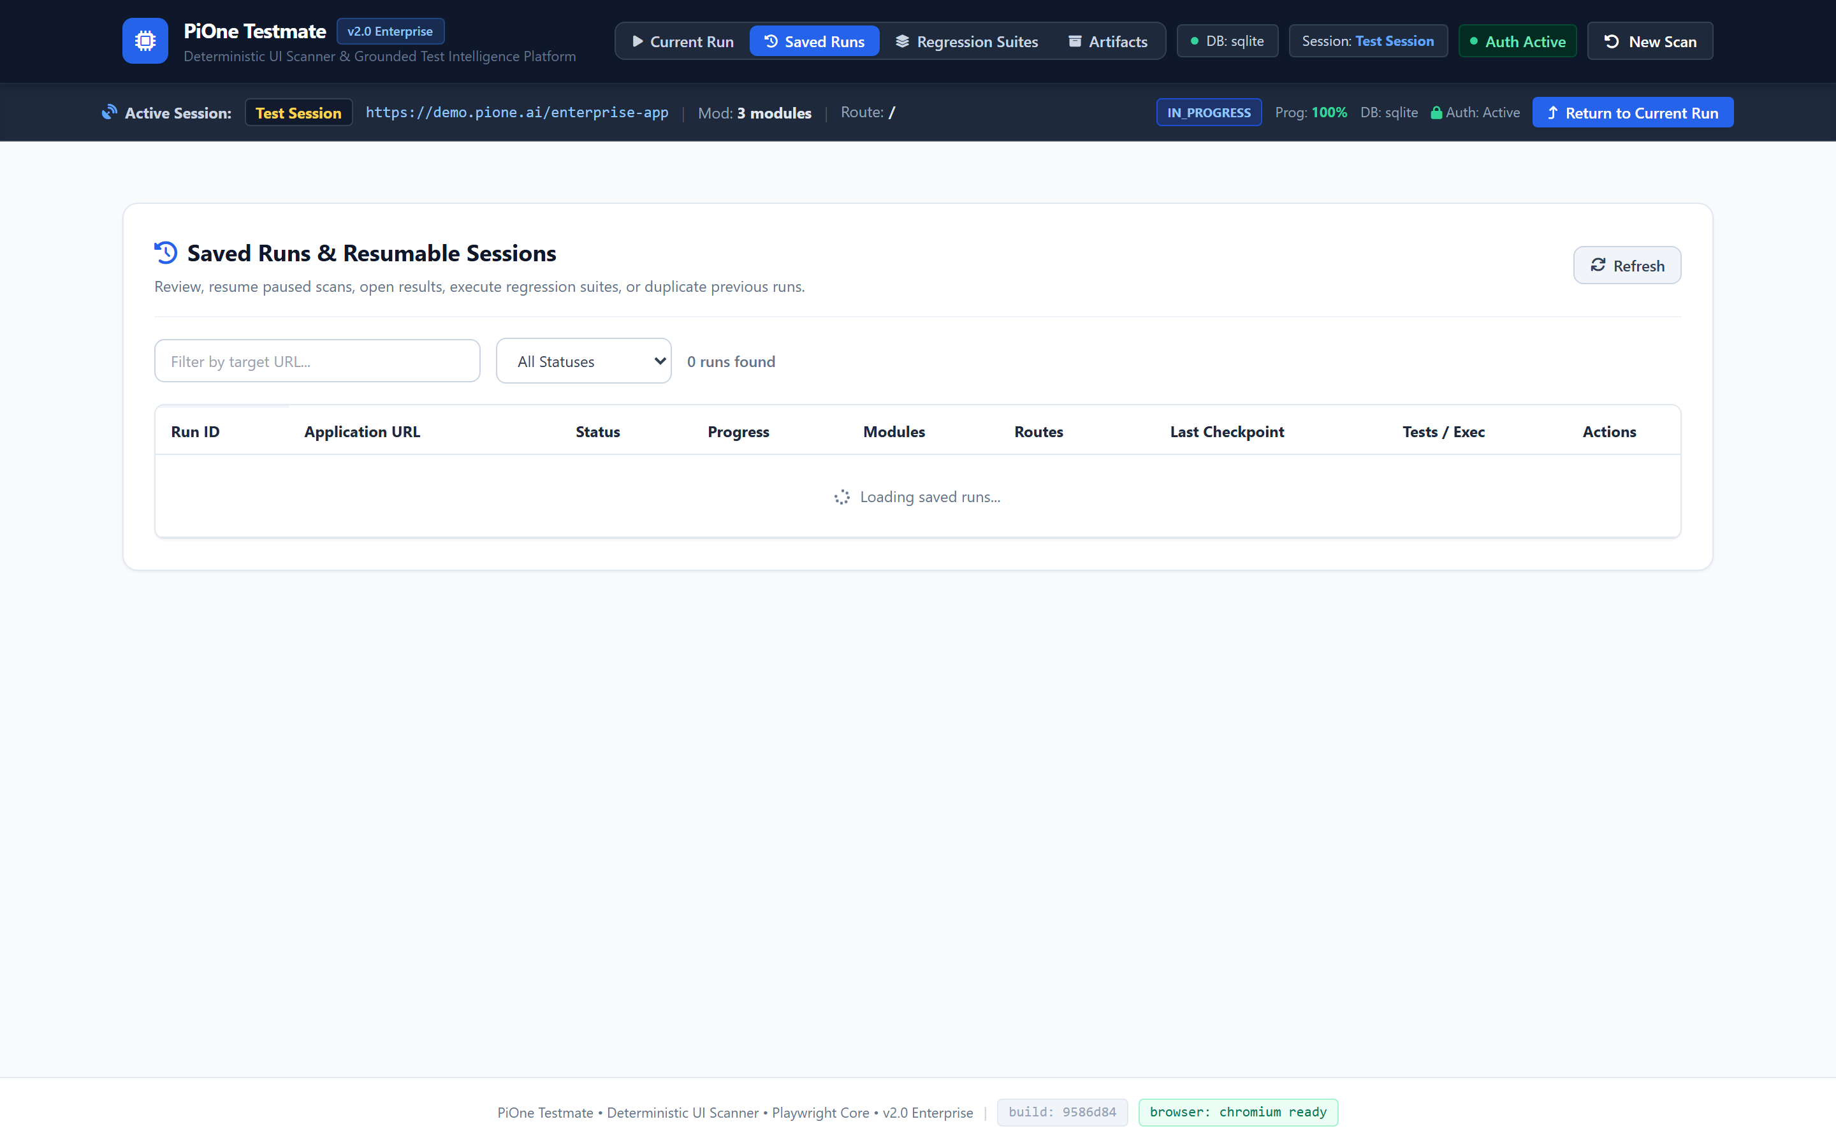
PLATFORM MANAGEMENT: SAVED RUNS
Enterprise Resilience: Saved Runs & Checkpoint Recovery
Durable SQLite / PostgreSQL Persistence with Zero Data Loss
✔ Historical Runs Catalog: Displays target URL, run status, progress %, module counts, and timestamps.
✔ Instant Checkpoint Resumption: Reconnect to interrupted or paused crawls and resume without data loss.
✔ Run Duplication & Archiving: Clone previous run parameters into a fresh run or archive completed runs.
✔ In-Place Session Renewal: /session/refresh re-authenticates expired sessions without losing run context.
🛡 Enterprise Guarantee: Eliminates the multi-hour test run crash problem completely.
LIVE PRODUCT CAPTURE: SAVED RUNS MANAGEMENT VIEW: HISTORICAL SCANS, METRICS & ACTIONS

Slide 14
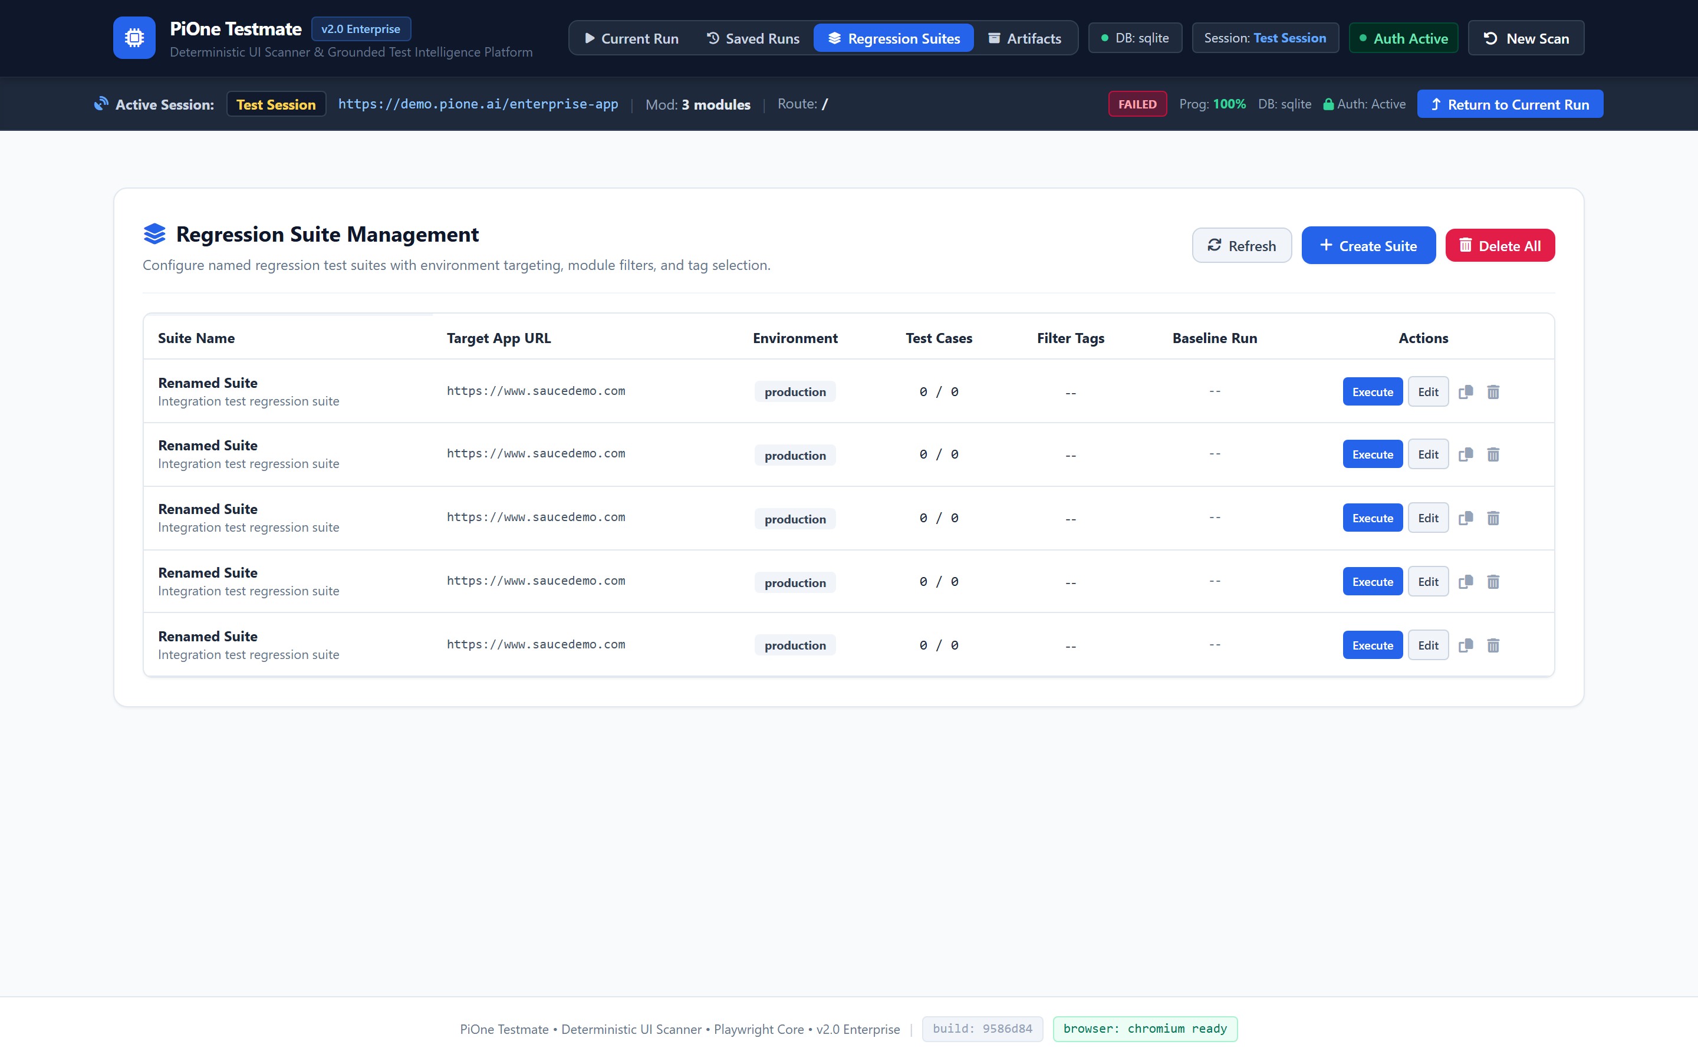
PLATFORM MANAGEMENT: REGRESSION SUITES
Continuous Regression: Named Suites & Replay Diffing
Selectable Test Execution & Automated Regression Diffing
✔ Named Regression Suites: Group tests by functional module, release tag, or test environment.
✔ Selectable Execution: Select specific test cases with an explicit confirmation modal before launching Playwright.
✔ Typed DELETE Safeguards: Bulk deletion requires typing 'DELETE', eliminating accidental data destruction.
✔ Baseline Regression Diffing: Calculates status transitions (PASSED -> FAILED), new routes, and selector drift.
🛡 Enterprise Guarantee: Instant visual diff reports for pull requests and CI/CD gates.
LIVE PRODUCT CAPTURE: REGRESSION SUITES VIEW: NAMED SUITES, FILTER PILLS & SELECTABLE EXECUTION

Slide 15
ENTERPRISE SUMMARY
Production Verification Benchmarks & Executive Summary
167 / 167
Pytest Suite Passing (100%)
0 Flaky Locators
12-Attribute Fingerprints
100% Safe
Zero Destructive Actions
10 Sheets
Audit-Ready Excel Workbooks
Executive Value Summary: Why Enterprises Choose PiOne Testmate
• 75% Reduction in Test Maintenance: 12-attribute resilient fingerprinting eliminates flaky selector breakdowns.
• Zero-Risk Safety Architecture: Parking lot action segregation and SSRF IP-level guards protect production data.
• Session & State Resiliency: In-place session refresh (/session/refresh) and atomic checkpoints guarantee test completion.
• Neutral AI Economics: Deploy with local open-weights models (Ollama), cloud APIs, or offline rules—zero vendor lock-in.
• Turnkey Compliance: Standard 10-sheet workbooks, step screenshots, and OWASP Top 10 security reviews satisfy technical and regulatory audits.

