Slide 1


ENTERPRISE QA CHALLENGE
The Enterprise Web QA Dilemma
Manual Screen Mapping Wastes Time
Teams spend 40% to 50% of test sprint cycles manually mapping routes and hand-authoring repetitive locators.
Fragile Locators and Hallucinating Bots
Minor frontend changes break brittle CSS selectors, while unconstrained black-box AI tools invent non-existent UI elements.
PiOne Testmate bridges deterministic browser scanning with evidence-grounded AI intelligence.

Slide 2
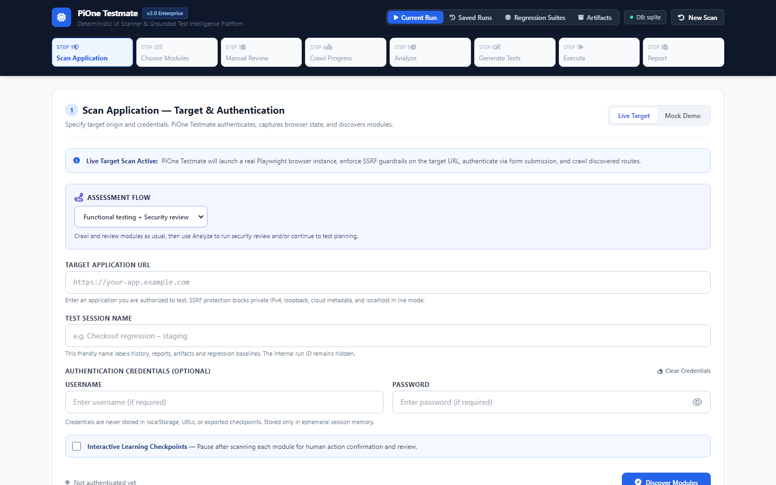
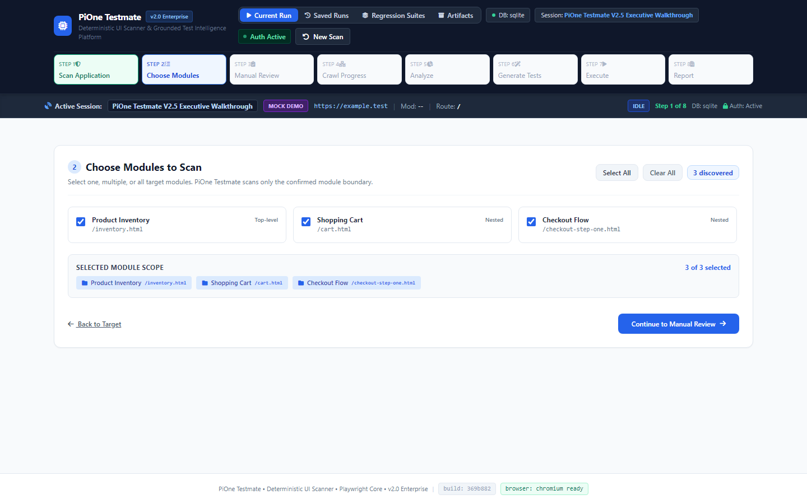
AUTONOMOUS DISCOVERY AND EVIDENCE CAPTURE
Scan Authorised Apps and Preserve Evidence
Playwright-Powered Bounded Traversal -- Strict SSRF Protection
Deterministic Exploration First:
- Discovers sidebars, top menus, and navigation trees
- 12-attribute DOM fingerprinting for every target
- Scope-locked to target origin with SSRF protection
- Preserves atomic RunContext and route graphs
AI Synthetic Presenter
PiOne Technical Briefing

Slide 3
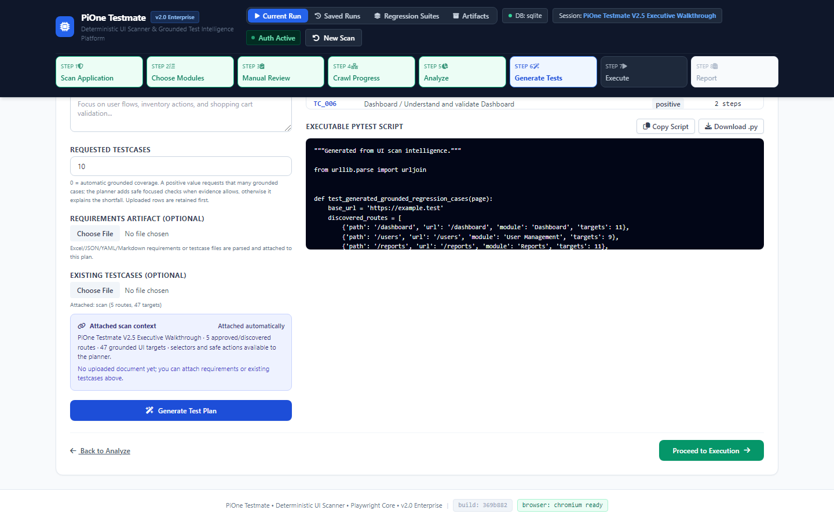
GROUNDED AI TEST PLANNING
100% DOM-Anchored Selectors
Zero Hallucinations -- Multi-Provider Neutral LLM Gateway
Zero Hallucination Guarantee:
- Every test step is anchored to real DOM evidence
- Role, CSS selector, and XPath fallback hierarchy
- Shortfall Protection Guard: Explains evidence bounds if fewer safe controls exist instead of inventing tests
- Supports Gemini, Claude, GPT-4o, and local Ollama
AI Synthetic Presenter
PiOne Technical Briefing
[CONFIRMED] 100% GROUNDED IN REAL DOM CONTROLS

Slide 4
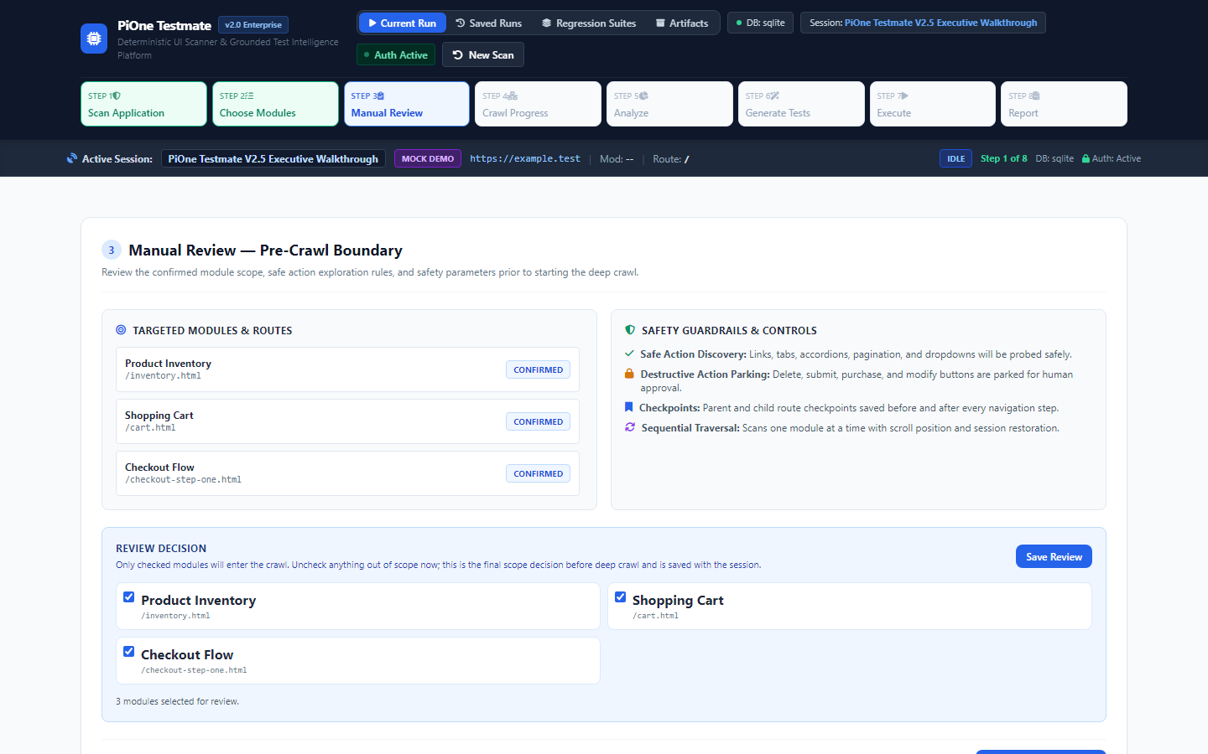
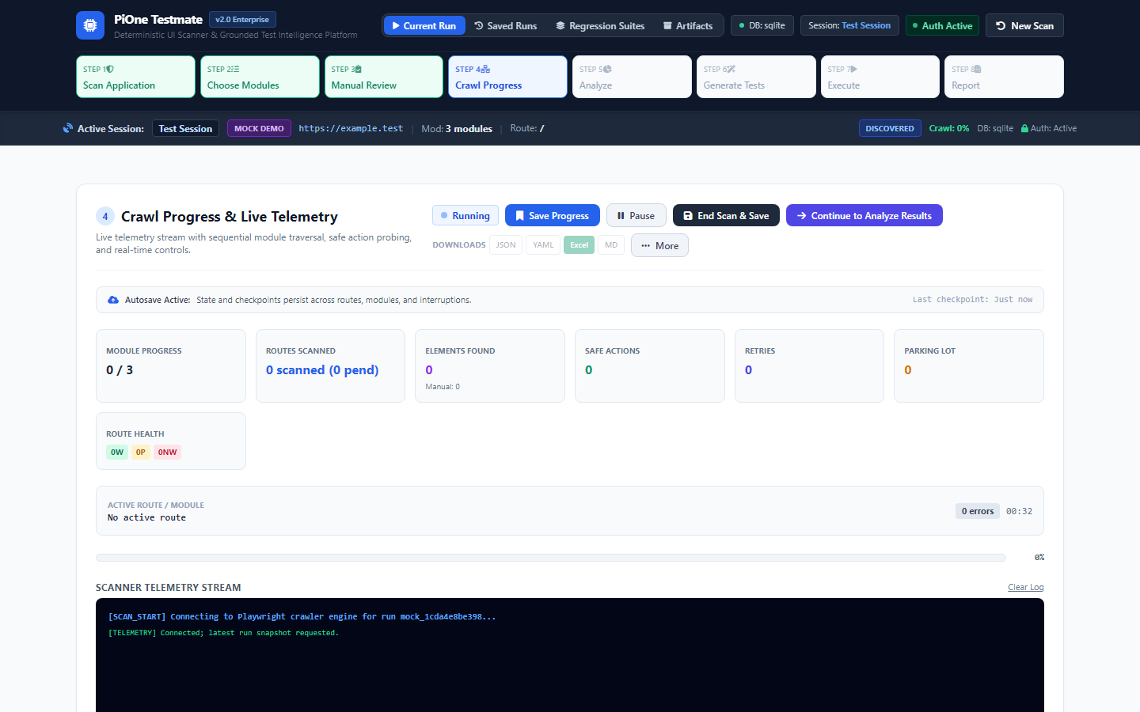
HUMAN-IN-THE-LOOP GOVERNANCE
Interactive Checkpoints and Safety Enclaves
ActionClassifier Quarantines Risky Verbs -- Supervisory Veto Power
Safety and Supervised Control:
- Safety Parking Lot quarantines destructive verbs (delete, pay, purge, cancel, submit)
- Interactive browser overlays inject checkpoint banner
- Testers select Confirm and Continue or End Scan
- Real-time route graph records manual guidance
AI Synthetic Presenter
PiOne Technical Briefing

Slide 5
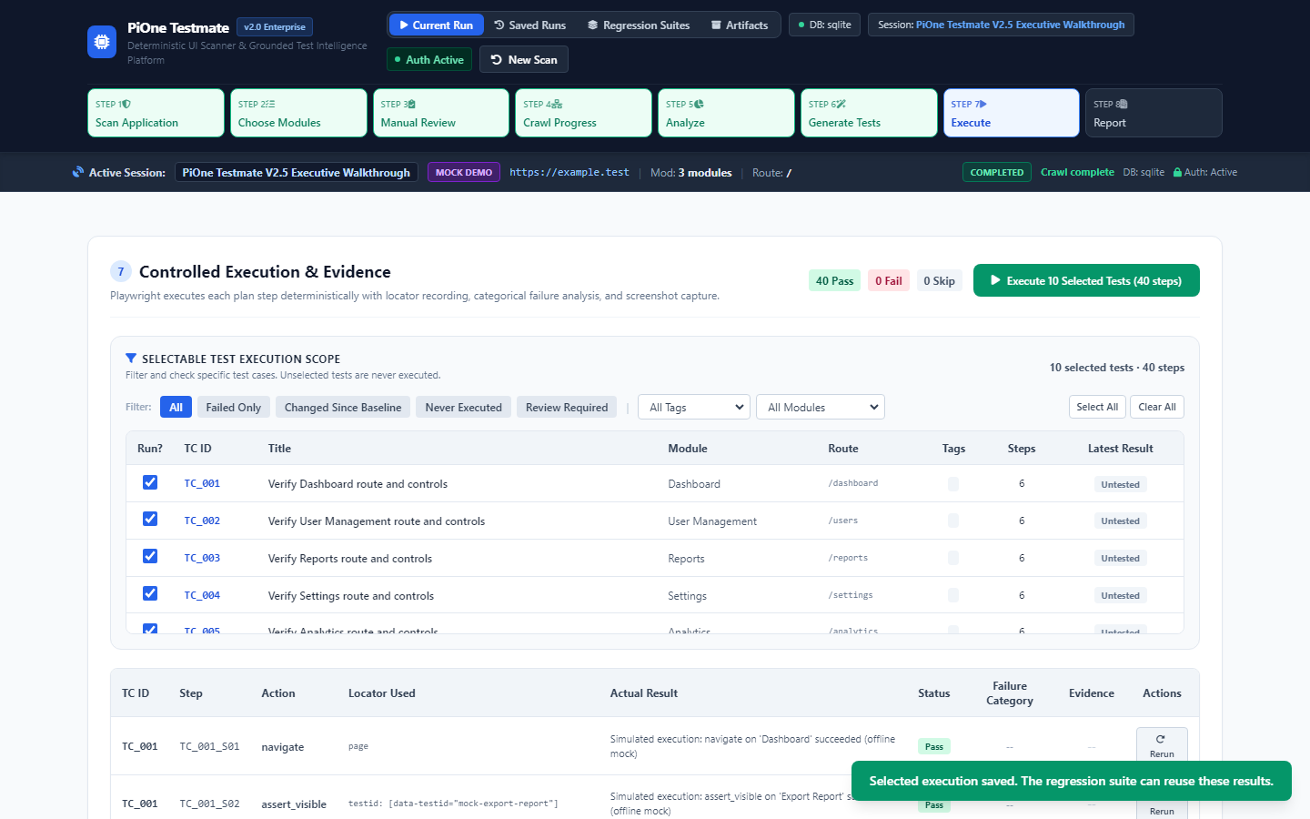
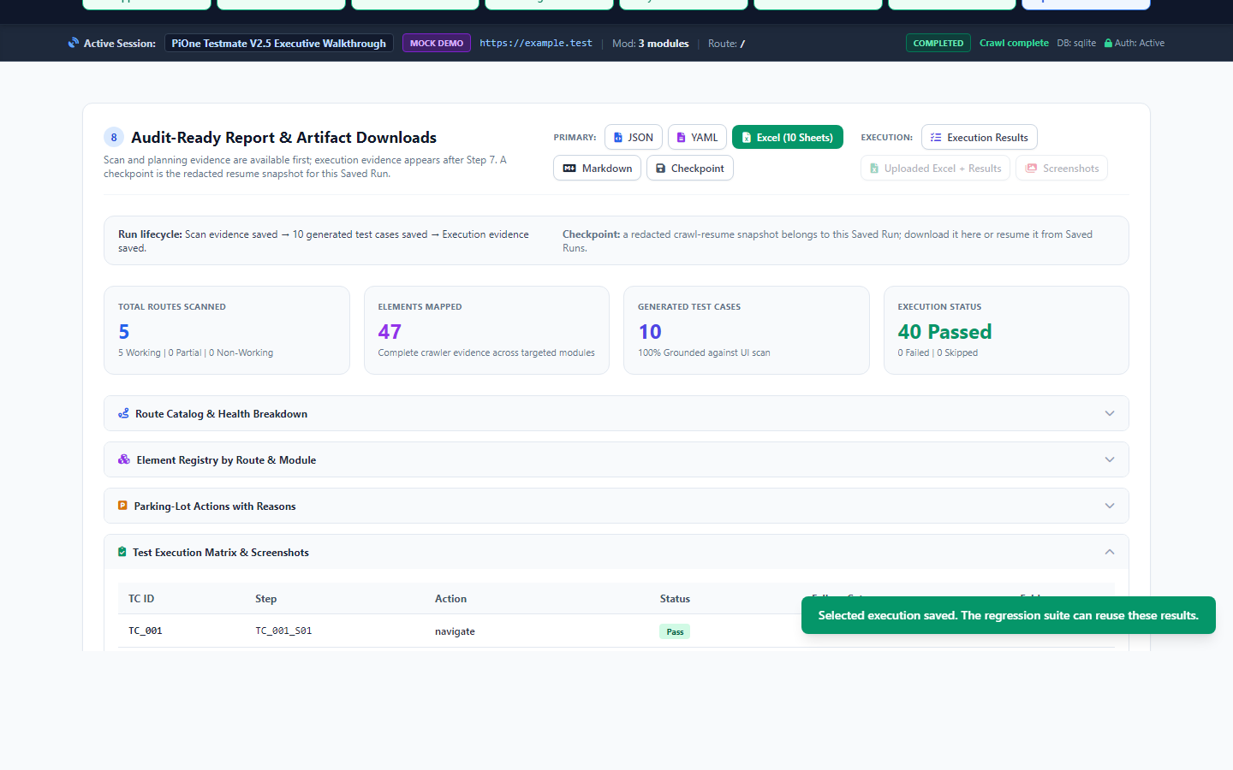
CONTROLLED EXECUTION AND AUDIT REPORTING
Live Assertions and 10-Sheet Workbook
Per-Step Forensic Screenshots -- Tamper-Evident Multi-Format Exports
Verified Execution and Compliance:
- 82/82 Steps Passed in Rendered Execution (100% Pass)
- Full-fidelity screenshot captured per assertion
- 10-Sheet audit Excel workbook: working routes, element map, parking lot, execution log
- Golden Baseline freezing for regression comparison
AI Synthetic Presenter
PiOne Technical Briefing

Slide 6

THE EVIDENCE-FIRST QA PLATFORM
PiOne Testmate
Evidence-first AI QA for controlled, explainable test automation.
Enterprise Assurance Capabilities:
- Autonomous Discovery Without Manual Scripts
- Grounded Test Planning Without Hallucinations
- Human-in-the-Loop Checkpoints With Safety Enclaves
- SSRF Protection and Parking Lot Safety
- 10-Sheet Audit-Ready Compliance Workbooks
- Transactional Persistence and Golden Baselines
Explore the Documentation Hub and Live Demo
PiOne Technologies LLP -- V2 Enterprise Baseline

