Slide 1
2D Image Processing & Augmented Reality Winter Semester 2019/2020 Survey on Face Tracking with Deep Learning
Vinay Balasubramanian
v_balasubr18@cs.uni-kl.de
Supervisor: Jilliam Diaz Barros

Slide 2
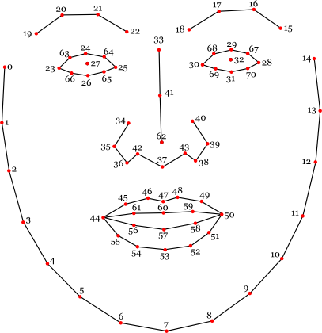
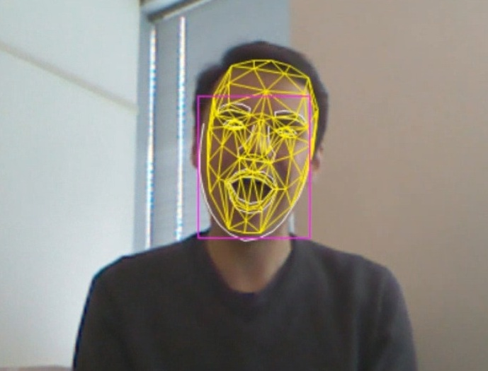
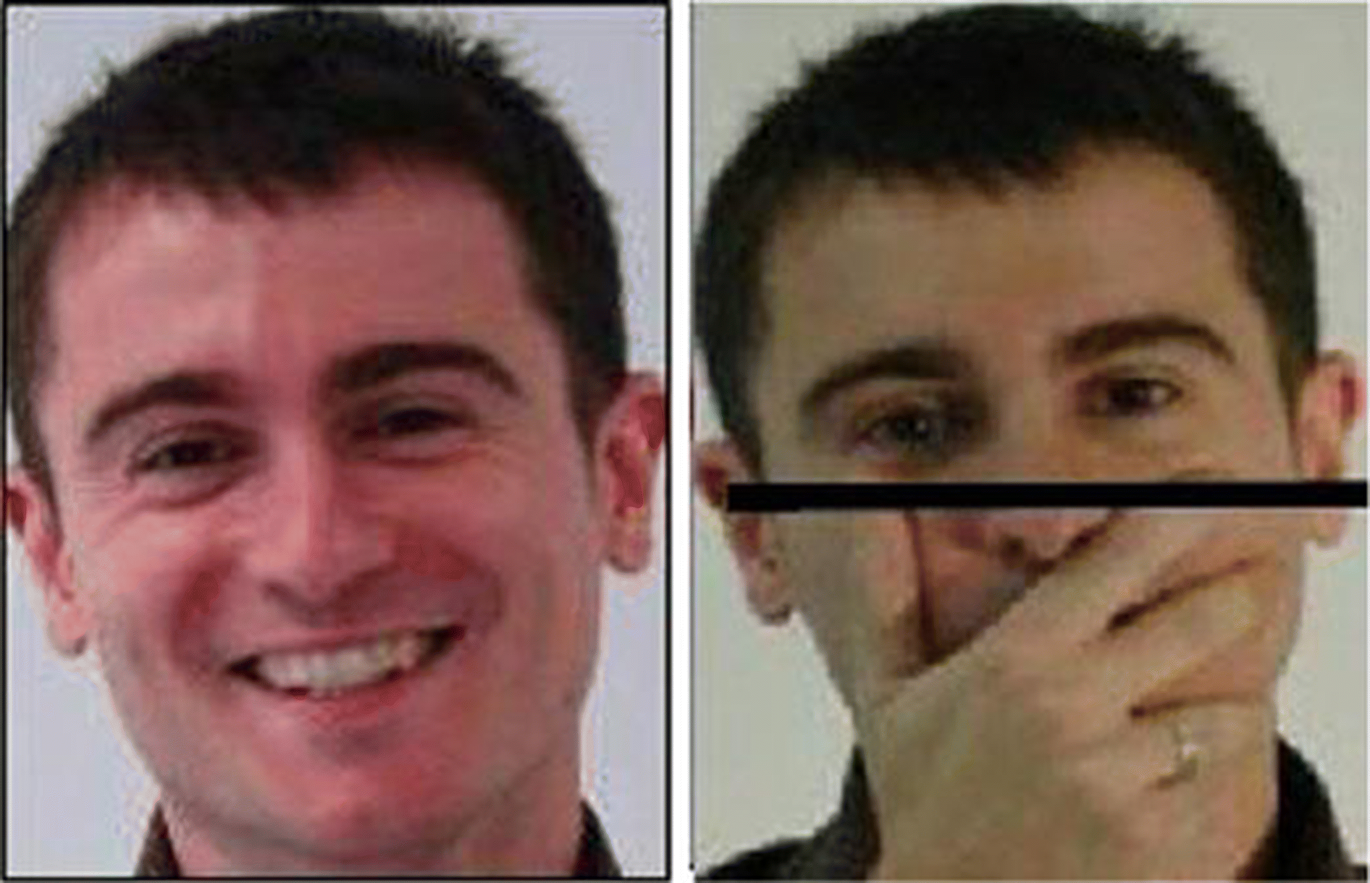
Outline
Face tracking is a computer vision task that involves tracking a specific number of landmarks on the face detected across all frames of a video.
Applications include Face analysis, Person identification, Activity recognition, Sentiment analysis, Face modeling etc.
It is a challenging problem as the videos are captured in unconstrained conditions which may include illumination variations, large head poses, occlusions, etc.

Slide 3
Outline
Image-based methods use models trained on still images in each frame.
Video-based methods make use of temporal information to predict facial landmarks in each frame.
Various approaches –
Regression-based methods
Video-based face alignment
Encoder-Decoder Networks

Slide 4
Recurrent Encoder-Decoder Network for Video-based Face Alignment
Temporal-variant features such as pose and expression are separated from Temportal-invariant features such as facial identity.
Employs recurrent learning at both spatial and temporal dimensions.
The network consists of 4 modules - Encoder-Decoder, Spatial recurrent learning, Temporal recurrent learning and Supervised identity disentangling.

Slide 5
Dynamic Facial Analysis: From Bayesian Filtering to Recurrent Neural Network
Improvises on previous approaches for dynamic facial analysis that use Kalman/Particle filters.
Bayesian filters require problem-specific design and tuning.
This RNN based method avoids tracker engineering by learning from data (large data).
CNN layers followed by recurrent layers as dense layers.
Uses FC-RNN to exploit generalization from a pre-trained CNN.

Slide 6
Dual-Agent Deep Reinforcement Learning for Deformable Face Tracking
Exploits the fact that bounding box tracking and landmark detection tasks are dependent. The accuracy of the latter depends on how good the former is.
The two tasks are modeled in a probabilistic manner by following a Bayesian model.
The architecture consists of a Tracking agent, Alignment agent and Communication channels between the agents.

Slide 7
Two-stream Transformer Networks for Video-based Face Alignment
Two stream deep learning method to capture spatial as well as temporal information.
Spatial stream captures information on still frames.
Temporal stream captures temporal consistency information across successive frames. It is followed by a RNN to model the sequential information over consecutive frames.
Finally, facial landmarks are determined by a weighted fusion of spatial and temporal streams.

Slide 8
Face Alignment Recurrent Neural Network
Recurrent regression based approach
Uses LSTM to exploit both spatial and temporal information.
Spatial – The predicted landmark location is used as basis for estimation in the next stage.
Temporal – The predicted landmark location is used as basis for estimation in the next frame.

Slide 9
Comparison metrics
Following are some of the metrics that will be used to compare the various methods in this survey :–
Dataset used for training (In the wild vs constrained)
Evaluation metrics
Number of landmarks tracked
Kind of landmarks retrieved (2D or 3D)
Robustness to large pose variations, illumination changes

Slide 10
Thank You

