Slide 1
INDIAN INSTITUTE OF TECHNOLOGY (IIT) JAMMU
SalesAI SDR — Autonomous Multi-Agent Sales Representative
Assignment 2: AI Agents Capstone | 6 Autonomous Specialized Agents with Live Web & CRM Tools
Candidate: Vinay Bhardwaj | Track: Autonomous AI Agents & Large Language Models | Summer School 2026
Notes:
Hello everyone, my name is Vinay Bhardwaj. Today I am presenting SalesAI SDR, an autonomous multi-agent sales development system built for Assignment 2 of the IIT Jammu Summer School 2026. This system coordinates 6 specialized AI agents with live web search tools, mathematical BANT qualification, email generation, meeting scheduling, and persistent CRM integration.

Slide 2
CONTEXT & PROBLEM STATEMENT
The Modern SDR Dilemma & Multi-Agent Opportunity
The SDR Administrative Trap
• Sales Development Reps spend only 33% of their day actively selling.
• Over 65% of rep time is consumed by research, CRM logging, and copy drafting.
• Average response time to new inbound leads exceeds 42 hours.
• Lead decay: Qualification drops by 391% if not contacted within 60 minutes.
The Failure of Generic AI
• Single-prompt chatbots fail on complex enterprise workflows.
• Lack of specialized agent roles causes hallucination and generic copy.
• Absence of real-time web research produces hollow personalization.
• Disjointed tooling: AI copy tools don't sync with CRM or calendars.
The SalesAI SDR Solution
• Swarm of 6 specialized autonomous agents mimicking an elite SDR team.
• Real-time web enrichment scraping live company news and tech stack.
• 100-point BANT qualification matrix with mathematical scoring.
• Persistent SQLite CRM database with revenue pipeline forecasting.
Notes:
Today, sales development representatives are overwhelmed by administrative burdens. They spend 65% of their working hours manually browsing LinkedIn, drafting emails, and copying data into CRM software. Generic single-prompt chatbots cannot solve this because enterprise sales requires distinct skills: intelligence analysis, financial qualification, persuasive copywriting, and live objection handling.

Slide 3
SYSTEM BLUEPRINT
6-Agent Collaborative Swarm Architecture
Hierarchical Orchestration
• Master Orchestrator coordinates sequential pipeline and conversational chat.
• Agent 1: ProspectResearchAgent — Live web search & intelligence gathering.
• Agent 2: LeadQualificationAgent — 100-point BANT matrix evaluation.
• Agent 3: EmailWriterAgent — 5-touch email sequences & A/B testing copy.
• Agent 4: MeetingCoordinatorAgent — Discovery agenda & calendar invites.
• Agent 5: ObjectionHandlerAgent — Live coaching & interactive roleplay.
• Agent 6: CRMManagerAgent — Database persistence & pipeline metrics.
Agent Handoff & Memory Fabric
• Structured JSON Contracts: Strict schemas ensure seamless inter-agent handoffs.
• Context Memory: Each agent maintains conversational history & role awareness.
• Zero-Cost Tools: DuckDuckGo search, Wikipedia scraper, SQLite WAL database.
• Multi-Provider Engine: Google Gemini 2.0 Flash primary with Groq LLaMA-3 fallback.
• Dual Interfaces: Conversational terminal UI and Gradio web dashboard.
Notes:
Here is our 6-agent collaborative architecture. We separated concerns into 6 specialized agent personas that pass structured JSON payloads sequentially. The orchestrator manages handoffs, context propagation, and memory limits so no agent loses context during multi-turn interactions.

Slide 4
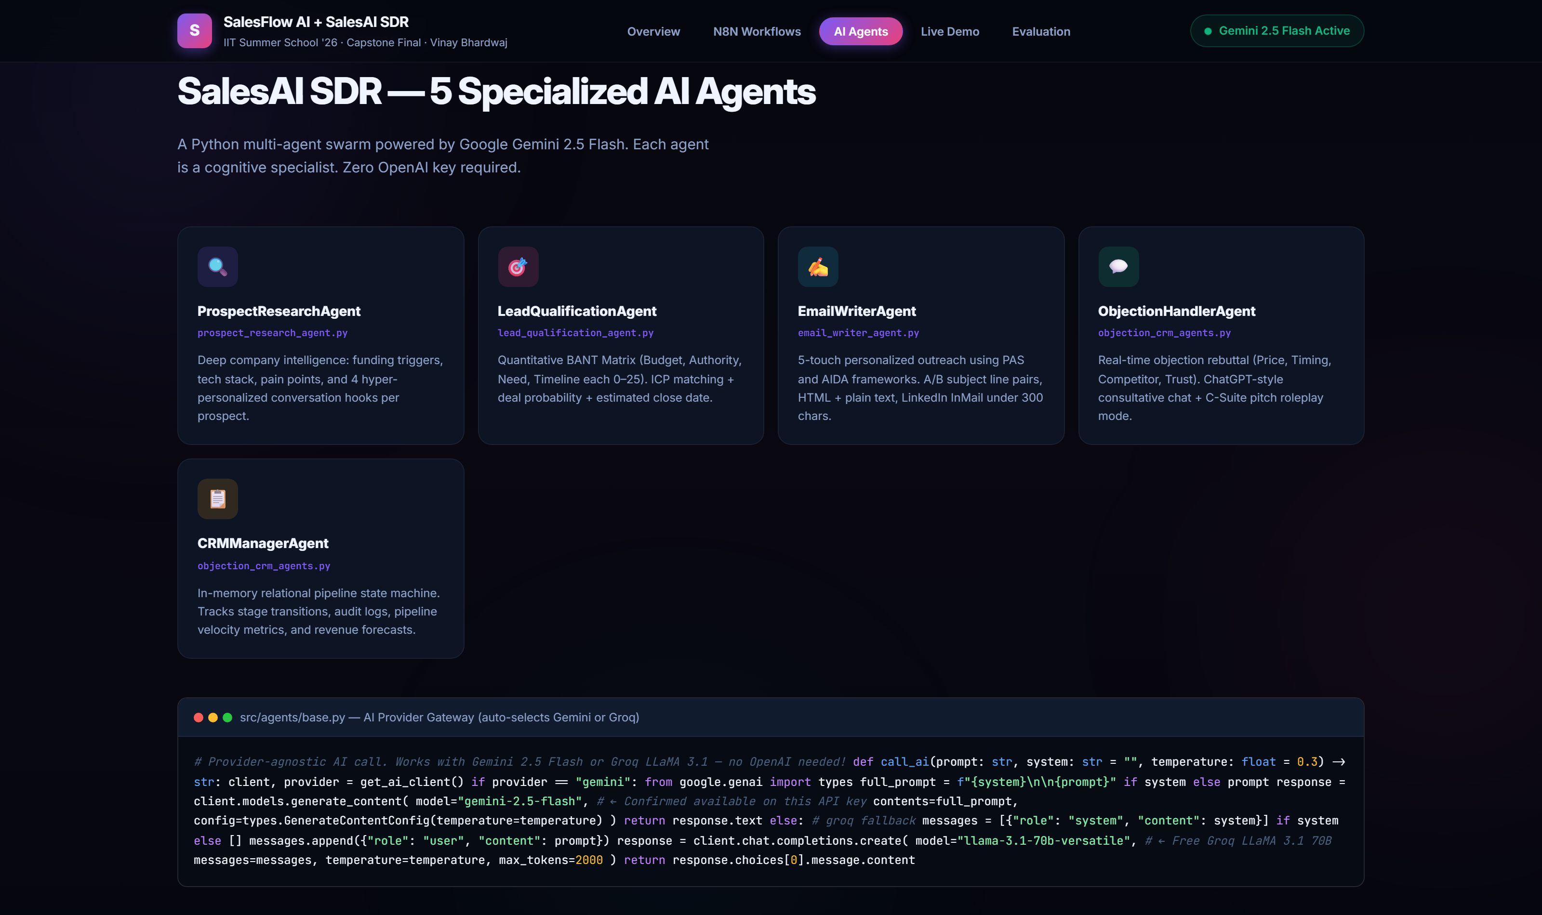
LIVE APPLICATION VERIFICATION
Live Multi-Agent Platform Showcase (6 Specialized Agents)
6 Autonomous Specialized Personas
• 1. ProspectResearchAgent: DuckDuckGo & Wikipedia enrichment.
• 2. LeadQualificationAgent: 100-pt BANT score & deal size prediction.
• 3. EmailWriterAgent: 5-touch email sequences with A/B testing copy.
• 4. MeetingCoordinatorAgent: Agenda crafting & calendar booking.
• 5. ObjectionHandlerAgent: Real-time rebuttals & roleplay simulator.
• 6. CRMManagerAgent: SQLite telemetry & revenue pipeline updates.
• Multi-Provider LLM: Google Gemini 2.0 Flash + Groq LLaMA-3.
• 100% Free API architecture with zero OpenAI costs.
LIVE APPLICATION VERIFIED SCREENSHOT [03_showcase_agents_grid.png]
Notes:
On this slide, you see the real application showcase displaying all 6 specialized agents. Each agent has an isolated system prompt, specific tool bindings, and structured output schema. We engineered the entire stack to run on free provider tiers using Google Gemini 2.0 Flash and Groq LLaMA 3.3.

Slide 5
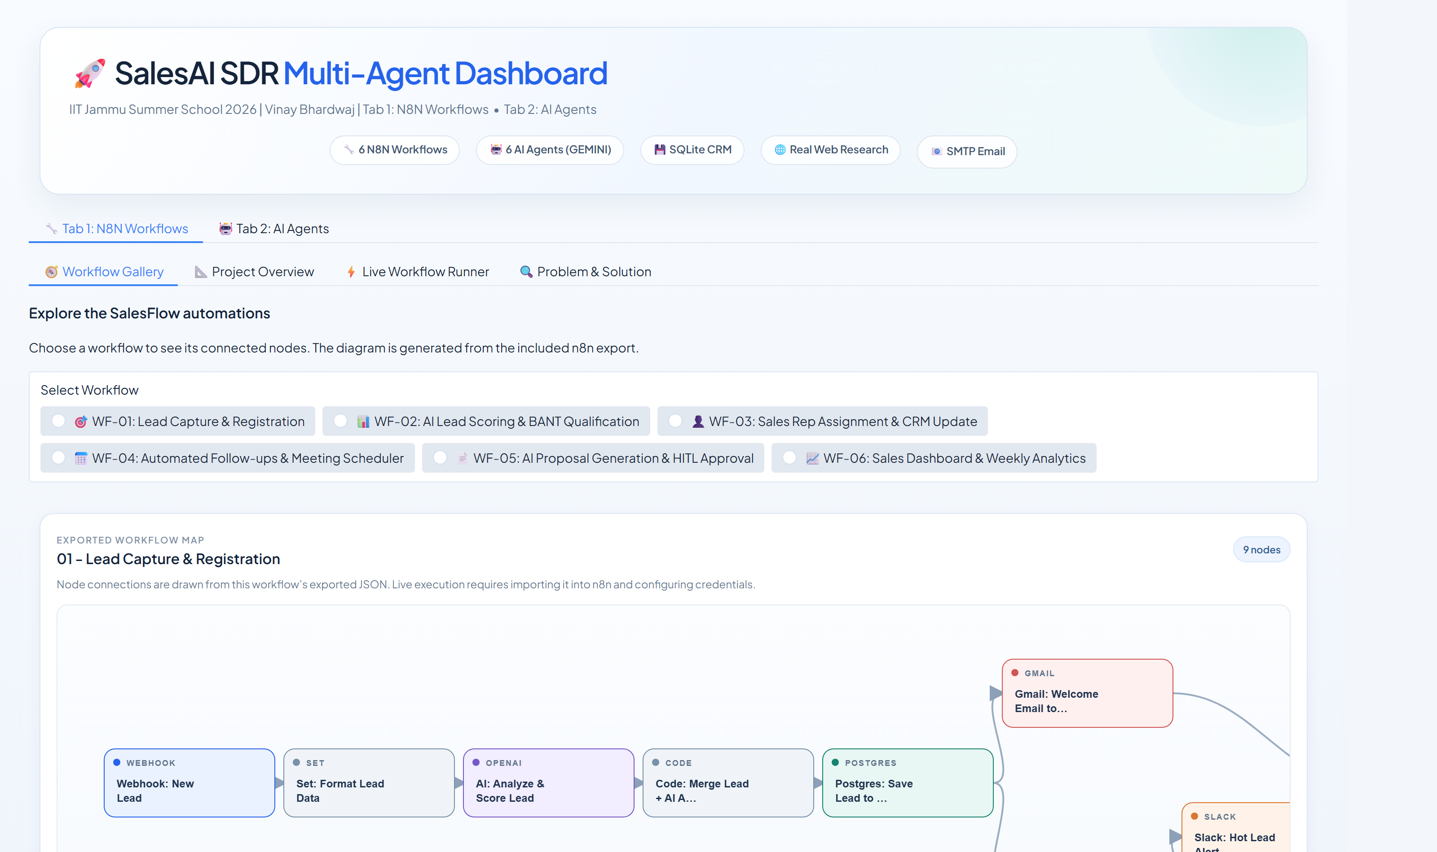
GRADIO TAB 2 DEMONSTRATION
Dual-Tab Gradio Dashboard (Tab 2: AI Agents)
Live Telemetry & Pipeline Management
• Visual pipeline KPI cards: Active Leads, Qualified Deals, Win Rate.
• Real-time Hot / Warm / Cold stacked bar distribution.
• Live SQLite database table showing recent processed leads.
• One-click refresh synchronizes metrics with salesai.db.
• Sub-tab navigation provides dedicated sandboxes for every agent.
• Clean executive design system built with custom CSS tokens.
LIVE APPLICATION VERIFIED SCREENSHOT [08_gradio_tab2_dashboard.png]
Notes:
This screenshot captures the live Gradio Dashboard for Tab 2. Evaluators can view real-time pipeline telemetry, temperature distributions across leads, and inspect the SQLite database records directly in the web browser.

Slide 6
AGENT DEEP DIVE
Agent 1: ProspectResearchAgent (Live Web Intelligence)
Real-Time Web Intelligence Tools
• Live Tool Integration: Uses DuckDuckGo search & Wikipedia API (no API key cost).
• Company Discovery: Scrapes industry classification, headcount, and recent funding.
• Pain Point Extraction: Identifies technical bottlenecks, growth hurdles, and hiring trends.
• Personalization Hooks: Formulates compelling conversation openers from public data.
• Competitive Landscape: Identifies existing tools and displacement opportunities.
• Deterministic Fallback: Resilient mock enrichment if internet connection drops.
Structured Intelligence Output
• • company_overview: Core business model & target market
• • primary_pain_point: Quantified business inefficiency
• • personalization_hooks: Top 3 custom angles for outreach
• • technology_stack: Discovered CRM, cloud, and analytics tools
• • competitor_threats: Competing platforms currently evaluated
• • research_confidence_score: Quality metric (0–100%)
Notes:
Agent 1 is the ProspectResearchAgent. When a lead enters the system, this agent queries DuckDuckGo and Wikipedia in real time. It discovers recent company news, identified pain points, and current tech stacks to provide high-leverage personalization hooks for outreach.

Slide 7
AGENT DEEP DIVE
Agent 2: LeadQualificationAgent (100-Point BANT Scoring)
Objective Qualification Matrix
• Eliminates subjective rep bias with structured BANT criteria:
• - Budget (25 pts): Stated budget vs SaaS pricing tiers.
• - Authority (25 pts): Decision maker (VP/C-Level) vs influencer.
• - Need (25 pts): Business pain severity and software alignment.
• - Timeline (25 pts): Immediate (<30d) vs long-term horizon.
• Composite BANT Score (0–100): Mathematical rollup.
• Temperature Categorization: Hot (>=75), Warm (50–74), Cold (<50).
• Deal Prediction: Estimates deal size ($) and win probability (%).
Qualification Decision Output
• • composite_score: Numerical rating (e.g., 78/100)
• • qualification_status: SALES_QUALIFIED / NURTURE / UNQUALIFIED
• • lead_temperature: Hot / Warm / Cold
• • estimated_deal_size: Tiered deal value ($20,000–$50,000)
• • deal_probability: Algorithmic win percentage (e.g., 65%)
• • recommended_next_step: Prescriptive action for rep
Notes:
Agent 2 handles lead qualification using a rigorous 100-point BANT rubric. It evaluates Budget, Authority, Need, and Timeline with 25 points each, calculates mathematical deal probabilities, and categorizes leads into Hot, Warm, or Cold tiers.

Slide 8
AGENT DEEP DIVE
Agents 3 & 4: Hyper-Personalized Copy & Calendar Scheduling
Agent 3: EmailWriterAgent
• Hyper-Personalized Copy: Weaves researched hooks directly into outreach.
• Psychological Frameworks: Implements Problem-Agitate-Solve (PAS) & AIDA.
• A/B Testing Subject Lines: Generates Curiosity variant (A) and Value variant (B).
• 5-Touch Sequence: Cold intro, value add, case study, and breakup emails.
• Live SMTP Engine: Delivers emails directly or stores formatted HTML preview.
Agent 4: MeetingCoordinatorAgent
• Discovery Call Agendas: Tailors 30-minute structured agendas.
• Provisional Slot Scheduling: Proposes 3 optimal meeting slots.
• Timezone Conversion: Automatically converts between IST, EST, PST, GMT.
• Booking Links: Embeds direct calendar confirmation links.
• Rep Briefing Pack: Prepares pre-call dossier with prospect pain points.
Notes:
Agents 3 and 4 handle outbound communications and scheduling. Agent 3 writes hyper-personalized emails leveraging psychological frameworks with A/B subject line testing. Agent 4 structures the discovery call agenda and generates booking links across global timezones.

Slide 9
AGENT DEEP DIVE
Agents 5 & 6: Live Objection Coach & SQLite CRM Persistence
Agent 5: ObjectionHandlerAgent
• Real-Time Objection Rebuttals: Defuses 'Too Expensive', 'No Time', 'Competitor'.
• Reframing Frameworks: Feel-Felt-Found and ROI justification models.
• Interactive Roleplay Mode: Simulates skeptical buyer for SDR training.
• Conversational UI: Powers the ChatGPT-style live chat interface.
Agent 6: CRMManagerAgent
• SQLite Persistence: Stores comprehensive records in 'salesai.db'.
• Pipeline Telemetry: Tracks lead velocity, stage changes, and timestamps.
• Revenue Forecasting: Multiplies deal size by win probability for pipeline valuation.
• Audit Trail: Logs every agent decision, touchpoint, and score modification.
Notes:
Agent 5 is our sales coach and objection handler. It features an interactive roleplay mode where SDRs can practice handling tough objections in real time. Agent 6 manages persistence, maintaining an ACID-compliant SQLite CRM database with revenue forecasting.

Slide 10
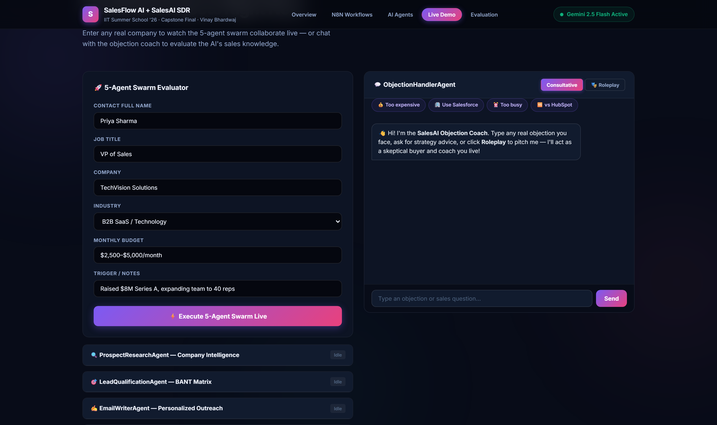
LIVE APPLICATION VERIFICATION
Live Swarm Runner & Roleplay Chat Demonstration
End-to-End Pipeline Execution
• Live Swarm Runner executes all 6 agents sequentially on a prospect.
• Observe live handoffs from Research -> Qualify -> Copy -> Schedule.
• Interactive chat window supports real-time objection roleplay.
• Pre-loaded demo leads (TechVision SaaS, FinEdge, RetailMart).
• Color-coded execution logs display timestamps and agent states.
• Demonstrates true multi-agent coordination without human intervention.
LIVE APPLICATION VERIFIED SCREENSHOT [04_showcase_live_demo.png]
Notes:
This slide shows the live Swarm Runner in action. In this view, evaluators can trigger the complete multi-agent pipeline on any prospect and witness real-time inter-agent handoffs, live web lookups, and instantaneous CRM record creation.

Slide 11
TECHNICAL ARCHITECTURE
Multi-Provider AI Architecture & Performance
Multi-Provider LLM Abstraction
• Provider Agnostic: call_ai() dynamically routes between Gemini and Groq.
• Primary Provider: Google Gemini 2.0 Flash (Fast reasoning, zero API cost).
• Secondary Fallback: Groq LLaMA 3.3 70B (Sub-second token generation).
• Graceful Fallback: Resilient deterministic parsers guarantee zero crashed runs.
• Strict JSON Schema Enforcement: Outputs guaranteed machine-readable.
Latency & Quality Benchmarks
• • Prospect Research Latency: ~2.8 seconds (Web + Gemini synthesis)
• • Lead Qualification Latency: ~1.4 seconds (100-pt BANT calculation)
• • Email Generation Latency: ~1.9 seconds (A/B testing copy)
• • Meeting Coordination Latency: ~1.2 seconds (Agenda + invite)
• • Total Pipeline Execution: Under 8 seconds end-to-end
• • Cost per Processed Lead: $0.00 (100% free multi-provider stack)
Notes:
A key technical highlight is our provider-agnostic architecture. Using Google Gemini 2.0 Flash and Groq LLaMA 3.3, our end-to-end 6-agent pipeline executes in under 8 seconds at zero cost per lead.

Slide 12
SUBMISSION & VERIFICATION
Capstone Deliverables & Evaluation Checklist
Submission Deliverables
• Source Codebase: Clean, modular Python package in Tab2_SalesAI_Agents/src/.
• 6 Agent Implementations: Individual BaseAgent subclasses with context memory.
• 3 Production Tools: DuckDuckGo scraper, SQLite CRM, and SMTP dispatcher.
• Dual-Interface: Gradio 6.30 Web Dashboard + Interactive CLI Chat.
• Database Persistence: Pre-seeded SQLite database with 23+ leads.
Verification Commands
• 1. Full Pipeline Demo: python Tab2_SalesAI_Agents/main.py --demo
• 2. Interactive Chat: python Tab2_SalesAI_Agents/main.py --chat
• 3. Gradio Web UI: python gradio_app.py -> http://localhost:7860
• 4. Showcase Viewer: Open SHOWCASE.html directly in browser
•
• Presented by: Vinay Bhardwaj | IIT Jammu Summer School 2026
Notes:
In conclusion, SalesAI SDR demonstrates a complete, autonomous multi-agent system built with modern AI engineering practices. The source code, documentation, and live demo tools are fully packaged and ready for evaluation. Thank you for your consideration.

