Slide 1
INDIAN INSTITUTE OF TECHNOLOGY (IIT) JAMMU
SalesAI SDR - Multi-Agent Sales Development System
Assignment 2: AI agents capstone | six custom Python agents
Candidate: Vinay Bhardwaj | Summer School 2026
Notes:
Introduce SalesAI SDR as six custom Python agent modules with local tools. The smoke suite checks local components but does not establish live model inference or external integrations.

Slide 2
CONTEXT & PROBLEM STATEMENT
The Modern SDR Dilemma & Multi-Agent Opportunity
Sales development workload
• Research, qualification, writing, and CRM work span several steps.
• Manual handoffs can make the process harder to track.
• Teams need clear records and consistent qualification criteria.
• These are project motivations, not measured market statistics.
Project design goals
• Split the work into specialized agent modules.
• Pass structured lead context between workflow steps.
• Keep CRM state in a local SQLite database.
• Make email output a draft or safe simulation by default.
SalesAI SDR
• Six custom Python agent classes cover sales development tasks.
• Gemini and Groq providers are configurable.
• Model calls depend on API keys, quota, and provider availability.
• Local smoke tests do not call live model APIs.
Notes:
Describe the workflow problems that motivated the project. The statistics in earlier drafts were not supported by project evidence and have been removed.

Slide 3
SYSTEM BLUEPRINT
6-Agent Collaborative Swarm Architecture
Agent responsibilities
• ProspectResearchAgent gathers company context.
• LeadQualificationAgent evaluates BANT fields.
• EmailWriterAgent drafts outreach copy.
• MeetingCoordinatorAgent prepares meeting materials.
• ObjectionHandlerAgent supports coaching and roleplay.
• CRMManagerAgent reads and writes local CRM records.
Agent framework and tools
• Agents share a project-defined BaseAgent class.
• Gemini 2.5 Flash is the default configured model.
• Groq models provide an alternate provider path when configured.
• Research, SQLite, and FastAPI tools are included.
• This code does not import the official openai-agents SDK.
Notes:
Walk through the six agent responsibilities and their project-defined BaseAgent framework. Confirm whether the course specifically requires the official OpenAI Agents SDK.

Slide 4
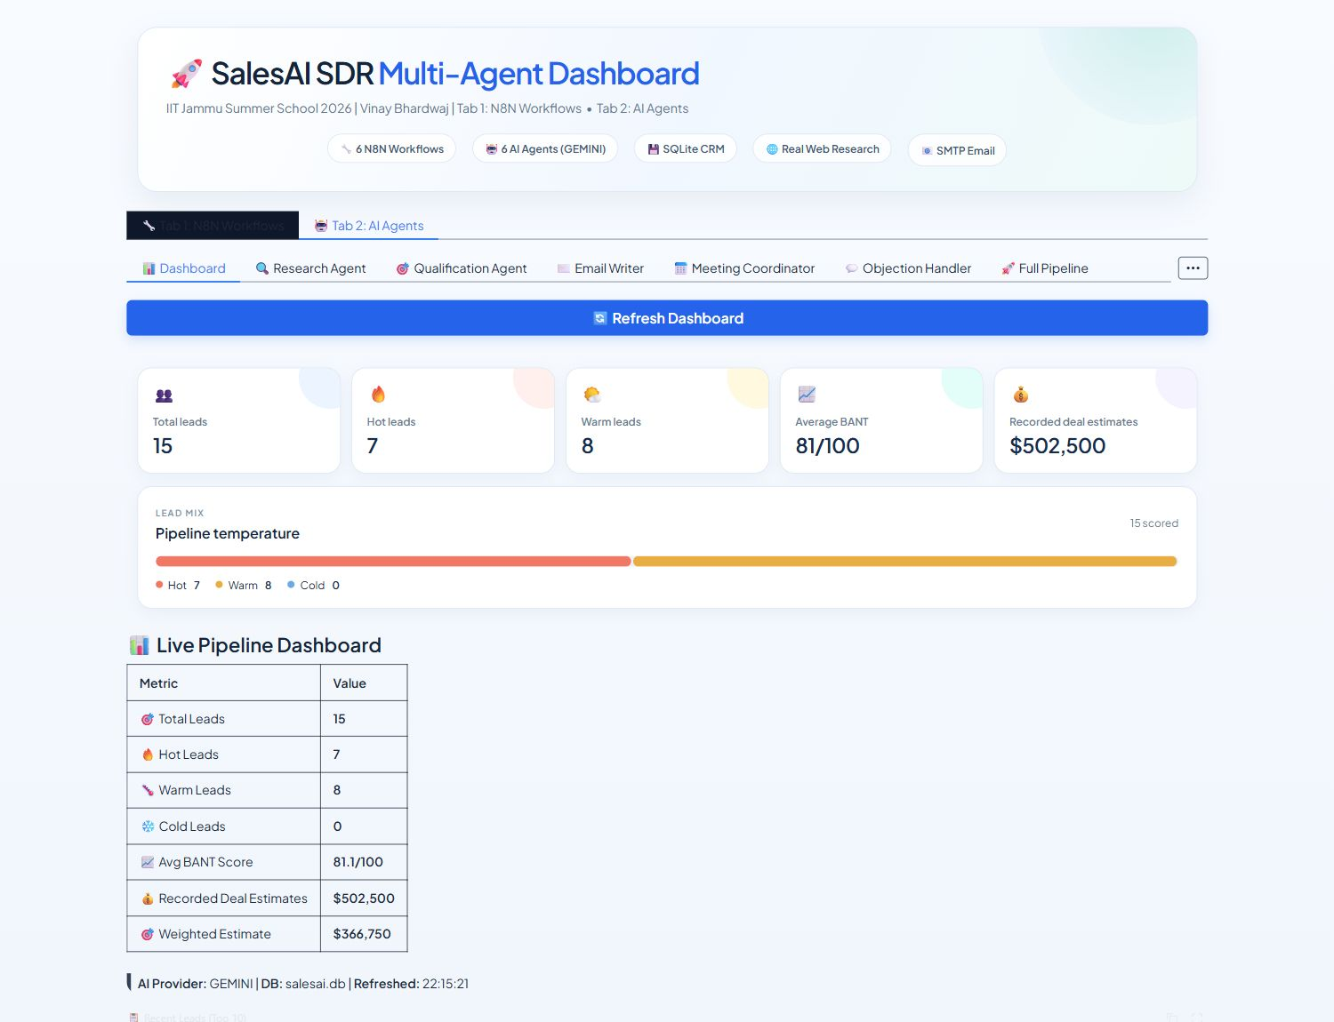
AGENT INVENTORY
Six Custom Python Agent Modules
Six agent modules
• Prospect research and qualification.
• Email drafting and meeting coordination.
• Objection handling and CRM management.
• The modules use a shared custom BaseAgent framework.
• The test runner verifies imports and instantiation.
• It does not verify live model output or external actions.
Local SQLite dashboard snapshot
Notes:
The dashboard presents the six agent areas and project tools. Do not describe the smoke-test result as proof of live AI calls.

Slide 5
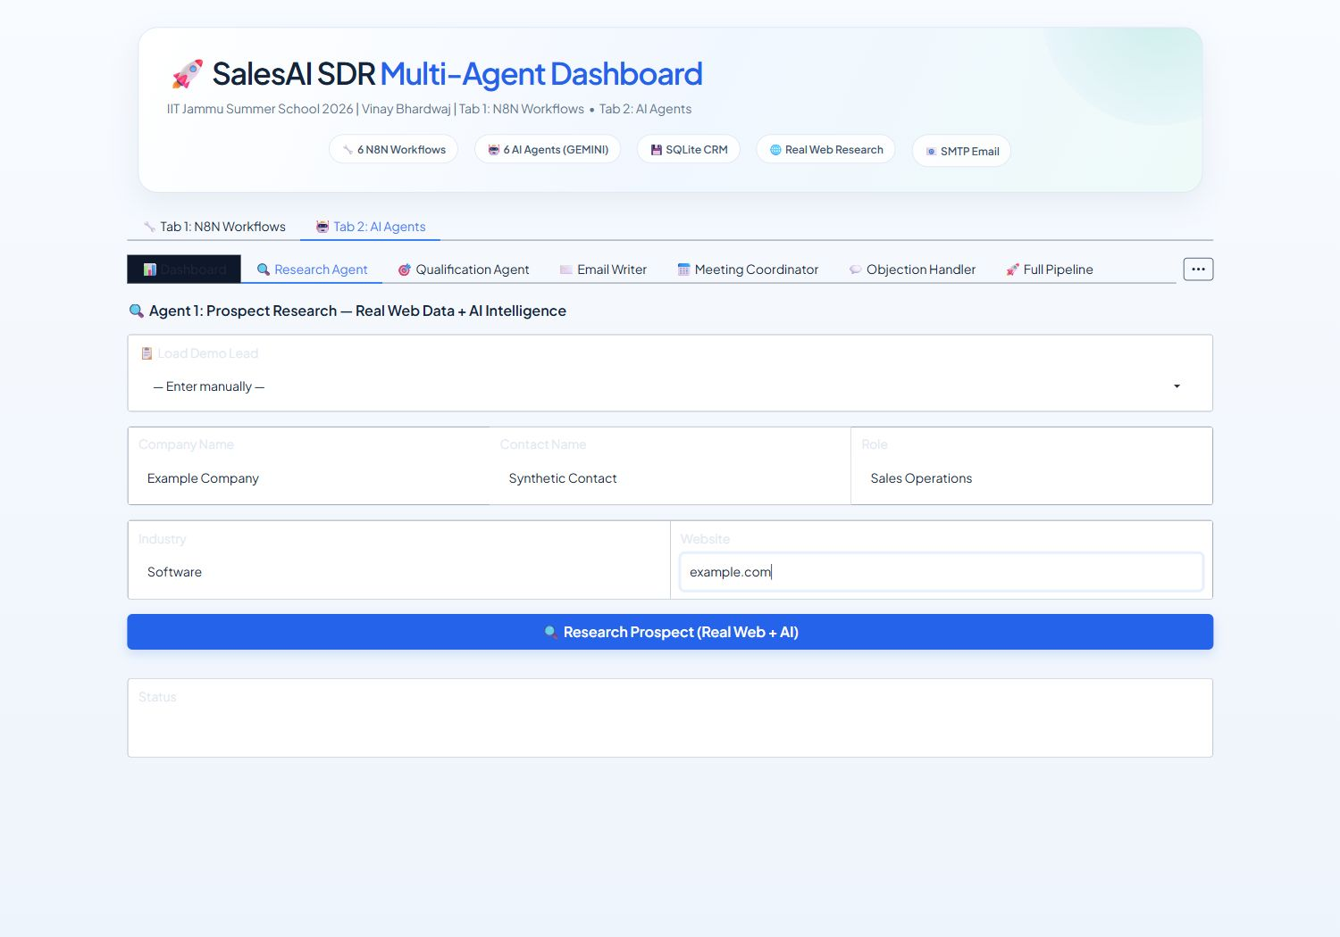
DASHBOARD AND LOCAL CRM
Gradio Dashboard and Local SQLite CRM
Dashboard and local CRM
• The unified Gradio app has n8n and AI agent project tabs.
• SQLite stores project CRM records locally.
• The agent UI includes dedicated workflows and chat areas.
• Agent inference requires a working configured provider.
• The safe smoke suite does not exercise provider inference.
Research-agent form with synthetic example fields
Notes:
Explain that the Gradio app and SQLite CRM are local project components. Provider calls and external services need separate setup and testing.

Slide 6
AGENT DEEP DIVE
ProspectResearchAgent: Web Research and Company Context
ProspectResearchAgent
• Uses configured web research tools when available.
• Produces company context for downstream qualification and drafting.
• Research output depends on source availability and the model provider.
• Local smoke checks import the tool but do not run web searches.
• Review evidence before using research in outreach.
Structured research fields
• Company overview and relevant context.
• Potential pain points and personalization ideas.
• Source quality can vary by company and web results.
• Treat model-generated summaries as suggestions.
• Verify claims before contacting a prospect.
Notes:
Describe research outputs as provider- and source-dependent suggestions. Verify source claims before using them in outreach.

Slide 7
AGENT DEEP DIVE
Agent 2: LeadQualificationAgent (100-Point BANT Scoring)
LeadQualificationAgent
• Scores Budget, Authority, Need, and Timeline.
• Produces a structured qualification result.
• BANT fields help organize lead context.
• Provider output may vary and needs review.
• Scores are decision support, not validated win probabilities.
Qualification output
• BANT scores and supporting notes.
• Qualification status and lead temperature.
• Suggested next steps for a sales representative.
• Any deal estimates are model-generated approximations.
• No historical calibration study is included.
Notes:
Explain the BANT fields and structured qualification output. Deal estimates are not calibrated predictions in this project.

Slide 8
AGENT DEEP DIVE
Agents 3 & 4: Hyper-Personalized Copy & Calendar Scheduling
EmailWriterAgent
• Drafts personalized outreach from supplied context.
• Can prepare subject line variants and follow-up copy.
• Email dispatch has a safe simulation path.
• The smoke test checks configuration only; it sends nothing.
• Review every draft before use.
MeetingCoordinatorAgent
• Prepares agendas and meeting-related content.
• Formats proposed times and invitation details.
• Live calendar availability is not verified in the smoke suite.
• Google Calendar credentials are separate configuration.
• Review meeting details before scheduling.
Notes:
Show generated email drafts and meeting materials. The default safe checks do not send emails or create live calendar events.

Slide 9
AGENT DEEP DIVE
Agents 5 & 6: Objection Handling and Local CRM
ObjectionHandlerAgent
• Supports objection responses and sales roleplay.
• Responses are generated by the configured provider.
• Use as coaching suggestions and check claims for accuracy.
• The smoke suite instantiates this agent only.
• Live model behavior requires a provider test.
CRMManagerAgent
• Uses SQLite for local lead and activity records.
• Supports CRM operations exposed by the project tools.
• Email-based fallback deduplication is covered by a temporary DB check.
• The app database contains local project records.
• No external CRM sync is configured.
Notes:
Present objection handling as a coaching tool and CRM management as local SQLite operations. Do not claim external CRM synchronization.

Slide 10
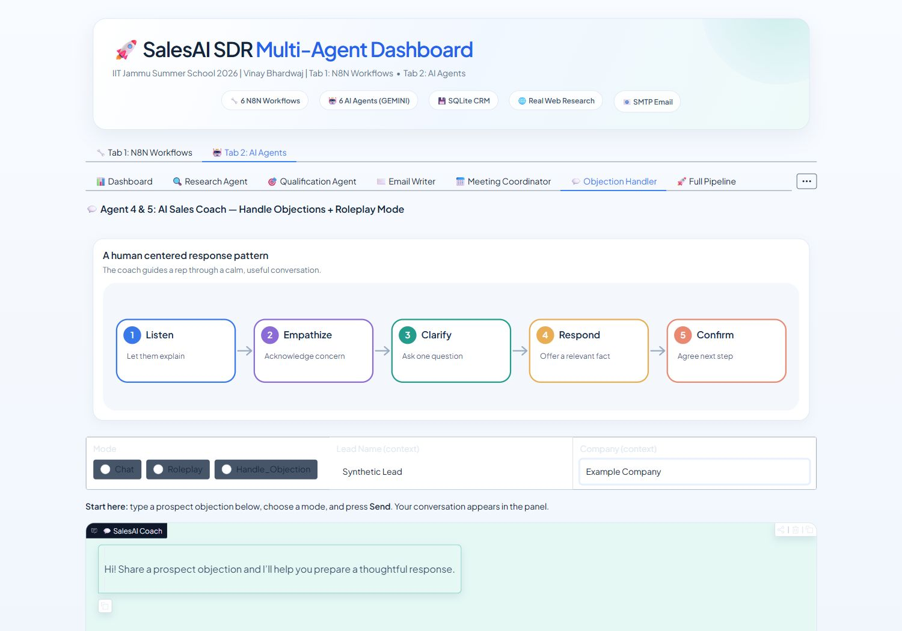
LOCAL VERIFICATION
Local Test Scope and Dashboard Views
Safe local demonstration
• The n8n local simulator reads JSON exports only.
• The six traces represent 50 nodes without calling n8n.
• The agent smoke tests check imports and instantiation.
• No live provider call, email, calendar, or CRM sync occurs.
• Use synthetic data for any later sandbox evaluation.
Objection coach interface using synthetic example context
Notes:
The local verification covers the Python smoke suite and local workflow simulator. It does not call a provider or run the entire agent pipeline.

Slide 11
TECHNICAL ARCHITECTURE
AI Providers and Verification Scope
Provider configuration
• Gemini 2.5 Flash is the default model setting.
• Groq models are tried when configured and available.
• Additional OpenAI-compatible endpoints can be configured.
• Provider usage may incur cost and is subject to quotas.
• The project uses a custom BaseAgent, not the official SDK.
Verification scope
• Smoke test passes local import and app checks.
• CRM deduplication is checked using a temporary database.
• Six workflow traces cover 50 exported n8n nodes.
• No latency, quality, or cost benchmark was performed.
• Model behavior varies by provider and prompt.
Notes:
State the configured provider options and explain that there are no measured latency or cost benchmarks. Provider quotas and pricing may apply.

Slide 12
SUBMISSION & VERIFICATION
Capstone Deliverables & Evaluation Checklist
Submission materials
• Six Python agent modules and local tools.
• SQLite CRM and FastAPI backend.
• Unified Gradio dashboard and local workflow simulator.
• Two 12-slide project presentations and demo scripts.
• Demo video and report candidate details remain pending.
Evaluator checks
• Run python test_import.py for local smoke checks.
• Open the Gradio app with python launch.py --gradio-port 7890.
• Use synthetic data and the local JSON simulator.
• Provider-backed inference needs configured credentials and quota.
• Confirm whether the official OpenAI Agents SDK is required.
Notes:
Point evaluators to the local smoke test and dashboard. The demo video, candidate report details, and SDK-specific requirement remain follow-up items.

