Slide 1
INDIAN INSTITUTE OF TECHNOLOGY (IIT) JAMMU
SalesFlow AI - N8N CRM & Sales Automation Platform
Assignment 4: Sales automation capstone | 6 workflow exports, 50 nodes
Candidate: Vinay Bhardwaj | Summer School 2026
Notes:
Introduce the six n8n workflow exports. The repository contains 50 nodes across the six JSON files. The local viewer and smoke tests inspect those exports; live integrations need separate n8n credentials and verification.

Slide 2
CONTEXT & PROBLEM STATEMENT
Industry Challenges in B2B Sales Operations
Lead handling challenge
• Manual intake can delay follow-up and create inconsistent records.
• Qualification criteria vary across sales teams.
• Repetitive CRM updates take time away from buyer conversations.
Workflow design goals
• Capture and normalize lead details.
• Apply a consistent qualification path.
• Route leads into follow-up or nurture branches.
• Keep manager approval in the proposal flow.
SalesFlow project
• Six n8n JSON workflow exports contain 50 nodes.
• The exports define AI, CRM, email, calendar, and reporting steps.
• A Gradio viewer displays the exported workflow structure.
• Local simulation is separate from live n8n execution.
Notes:
Describe the project problem as a design target: reduce manual handling and make qualification steps consistent. Do not cite unsupported industry statistics or claim measured business outcomes.

Slide 3
ARCHITECTURAL BLUEPRINT
System Architecture: Decoupled State Machine
Workflow structure
• Six exports cover lead intake through weekly reporting.
• Webhook and schedule triggers start the designed flows.
• PostgreSQL nodes represent CRM reads and updates.
• WF-02 and WF-05 source exports include webhook responses on the reviewed branches.
• Live behavior depends on credentials and n8n configuration.
Configured integration points
• AI nodes are configured in the exports.
• PostgreSQL, Gmail, Sheets, Calendar, Drive, and Slack nodes appear in the designs.
• The active n8n instance has no saved project credentials.
• WF-02 and WF-05 fixes are not yet synced to that instance.
• WF-01 shares its webhook path with another active workflow.
Notes:
Explain that the architecture is represented by workflow exports. The exports include integration nodes, while active n8n credentials and live service behavior have not been verified.

Slide 4
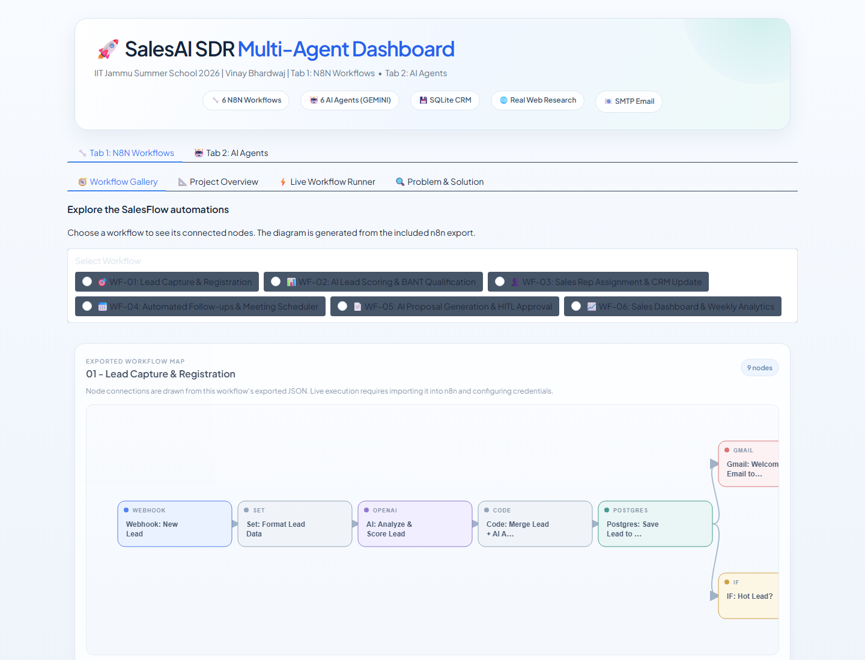
WORKFLOW EXPORT INVENTORY
Six n8n Workflow Exports: 50 Nodes
Workflow export inventory
• WF-01: Lead capture and registration (9 nodes)
• WF-02: Lead scoring and qualification (8 nodes)
• WF-03: Rep assignment and CRM update (8 nodes)
• WF-04: Follow-up and meeting scheduler (8 nodes)
• WF-05: Proposal approval (10 nodes)
• WF-06: Dashboard analytics (7 nodes)
• Local checks validate 50 nodes and internal edge targets.
Workflow export gallery from the local dashboard
Notes:
Walk through the six source JSON files and their node counts. The local checks validate JSON structure, node totals, and internal connection targets.

Slide 5
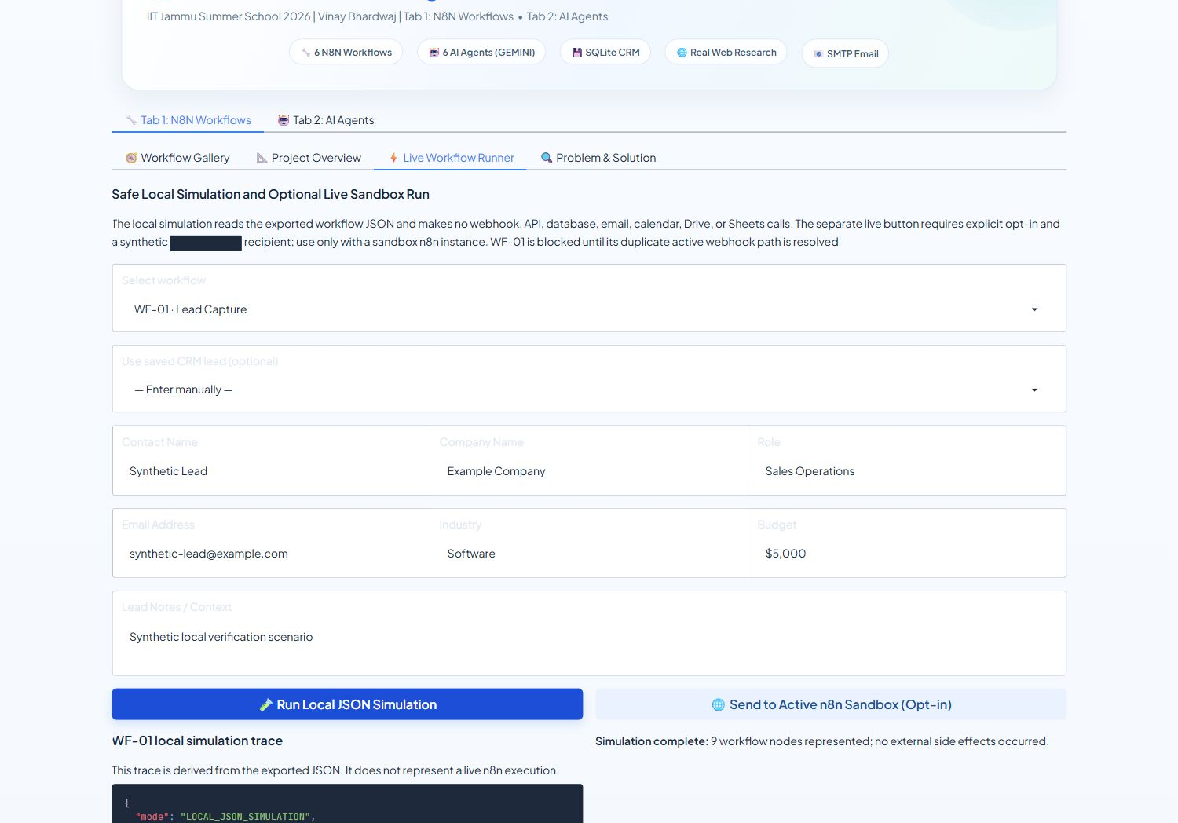
LOCAL DASHBOARD DEMONSTRATION
Interactive Workflow Gallery & Graph Visualization
Workflow Gallery
• Reads the six workflow JSON exports.
• Shows each workflow's node connections and details.
• Local JSON simulation creates a trace without external calls.
• The separate live runner is disabled unless explicitly opted in.
• Live n8n use still requires credentials and route checks.
Local JSON simulation with synthetic input; no external calls
Notes:
Show the workflow gallery and local simulation. The gallery reads the exported JSON. Its local trace does not call n8n or external providers.

Slide 6
WORKFLOW DEEP DIVE
Workflows 01 & 02: Inbound Capture & AI BANT Scoring
WF-01: Lead capture (9 nodes)
• Webhook path: /capture-lead.
• Maps submitted lead fields into a normalized record.
• Export includes AI analysis, a CRM write, and email/alert steps.
• These external nodes need credentials in n8n.
• The active instance has a second workflow on this path.
WF-02: Qualification (8 nodes)
• Starts from a webhook request.
• Export includes AI scoring and a score-based route.
• Qualified and nurture branches use configured CRM or Sheets steps.
• Nurture branch now connects to Webhook Response in the source JSON.
• Live sync and provider credentials remain pending.
Notes:
Use the exported definitions to describe lead intake and qualification. Clarify that the OpenAI configuration is a node in the n8n export, not a verified live model call.

Slide 7
WORKFLOW DEEP DIVE
Workflows 03 & 04: Rep Assignment & 5-Touch Cadence
WF-03: Rep assignment (8 nodes)
• Export defines a lead assignment and CRM update path.
• Assignment rules and data fields are visible in the JSON.
• Email and Slack nodes are configured as integration points.
• Their delivery has not been verified in the active instance.
• Review and configure the required credentials before a sandbox run.
WF-04: Follow-up and meetings (8 nodes)
• Starts on an eight-hour schedule.
• Queries eligible leads and prepares follow-up actions.
• Calendar and email steps are defined in the export.
• This schedule was not run during local verification.
• Verify SQL and credentials in a sandbox first.
Notes:
Describe the assignment and follow-up workflow designs. Scheduled execution, database queries, email, and calendar behavior need sandbox credentials and testing.

Slide 8
HUMAN-IN-THE-LOOP GOVERNANCE
Workflow 05: Proposal Generation & HITL Approval (10 Nodes)
WF-05 approval path
• The export retrieves deal data and prepares a proposal.
• A Wait step supports manager review.
• The approval branch includes proposal delivery and a CRM status update.
• Approved path now reaches Webhook Response in the source JSON.
• The updated export has not been synced to active n8n.
WF-05 integration points
• Google Drive and Gmail steps are configured in the export.
• The Wait node and approval branches are present.
• The approved path is Gmail, PostgreSQL update, then webhook response.
• The rejected path also returns a webhook response.
• Live approval delivery and resume behavior remain unverified.
Notes:
Explain the Wait node and approval branches in the exported WF-05 definition. The source file has the response paths, but the active instance still needs the updated export and credentials.

Slide 9
REVENUE TELEMETRY
Workflow 06: Weekly Analytics & Executive Briefing (7 Nodes)
WF-06 reporting design
• Starts every Monday at 08:00 in the schedule definition.
• PostgreSQL query calculates weekly pipeline metrics.
• Google Sheets, Gmail, and Slack steps are configured in the export.
• No live report was generated during local checks.
• Sandbox credentials are required to verify delivery.
Local verification
• Six workflow JSON exports parse successfully.
• The exports contain 50 nodes.
• Internal connection targets and WF-02/WF-05 response paths pass checks.
• Six local traces represent all 50 nodes.
• Smoke checks do not test live n8n credentials or SaaS delivery.
Notes:
Describe the schedule and reporting nodes as configured design. No weekly report was sent during local verification.

Slide 10
QUALITY ASSURANCE
Technical Verification & Automated Test Suite
What the project demonstrates
• A six-workflow design for common sales operations.
• Branches for qualification, nurture, and proposal approval.
• Local tests validate export structure and simulator traces.
• Business improvements are design goals, not measured results.
• No response-time, conversion, or ROI study has been completed.
Workflow export inventory
WF-01 Lead capture: 9 nodes
WF-02 Qualification: 8 nodes
WF-03 Rep assignment: 8 nodes
WF-04 Follow-up: 8 nodes
WF-05 Proposal approval: 10 nodes
WF-06 Analytics: 7 nodes
Total: 50 nodes
Notes:
The local test suite passed checks for imports, local database behavior, workflow JSON, the simulator, and the API app. It does not validate credentials or live SaaS workflows.

Slide 11
POTENTIAL BENEFITS
Potential Benefits and Evidence Limits
Designed workflow outcomes
• Standardize lead intake and qualification steps.
• Route low-score leads to a nurture path.
• Schedule follow-up actions from a recurring trigger.
• Require human review before the proposal branch proceeds.
• These outcomes have not been measured in a live deployment.
Evidence available now
• Local verification checks JSON structure and response branches.
• Six local simulations represent 50 workflow nodes.
• No live SaaS workflow run has been verified.
• No before-and-after sales metrics are available.
• Treat impact estimates as future evaluation questions.
Next evaluation steps
• Sync WF-02 and WF-05 into a sandbox n8n instance.
• Resolve the duplicate /capture-lead route before WF-01 testing.
• Configure sandbox credentials and use synthetic records.
• Record measured outcomes only after controlled runs.
• Do not report projected figures as achieved results.
Notes:
Present the workflow's intended operational benefits as goals for a future sandbox evaluation. No response time, conversion, or return-on-investment measurements are available.

Slide 12
SUBMISSION & VERIFICATION
Capstone Deliverables & Evaluation Checklist
Project materials
• Six workflow JSON exports are in Tab1_SalesFlow_N8N/workflows/.
• Gradio dashboard includes a workflow gallery and local simulator.
• Python agents and SQLite CRM form the second project track.
• Two 12-slide presentations and demo scripts are included.
• The demo video and candidate report fields remain pending.
Evaluator checks
• Start the dashboard with python launch.py --gradio-port 7890.
• Run python test_import.py for local smoke checks.
• Use Run Local JSON Simulation for workflow traces.
• Live n8n integration requires a configured sandbox.
• Demo video and report candidate details still need completion.
Notes:
Point evaluators to the local smoke test and safe simulator. Note that the demo video, report candidate details, sandbox sync, and live credentials remain outstanding.

