Slide 1


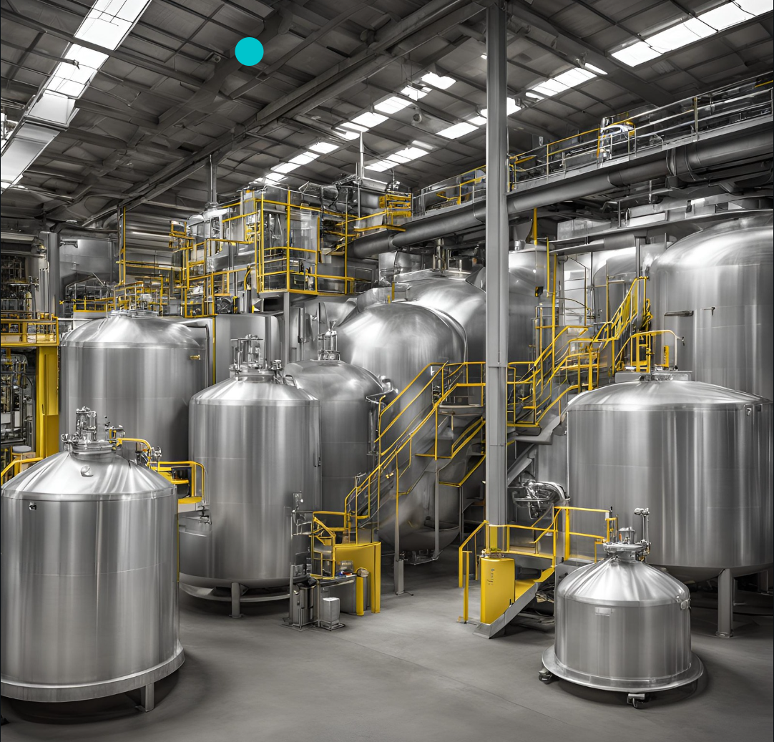



Batch Optimization
Helps manufacturing org to bring cost and time efficiency in their production process..

Slide 2
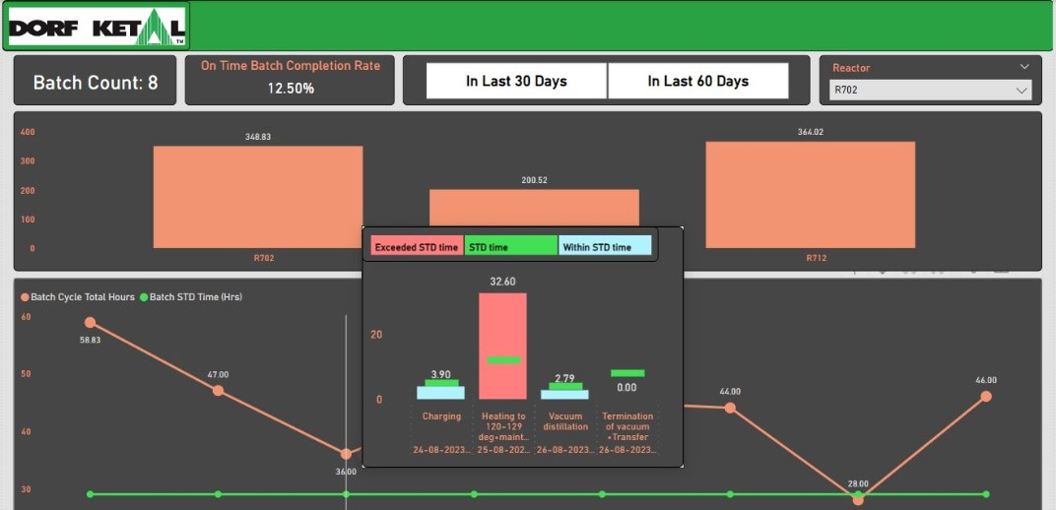
Batch Efficiency Analytics
Batch Level - Dashboard to monitor "On Time Batch Completion Rate" for corrective measures

