Slide 1
Compression
Do we really need to store all data in Compressed file?
Behind the Pixels: How Image Lossy Compression Works?

Slide 2
Acknowledgments
References
Sharma, Kajal, and Nagresh Kumar. "Spatial Domain Lossless Image Data Compression.“
IRE Journals, Volume 1, Issue 10, April 2018. ISSN: 2456-8880.
“Image Compression: DCT Method,” Towards Data Science,
https://towardsdatascience.com/image-compression-dct-method-f2bb79419587/

Slide 3
Data Compression methods are mainly categorized into two types . Lossy and lossless Compression.
Lossless Compression : Lossless compression preserves all original data, ensuring no information is lost during compression and decompression.
Lossy Compression :
Lossy compression, on the other hand, reduces file size by discarding some data, which can lead to a slight decrease in quality but results in a larger compression ratio.

Slide 4
Comparision between the Compressions
Lossy Compression Lossy compression reduces the size of data. In Lossy compression, Data's quality is compromised. Lossy compression is used in Images, audio, video. Compression methods like JPEG etc.. | Lossless Compression But Lossless Compression does not reduce the size of data. But Lossless Compression does not compromise the data's quality. Lossless Compression is used in Text, images, sound Compression methods like Huffman encoding for texts and for some image formats like GIF and PNG etc..

Slide 5
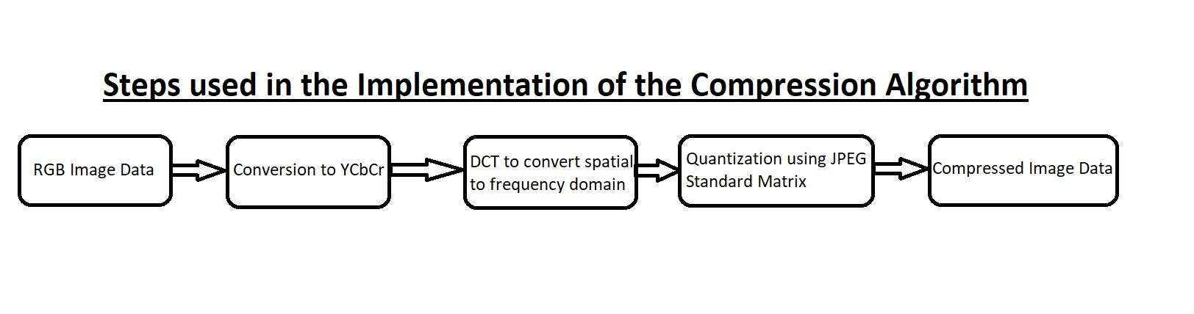
Illustration of image lossy Compression :
The diagram above illustrates the steps involved in JPEG lossy image compression. The process begins with RGB Image Data, which contains three color channels (Red, Green, and Blue). To exploit human visual sensitivity, this data is first converted to YCbCr color space, separating luminance (Y) from chrominance (Cb and Cr).
Next, the image is divided into 8×8 blocks, and each block undergoes a Discrete Cosine Transform (DCT), converting spatial domain data into frequency domain coefficients. The resulting frequency values are then quantized using a standard JPEG quantization matrix, which reduces precision (and file size) by discarding less perceptually important information. Finally, the quantized values are encoded (typically using entropy coding methods) to produce the Compressed Image Data.
Quantization is the state where we loss redundant data.

Slide 6
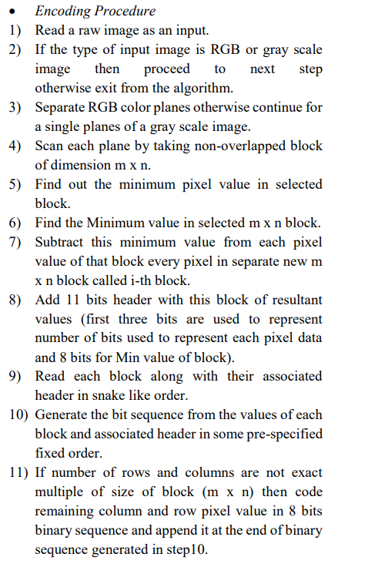
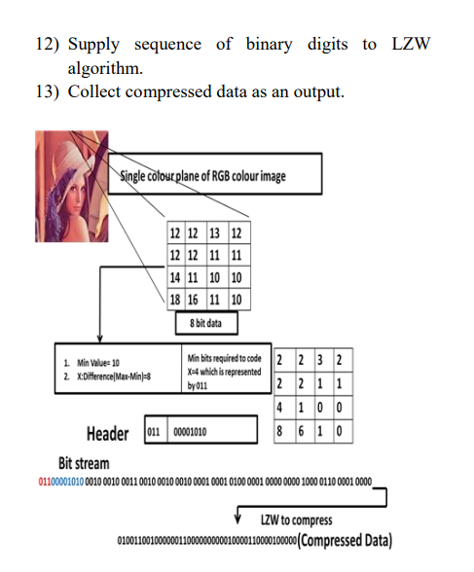
Algorithm that can Compresses Image

Slide 7
Usually each pixel in image have three Channels Red,blue,Green . After separating these three Channels the algorithm compresses each of these channels separately and store these in Compressed file . Then dividing the channel into non overlapping blocks of size 8 x 8 pixels .
Now converting each block into bit stream by encoding values of difference between values of pixels and the minimum value of pixel in block and no:of bits required to represent the difference values for each pixel and the differenced values of each pixel in the block.
Decompression is a bit easier than Compression

Slide 8
