Slide 1
Bank loan risk analysis
Credit EDA Assignment by Vinay Chutake
DS-C50

Slide 2
CONTENTS
Business Objective
Tools Used
Approach Followed
Data Analysis
Conclusion

Slide 3
Business Objective
In this case study/assignment we aim to analyize the provided dataset and to find the patterns to indicate if user is able to pay his instalments which should help bank to take various business decisions regarding loan application of a client.

Slide 4
Tools Used
Python with following libraries:
Pandas
Numpy
Matplotlib
Seaborn
Jupyter Notebook to showcase code

Slide 5
Approach Followed
As we have 2 datasets provided to use "application_data.csv" and "previous_application.csv" which denote current application and previous application history of a client.
The general steps we followed are:
Data cleaning of current application
Analyzing the current application data individually to get idea what we are in for
Data cleaning of previous application
Analyzing the previous application data individually
Merging these two data sets and analyzing it to see the full picture
Cntd…

Slide 6
Approach Followed
Each dataset is tackled by keeping below steps in mind:
Data understanding
Data cleaning
Handling null values
Handling outliers
Dropping the extra columns
Imputing (If needed)
Typecasting data types
Data visualization for univariate and multivariate

Slide 7
Data Analysis

Slide 8
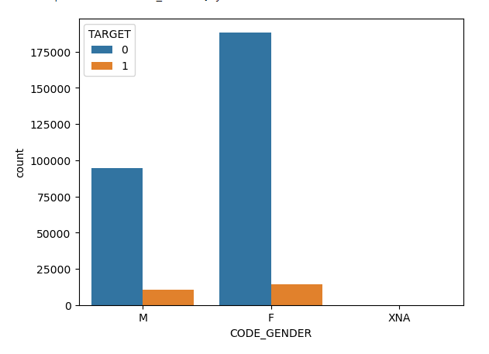
Gender wise Defaulters
In chart we can clearly see percentage of Males are more likely to be defaulter than females. In other words females would be better candidate to give loan to.

Slide 9
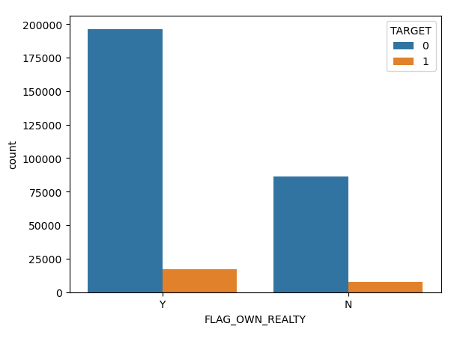
Defaulters statistics against Immovable Properties (House/Flat)
People who own a house or flat which is immovable property are likely to pay off their debt than those who do not own house/flat.
It is one of good insight we found, maybe who do not have house/flat think even if they become defaulter bank can not do much damage to them and they simply can move away anytime they want, Or another assumption we can make is who do not own a house have to pay rent and have more expenses

Slide 10
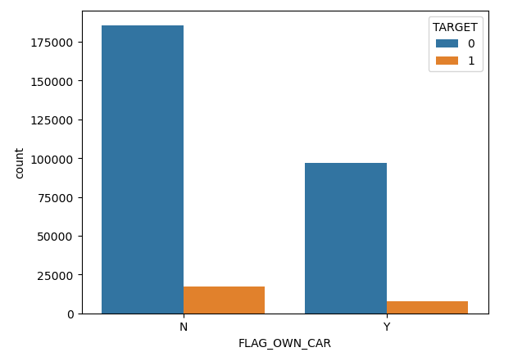
Defaulter against Car Ownership
People who own a car are more in percentage to become defaulter.
Not sure why... Do they have too many expenses? Do they show-off things and things which are hidden like credit score they don't care ?

Slide 11
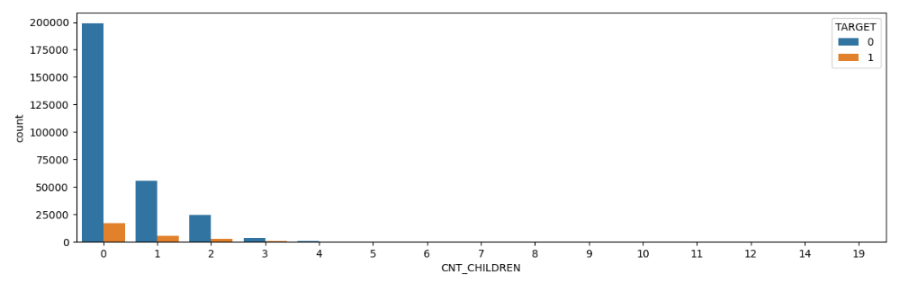
Defaulters vs Count of Children
Client who have less children are more likely to payoff their debts. Lower the number of children, higher is the probability of client being ideal candidate

Slide 12
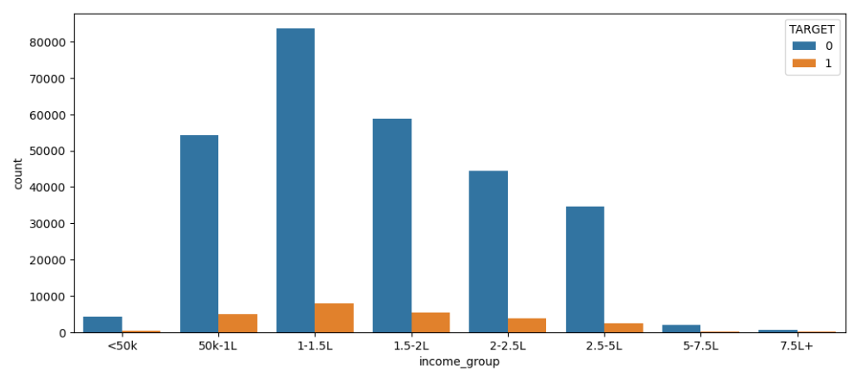
Income Range Effect
Most efficient income group is with income in range of 1 to 1.5 lakh who pay-off their debts

Slide 13
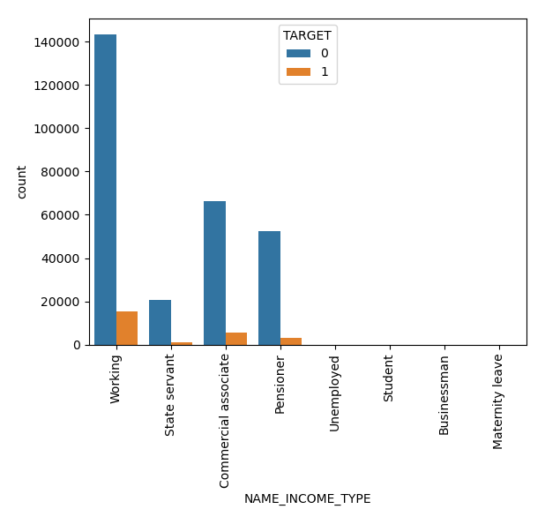
Income Type Area of Defaulters
As always, working people are being good citizen and paying off their debts.

Slide 14
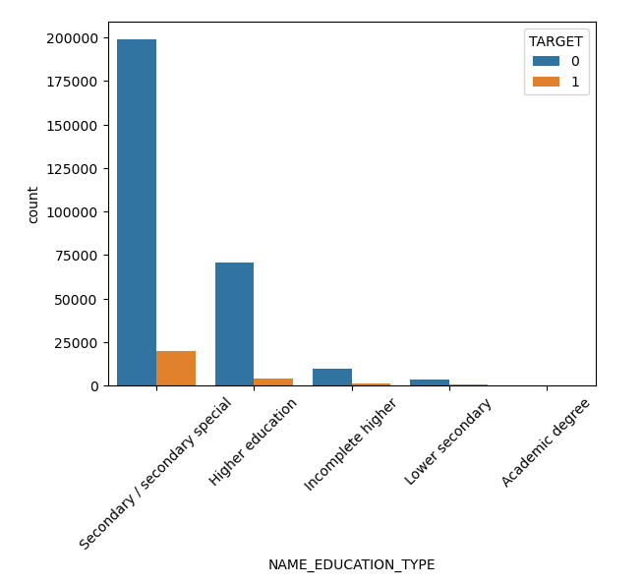
Education
Most efficient group to NOT become defaulters are Secondary / secondary special

Slide 15
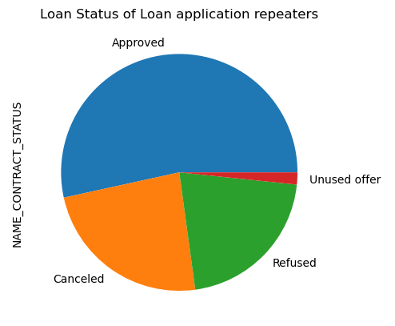
Loan Status of Repeaters
Once people get loan they keep trying to get loans again. Most repeaters are the one who got loan approved.
So customer retention is the key
Very few people do not use the offer

Slide 16
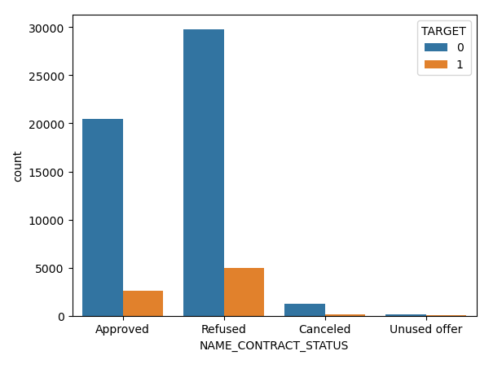
Defaulters from current application vs Their Previous Application Status
Most defaulters clients are the the ones whos previous application was refused
But also the most good citizens are also the ones whos previous applications were rejected

Slide 17
Conclusion & Recommendations
Males are more likely to be defaulter than females. In other words females would be better candidate to give loan to.
People who own a car are more in percentage to become defaulter. Not sure why... Do they have too many expenses? Do they show-off things and things which are hidden like credit score they don't care ?
People who own a house or flat which is immovable property are likely to pay off their debt than those who do not own house/flat.
Client who have less children are more likely to payoff their debts
Most efficient income group is with income in range of 1 to 1.5 lakh who pay-off their debts
As always, working people are being good citizen and paying off their debts.
most efficient group to not become defaulters are Secondary / secondary special
More defaulters are the people with lower income range
Most repeaters are the one who got loan approved. So customer retention is the key
Most defaulters clients are the ones whos previous application was refused

