Slide 1
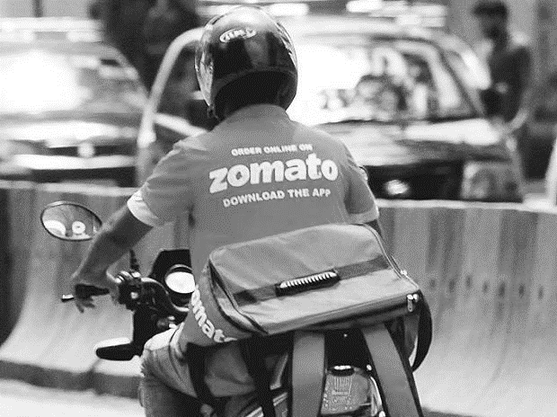
zomato
Restaurants Analysis
Presented By : Group 2

Slide 2
Introduction
Objectives
Challenges Faced
Key Insights
Dashboard
Conclusion
TABLE OF CONTENTS

Slide 3
INTRODUCTION
Zomato is a leading online food delivery and restaurant discovery platform operating across multiple countries.
This project focuses on analyzing restaurant data available on Zomato to understand customer preferences, restaurant distribution, pricing, ratings, and service availability such as online delivery and table booking.
The dashboards created provide a comprehensive view of restaurant performance across 15 countries over multiple years.

Slide 4
OBJECTIVES
1
To analyze the global presence of Zomato-listed restaurants
To understand customer engagement using ratings and votes
To compare average cost for two across different countries
To analyze availability of online delivery and table booking services
To identify trends in restaurant openings over time
2
3
4
5

Slide 5
CHALLENGES FACED
Handling large datasets with 9,500+ restaurant records
Converting different country currencies into USD for comparison
Data cleaning issues such as special characters and inconsistent values
Managing multiple dimensions like country, year, rating, and cuisine
Designing dashboards that are clear, interactive, and user-friendly

Slide 6





KEY INSIGHTS
Overall Performance
15 Countries
9,551 Restaurants
2.89
Average Rating
1.49 M
Total Votes
1,800+
Cuisines

Slide 7
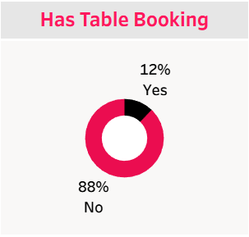
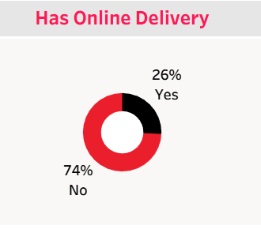
SERVICES OFFERED
Online Delivery & Table Booking
Just 12% provide table booking facilities
Only 26% of restaurants offer online delivery
Majority of restaurants still operate without these services, indicating growth potential

Slide 8
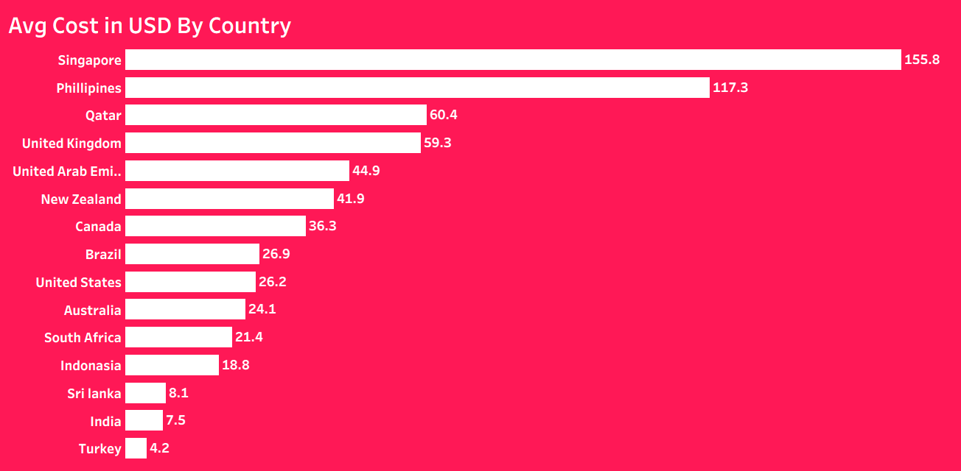
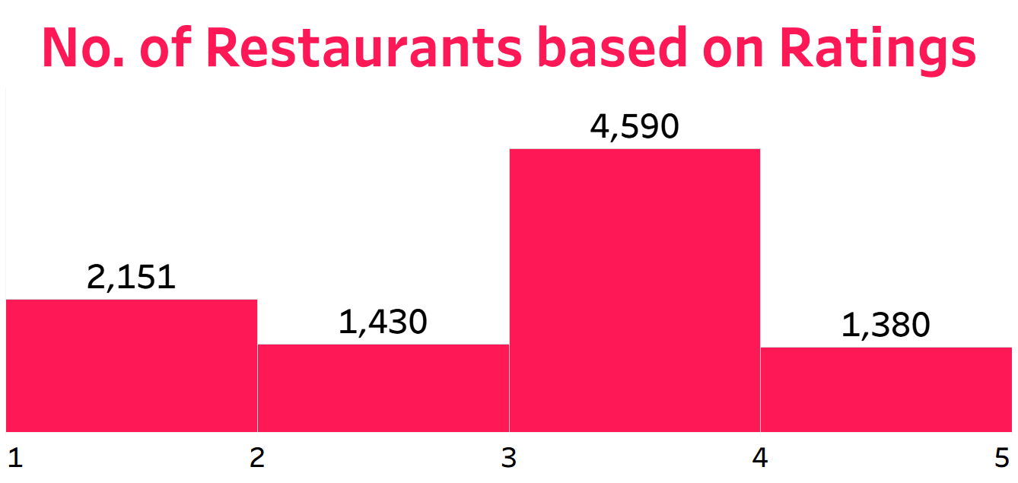
COST & RATINGS
Pricing and Customer Ratings
Most restaurants fall under rating 3 to 4
Very few restaurants achieve top ratings, highlighting quality gaps
Singapore has the highest average cost for two
India and Turkey have the lowest average cost

Slide 9
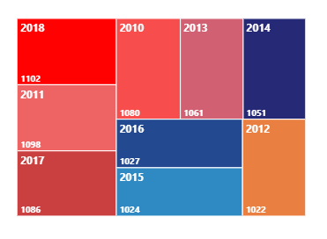
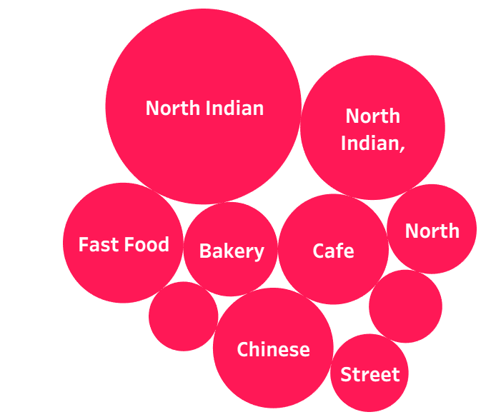
TIME & GEOGRAPHY
Year-wise and Country-wise Trends
Restaurant openings peaked around 2018
Popular cuisines include
North Indian, Chinese, and Fast Food

Slide 10
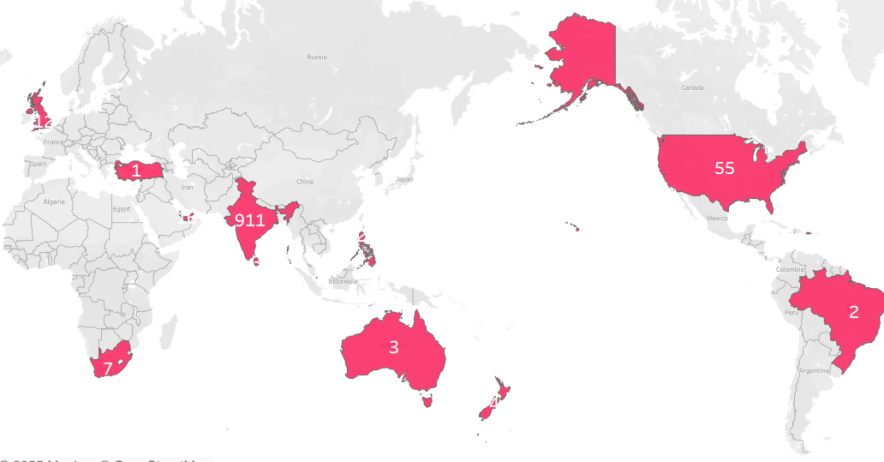
Majority of restaurants are concentrated in India
Other countries show limited but growing presence

Slide 11
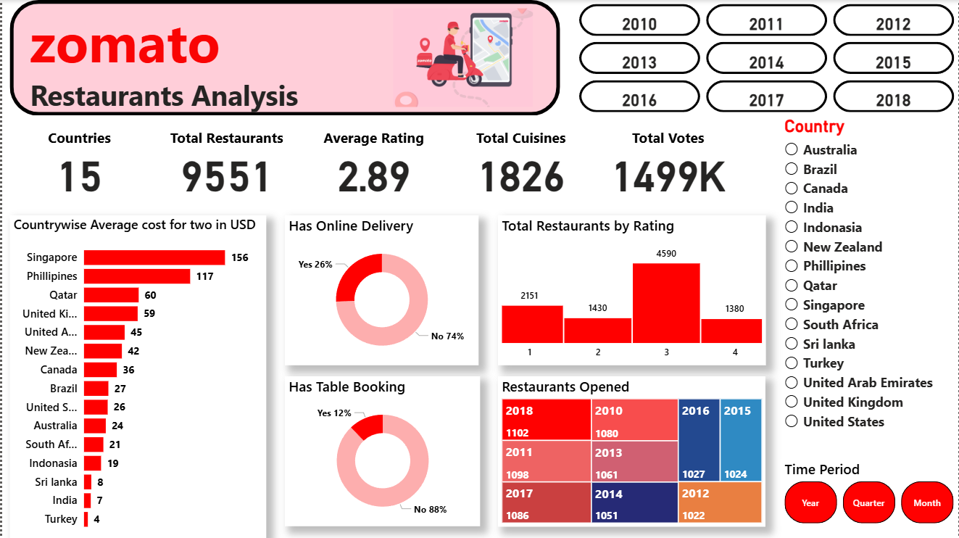
POWER BI DASHBOARD

Slide 12
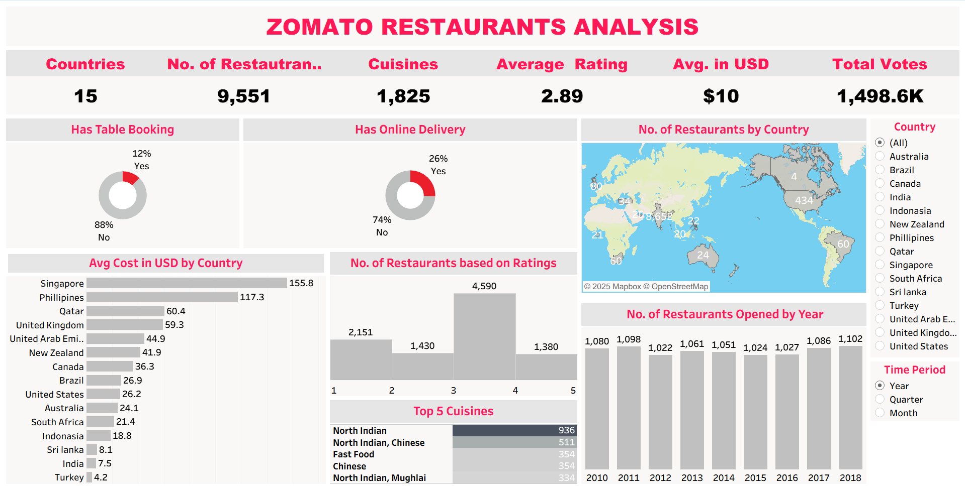
TABLEAU DASHBOARD

Slide 13
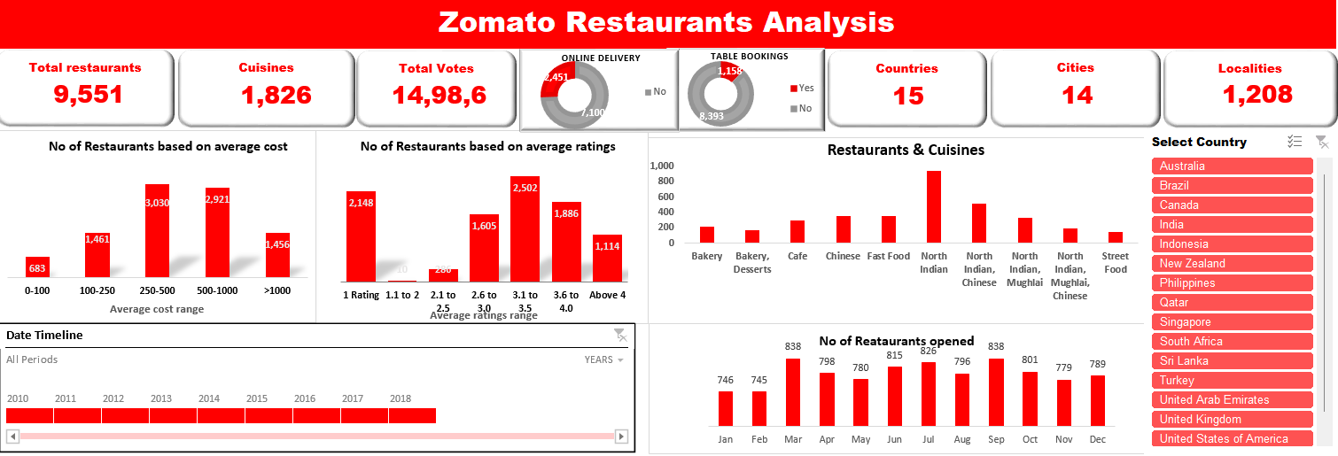
EXCEL DASHBOARD

Slide 14
CONCLUSION
This Zomato Restaurants Analysis provides valuable insights into global restaurant trends, customer preferences, and service availability.
Overall, data visualization helped transform complex data into clear, actionable insights for business decision-making.
The analysis highlights:
Strong presence in selected countries
Opportunity to expand online delivery and table booking
Pricing differences across regions
Scope for improving restaurant ratings and customer satisfaction

Slide 15
THANK YOU

