Slide 1
WordNet

Slide 2
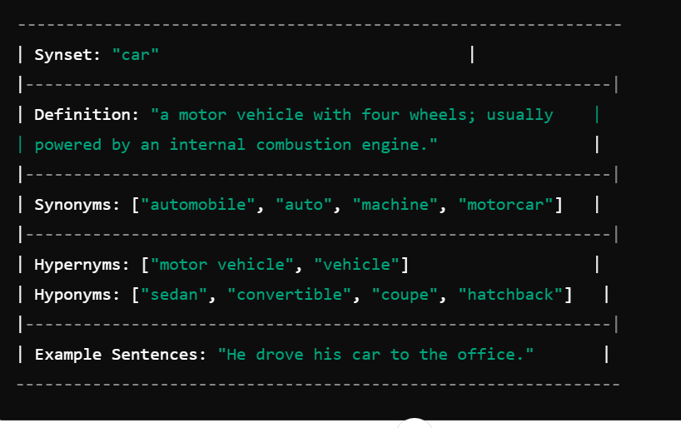

Slide 3
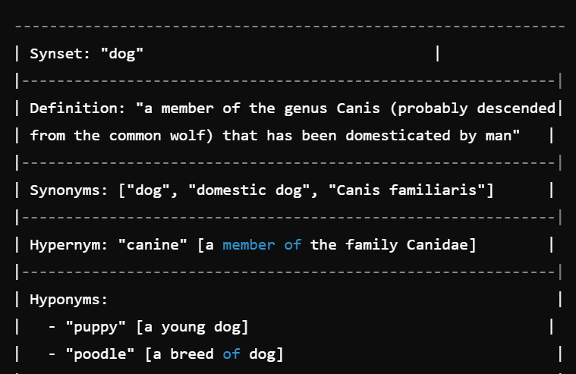

Slide 4
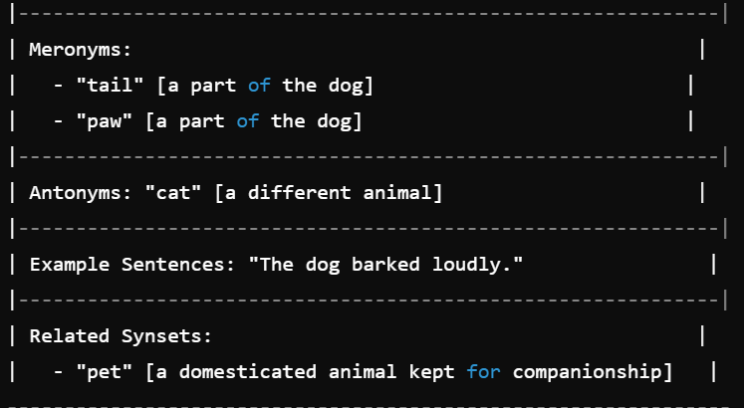

Slide 5
WordNet is a large lexical database of the English language that groups words into sets of synonyms
called synsets. It provides short definitions, usage examples, and various semantic relationships between these synonym sets, making it a valuable resource in Natural Language Processing (NLP) and
computational linguistics. Here’s a detailed overview of WordNet:
What is WordNet?
WordNet: A lexical database that organizes English words into sets of synonyms (synsets) and connects these synsets through various semantic and lexical relationships. It was developed at Princeton University and is widely used in NLP applications.

Slide 6
Structure of WordNet
1.Synsets:
Synonym Sets: The core concept of WordNet, where each synset represents a distinct concept or meaning and groups together words that are synonymous in that context. For example, the synset {car, automobile} refers to a motor vehicle with four wheels.
Gloss: Each synset is accompanied by a gloss—a brief definition or description of the concept—and, in many cases, example sentences illustrating its use.

Slide 7
Semantic Relations:
Hyponymy/Hypernymy: A hierarchical relationship where a hyponym (subordinate) is a more
specific instance of a hypernym (superordinate). For example, “dog” is a hyponym of “animal.”
Meronymy/Holonymy: A part-whole relationship where a meronym is a part of a holonym. For
instance, “wheel” is a meronym of “car.”
Antonymy: Pairs of words with opposite meanings, such as “hot” and “cold.”
Lexical Relations:
Synonymy: Words that have similar meanings and are interchangeable in some contexts.
Antonymy: Words with opposite meanings, often connected directly in WordNet.

Slide 8
A synset (synonym set) is a group of words or phrases that share the same or very
similar meanings and are interchangeable in some contexts. It represents a single concept or meaning. Each synset includes a brief definition, example sentences, and information about related synsets.

Slide 9
Importance in NLP
Word Sense Disambiguation (WSD): WordNet is a key resource in WSD, helping systems determine which
sense of a word is being used in a particular context by leveraging the synsets and their relationships.
Semantic Similarity and Relatedness: WordNet’s structure allows the calculation of semantic similarity and
relatedness between words by analyzing the distance and connections between synsets.
Text Understanding and Generation: WordNet is used to enhance machine understanding of text, supporting
tasks
like question answering, text summarization, and automated reasoning.
4.Information Retrieval: Synsets and semantic relationships in WordNet help improve search results by
expanding queries to include synonyms and related concepts.

Slide 10
Challenges and Limitations
Coverage: While extensive, WordNet is not exhaustive and may lack coverage of certain
contemporary terms, slang, or domain-specific jargon.
Language-Specific: WordNet is primarily focused on English. Although there are similar projects for other languages (e.g., EuroWordNet, Global WordNet), these are separate resources and may not be as extensive.
Static Resource: WordNet is relatively static, meaning it doesn’t continuously update to include new words or usages that emerge over time, unlike more dynamic resources.

Slide 11
Examples of Use in NLP
Information Retrieval: Enhancing search engines to return more relevant results by expanding search
queries with synonyms and related terms from WordNet.
Text Summarization: Utilizing WordNet to ensure that summaries include important concepts and
relationships between ideas in the text.
Machine Translation: Improving translation quality by using WordNet to find the most appropriate translations for ambiguous words.
Chatbots and Virtual Assistants: WordNet can help these systems understand user queries better by recognizing synonyms and related concepts, leading to more accurate responses.
Conclusion
WordNet is a foundational resource in the field of NLP, providing a structured way to understand and utilize
the meanings and relationships of words in the English language. Its applications span a wide range of tasks, from improving search engines to aiding in the development of more intelligent conversational agents. Despite its limitations, WordNet remains a crucial tool for linguists and NLP practitioners alike.

Slide 12
VerbNet

Slide 13
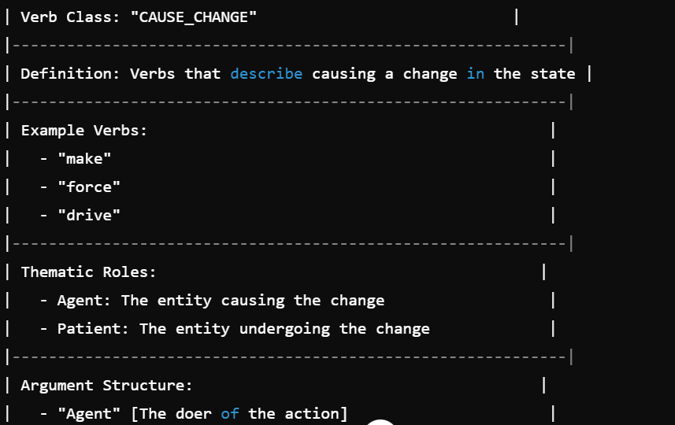

Slide 14
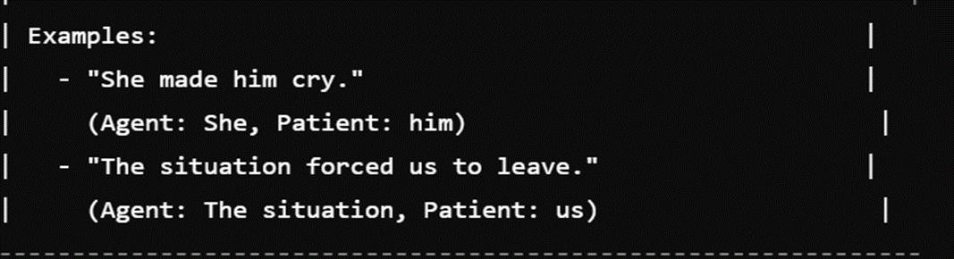

Slide 15
VerbNet is a resource that provides a comprehensive and detailed classification of English verbs based on their syntactic and semantic behaviors. It builds on the principles of WordNet and extends them to include information about verb argument structure and thematic roles. Here’s a detailed overview of VerbNet: What is VerbNet?
VerbNet:
A lexical resource that organizes verbs into classes based on their shared syntactic and
semantic properties. Each class groups together verbs that exhibit similar patterns of argument structure and verb frames.

Slide 16
Structure of VerbNet
Verb Classes:
Verb Classes: Verbs are grouped into classes according to their syntactic and semantic similarities. Each class represents a set of verbs that share common argument structures and can be used in similar syntactic frames.
Class Entries: Each entry provides information on the syntactic and semantic properties of the verbs in that class, including argument structure, thematic roles, and syntactic frames.
Frames and Thematic Roles:
Syntactic Frames: The possible syntactic constructions that a verb can appear in, such as transitive,
intransitive, or causative frames.
Thematic Roles: The roles that participants in a verb’s event play, such as Agent, Patient, Experiencer, or Goal.
Subclasses and Relations:
Subclasses: Verb classes can be further divided into more specific subclasses, providing more granular
information about verb behavior.
Hierarchical Relationships: Classes are organized hierarchically, with more general classes at the top and more specific ones below, reflecting how different verbs relate to one another.

Slide 17
Challenges and Limitations
Coverage: While comprehensive, VerbNet does not cover all verbs and may have gaps in its classification, particularly with more recent or less common verbs.
Language-Specific: VerbNet is primarily focused on English. Similar resources for other
languages are not as extensive, limiting cross-linguistic applications.

Slide 18
Conclusion
VerbNet is a valuable resource for understanding the syntactic and semantic properties of verbs in English.
By classifying verbs into detailed classes based on their argument structures and thematic roles, VerbNet supports a range of NLP applications, from semantic parsing to text generation. Despite its complexities and limitations, VerbNet remains an important tool for improving the accuracy and effectiveness of language processing systems.

Slide 19
IndoNET

Slide 20
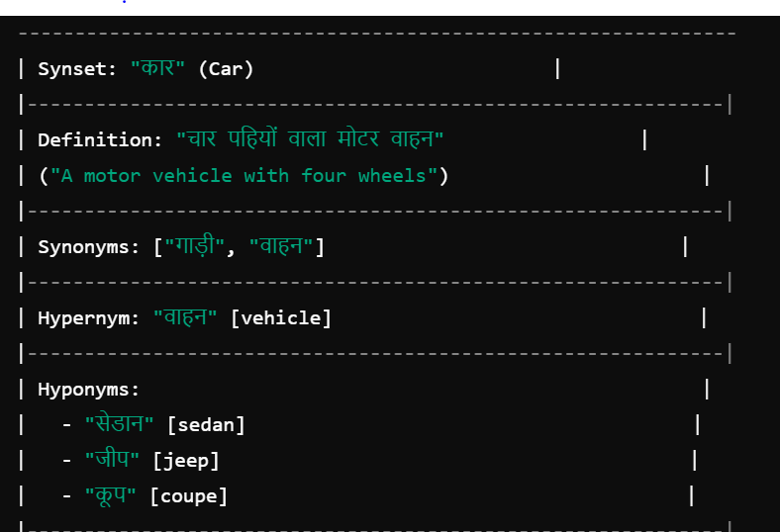

Slide 21
1.The IndoNet corpus is an important resource in Natural Language Processing (NLP) that deals with
Indian languages. Specifically, it is a lexical knowledge base project,but
similar to the WordNet
tailored for Indian languages.
Key Features of IndoNet:
Multilingual Lexical Resource:
IndoNet is a multilingual lexical resource that connects WordNets of multiple Indian languages
like Hindi, Bengali, Telugu, Tamil, and others.
It aims to standardize the vocabulary and concepts across these languages by providing semantic relationships (synonymy, antonymy, hyponymy, etc.) similar to Princeton's English WordNet.

Slide 22
WordNet Integration:
IndoNet integrates the WordNet structures of different Indian languages, making it possible to have
cross-lingual word sense relations.
Each word (or lexical unit) in IndoNet is linked with the corresponding concept or sense in Princeton's English WordNet, facilitating bilingual and multilingual tasks like machine translation or cross-lingual
information retrieval.

Slide 23
1.Challenges:
1. The diversity and complexity of Indian languages,
with their various scripts, syntax, and
rich morphological systems,
make building resources like IndoNet challenging. Nonetheless, it
is a crucial resource for advancing NLP in multilingual settings in India.
Example:
In the IndoNet corpus, the Hindi word "पानी" (water) would be linked to its corresponding senses in the Hindi WordNet, and then these senses would be connected to the corresponding word in the English WordNet ("water"). Similarly, in Bengali or Tamil WordNet, the equivalent word for "water" would also be linked to the same synset, allowing cross-lingual understanding and mapping.

Slide 24
The diversity and complexity of Indian languages present significant challenges in the development and implementation of resources like IndoNet. Indian languages encompass a wide array of scripts, such as Devanagari for Hindi, Bengali script for Bengali, and Tamil script for Tamil, each with unique orthographic and phonological features. Additionally, the syntax of these languages varies greatly, with languages like Hindi being subject-object-verb (SOV) and others like English being subject-verb-object (SVO). The rich morphological systems, particularly in languages like Malayalam and Kannada, involve extensive use of inflection and agglutination, leading to a large number of word forms for a single root.
For example, in Hindi, the verb "to go" (जाना - jānā) can have multiple forms like "गया" (gayā - went), "जाऊँ गा" (jāūngā - will go), "जाता हँ" (jātā hūn - going). Managing these variations across multiple languages in IndoNet requires sophisticated algorithms and extensive linguistic knowledge, making the task highly challenging.

Slide 25
QA corpus
A QA corpus (Question–Answer corpus) is a collection of questions and their corresponding answers used for training, testing, and evaluating Question Answering (QA) systems in Natural Language Processing (NLP).

Slide 26
What is QA Corpus?
A structured dataset that contains:
Questions (factoid, descriptive, yes/no, multiple-choice, etc.)
Answers (short spans, long text, knowledge-base entries, etc.)
Helps in training models to understand queries and provide correct answers.

Slide 27
Types of QA Corpus
Factoid QA Corpus
Contains short, factual questions (who, what, when, where).
Example:
Q: Who is the Prime Minister of India?
A: Narendra Modi
Yes/No QA Corpus
Questions with binary answers.
Example:
Q: Is water a compound?
A: Yes

Slide 28
List QA Corpus
Answers are lists of items.
Example:
Q: Name programming languages starting with P.
A: Python, PHP, Perl
Descriptive (Non-factoid) QA Corpus
Requires long, explanatory answers.
Example:
Q: Explain the process of photosynthesis.
A: Photosynthesis is the process by which green plants…

Slide 29
Reading Comprehension QA Corpus
A passage is given; answers are extracted from it.
Example: SQuAD dataset
Knowledge Base QA Corpus
Questions answered using structured knowledge bases (like Wikidata, Freebase).
Example: WebQuestions, SimpleQuestions
Community QA Corpus
Data from forums/Q&A websites like Quora, StackOverflow.
Example: Quora Question Pairs dataset

Slide 30
Applications of QA Corpus
Training chatbots and virtual assistants (like Alexa, Siri, ChatGPT).
Evaluating question answering systems.
Improving machine reading comprehension.
Building domain-specific QA systems (medical QA, legal QA, education QA).

Slide 31
Thank You

