Slide 1
Improving Checkout Experience for First-Time Mobile Shoppers
Comparative UI/UX Case Study
Your Name | Course | Date

Slide 2
Problem Statement & Objective
Problem:
• Cart abandonment due to friction in mobile checkout
• Cognitive overload from cluttered navigation
Objective:
• Evaluate Navigation, Visual Hierarchy & Checkout Flow

Slide 3
Research Method – Task-Based Testing
Task Given to Each App:
• Buy a black men’s T-shirt under ₹1000
Measured:
• Number of steps
• Visibility of filters
• Checkout clarity

Slide 4
Comparative Evaluation Table
App | Navigation | Visual Hierarchy | Checkout Flow
Amazon | Excellent | Strong CTA clarity | Fast (4 steps)
Flipkart | Moderate (Cluttered) | Offer-heavy | Medium (5 steps)
Meesho | Weak (Feed-style) | Inconsistent visuals | Slow (6 steps)

Slide 5
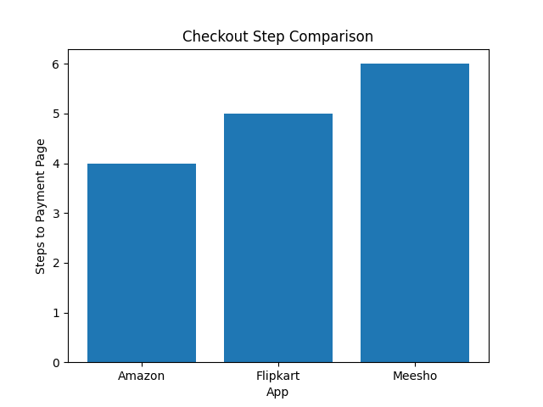
Checkout Step Count Comparison

Slide 6
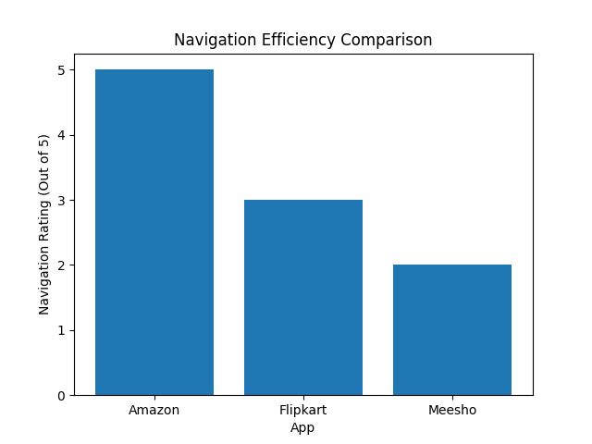
Navigation Rating Comparison

Slide 7
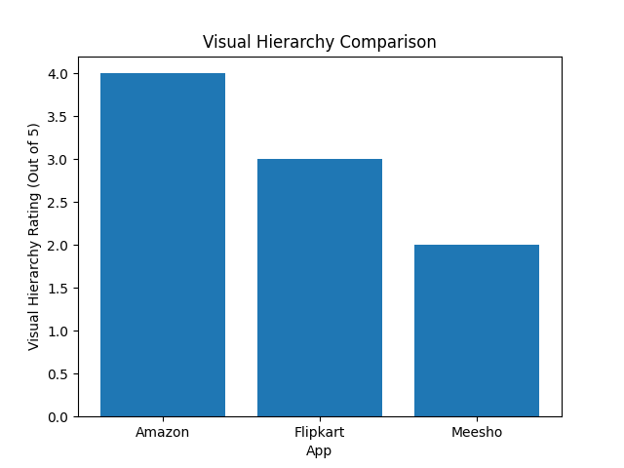
Visual Hierarchy Rating Comparison

Slide 8
Key Findings
• Fewer steps increase conversion probability
• Clear CTA placement reduces hesitation
• Excessive banners increase cognitive load
• Urgency-based design reduces trust

Slide 9
Design Recommendations
• Reduce homepage clutter
• Expose filters upfront
• Implement sticky bottom CTA
• Remove dark-pattern urgency triggers

