Slide 1
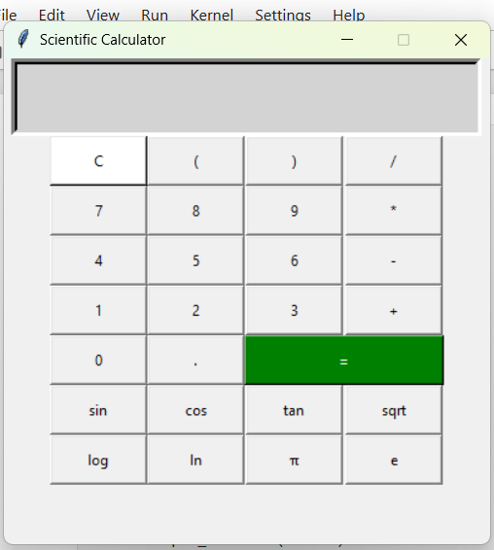
SCIENTFIC CALCULATOT

Slide 2
Scientific Calculator Project
Using Python (Tkinter & Math Library)

Slide 3
Objective
• To design and implement a GUI-based scientific calculator.
• Provide both basic arithmetic and advanced scientific functions.
• Ensure user-friendly interface with Tkinter.

Slide 4
Tools & Technologies
• Python Programming Language
• Tkinter (GUI library)
• Math module for scientific functions
• Object-Oriented Programming concepts

Slide 5
Features
• Basic operations: Addition, Subtraction, Multiplication, Division
• Parentheses support
• Decimal calculations
• Scientific functions: sqrt, log, ln, sin, cos, tan
• Constants: π, e
• Error handling

Slide 6
Workflow
1. User inputs expression through GUI buttons.
2. Expression is updated in input field.
3. On pressing '=', eval() computes result.
4. Scientific functions handled via math module.
5. Results displayed in entry box.

Slide 7
Output
• GUI shows calculator layout.
• Buttons respond to user clicks.
• Results appear instantly.

Slide 8
Conclusion & Future Scope
• Successfully implemented a GUI-based scientific calculator.
• Combines basic and scientific operations in one interface.
• Future Enhancements:
- Add history of calculations
- Support for more advanced functions (factorial, power, exp)
- Degree/Radian toggle

