Slide 1
OPENAI BUILD WEEK · CODEX + GPT-5.6
Ledger Sense
A safety-first reasoning layer for the ambiguous AR payments traditional rule engines leave behind.
GPT-5.6 resolves ambiguity. Deterministic code verifies every dollar.
Ledger Sense AI | Work & Productivity

Slide 2
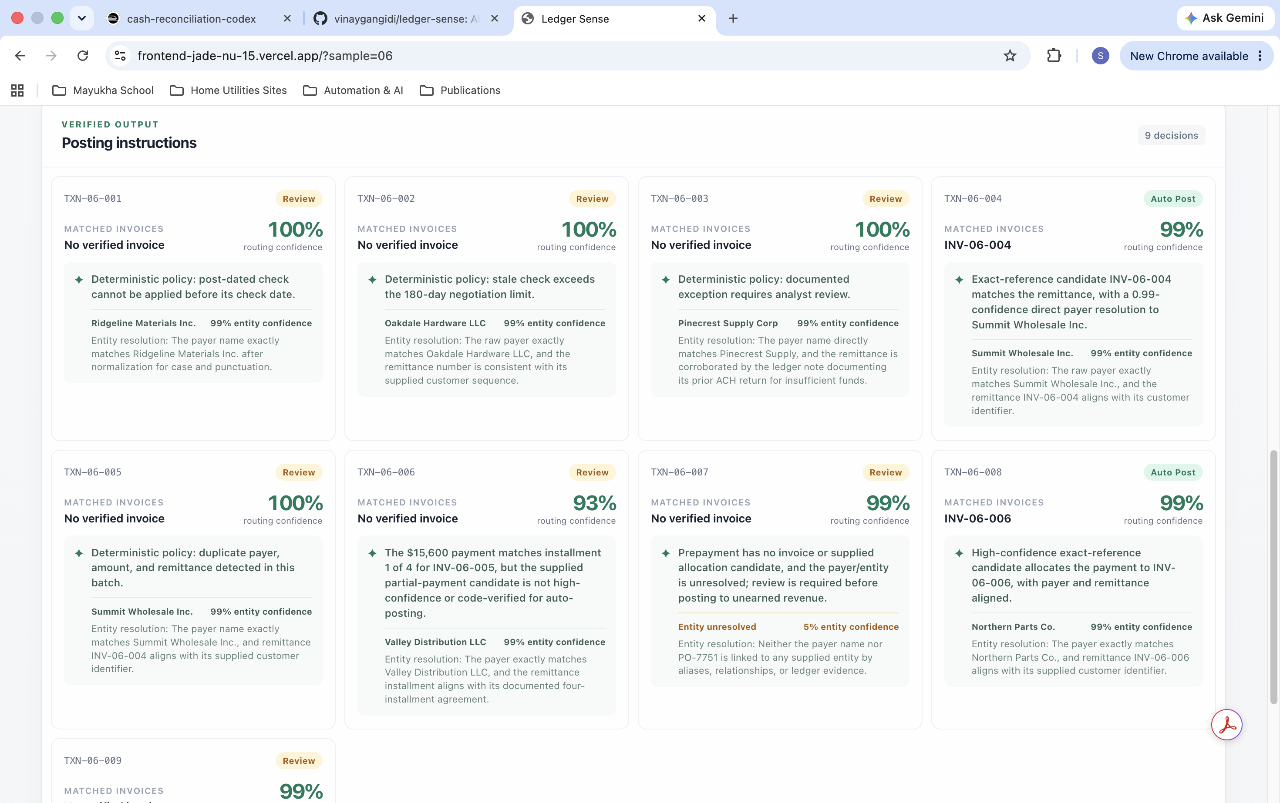
THE PROBLEM
The hard 15–20% of payments need judgment, not another rule.
Bank statements arrive with truncated payer names, factoring intermediaries, partial payments, disputed invoices, and compliance holds. Exact-match automation stops there.
TRUNCATED NAMES
FACTORING
DISPUTES
Messy incoming payments beside the internal open-AR ledger
LEDGER SENSE · OPENAI BUILD WEEK
2

Slide 3
HOW IT WORKS
Five agents separate judgment from financial truth.
Bank payments
+ Open AR
1. Normalize
Deterministic + GPT-5.6
2–3. Index & verify
Deterministic Decimal math
4. Reason exceptions
GPT-5.6 + hard gates
5. Create postings
Deterministic
Input
Entity resolution
Candidate evidence
Route decision
Posting instruction
Every stage appends its decision to SQLite audit events; SSE streams the same progress to the Next.js dashboard.
LEDGER SENSE · OPENAI BUILD WEEK
3

Slide 4
SAFETY ARCHITECTURE
A model recommendation is never enough to move money.
1
2
3
4
Deterministic math
GPT-5.6 judgment
Hard gates
Append-only audit
Amounts, allocations, duplicate checks, and FX calculations use Decimal-backed code.
Entity resolution, aliases, factoring relationships, and analyst-readable routing rationales.
Compliance and legal holds cannot be bypassed. Auto-post requires a verified allocation at ≥95%.
Every agent decision is recorded; no updates or deletes are permitted.
Worked example
A prior test found an unsafe auto-post recommendation without a verified invoice. The fix: the routing safety gate forces review unless deterministic code verifies the allocation.
LEDGER SENSE · OPENAI BUILD WEEK
4

Slide 5
DATA PRIVACY
Model context is intentionally narrow and reviewable.
Sent to GPT-5.6
Explicitly not forwarded
• Payer and remittance text
• Amount, currency, payment type
• Statement date and transaction ID
• Customer identity catalog
• Narrow deterministic candidate facts
• Account and routing numbers
• Tax IDs or arbitrary upstream fields
• Full ledger records
• Invoice amounts beyond scoped deterministic facts
An enforced payment-field allowlist and regression test keep new sensitive integration fields local by default.
LEDGER SENSE · OPENAI BUILD WEEK
5

Slide 6
HOW CODEX MATTERED
Codex accelerated implementation—and exposed the design flaws worth fixing.
01
02
03
Designed
Debugged
Verified
Defined the five-agent split: code for math, GPT-5.6 for ambiguity, gates for irreversible actions.
Found the unsafe auto-post path, environment-key shadowing, confidence calibration drift, and alias mapping defects.
Built synthetic edge cases, privacy allowlist tests, and a live cross-sample audit across all 83 transactions.
LEDGER SENSE · OPENAI BUILD WEEK
6

Slide 7
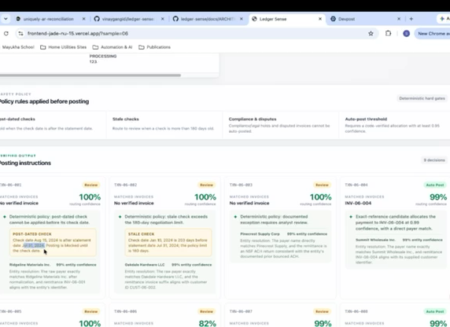
EVIDENCE
The demo makes the safety policy visible—not hidden in a prompt.
34
83 / 83
5
real-world AR edge cases
cross-sample audit checks passing
specialized agents
Human review remains the default whenever evidence is incomplete, ambiguous, or blocked by policy.
LEDGER SENSE · OPENAI BUILD WEEK
7

Slide 8
LEDGER SENSE
Reason through
what rules cannot.
GPT-5.6 for ambiguity.
Deterministic verification for financial truth.
Hard gates for trust.
github.com/vinaygangidi/ledger-sense
OpenAI Build Week · 2026

