Slide 1
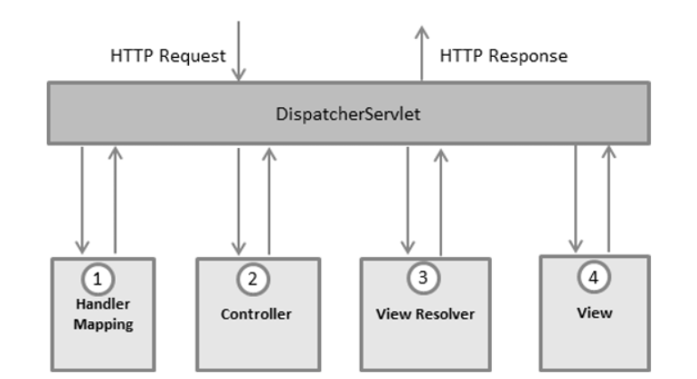
Spring MVC

Slide 2
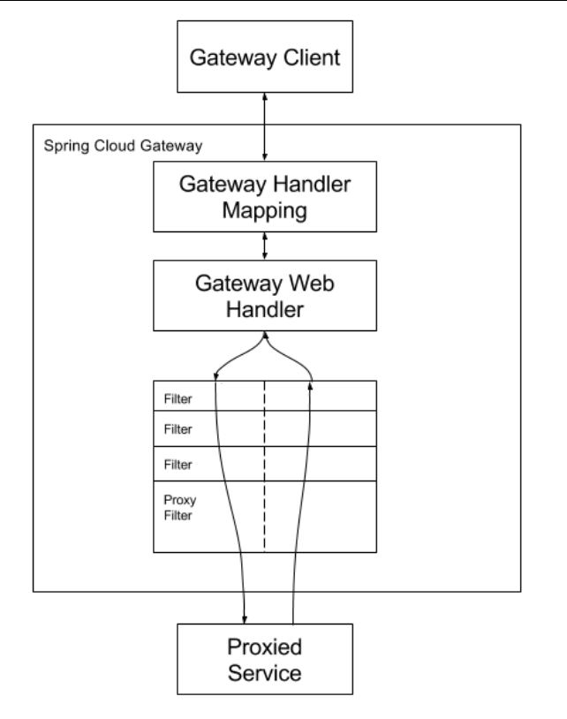
Spring Cloud Gateway
• Spring Cloud Gateway matches routes using the Spring WebFlux HandlerMapping infrastructure. • Spring Cloud Gateway makes use of the Actuator API, a well-known Spring-Boot library that provides several out-of-the-box services for monitoring the application.
• Gateway pattern to retrieve data from multiple services with a single request.
• out-of-the-box routing mechanisms often used in microservices applications as a way of hiding multiple services behind a single facade

Slide 3
References
https://cloud.spring.io/spring-cloud-gateway/reference/html/

