Slide 1
DATA STRUCTURES AND ALGORITHMS · FINAL REVIEW
Intelligent Content Moderation and Sensitive Pattern Detection
Automated detection of offensive, harmful, and prohibited content.
2510030417 — Srianish · 2510030339 — Vinay Goud · 2510030353 — Numair · 2510030336 — Mohit

Slide 2





01 — THE SCALING PROBLEM
Manual moderation cannot scale with user-generated text
Slow and expensive
Lists miss variation
Core question
Basic keyword filters miss variations and depend on constantly maintained keyword lists.
False positives
Core question: how can DSA detect sensitive patterns efficiently at high text volume?
Manual review is slow, difficult to scale, inconsistent, and expensive.
False positives make simple filtering unreliable.
Intelligent Content Moderation and Sensitive Pattern Detection
2

Slide 3
02 — HYBRID PIPELINE
A hybrid pipeline turns raw text into a moderation decision
Each stage narrows uncertainty before the final moderation action.
01
02
03
04
05
Clean and tokenize
Search candidates
Verify
Classify
Moderate
Clean, normalize, and tokenize the input.
Use string matching and hash-based lookup.
Verify candidates with randomized checks.
Assign safe, sensitive, offensive, or prohibited.
Support an allow, flag, or block action.
Intelligent Content Moderation and Sensitive Pattern Detection
3

Slide 4
Input flows through five decision layers
User input
Receive text.
Preprocessing
Clean, normalize, and tokenize.
Detection engine
Combine string matching, hashing, and randomized checks.
Classification
Assign a risk category.
Moderation result
Allow, flag, block, or escalate.
Intelligent Content Moderation and Sensitive Pattern Detection
4

Slide 5
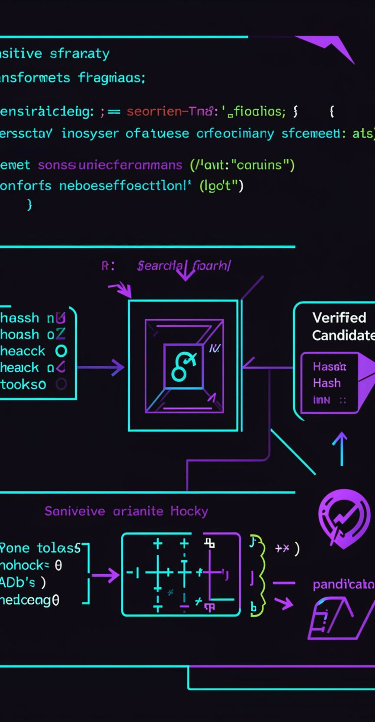
04 — DETECTION ENGINE
Three algorithmic ideas power detection
String matching
Hashing
Search input text for sensitive patterns.
Turn patterns into hash values for fast lookup.
Randomized algorithms
String processing
Filter candidates, then verify likely matches.
Clean, tokenize, and normalize text.
Intelligent Content Moderation and Sensitive Pattern Detection
5

Slide 6
05 — DATA STRUCTURES AND COMPLEXITY
Data structures reduce unnecessary comparisons
The optimization path is explicit: large input → preprocessing → candidate filtering → efficient matching → verification.
String / array
List
Hash map
Set
Map / dictionary
Store and process text.
Store sensitive patterns.
Support fast pattern lookup.
Keep patterns unique.
Connect categories with results.
COMPLEXITY
AVERAGE LOOKUP
MATCHING
O(N)
O(1)
Algorithm-dependent
Preprocessing for input length N
Hash lookup
Matching complexity depends on the selected algorithm.
Intelligent Content Moderation and Sensitive Pattern Detection
6

Slide 7
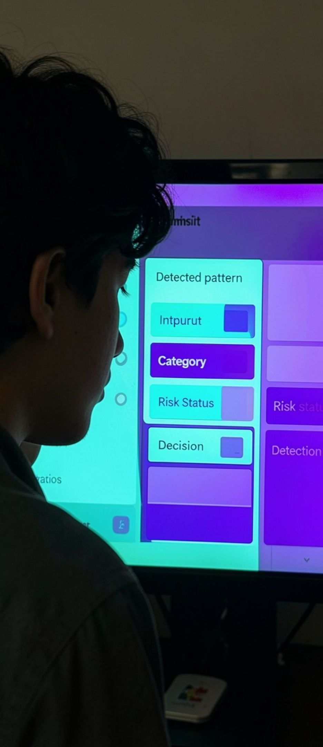




06 — PROTOTYPE
The prototype connects detection to a usable dashboard
A modular implementation links text processing, hybrid matching, classification, and moderation action.
Programming
Text processing
Python / Java.
NLTK + spaCy.
Search and storage
Interface
Hash-based lookup + Elasticsearch.
Streamlit dashboard.
Intelligent Content Moderation and Sensitive Pattern Detection
7
Modules: preprocessing · sensitive pattern detection · hybrid matching · randomized detection · classification · moderation dashboard

Slide 8
07 — TESTING AND EVALUATION
Testing separates safe, sensitive, and prohibited outcomes
Each test case connects detection evidence to classification and moderation action.
Test case | Detection | Classification | Action
Safe text | No pattern detected | SAFE | ALLOW
Sensitive text | Pattern detected | SENSITIVE | FLAG
Prohibited text | Detected and verified | PROHIBITED | BLOCK / ESCALATE
Safe text: “The weather is beautiful today.” · Evaluate with detection accuracy, false-positive rate, false-negative rate, processing time, throughput, and latency. No measured percentages or timings are supplied yet.
Intelligent Content Moderation and Sensitive Pattern Detection
8

Slide 9

08 — SCALE AND APPLICATION
Fast detection can support moderation across high-volume text
Advantages: fast pattern detection, efficient lookup, scalable processing, hybrid matching, and automated moderation support.
Applications: social media comments, content moderation, cybersecurity, and harmful or abusive e-commerce reviews.
Future scope: context-aware detection, machine learning integration, multilingual support, real-time streaming, adaptive pattern databases, and advanced moderation analytics.
Intelligent Content Moderation and Sensitive Pattern Detection
9

Slide 10
09 — FINAL REVIEW
DSA turns moderation into a systematic, scalable process
01
02
03
04
Find
Accelerate
Verify
Moderate
String matching finds candidate patterns.
Hashing accelerates lookup.
Randomized algorithms support filtering and verification.
Efficient text processing connects detection to classification and moderation.
“Efficient algorithms can transform large-scale text moderation into a faster, systematic and scalable process.”
Final deliverables: working implementation · testing and evaluation · Streamlit prototype · project report · source code · final demonstration
Intelligent Content Moderation and Sensitive Pattern Detection
10

