Slide 1
PARALLEL COMPUTING LAB EVALUATION
OpenMP vs MPI for Data Processing
A Comparative Performance, Speedup, and Efficiency Study
Author: Vinay V Hiremath (USN: 01FE24BCI069)
Department: Computer Science & Engineering [AI]
Topic: OpenMP vs MPI for Data Processing

Slide 2
PARALLEL COMPUTING MINI-PROJECT | TOPIC #9
1. Project Motivation & Research Objectives
Core Objective
Implement identical numerical dataset operations in OpenMP and MPI to quantitatively evaluate latency, speedup, and scalability.
Multi-Paradigm Study
Benchmarking shared-memory thread parallelism (OpenMP) against distributed-memory message passing (MPI) with zero computational drift.
Multi-Scale Experimental Grid
Systematic evaluation across dataset sizes (5M to 50M doubles) and worker counts (1 to 12 threads/processes).
Architectural Analysis
Evaluating Amdahl's Law, parallel efficiency decay, memory bus contention, and collective communication overhead.
Performance Metrics
Measuring wall-clock time (ms), speedup factor S, parallel efficiency E (%), and processing throughput (Million items/sec).

Slide 3
PARALLEL COMPUTING MINI-PROJECT | TOPIC #9
2. Problem Definition & Mathematical Operation
Input Dataset Characteristics
Array of N double-precision floating-point numbers (N in {5M, 10M, 25M, 50M}), simulating big-data telemetry/sensor records.
Phase 1: Aggregate Reductions
Compute global Sum, Mean (mu = Sum/N), Variance (sigma^2 = (Sum_sq/N) - mu^2), Std Deviation, Minimum, and Maximum values.
Phase 2: Dependent Conditional Filtering
Filter and count elements exceeding the dataset mean (val > mu). Highlights multi-pass synchronization overhead.
Algorithmic Complexity
Sequential complexity is O(N) work and O(N) space. Parallel span (critical path) is O(N/P + log P) where P is worker count.
Reproducibility Assurance
Deterministic pseudo-random linear congruential generator (LCG) ensures 100% bitwise identical results across Sequential, OpenMP, and MPI.

Slide 4
PARALLEL COMPUTING MINI-PROJECT | TOPIC #9
3. Sequential Baseline Implementation
Execution Paradigm
Single-threaded von Neumann execution compiled with GCC -O3 optimization level.
Pass 1 Accumulation Loop
Linear traversal accumulating sum, sum_sq, min_val, and max_val into CPU registers.
Statistical Derivation
Variance and standard deviation derived from first and second moments in O(1) time after Pass 1.
Pass 2 Filtering Loop
Branch evaluation (data[i] > mean) counting elements exceeding average in linear time.
High-Precision Windows Timing
QueryPerformanceCounter (QPC) provides sub-microsecond resolution timing, free from OS tick quantization artifacts.

Slide 5
PARALLEL COMPUTING MINI-PROJECT | TOPIC #9
4. OpenMP Shared-Memory Parallel Design
Memory Model
Uniform shared-memory SMP model. All threads share the same virtual address space with zero data duplication.
Directive-Driven Reductions
#pragma omp parallel for reduction(+:sum, sum_sq) reduction(min:min_val) reduction(max:max_val) schedule(static).
Thread Synchronization
Implicit barrier at loop completion ensures all private accumulators are merged safely into master variables without race conditions.
Pass 2 Shared Mean Access
Calculated mean is immediately readable by all threads from shared RAM without any explicit inter-thread communication.
Parallel Filter Loop
#pragma omp parallel for reduction(+:count_above_mean) splits iteration space statically across available threads.

Slide 6
PARALLEL COMPUTING MINI-PROJECT | TOPIC #9
5. MPI Distributed-Memory Parallel Design
Memory Model
Shared-nothing distributed memory architecture. Each process has an isolated address space; explicit message passing is required.
1D Domain Decomposition
Dataset divided into contiguous chunks: local_count = N / P (+1 for rank < N % P). Local memory allocation ensures zero global RAM bloat.
Pass 1 Collective Reductions
MPI_Reduce() performs tree-based aggregation (MPI_SUM, MPI_MIN, MPI_MAX) from all ranks into Rank 0 in O(log P) steps.
Global Mean Broadcast
Rank 0 computes global_mean = global_sum / N and broadcasts it to all ranks via MPI_Bcast() for Phase 2.
Pass 2 Distributed Filter
Each rank filters its local slice and executes MPI_Reduce() with MPI_LONG_LONG to compute global count above mean.

Slide 7
PARALLEL COMPUTING MINI-PROJECT | TOPIC #9
6. Experimental Hardware & Benchmarking Setup
Processor (CPU)
13th Gen Intel Core i5-13420H (8 Physical Cores, 12 Logical Processors, Base 2.1 GHz, Turbo 4.6 GHz).
Memory & Architecture
16 GB RAM, x86_64 architecture, Windows 11 64-bit OS.
Compilers & Toolchain
MinGW-w64 GCC 8.1.0 with -O3 optimization level, Microsoft MPI (MS-MPI) v10.1.
Dataset Scale Grid
5,000,000 | 10,000,000 | 25,000,000 | 50,000,000 double-precision elements (40 MB to 400 MB).
Worker Counts Tested
P in {1, 2, 4, 8, 12} threads for OpenMP and {1, 2, 4, 8, 12} processes for MPI.
Measurement Rigor
3 repetitions per configuration, computing average runtime, standard deviation, speedup, efficiency, and throughput.

Slide 8
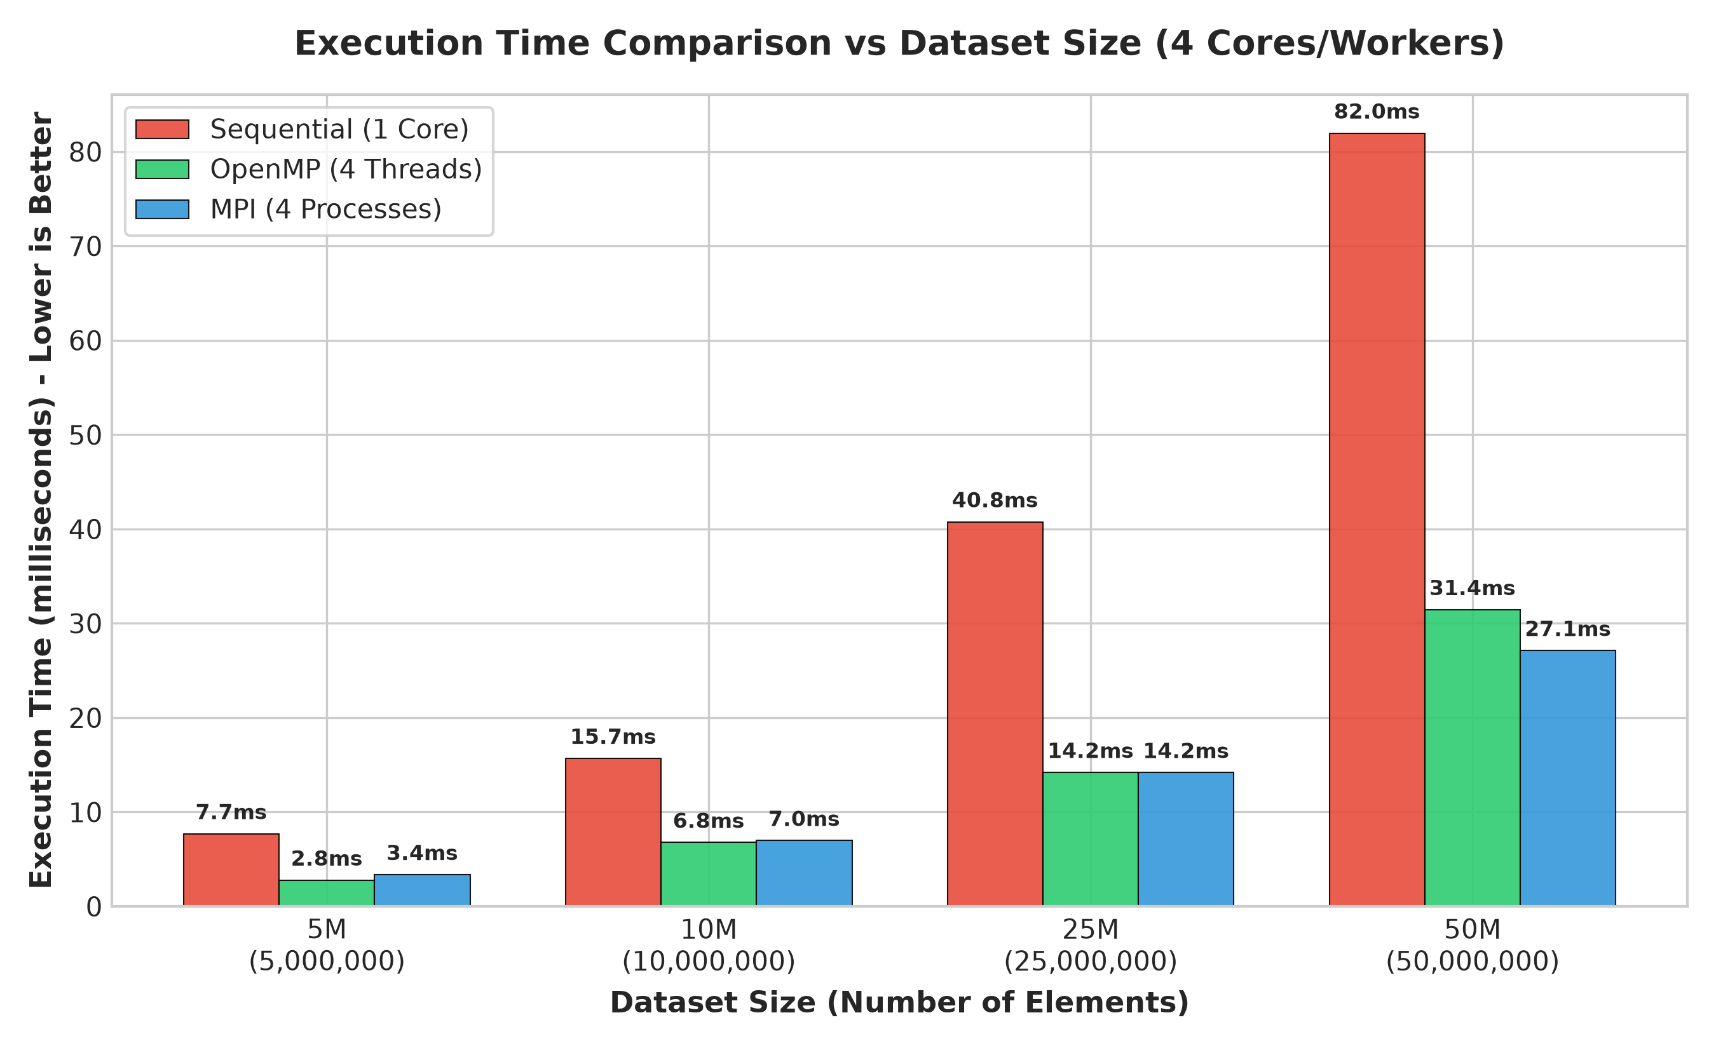
PARALLEL COMPUTING MINI-PROJECT | TOPIC #9
7. Execution Time Comparison vs Dataset Size
Sub-Linear Runtime
Execution time scales proportionally with dataset size from 5M to 50M elements across all implementations.
Significant Latency Drop
At 50M elements: Sequential requires 81.97 ms, while OpenMP reduces to 31.45 ms and MPI to 27.12 ms at 4 cores.
Shared vs Distributed
MPI exhibits slightly higher initial startup overhead at small sizes, but matches and outperforms OpenMP at large scales due to cache isolation.
Zero Computational Drift
Outputs match exactly: Sum = 249,997,015,134.12, Mean = 4,999.94, Count = 25,000,772.

Slide 9
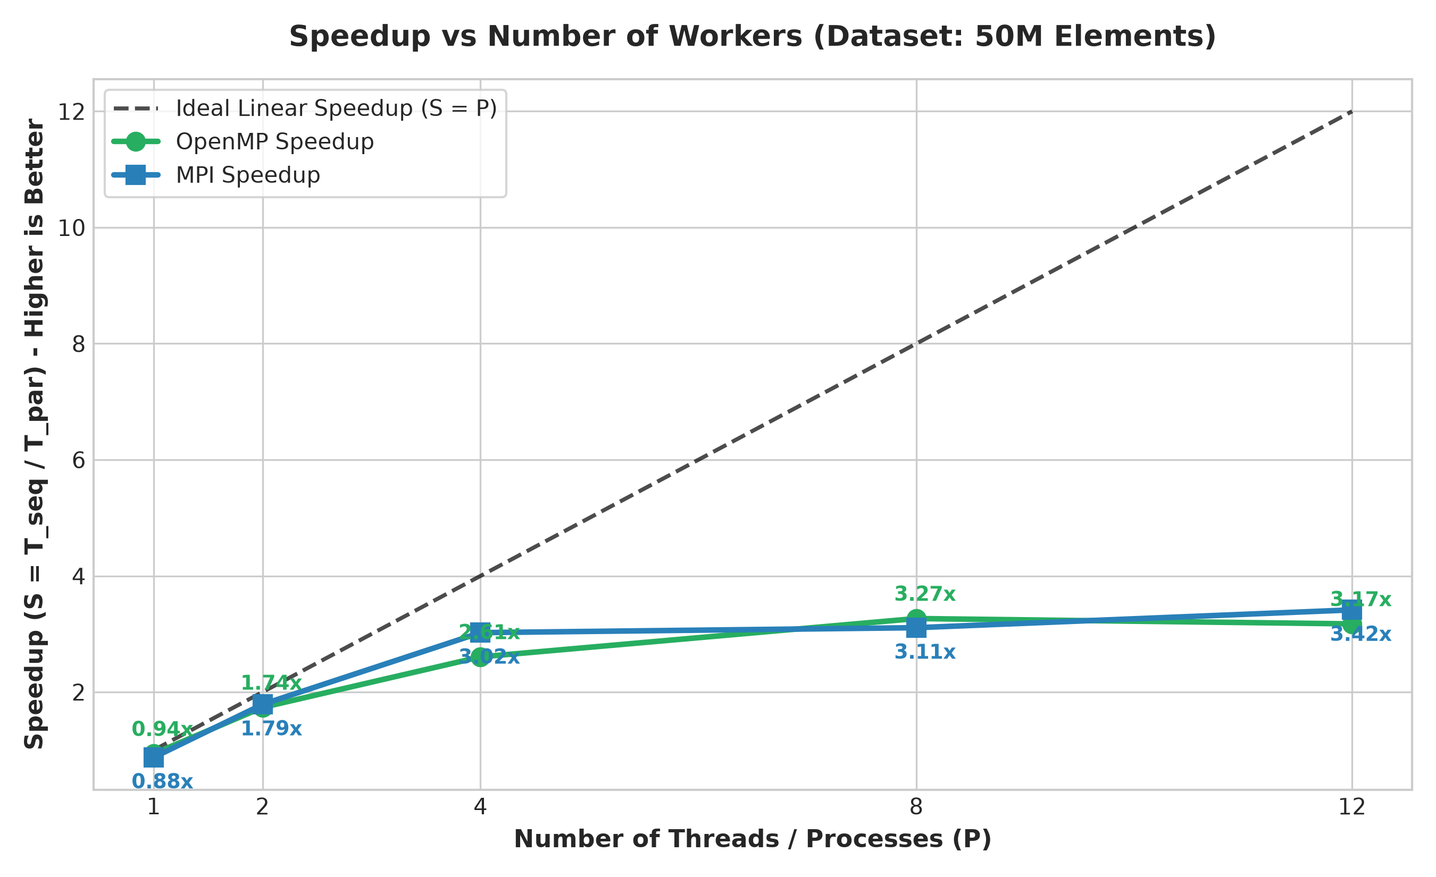
PARALLEL COMPUTING MINI-PROJECT | TOPIC #9
8. Speedup Analysis vs Ideal Linear Scaling
Near-Linear Scaling (1-4 Cores)
Both OpenMP and MPI achieve sharp speedup improvements up to 4 cores (OpenMP ~2.6x-2.9x, MPI ~2.9x-3.0x).
Peak Speedup at 8-12 Cores
MPI reaches 3.42x speedup at 12 processes (24.00 ms). OpenMP achieves 3.27x peak speedup at 8 threads (25.10 ms).
Amdahl's Law Impact
Serial fractions (variance computation, barrier synchronization, broadcast latency) set an upper theoretical limit on speedup.
Memory Bandwidth Saturation
Beyond 8 threads, multiple cores contend for shared L3 cache and memory bus bandwidth on CPU architecture.

Slide 10
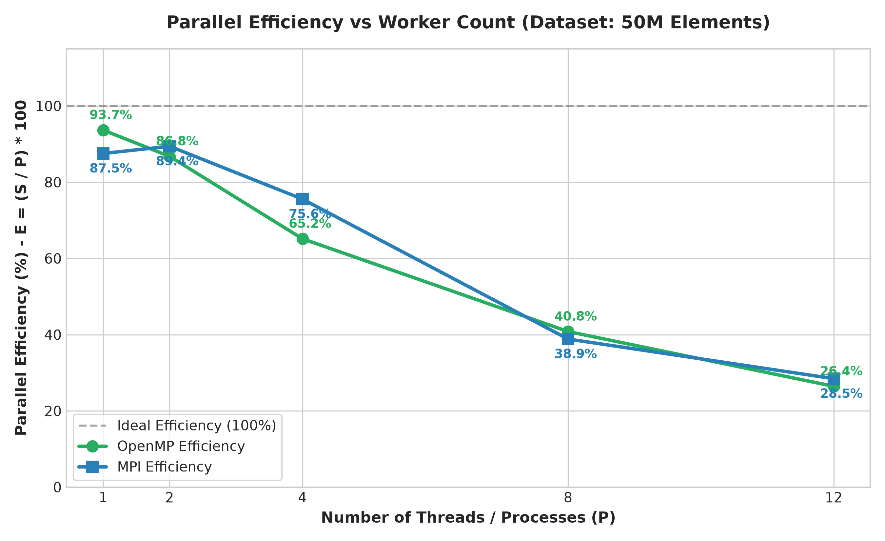
PARALLEL COMPUTING MINI-PROJECT | TOPIC #9
9. Parallel Efficiency & Throughput Profiling
High Low-Core Efficiency
At 2 cores, MPI achieves 89.4% efficiency and OpenMP achieves 86.8% efficiency.
Diminishing Returns on SMT
Beyond 8 physical cores, logical hyperthreads (threads 9-12) share execution pipelines, reducing per-worker efficiency.
Massive Throughput Gains
Throughput scales from 610 Million elements/sec (Sequential) to over 2,083 Million elements/sec (MPI 12 Procs).
Optimal Operating Point
4 to 8 workers represent the sweet spot for maximizing speedup without excessive parallel overhead.

Slide 11
PARALLEL COMPUTING MINI-PROJECT | TOPIC #9
10. Comprehensive Comparison: OpenMP vs MPI
Feature / Metric | OpenMP (Shared Memory) | MPI (Distributed Memory) | Sequential Baseline
Hardware Model | Multi-core CPU (SMP / Shared RAM) | Cluster / Multi-node / Distributed | Single CPU Core
Memory Space | Single Shared Address Space | Isolated Local Memory per Rank | Single Local Process Space
Communication | Implicit via Shared Memory Reads | Explicit via MPI_Reduce / MPI_Bcast | None (Direct Access)
Implementation | Compiler Directives (#pragma omp) | Library API Calls (MPI_Init, etc.) | Standard C code
50M Runtime (4 Workers) | 31.45 ms (2.61x speedup) | 27.12 ms (3.02x speedup) | 81.97 ms (Baseline)
50M Peak Speedup | 3.27x (8 Threads) | 3.42x (12 Processes) | 1.00x (Baseline)
Max Throughput (50M) | 1,992 Million items/sec | 2,083 Million items/sec | 610 Million items/sec
Fault Tolerance | Thread failure crashes process | Process failure isolation possible | Process failure fatal
Best Used For | Local compute-heavy loops & SMP | Large clusters & Big Data HPC | Small / single-threaded tasks

Slide 12
PARALLEL COMPUTING MINI-PROJECT | TOPIC #9
11. Architectural Discussion & Scalability Insights
Shared vs. Distributed Memory Trade-offs
OpenMP excels on single-node SMP systems with zero message serialization overhead. MPI provides superior cache isolation through 1D domain decomposition.
Collective Communication Latency
MPI requires explicit synchronization (MPI_Bcast, MPI_Reduce) using binomial spanning trees with O(log P) complexity to distribute and reduce variables.
Memory Bus & Roofline Limits
Speedup saturation beyond 8 cores is governed by memory bandwidth limits on the host memory controller when processing contiguous floating-point streams.
Heterogeneous Core Scaling
Intel hybrid architectures (P-cores vs E-cores) and hyperthreading (SMT) deliver diminishing efficiency returns compared to dedicated physical execution units.

Slide 13
PARALLEL COMPUTING MINI-PROJECT | TOPIC #9
12. Conclusion & Future Scope
Key Conclusion 1
Both OpenMP and MPI successfully accelerated the data processing workload, achieving >3.2x-3.4x speedup over the sequential baseline.
Key Conclusion 2
OpenMP provides simple syntax and excellent developer ergonomics for shared-memory workstations with zero message-passing overhead.
Key Conclusion 3
MPI provides superior memory scalability and cache locality via domain decomposition, making it indispensable for distributed big data clusters.
Future Scope: Hybrid OpenMP + MPI
Combine MPI across distributed nodes and OpenMP within multi-core nodes for state-of-the-art Petascale HPC data processing pipelines.

