Slide 1

Project Presentation & Demonstration on Sentimental analysis of Twitter Data on Economic Crisis During COVID-19
Students:
1.Vinay D (1RN19CS181)
2.Vinay H R (1RN19CS182)
3.Vivek S Hegde(1RN19CS186)
Guide:
Prof. Phanikanth K V
Asst. Prof. Dept. of CSE, RNSIT
Department of Computer Science and Engineering
RNS INSTITUTE OF TECHNOLOGY
2022-23

Slide 2
CONTENTS
INTRODUCTION
Problem Statement
Existing System and Limitations
Proposed system
REQUIREMENTS
Functional Requirements
Non-functional Requirements
Hardware & Software Requirements
SYSTEM ARCHITECTURE/BLOCK DIAGRAM
System architecture
Data Flow Diagrams (DFD)/ Flow charts
DETAILED DESIGN (Module wise)
Libraries used / API’s
IMPLIMENTATIONS (Module wise)
Algorithm/Methods/Pseudo code
RESULT ANALYSIS
Snapshots
CONCLUSION
Conclusion
REFERENCES

Slide 3
INTRODUCTION
Problem Statement
COVID-19 created some severe issues in every nation like downfall in the economy and thus in GDP and other impacts. The social media platforms like Twitter, Facebook, etc. gave people to just express their opinions but did not feature any type analysis on these opinions.
Existing System and Limitations
The social media platforms like Twitter, Facebook, etc gives people to express their opinions but did not feature any type analysis on these opinions to bring sentiments out of it which is valuable.
Proposed system
Through our project we will analyse sentiments of various tweets on economic crisis tweeted by various twitter users. This analytics can help various organizations in improving their service to the people or to their employees leading to its growth in various aspects including in finance and social relationships and government of different countries for better governance of people or improving its foreign relationships among countries or to assess and improve on economic situation.

Slide 4
REQUIREMENTS
Functional Requirements
Data Extraction:- Using “Tweepy” API python to extract tweets.
Data Preprocessing:- Using Natural Language Toolkit (NLTK) library of Python and regular expressions.
Vader Lexicon Sentiment Analysis Tool:- Tweets are classified as positive, negative, neutral, using Vader library
Machine learning classification techniques:- Primarily algorithms like Naïve Bayes, Support Vector Machine (SVM), Logistic Regression models are trained on tweets dataset which can be later used to analyze sentiment of new tweets.
Non-functional Requirements
Accessibility:- The design of services or environments so as to be easily usable by people. (Web Application)
Emotional factors:- Users emotions can be understood.
Maintainability:- Tools used are open source and has easy documentation support.

Slide 5
Hardware Requirements Software Requirements
Name of Components | Specification
Operating System | Windows 10 or 11
Language | Python, HTML, CSS, JavaScript
Browser | Google Chrome
Integrated Development Environment | Microsoft Visual Studio Code
Name of Components | Specification
Processor | Intel CORE i5 10th Gen
RAM | 8GB
Hard Disk | 256 GB SSD

Slide 6
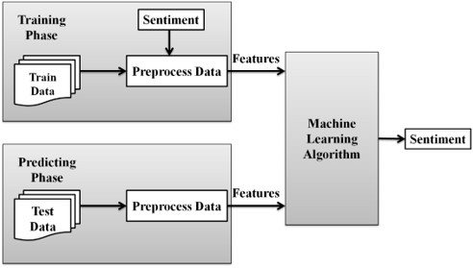
SYSTEM ARCHITECTURE/BLOCK DIAGRAM

Slide 7
Data collection: The first step is to collect a sample of Twitter data related to the topic of interest (in this case it is on economic crisis). This can be done using the Twitter API or by using web scraping tools to extract tweets containing specific hashtags.
Data cleaning and preprocessing:- Once the data has been collected, it needs to be cleaned and preprocessed to remove any irrelevant information and prepare it for analysis. This may involve removing, twitter handles, hyperlinks, hashtags, stop words, punctuation, and special characters, as well as stemming or lemmatizing the text to reduce the dimensionality of the data.
Text representation:- The next step is to represent the preprocessed text in a numerical format that can be used for analysis. This can be done using methods such as bag-of-words, TF-IDF (term frequency-inverse document frequency), or word embeddings.
Classification Procedure:- Machine Learning models are trained from dataset. Then new tweets are imported from twitter by providing hash tag or a query on a subject by using SNScrape or tweepy libraries. The imported tweets are analyzed for their sentiments and classified as positive, negative, and neutral by trained Machine Learning models like Naïve Bayes, Support Vector Machine (SVM), Logistic Regression models along with Vader Library and the results of ML models and Vader are compared to prove that the Machine Learning models prediction are comparable with Vader library’s classification.

Slide 8
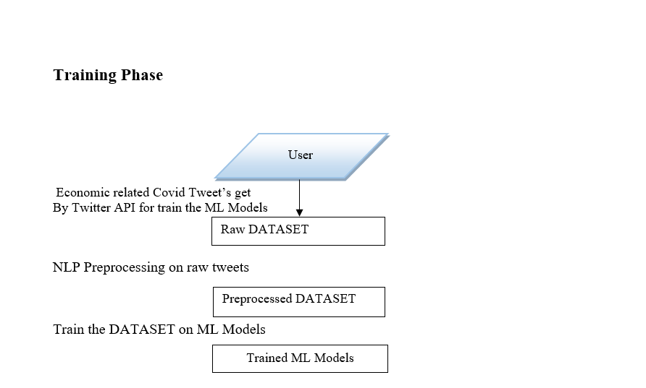
Data Flow Diagrams (DFD)/ Flow charts

Slide 9
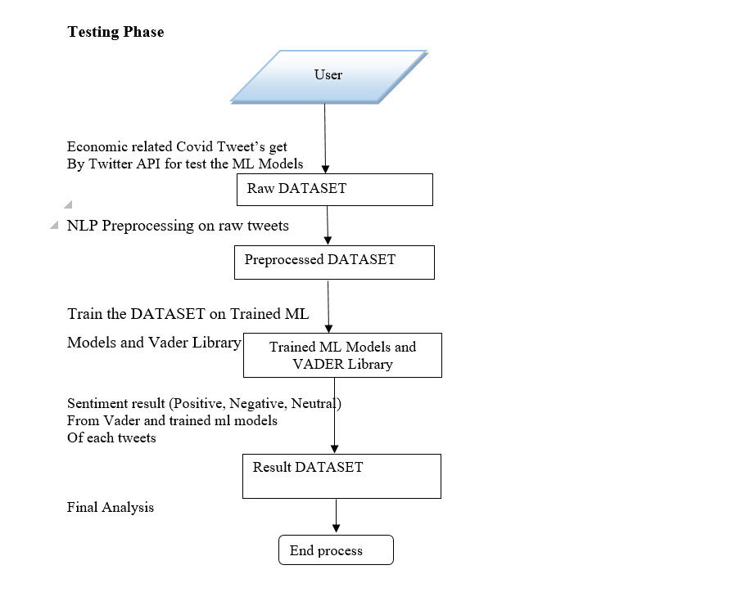
Compare ML and Vader Library Results

Slide 10
Libraries used / API’s
Tweepy
Tweepy is a Python library that provides a simple interface for accessing the Twitter API. The Twitter API allows developers to programmatically access a wide range of Twitter data, including tweets, user profiles, and follower lists, and more. Tweepy simplifies the process of interacting with the Twitter API by ways to authenticate, build requests, and parse responses. Tweepy provides a simple interface for handling real-time streaming of Twitter data, such as tweets matching specific keywords in query or hashtags to search.

Slide 11
SNScrape
SNScrape is a Python library that is used for scraping social media data from various platforms such as Twitter, Instagram, and YouTube. It provides an alternative way to collect data from social media platforms that do not offer a public API or limit access to their API. SNScrape works by scraping the HTML code of a social media page and extracting relevant information such as tweets, Instagram posts, and YouTube videos. SNScrape is particularly useful for need to collect large amounts of social media data for analysis. It can be used to collect data for sentiment analysis, trend analysis, or any other type of analysis that requires social media data. It is compatible with major OS distributions like Windows, Linux and macOS.

Slide 12
IMPLEMENTATION
Algorithms
Support Vector Classifier:
Support Vector Machine (SVM) is a supervised machine learning algorithm used for both classification and regression.
The objective of SVM algorithm is to find a hyper plane in an N-dimensional space that distinctly classifies the data points.
The dimension of the hyper plane depends upon the number of features.
If the number of input features is two, then the hyper plane is just a line. If it is three, then the hyper plane becomes a 2-D plane. It becomes difficult to imagine when it exceeds three.

Slide 13
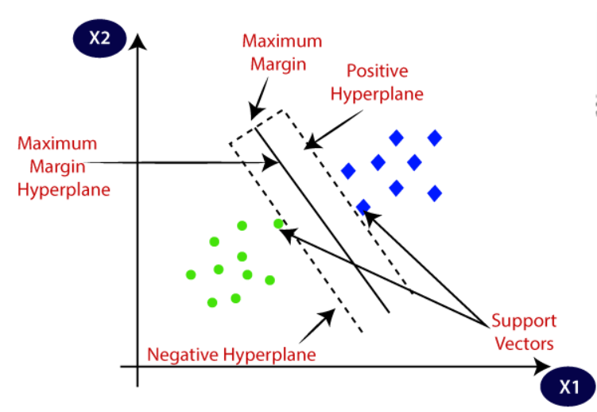

Slide 14
Naive Bayes: Bayes Theorem:
Naïve Bayes Algorithm is based on Bayes' theorem is also known as Bayes' Rule or Bayes' law, which is used to determine the probability of a hypothesis with prior knowledge. It depends on the conditional probability.
The formula for Bayes' theorem is given as:
P(A | B) = (P(B | A)P(A)) / P(B)
P (A | B) is Posterior probability: Probability of hypothesis A on the observed event B.
P (B | A) is Likelihood probability: Probability of the evidence given that the probability of a hypothesis is true.
P (A) is Prior Probability: Probability of hypothesis before observing the evidence.
P (B) is Marginal Probability: Probability of Evidence.

Slide 15
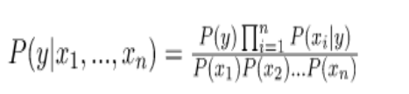
The prior P(y) is easy to estimate from a dataset, but the conditional probability of the observation based on the class P(x1, x2, …, xn | y) is not feasible unless the number of examples is extraordinarily large, e.g., large enough to effectively estimate the probability distribution for all different possible combinations of values.

Slide 16
Logistic Regression:
It is used for predicting the categorically dependent variable using a given set of independent variables.
The outcome must be a categorical or discrete value. It can either be Yes or No, 0 or 1, true or False, etc. but instead of giving the exact value as 0 and 1, it gives the probabilistic values which lie between 0 and 1.
Logistic Regression is much like Linear Regression except that how they are used. Linear Regression is used for solving Regression problems, whereas Logistic regression is used for solving the classification problems.
In Logistic regression, instead of fitting a regression line, we fit an "S" shaped logistic function, which predicts between two maximum values (0 or 1).
Logistic Regression can be used to classify the observations using different types of data and can easily determine the most effective variables used for the classification.

Slide 17
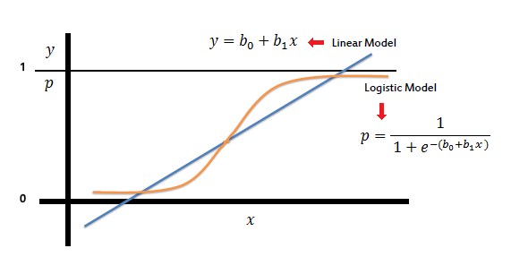
Logistic Regression Example

Slide 18
Pseudo code
Extract tweets from twitter hashtags
class Import_tweet_sentiment:
consumer_key="QIqgjITOfksfMW4lRLDacQ"
consumer_secret="R8x0xN9iSKXGNxUtGKA2hgnlIhh5INZIOdgEfxzk"
access_token="1401204486-BeLUAuruh294KeJX8NXvdqjCeZOQcLl6HWmMlgA"
access_token_secret="pwjiLF42TbORaXtkCS5Oc24qywOU0eFN0esVcibA“
def get_hashtag(self, hashtag):
auth = OAuthHandler(self.consumer_key, self.consumer_secret)
auth.set_access_token(self.access_token, self.access_token_secret)
auth_api = API(auth)
account = hashtag
q = "lang:en(((India OR Sri Lanka OR Pakistan) AND (covid AND economic crisis)) AND (income OR tax OR gdp OR corona OR pandemic OR covid crisis OR poor OR #COVID19 OR #Corona OR #Coronavirus))"# since:2019-12-05 until:2022-12-05)"

Slide 19
SNScrape
atweets = []
for i, tweet in enumerate(sntwitter.TwitterSearchScraper(q).get_items()):
if i >= 50:
break
else:
cleaned_tweet = senti.sentiment_analysis_code.cleaning(self,tweet.rawContent)
tweet_sentiment = senti.sentiment_analysis_code.get_tweet_sentiment(self, cleaned_tweet)
atweets.append([tweet.user.username, tweet.rawContent, cleaned_tweet , tweet_sentiment])
return atweets
Tweepy
atweets = []
for tweet in tweepy.Cursor(api.search, q, lang="en").items(100):
cleaned_tweet = senti.sentiment_analysis_code.cleaning(self, tweet.text)
tweet_sentiment = senti.sentiment_analysis_code.get_tweet_sentiment(self, cleaned_tweet)
atweets.append([tweet.user.screen_name, tweet.text, cleaned_tweet , tweet_sentiment])
return atweets

Slide 20
Preprocessing of tweets
class sentiment_analysis_code:
def cleaning(self, text):
text = text.lower()
text = re.sub(r'(\\u[0-9A-Fa-f]+)', ' ', text)
text = re.sub(r'[^\x00-\x7f]',r' ',text)
text = re.sub('@[^\s]+',' ',text)
text = " ".join(re.split(r'\s|-', text))
text = re.sub('((www\.[^\s]+)|(https?://[^\s]+))',' ',text)
text = re.sub(r'#covid', r' covid ', text)
text = re.sub(r'#corona', r' corona ', text)
text = re.sub(r'#coronavirus', r' coronavirus ', text)
text = re.sub(r'#([^\s]+)', r' ', text)
text = ''.join([i for i in text if not i.isdigit()])
text = re.sub(r"(\?)\1+", ' ', text)
text = re.sub(r"(\.)\1+", ' ', text)
text = re.sub(':\)|;\)|:-\)|\(-:|:-D|=D|:P|xD|X-p|\^\^|:-|\^\.\^|\^\-\^|\^\_\^|\,-\)|\)-:|:\'\(|:\(|:-\(|:\S|T\.T|\.\_\.|:<|:-\S|:-<|\\-\*|:O|=O|=\-O|O\.o|XO|O\_O|:-\@|=/|:/|X\-\(|>\.<|>=\(|D:', ' ', text)
text = re.sub('&amp;', 'and', text)

Slide 21
stop_words = set(stopwords.words('english'))
stop_words.discard('not')
stop_words.discard('and')
stop_words.discard('but')
translator = str.maketrans('', '', string.punctuation)
text = text.translate(translator) # Technique 7: remove punctuation
tokens = nltk.word_tokenize(text)
tokens = [tokens for tokens in tokens if not tokens in stop_words]
lemmatizer = WordNetLemmatizer()
tokens = [lemmatizer.lemmatize(token) for token in tokens]
tagged = nltk.pos_tag(tokens) # Technique 13: part of speech tagging
allowedWordTypes = ["J","R","V","N"] # J is Adjective, R is Adverb, V is Verb, N is Noun. These are used for POS Tagging
return text

Slide 22
Training ML models
data = pd.read_csv("finalD.csv", encoding_errors='ignore', low_memory=False)
data = data.dropna()
data = data.reset_index(drop=True)
XX=data['Cleaned Tweet Text']
YY=data['Result']
XX_train, XX_test, YY_train, YY_test = train_test_split(XX,YY,test_size=0.2,random_state=42)
tfacc = TfidfVectorizer(ngram_range=(2,2))
xx_train = tfacc.fit_transform(XX_train)
xx_test = tfacc.transform(XX_test) BNBmodel = BernoulliNB()
BNBmodel.fit(xx_train, YY_train)
y_predBNB = BNBmodel.predict(xx_test)
score = round(accuracy_score(YY_test, y_predBNB)*100, 3)
pscore = round(precision_score(YY_test, y_predBNB, average="micro")*100, 3)

Slide 23
Vader Analysis
def get_tweet_sentiment(self, tweet):
#cleaning of tweet
sid_obj = SentimentIntensityAnalyzer()
sentiment_dict = sid_obj.polarity_scores(sentiment_analysis_code().cleaning(tweet))
if sentiment_dict['compound'] >= 0.05 :
return 'Positive'
elif sentiment_dict['compound'] <= - 0.05 :
return 'Negative'
else :
return 'Neutral'

Slide 24
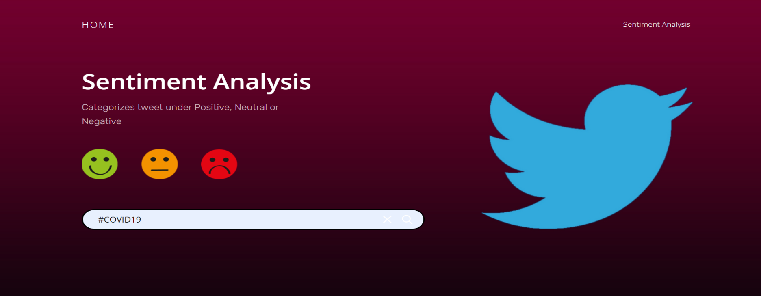
RESULTS
Snapshots of the Project
Fig 1: Tweets Search Screen.

Slide 25
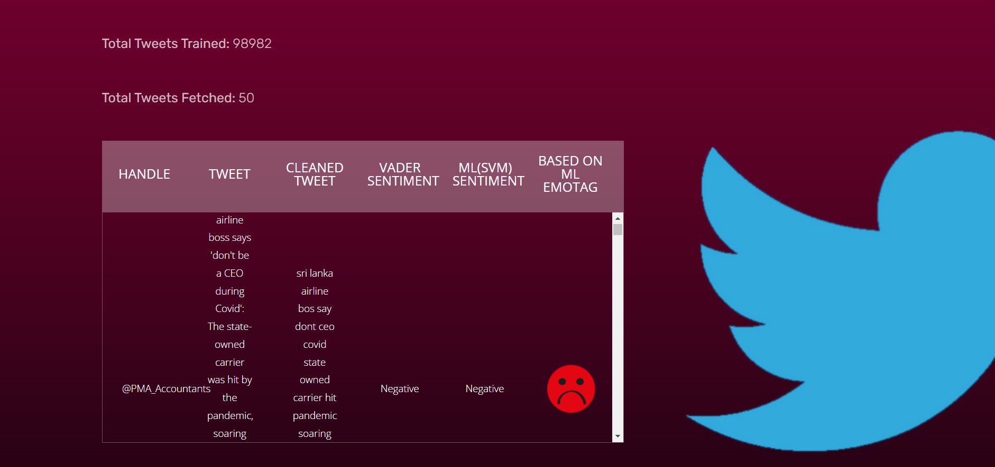
Fig 2. Tweets Fetched from Twitter along with Twitter Username, Tweets, Cleaned Tweets and other columns.

Slide 26
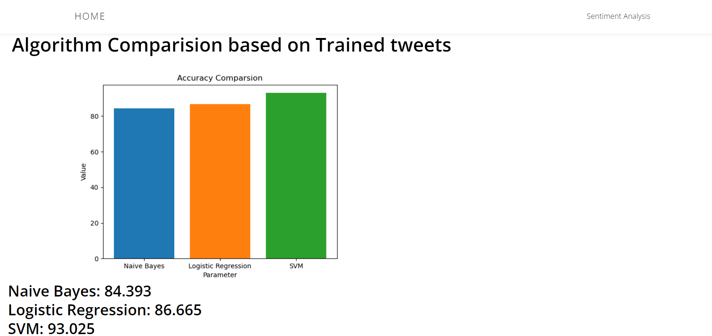

Slide 27
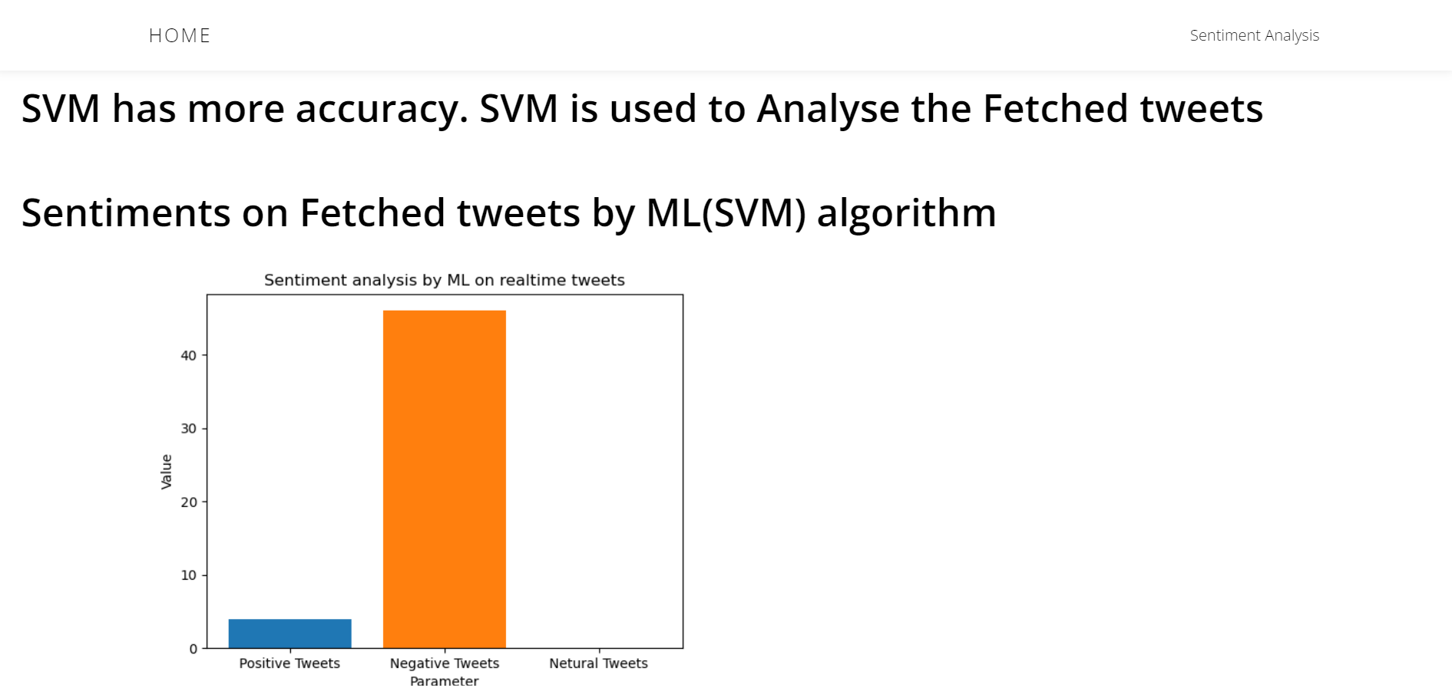

Slide 28
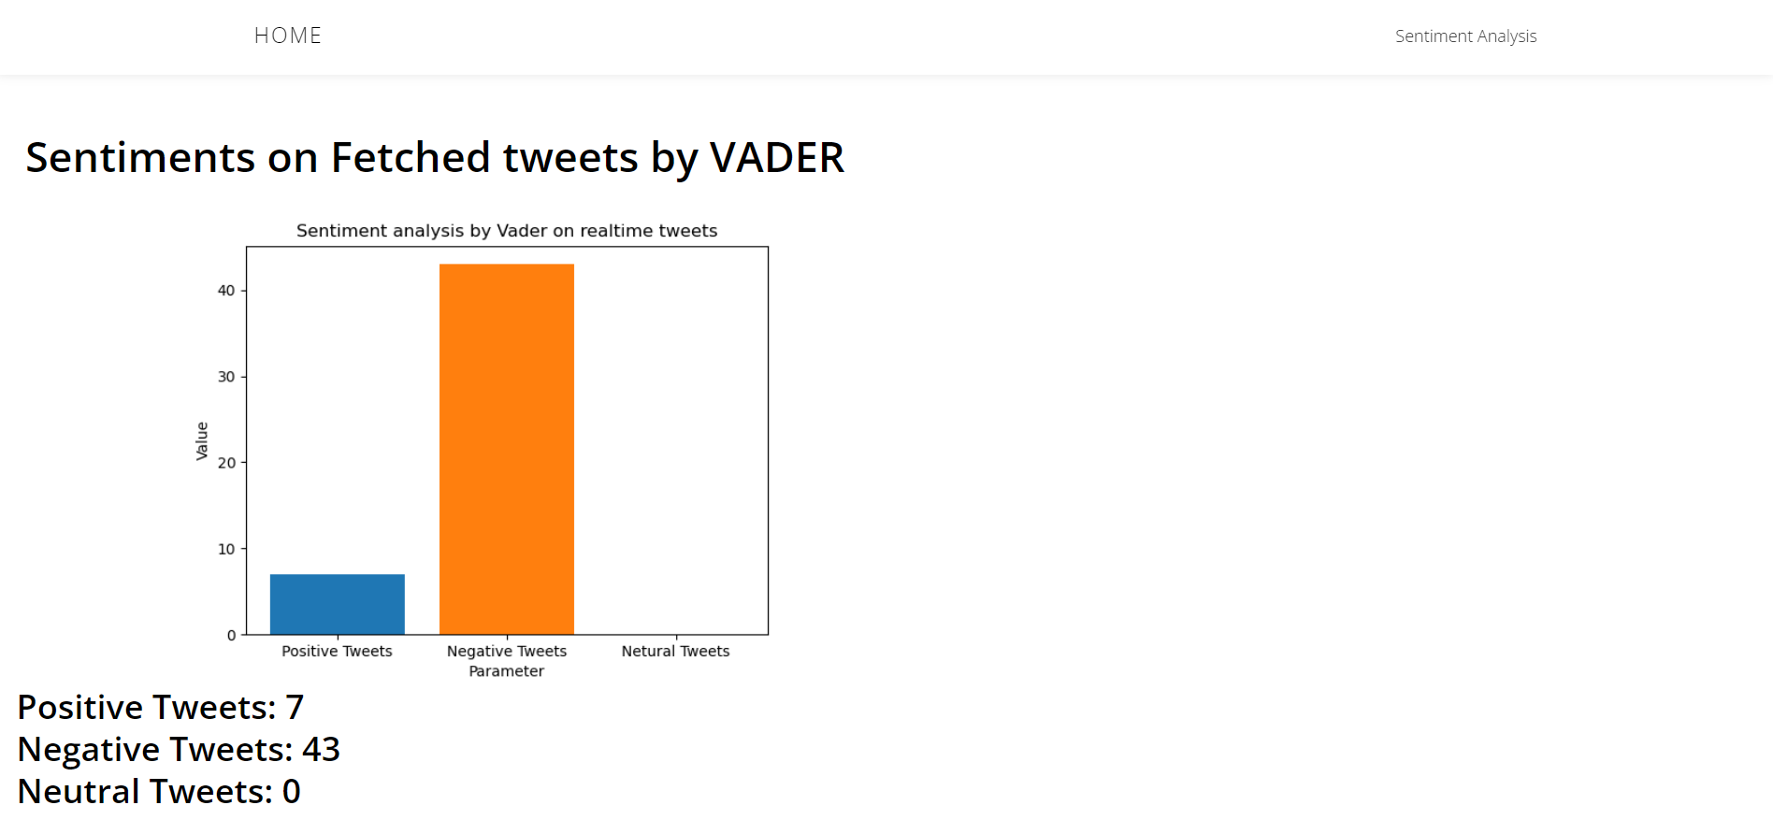

Slide 29
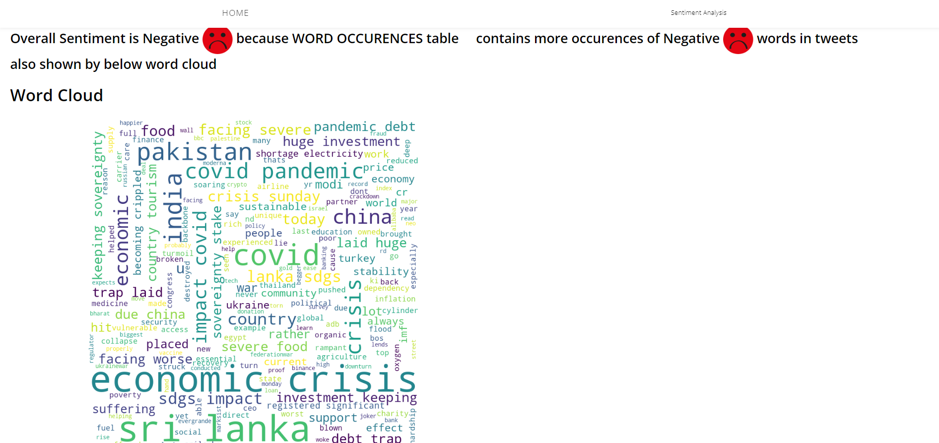

Slide 30
CONCLUSION
Social media is witnessing a massive increase in the number of users per day.
People prefer to share their honest opinions on social media instead of sharing with someone in person.
Using the posts from Twitter, we can examine the common public’s aggregate reaction on economic impact due to COVID-19.
Then the web application which takes the tweets as input and predict the sentiments using Machine Learning models are used to obtain the sentiment of new tweets along with Vader library results and compared to see that both results are comparable.

Slide 31
REFERENCES
[1] Wu, J. T., Leung, K., & Leung, G. M. (2020). Nowcasting and forecasting the potential domestic and international spread of the 2019-nCoV outbreak originating in Wuhan, China: a modelling study. The Lancet, 395(10225), 689-697.
[2] Medford, R. J., Saleh, S. N., Sumarsono, A., Perl, T. M., & Lehmann, C. U. (2020). An “Infodemic”: leveraging high-volume Twitter data to understand public sentiment for the COVID-19 outbreak. medRxiv. Preprint posted online April 7.
[3] Li, S., Wang, Y., Xue, J., Zhao, N., & Zhu, T. (2020). The impact of COVID-19 epidemic declaration on psychological consequences: a study on active Weibo users. International journal of environmental research and public health, 17(6), 2032.
[4] Jung, S. M., Kinoshita, R., Thompson, R. N., Linton, N. M., Yang, Y., Akhmetzhanov, A. R., & Nishiura, H. (2020). Epidemiological Identification of A Novel Pathogen in Real Time: Analysis of the Atypical Pneumonia Outbreak in Wuhan, China, 2019–2020. Journal of clinical medicine, 9(3), 637.
[5] Pandey, R., Gautam, V., Pal, R., Bandhey, H., Dhingra, L. S., Misra, V., ... & Sethi, T. (2022). A machine learning application for raising wash awareness in the times of covid-19 pandemic. Scientific reports, 12(1), 1-10.
[6] Kayes, A. S. M., Islam, M. S., Watters, P. A., Ng, A., & Kayesh, H. (2020). Automated measurement of attitudes towards social distancing using social media: a COVID-19 case study.

Slide 32

PROJECT SETUP AND DEMONSTRATION

Slide 33
Suggestions….!

Slide 34
THANK YOU!!!

