Slide 1

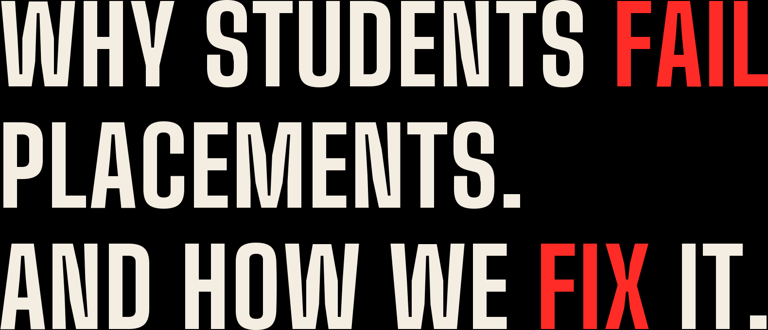
Communication IQ in the Indian placement context — what actually goes wrong for students, and the exact mechanisms that fix it.
STUDENT IMPACT BRIEF · AUGUST 2026

Slide 2


THE INDIAN CONTEXT
Final year, tier-2/3 engineering college. Regional-medium schooling. Often the first graduate in the family. Three years spent preparing for exactly two things:
THEN THE GATE APPEARS
TCS, Infosys, Amazon and Accenture put an AI voice round in front of them — Pearson Versant, SHL SVAR, or Mercer | Mettl SpeechX.
A mic, a countdown — and a format they have never seen in their lives.
APTITUDE
months of practice, mock tests, coaching
PREPARED
CODING / DSA
hundreds of problems, playbooks, CRT drills
PREPARED
And many of them fail it.
AI COMMUNICATION ROUND
first exposure is the real test itself
ZERO PREP
PYRAMID INNOVATIONS · COMMUNICATION IQ
02

Slide 3

WHY THIS FAILURE IS UNIQUELY CRUEL
01 · IT'S INVISIBLE
02 · IT'S UNTRAINABLE TODAY
03 · IT'S UNFAIR — IN A FIXABLE WAY
The rejection email says nothing. Pronunciation? Pace? Grammar? Hesitation? The student never finds out — so they can't fix it. They conclude “my English is bad”: a character verdict, not a diagnosis.
The college trainer runs group discussions for 40 students at once. Local spoken-English coaching costs ₹15–30K, teaches accent imitation, and has zero connection to how the algorithm scores. Apps teach vocabulary, not test survival.
Most of these students are perfectly intelligible. They fail on format shock — speed, memory load, latency under pressure — and 3–4 specific L1 habits. A narrow, trainable gap scored as a broad disqualification.
Cruelty № 3 is the business opportunity: a fixable gap nobody is fixing.
PYRAMID INNOVATIONS · COMMUNICATION IQ
03

Slide 4
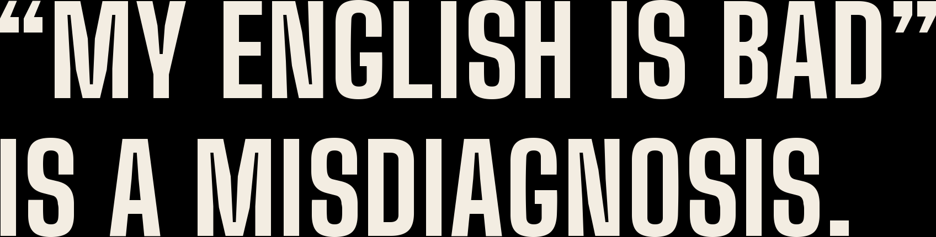
THE CORE INSIGHT
WHAT THE STUDENT BELIEVES
WHAT IS ACTUALLY TRUE
“My English is bad.”
A 9-point fluency gap. Two phoneme habits. Slow response latency.
Broad. Shameful. Feels unfixable before placement season. So they avoid speaking, avoid practice, and walk into the real test cold.
Narrow. Nameable. Closeable in ~12–18 targeted hours — not 200 hours of “English classes.” You can work on a measured gap. You cannot work on shame.
Everything the product does is one operation: replace the verdict with the diagnosis.
PYRAMID INNOVATIONS · COMMUNICATION IQ
04

Slide 5

THE SOLUTION · COMMUNICATION IQ
SIMULATE
SCORE
DIAGNOSE
TRAIN
RESIMULATE
A full-fidelity simulation of the assessment the student will actually face — timed, mic-driven, section by section — followed by a diagnosis of exactly what lost marks, targeted drills to fix it, and a re-simulation to prove the gap closed.
BUILT AS SIMULATION PROFILES OF THE GATES STUDENTS ACTUALLY FACE
Pearson Versant-style
SHL SVAR-style
Mercer | Mettl SpeechX-style
Company voice rounds (TCS · Infosys · Accenture)
HR interview English
“-style” is deliberate: we replicate the task formats, timing and pressure — never the vendors' proprietary items or algorithms.
PYRAMID INNOVATIONS · COMMUNICATION IQ
05

Slide 6

THE SIMULATIONS, MAPPED
TASK TYPE WE SIMULATE
VERSANT-STYLE
SVAR-STYLE
SPEECHX-STYLE
Read Aloud — read a passage into the mic
Repeat Sentence — hear it once, say it back
—
Sentence Build — rearrange jumbled words, speak
—
—
Short Answer Q&A — comprehension under the clock
Story Retell — listen, understand, retell
—
Open Response — opinion / interview questions
—
Plus the environment itself: countdown timers, one-shot audio, mic capture flow, section pacing and no-replay pressure — the parts of the test nobody practices.
Six task types cover the spoken-assessment space. A new test tomorrow = a new profile on the same engine, not a new product.
PYRAMID INNOVATIONS · COMMUNICATION IQ
06

Slide 7

UNDER THE HOOD
Every response the student speaks is decomposed into measurable evidence — the LLM is one component, never the judge:
ACOUSTIC
LINGUISTIC
PRONUNCIATION
BEHAVIOURAL
pitch · speech rate · pauses · rhythm · stress · intonation
grammar · vocabulary · complexity · coherence · relevance
phoneme accuracy · substitutions · stress errors · intelligibility
hesitation · fillers · self-correction · response latency
ASSESSMENT INTELLIGENCE ENGINE converts those features into each test-style scoring scale — so a Versant-style simulation scores like Versant scores, not like a generic English app.
Why believe the scores? (1) Grounded in published phoneme-level pronunciation research and expert-labelled corpora (SpeechOcean762). (2) A calibrated item bank — every question carries difficulty, discrimination and Indian-learner statistics refined over thousands of attempts. (3) The closed loop: predictions are checked against real assessment results in our partner colleges, and recalibrated every season.
PYRAMID INNOVATIONS · COMMUNICATION IQ
07

Slide 8

MECHANISM 01
First simulation, first result screen. Not a number — an explanation.
YOUR RESULT — RAVI K., B.TECH FINAL YEAR
WHY THIS CHANGES BEHAVIOUR
Grammar
78
Fine. Stop worrying about it.
A student who believed “my English is weak” now has a target: a 9-point fluency gap and a latency habit.
You can train a gap. You cannot train shame. Diagnosis alone converts avoidance into practice.
Pronunciation
74
Intelligible. Two habits to polish.
Fluency
61
Your biggest lever: +4 predicted points.
Response speed
55
This is what's failing you — not your English.
PYRAMID INNOVATIONS · COMMUNICATION IQ
08

Slide 9

MECHANISM 02
Every practice hour attacks the student's specific weakness — the loop that turns an assessment into a training engine:
FAIL
WHY
DRILL
CHALLENGE
RE-TEST
MASTERY
Sentence Build task
→
“Right words, wrong grammatical order”
→
5 similar sentences
→
1 harder sentence
→
Same task type
→
54 → 78
THE ARITHMETIC THAT MAKES IT POSSIBLE A Telugu-medium student doesn't need 200 hours of English classes — they need ~12–18 targeted hours on 2–3 skills. “Improve your English” is impossible before placement season. “Close this gap in two weeks” is not.
PYRAMID INNOVATIONS · COMMUNICATION IQ
09

Slide 10

MECHANISM 03
Half the failure in Versant/SVAR-style rounds is a student hearing “repeat the sentence” for the first time in the real test — speed, memory load and the countdown clock doing the damage, not English.
TODAY
WITH COMMUNICATION IQ
The real assessment is attempt № 1.
The real assessment is attempt № 15.
Unfamiliar format + pressure + one chance per company. The most expensive first attempt of their lives.
Unlimited simulations kill format shock. Familiarity is the cheapest score improvement that exists.
The mechanism is already proven in India: mock CATs did exactly this for MBA admissions. Nobody applied it to spoken rounds — until now.
PYRAMID INNOVATIONS · COMMUNICATION IQ
10

Slide 11

MECHANISM 04
We score intelligibility — “were you understood?” — not “do you sound American?” For a student from Warangal or Kanpur, that one design choice decides whether they stay on the platform or abandon it in embarrassment.
WHAT ACCENT-COACHING SAYS
WHAT WE SAY
“Your accent is the problem. Erase it.”
“Your accent is fine. Being understood is the goal — and you are closer than you think.”
Shame in. Dropout out.
Dignity in. Practice out.
This is not feel-good positioning. Intelligibility is what employers and assessments actually reward — it is the honest metric and the retention strategy at once.
PYRAMID INNOVATIONS · COMMUNICATION IQ
11

Slide 12

MECHANISM 05 · THE CAMPUS SIDE
CAMPUS COMMUNICATION INTELLIGENCE — 90 DAYS BEFORE DRIVES
BUILT FOR CAMPUS SCALE
4,821
2,947
1,432
442
Deployed college-wide in days, not semesters — every student, every branch, on their own phone. Private, repeatable, unlimited practice — a depth of individual attention that human coaching economics can never reach at cohort scale. No campus can give 4,800 students a human speaking coach. Every campus can give them this.
assessed
placement ready
need training
high risk
1,120 students likely to struggle in AI spoken rounds. Recommended: 18 hours of targeted intervention per cohort — assigned, tracked, re-assessed before companies arrive.
The officer stops discovering the problem in the results — and starts fixing it a quarter early.
PYRAMID INNOVATIONS · COMMUNICATION IQ
12

Slide 13

MECHANISM 06 · THE CLOSED LOOP
Because Communication IQ deploys inside Pyramid's live CRT programs across 30+ colleges, the loop closes: simulation score → real assessment result → interview → placement outcome. Within a few seasons, the platform can tell a student, with data:
“At your current profile, students like you clear the Infosys communication round 82% of the time. Close your fluency gap, and it becomes 91%.”
No English app on earth can say that sentence today. Not Duolingo, not ELSA, not any test-prep tool — because none of them see placement outcomes. Pyramid's network is what makes the promise real instead of theoretical.
PYRAMID INNOVATIONS · COMMUNICATION IQ
13

Slide 14

HONESTY AS STRATEGY
WE DON'T CREATE JOBS
WE DON'T FIX TECHNICAL FAILURE
WE DON'T GUARANTEE VENDOR SCORES
If a campus has 400 offers for 4,000 students, communication readiness reallocates who gets them. It widens an individual's odds, not the national job pool.
A student who fails DSA rounds fails regardless of fluency. Pyramid's FORGE/APEX programs cover that side — Communication IQ is the missing sibling, not a replacement.
We predict readiness from correlated skills. We never claim to replicate Pearson's or SHL's proprietary algorithms — legally and ethically important.
Saying this out loud is what makes placement officers and investors trust the rest of the story.
PYRAMID INNOVATIONS · COMMUNICATION IQ
14

Slide 15

THE ONE-LINE TRUTH
Students don't fail placements because their English is bad. They fail because nobody ever showed them exactly what the algorithm penalizes — and nobody gave them a cheap, private, repeatable place to fix it. Communication IQ is that place.
BEFORE
AFTER
Silent rejection → “my English is bad” → avoidance → real test as attempt № 1 → another silent rejection.
Diagnosis → named gap → 12–18 targeted hours → real test as attempt № 15 → a fair shot, taken with confidence.
PYRAMID INNOVATIONS · COMMUNICATION IQ
15

