Slide 1
GAMER-AI
By: Vinay Jaibheem
Fatema Hasta
Kartheek Katta

Slide 2
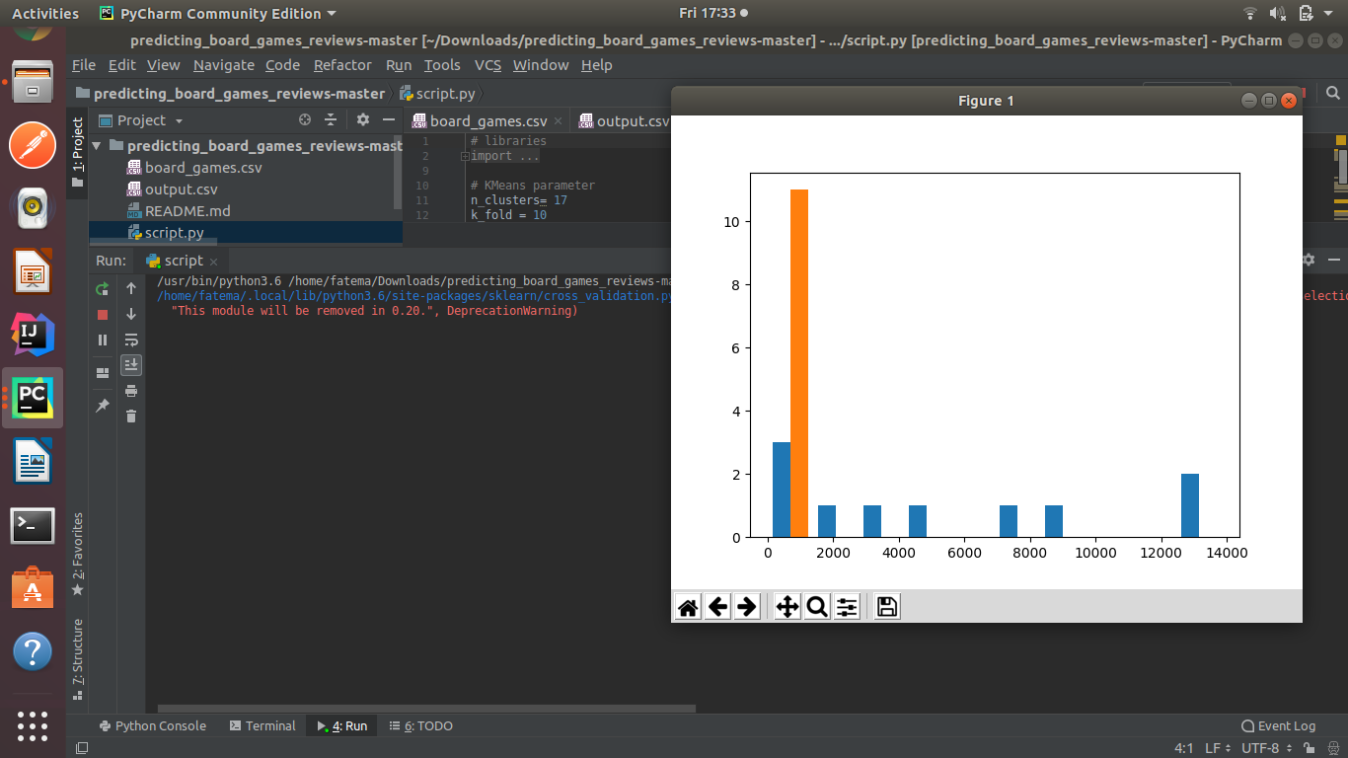

Slide 3
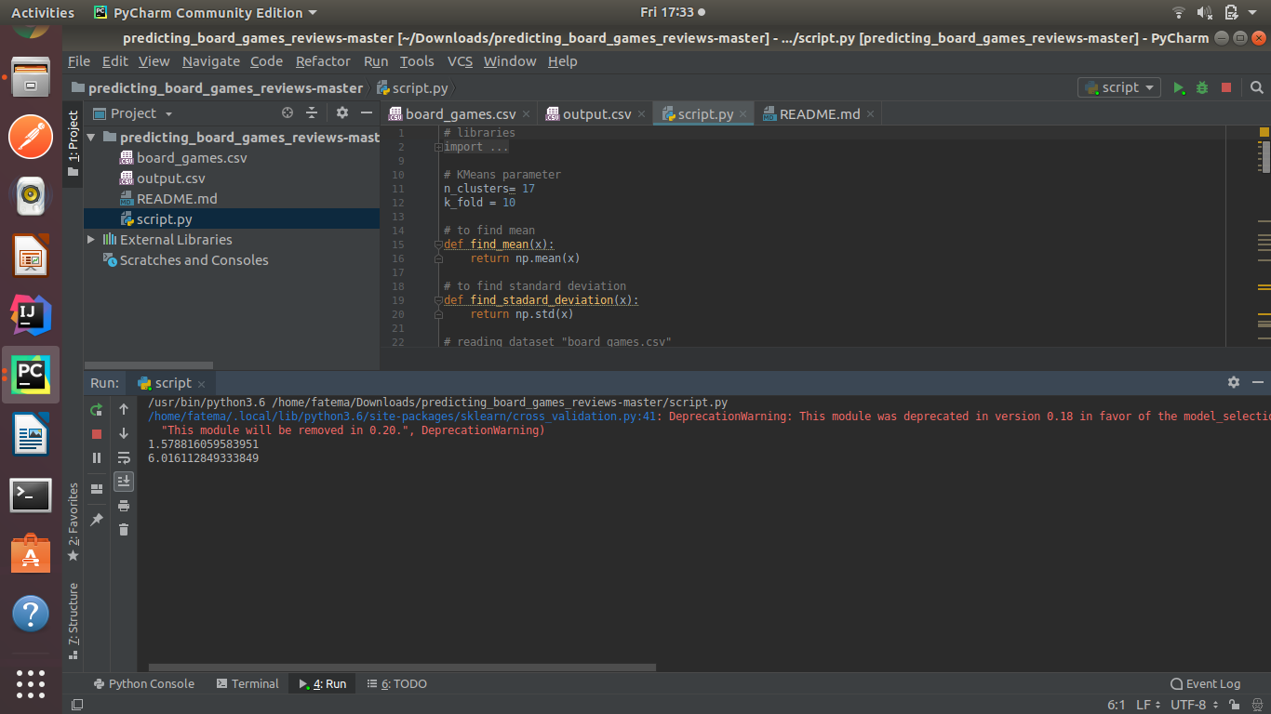

Slide 4
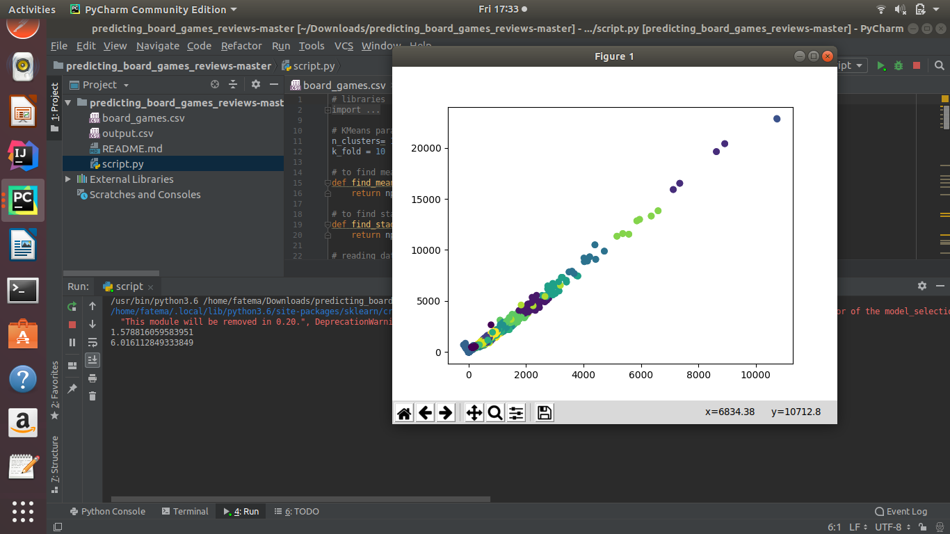

Slide 5
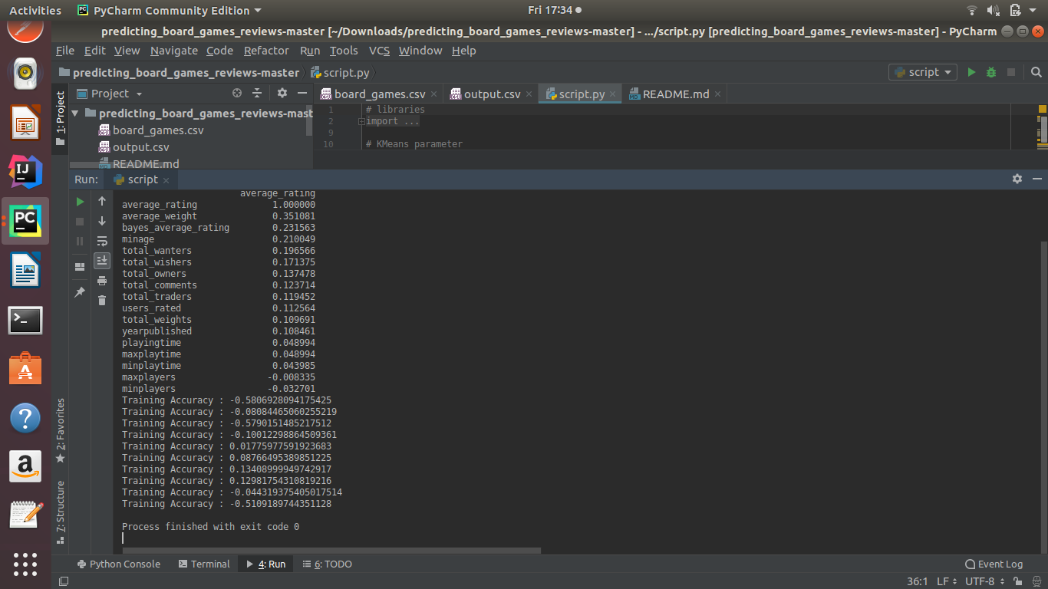

Slide 6


