Slide 1

Uber
Supply Demand Gap Analysis

Slide 2

Supply Demand Gap Analysis
According to data provided following are the insights
No cars available status is more in Airport than City
Cancellations are made 80% from City and 20% from Airport
Trips completed more from City compare to Airport

Slide 3
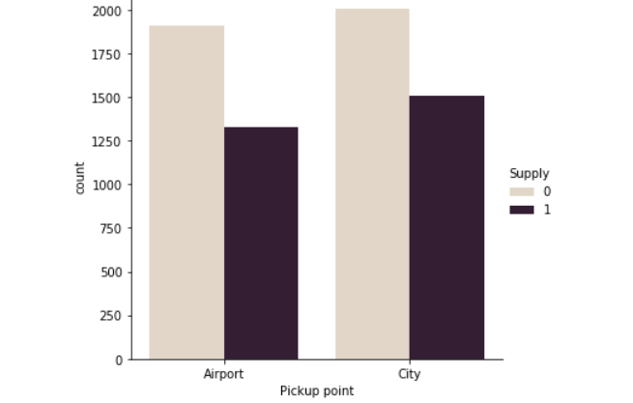
Supply Demand Gap

Slide 4
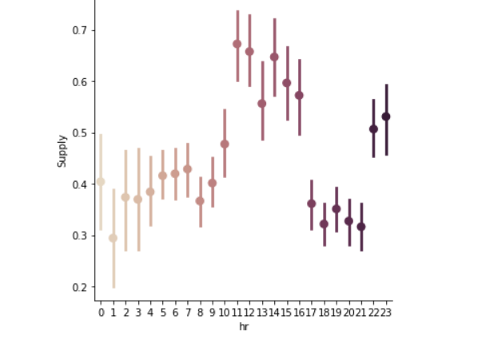
Supply is less during night hours and early mornings

Slide 5
To cope up Demand
More Cabs to be deployed in Airport during late night and early mornings

Slide 6
Thank You

