Slide 1
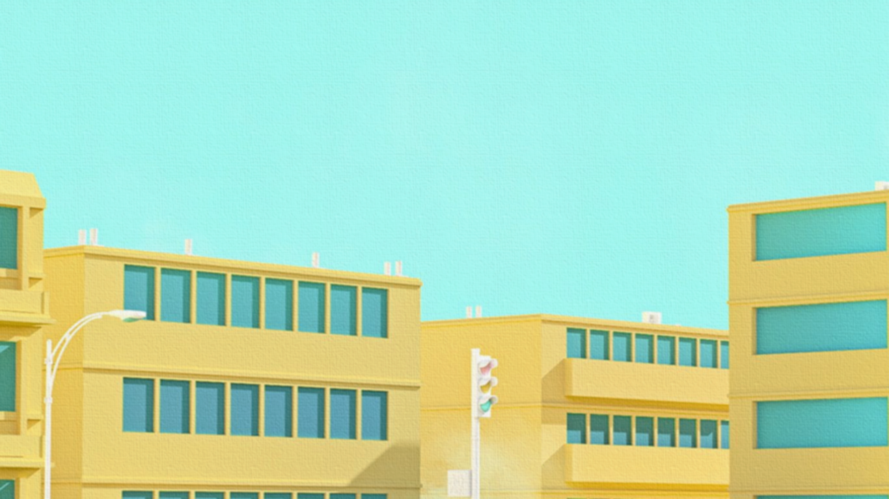
CASE STUDIES; THE SGOTORGET KINDERGARDEN AND JUMPSTART PRESCHOOL
EKTA DHIMAN AND SUPREENA DASH

Slide 2
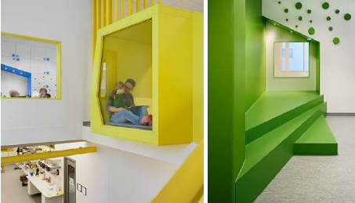
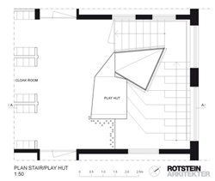
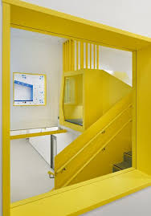
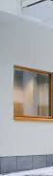
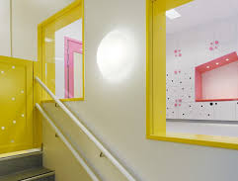
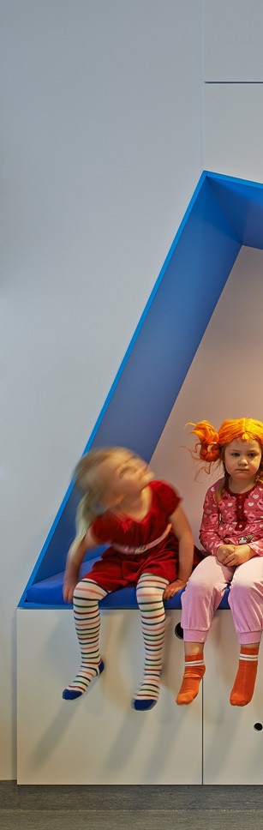
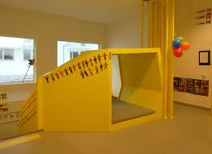
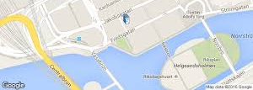
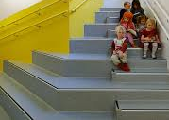
THE SGOTORGET KINDERGARDEN
Rotstein Arkitekter has designed a kindergarten on the ground level of a new residential block in Stockholm. They envisioned a playful environment designed to encourage and inspire the creativity of the children.
“There is an abundance of natural light and sight lines through the building.”
SOME FEATURES: Some of the interior design budget was earmarked for solutions with architectural qualities, specific for this space. Using built-in storage units and niches is space saving. Maximizing the room height makes a huge difference, especially when it comes to the acoustic environment. etc…

Slide 3
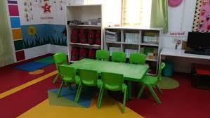
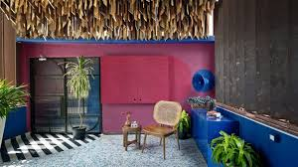
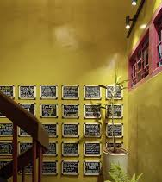
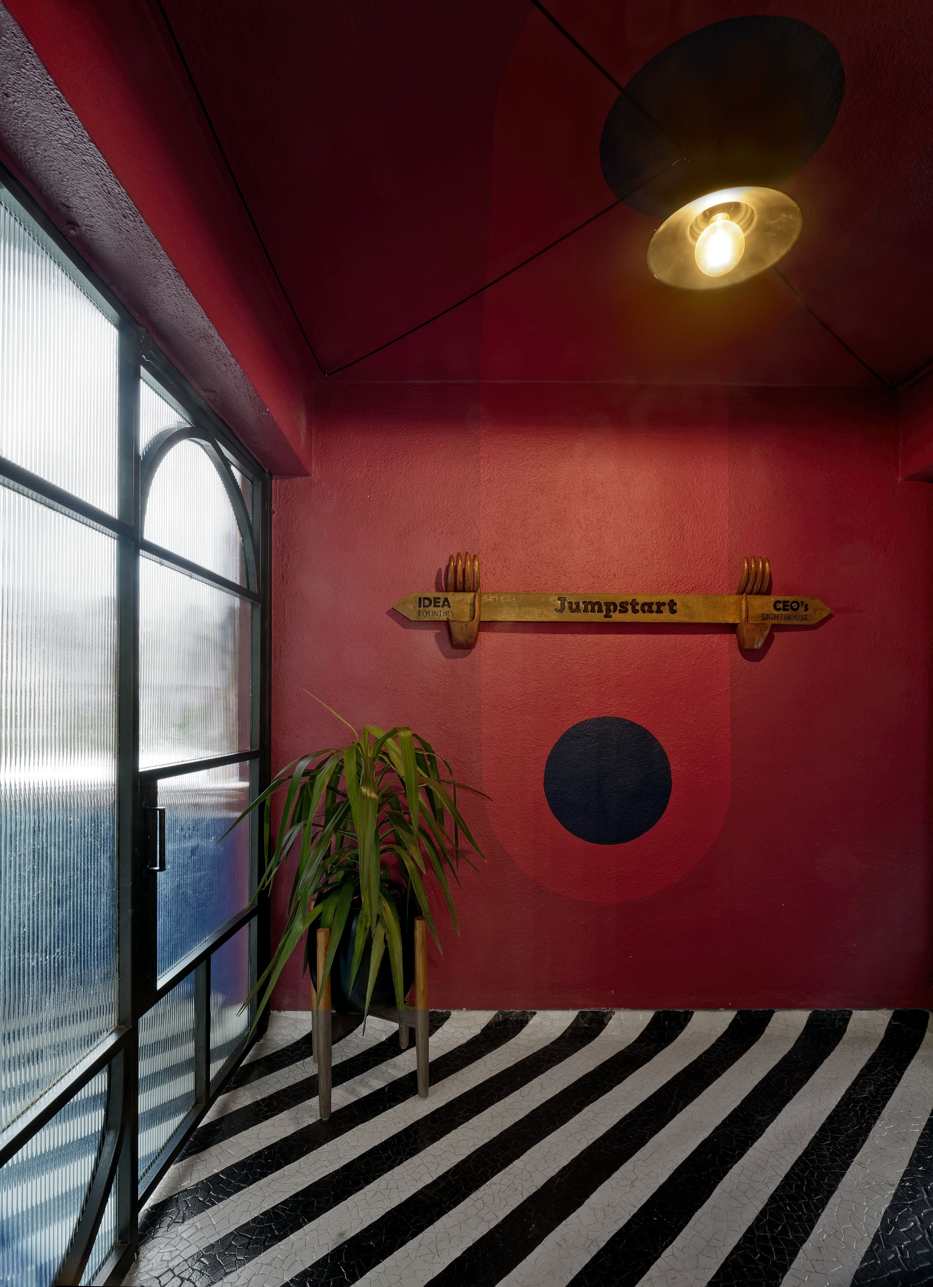
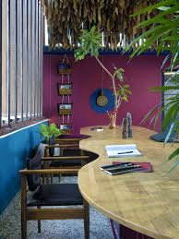
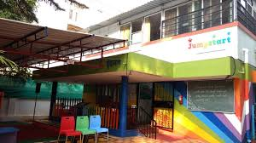
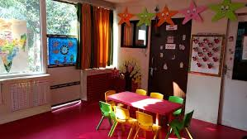
THE JUMPSTART PRESCHOOL
Jumpstart, designed by Manifestation Design LLP uses 90’s nostalgia to create a happy space for interaction, fun and learning. Other ‘old school’ elements like slates, boards and a call bell are peppered throughout the décor for added effect.
“The space had to be designed in a way which would seem welcoming to the parents coming to enrolL their kids as well as visually appealing to their tiny tots—a clever union of the old and new,”
SOME FEATURES: A cozy waiting lobby separates the director’s cabin from the Lego-inspired set-up along with an amphitheater is a storage space that also doubles up as a playful area for kids. The area is used for children's’ recreation, staff training, movie screening, special classes as well as social gatherings. etc..

