Slide 1

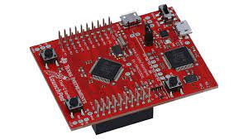
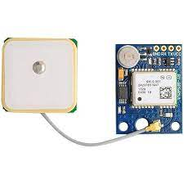
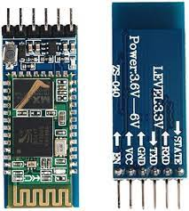
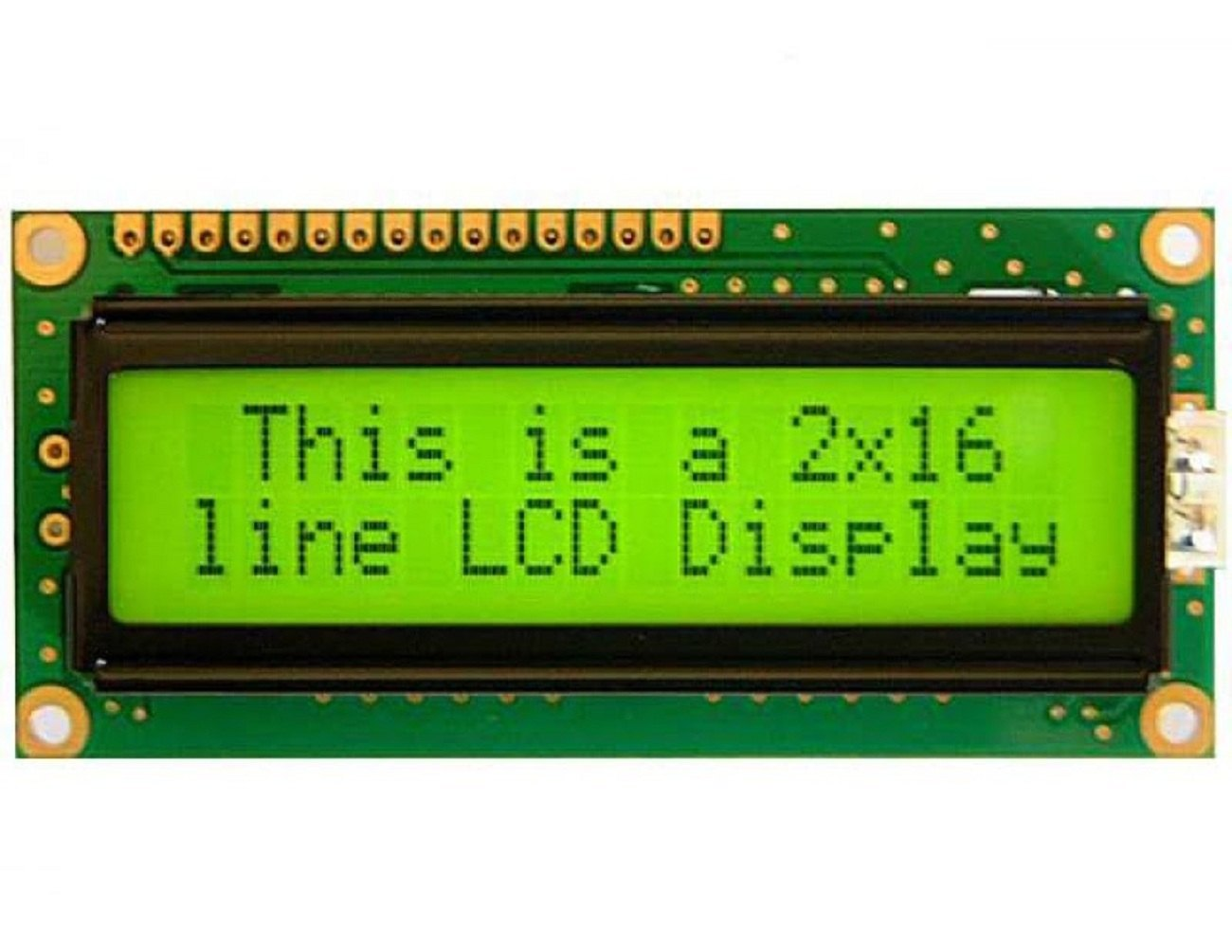
GPS TRACKING SYSTEM
The Project is mainly a mainly a GPS tracking system module which stores the coordinates start point and after reaching a end point it calculates the total distance taken by user to navigate between them.
INPUT DEVICES USED
The Bluetooth module seamlessly facilitates wireless communication, enhancing connectivity for a variety of applications. GPS module Neo 6M provides precise location information, enabling accurate geospatial tracking and mapping.
Hardware Used: TIVA C
OUTPUT DEVICES
The Tiva C series board serves as the powerhouse behind innovative GPS tracking systems, seamlessly integrating with global positioning technology. From collecting location data to managing tracking algorithms, the Tiva C board excels in providing a versatile and reliable foundation for the development of sophisticated GPS tracking systems.
In GPS tracking system, a GPS module is controlled by Tiva C GPIO to get the longitude and latitude from sattelite . LCD display provides feedback on distance travelled.
TEAM MEMBERS: N KRISHNA REDDY, P SHESHU, RESHIHA,T VINAY KUMAR

