Slide 1
Gau-Gas Metering&Billing Automation

Slide 2
Sustain earth
CLEAN ENERGY TO RURAL AREAS
Provide clean and affordable cooking gas to rural households in India using Innovative Biogas Technology & Enterprise models
Social Entrepreneur

Slide 3
Problem
Nine out of every 10 households in rural India rely on firewood and other biomass for cooking.
144 Million households do not have access to clean cooking fuel in India.
For their cooking, people use firewood, crop residue and dung cakes, which emit hazardous smoke.
This alone results in about 1 Million deaths annually.
Apart from being a major health hazard, these fuels leads to widespread deforestation and environmental damage via emission of greenhouse gases.

Slide 4
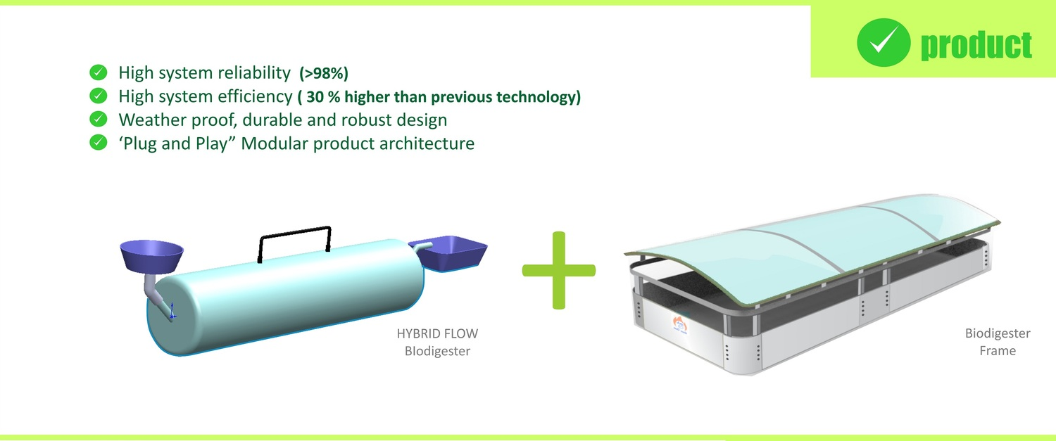
architecture

Slide 5
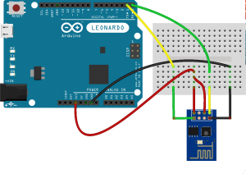
Previous billing mechanism
To get the logistics usage of the gas, the billing person connects the ESP8266 and acquire the data from the Arduino Leonardo , i.e. the ON time of the pump . He then connects this module to a IP address to send the logistics to the data server . The pump is then reset using an other IP address .

Slide 6
Our Approach
The usage logs is transmitted to the database using a GSM module.
We use a Android Application for transmission purpose and the usage logs are encoded before transmission.
Dashboard/statics display are used to represent the usage logs.
Based on these readings the billing company can prepare the required bill for the customer.

Slide 7
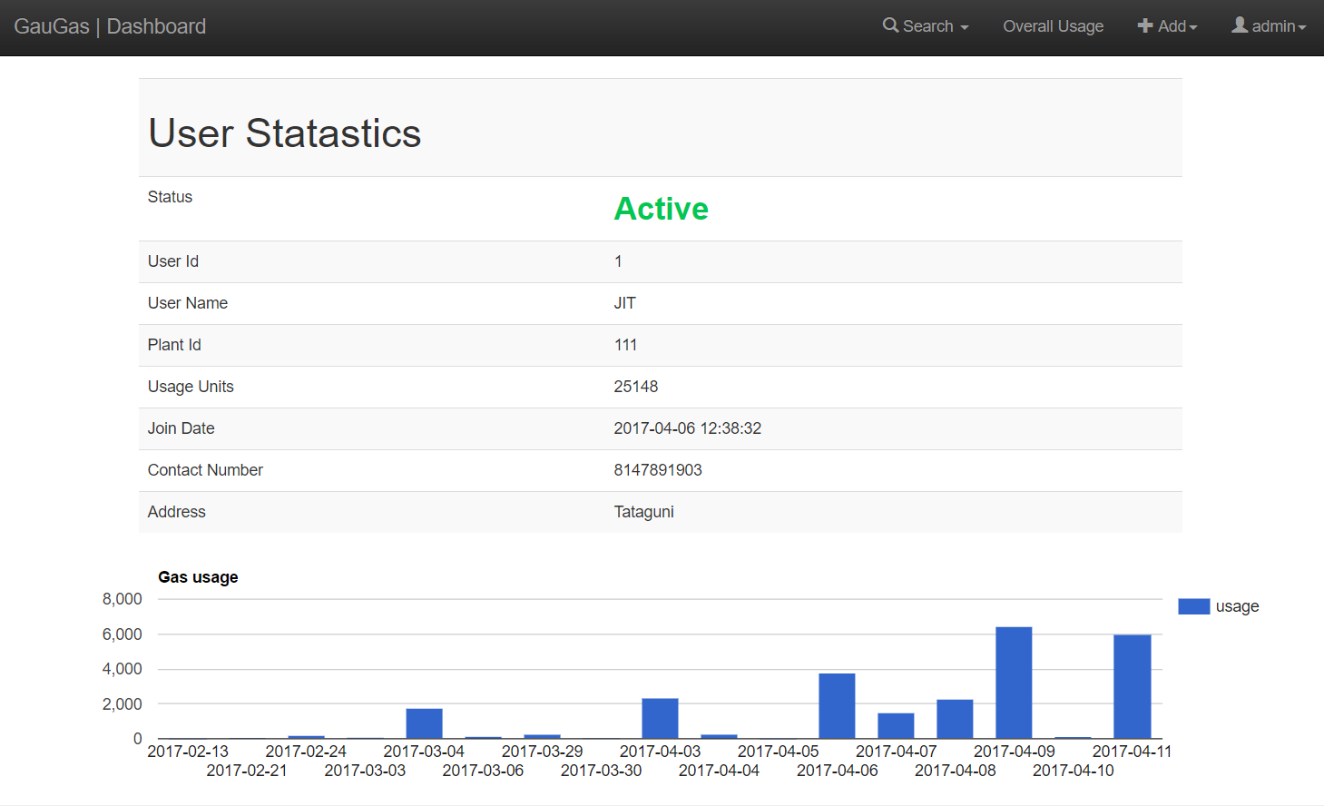

Slide 8
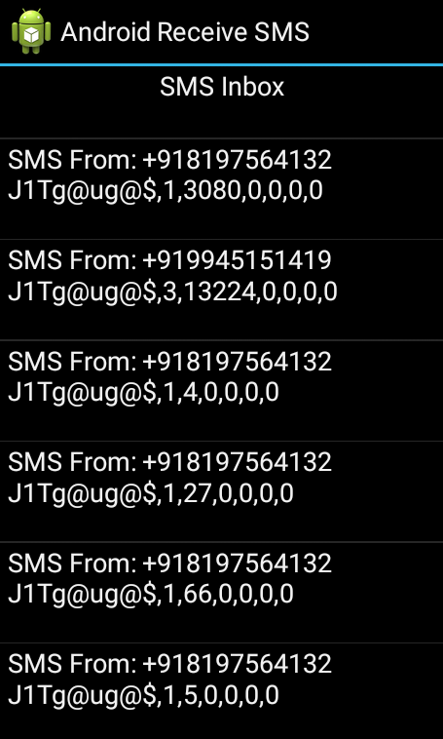
The android App
Shows the Inbox Messages in the phone .
Displays “SMS From:” i.e. the phone number
Next Line Displays the Actual Text Message Received .
Once The Sms Matches the Format Specified , The usage logs will be uploaded .
SMS conatins the ‘auth code’ , ’plant id’ , ‘usage values’.

Slide 9
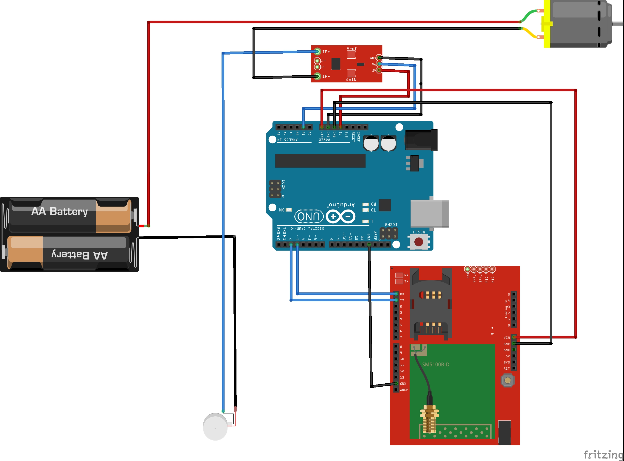
Iot module for Gau gas metering

Slide 10
Thank you

