Slide 1
Association Learning

Slide 2
Association Analysis
Simplest form of analysis
Given a set of transactions, find rules that will predict the occurrence of an item based on the occurrences of other items in the transaction

Slide 3
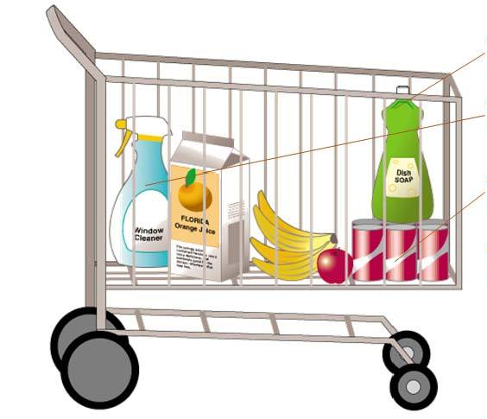
Market Basket Analysis
Image Source: https://www.analyticsvidhya.com/blog/2014/08/effective-cross-selling-market-basket-analysis/

Slide 4

Concept
Available Information
List of purchases made by customer over the period of time (No personal information of customer)
Decision Making
Can we find purchase patterns?
What items tends to be purchased together?
Seasonal pattern of item purchase?
Product suggestion to customers
Selecting items for promotion
Find promotional opportunity

Slide 5
Purchase Profiles
Beauty Conscious
Health Conscious
New Family
Personal Care
Sentimental
Smoker
Pet Lover
Casual Reader
Sports Conscious
Tech Enthusiast
Automotive
Photographer

Slide 6
Other Application Areas
Banking Services
Insurance Companies
Medical – Symptom Analysis

Slide 7
Association Rule
{X} => {Y}
X , Y = Item or Itemset
{Bread} => {Milk}
Rule gives relation between Bread and Milk

Slide 8
Example 1 - Association Analysis
Record | Items Bought
Record 1 | Bread, Milk, Beer
Record 2 | Bread, Diapers, Eggs
Record 3 | Milk, Diapers, Beer, Cola
Record 4 | Bread, Milk, Diapers, Beer
Record 5 | Bread, Milk, Cola
Ref : https://en.wikipedia.org/wiki/Truth_table#Logical_implication

Slide 9

Support - Rule Evaluation Metrics -
Support (s) range[0,1]
Fraction of transactions that contain both X and Y
$$Supp\left(X\right)= \frac{Occurance of X}{Total records in Dataset}$$
{Milk} = 4/5 = 0.8
{Beer} = 3/5 = 0.6
{Beer, Milk} = 3/5 = 0.6
Generally used to filter dataset with only significant items/itemsets

Slide 10

Confidence - Rule Evaluation Metrics
Confidence (c) range[0,1]
Measures how often items in Y appear in transactions that contain X
$$conf\left(X→Y\right)=\frac{Supp(X∩Y)}{Supp(X)}$$
{Milk} => {Beer} = 3/4 = 0.75
{Milk} =. {Bread} = 3/4 = 0.75
{Beer} => {Milk} = 3/3 = 1
Venn diagram

Slide 11

Lift - Association Rule Metrics
Lift (lift) range [0, ∞]
How much more often the antecedent and consequent of a rule
$$lift\left(X→Y\right)=\frac{Conf(X∩Y)}{Supp(Y)}$$
{Milk} => {Beer} = 0.6/(0.8*0.6) = 1.25
{Milk} =. {Bread} = 0.6/(0.8*0.8) = 0.93
{Beer} => {Milk} = 0.6/(0.6*0.8) = 1.25
0 inverse relation | 1 Implies both are Independent | ∞ Strong Correlation

Slide 12

Leverage - Association Rule Metrics
Leverage (leverage) range[0,1]
It computes the difference between the observed frequency of X and Y appearing together and the frequency that would be expected if X and Y were independent.
leverage $\left(X→Y\right)=supp\left(X→Y\right)$ - $supp$(X)* $supp$(Y)

Slide 13
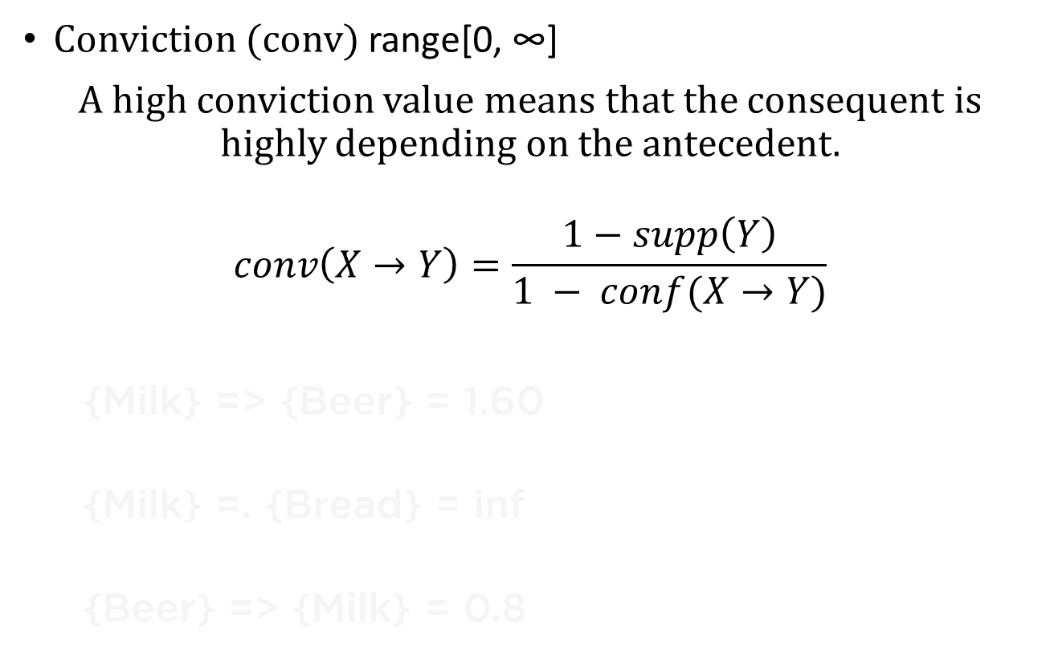
Conviction - Association Rule Metrics
Conviction (conv) range[0, ∞]
A high conviction value means that the consequent is highly depending on the antecedent.
$$conv\left(X→Y\right)=\frac{1−supp\left(Y\right)}{1 − conf(X→Y)}$$
{Milk} => {Beer} = 1.60
{Milk} =. {Bread} = inf
{Beer} => {Milk} = 0.8

Slide 14
Available Algorithms
Apriori Algorithm
Eclat Algorithm
FP-growth Algorithm

Slide 15
Apriori algorithm
Apriori is an algorithm for frequent item set mining and association rule learning over transactional databases.
It proceeds by identifying the frequent individual items in the database and extending them to larger and larger item sets as long as those item sets appear sufficiently often in the database.

Slide 16
Transaction Table (Transaction Encoder-Apriori)
 | Beer | Bread | Cola | Diapers | Eggs | Milk
Record 1 | T | T | F | F | F | T
Record 2 | F | T | F | T | T | F
Record 3 | T | F | T | T | F | T
Record 4 | T | T | F | T | F | T
Record 5 | F | T | T | F | F | T

Slide 17
Limitation
Takes over 18 months to implement
Only hypotheses, needs explicit testing
Measurement of impact needed
Difficult to identify product groupings
Complexity grows exponentially

Slide 18
AssociationLearning_MarketBasketAnalysis.ipynb

Slide 19
References
https://en.wikipedia.org/wiki/Association_rule_learning
http://cbafiles.unl.edu/public/cbainternal/facStaffUploads/KM3MarketBasket.ppt
https://rasbt.github.io/mlxtend/user_guide/frequent_patterns/association_rules/
https://www.youtube.com/watch?v=WxDV9WEYqPw

