Slide 1
Machine Learning with Python

Slide 2
Definition of ML
The machine learning is the field of study to give the ability to a Machine to learn without being explicitly programmed
The ability of a machine to improve its performance based on previous results.

Slide 3
Formal Definition of ML
A program can be said to learn from experience E with respect to some class of tasks T and performance measure P, if its performance at tasks in T, as measured by P, improves with experience E
- Tom Mitchell
Notes:
For example, assume that you have a collection of pictures. Each picture depicts either a dog or cat. A task could be sorting the pictures into separate collections of dog and cat photos. A program could learn to perform this task by observing pictures that have already been sorted, and it could evaluate its performance by calculating the percentage of correctly classified pictures.

Slide 4





Simple ML Application

Slide 5
What is Machine Learning
Getting better at certain task with time
The act of remembering experience
Exploiting generalization similarity
Learning with adaptation
Spam Email detection using Machine learning
Notes:
Machine learning is the design and study of software artifacts that use past experience to make future decisions;
It is the study of programs that learn from data.
The fundamental goal of machine learning is to generalize, or to induce an unknown rule from examples of the rule's application.
The canonical example of machine learning is spam filtering.
By observing thousands of emails that have been previously labeled as either spam or ham, spam filters learn to classify new messages.

Slide 6


Spam email detection
Email has title and body
Spam emails contains some specific keywords (like us, tweet, join today, offers, etc.)
Emails without specific text, which has been marked as spam
Notes:
User marking Get better at certain task
Remembering experience

Slide 7
Application
Association Analysis
Supervised Learning
Classification
Regression/Prediction
Unsupervised Learning
Reinforcement Learning (Semi supervised)
Notes:
Sorting group of people into two groups
Supervised
Consider a system which attempts to play super Mario, which receives rewards when it completes stage or receives punishment when loose his wife or get bit by creature

Slide 8
Machine Learning Vs Statistical Analysis
Machine learning is an algorithm that can learn from data without relying on rules-based programming
Subfield of computer science and artificial intelligence and explores the study and construction of algorithms
Prediction
Statistical modeling is the formalization of relationships between variables in the form of mathematical equ.
Subfield of mathematics and deals with finding relationships between variables to predict.
Estimation

Slide 9
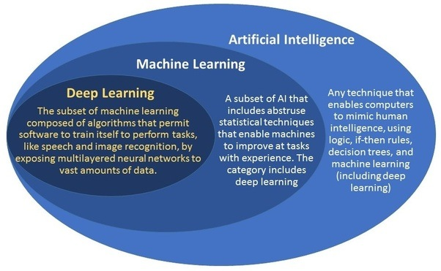
How are AI and ML different ?

Slide 10
Where else is it used
Face recognition
Speech recognition
Handwriting recognition
Real Life Examples
Facebook People You May Know
Product Recommendation
Virtual Assistants

