Slide 1

CLASSIFICATION
Decision Tree Method

Slide 2
Decision Tree Example 1
Given customer information, Can we find eligibility for personal Loan (Gender, Occupation, Age, Salary)

Slide 3
Decision Tree Example 2
Based on data points
Y
X

Slide 4
Multiclass Decision Tree
Y
X

Slide 5
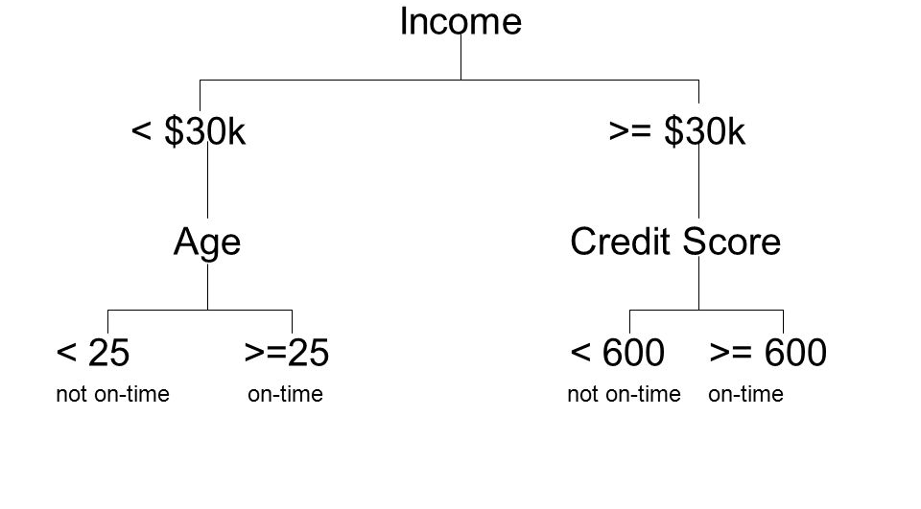
Sample Decision Tree

Slide 6
Why Decision Tree
Simple yet very powerful for classification or prediction
Simple rule based models, which can be understood by human

Slide 7
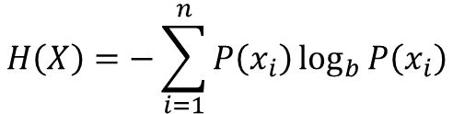
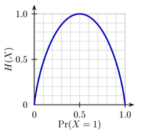
Performance Measure
Entropy : Similar to uncertainty, quantify the amount of uncertainty using a measure called entropy
$$H\left(X\right)=−\sum_{i=1}^{n}{P\left(x_{i}\right)\log_{b}{P\left(x_{i}\right)}}$$

Slide 8
Entropy- Coin Example
Unbiased Coin (H-0.5,T-0.5)
Biased Coin (H-0.8,T-0.2)
- 0.5*log₂(0.5) - 0.5*log₂(0.5) = 0.5 + 0.5 = 1.0
- 0.8*log₂(0.8) - 0.2*log₂(0.2) = 0.2575 + 0.4643 = 0.7218

Slide 9
Information Gain
Being certain as we move down in the tree, reduction in entropy

Slide 10
http://www.saedsayad.com/decision_tree.htm

