Slide 1

CLASSIFICATION
Random Forest Method
Tree Ensemble

Slide 2
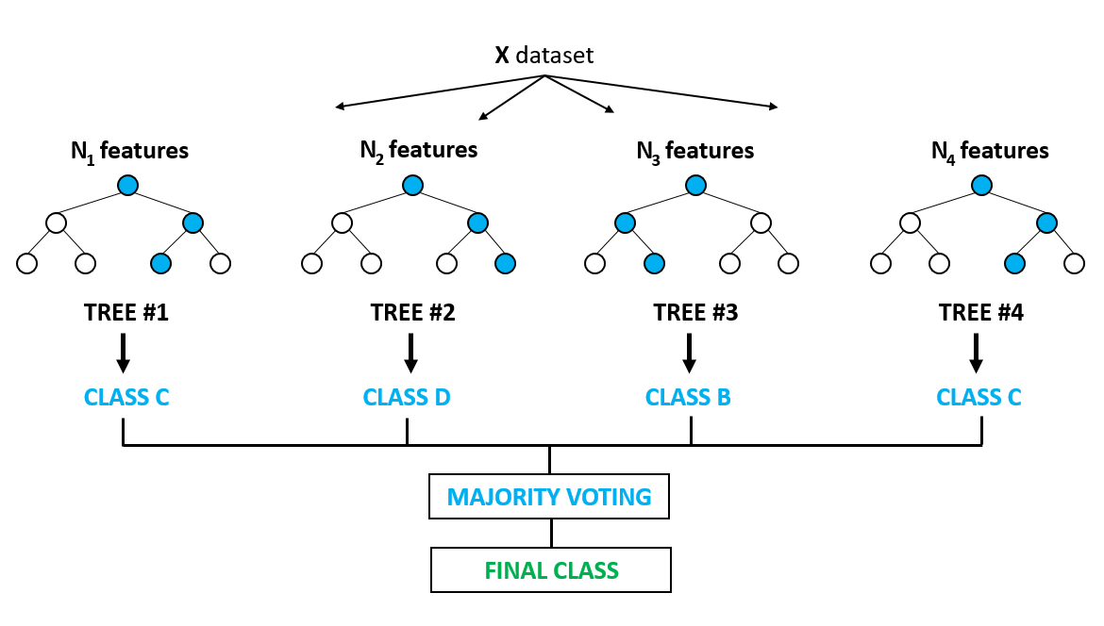
Random Forest Method

Slide 3
Random Forest Example 1
Based on data points
Y
Y
X
X

