Slide 1
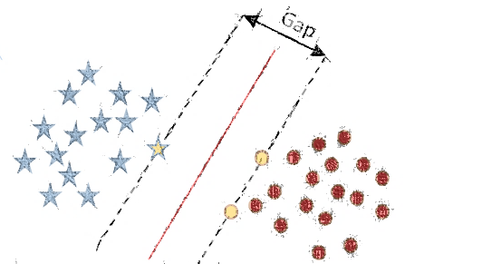
CLASSIFICATION
Support Vector Machine

Slide 2
What is SVM
The goal of a support vector machine is to find the optimal separating hyperplane which maximizes the margin of the training data.

Slide 3
Example 1 – Maximum Margin Classification
Y
X

Slide 4
Multiple problems
Biased Classification
Optimal separation

