Slide 1



GEMINI-QUIZIFY
RUHI TYAGI

Slide 2

PROJECT OVERVIEW

Slide 3

ABOUT GEMINI-QUIZIFY
Document Ingestion: Easily upload PDFs for quizzes.
Intelligent Quiz Generation: Generate quizzes from uploaded content using NLP.
User-Friendly Interface: Sleek UI built with Streamlit.
Session Management: Maintain quiz progress effectively.
Customizable Quizzes: Configure questions and topics for tailored quizzes.

Slide 4
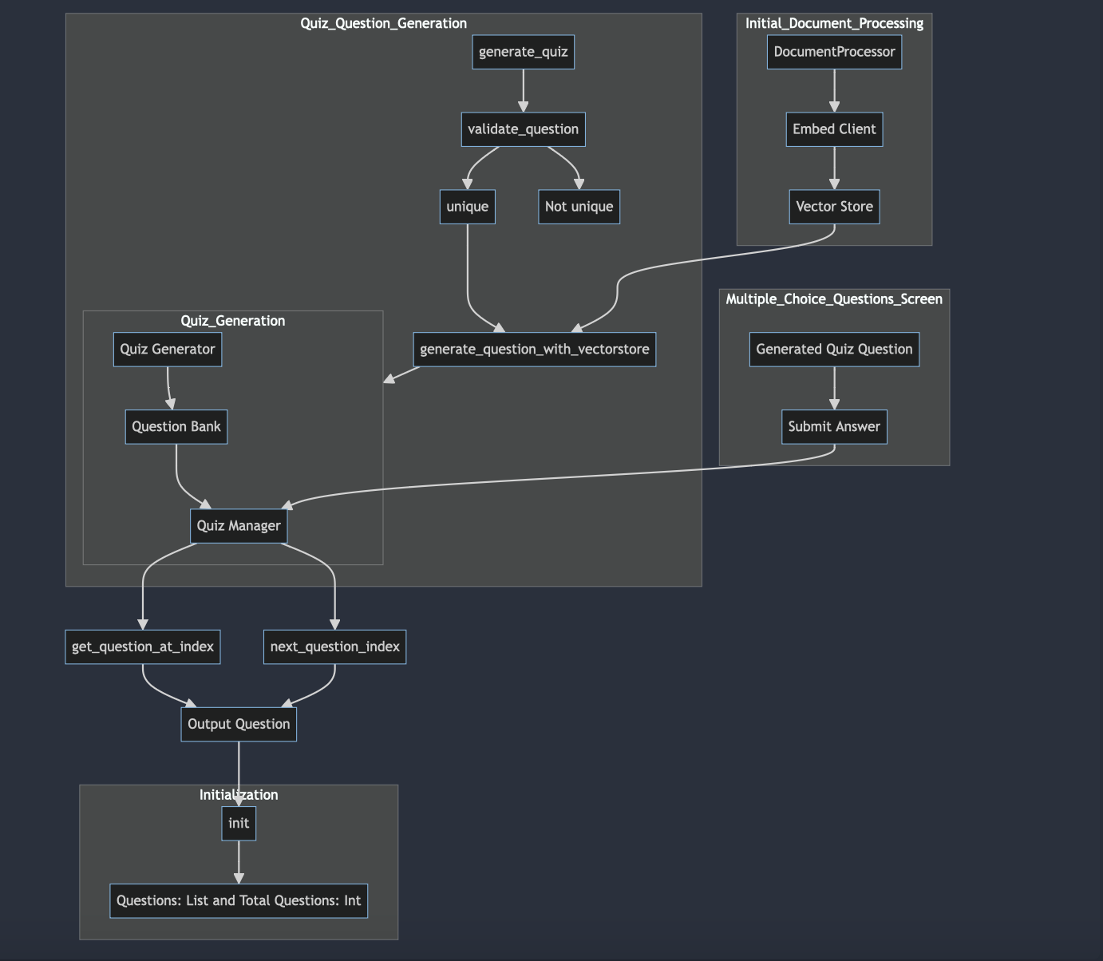
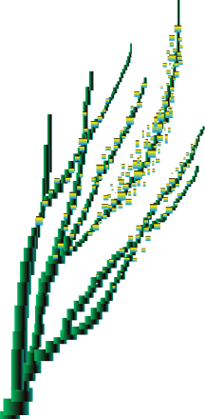
FLOWCHART:
A SIMPLE VERSIONW

Slide 5

DEMOSTRATION
Briefly elaborate on what you want to discuss.

Slide 6

CONCLUSION

Slide 7
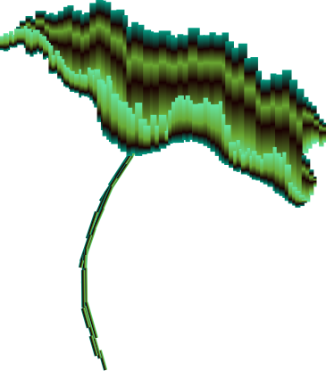
Streamlit for UI
GCP Embedding Services
Created a user-friendly interface for seamless interaction.
Utilized Google Cloud Platform for robust text embeddings.
LEARNINGS!
PyPDFLoader
ChromaDB
Efficiently processed and extracted content from PDF documents.
Implemented ChromaDB for efficient data storage and retrieval.
LangChain Integration
Quiz Generation Logic
Leveraged advanced NLP techniques for content embedding.
Developed dynamic quiz creation and management.

Slide 8




THANK YOU!

