Slide 1

EZERKA-PINGO
EZERKA INC
Created & Designed by Ezerka Inc – 2019

Slide 2
PRESENTATION AGENDA
Problem Statement
Statistics
Pingo Solution
Target Audience
Competitors
Requirements for Project

Slide 3
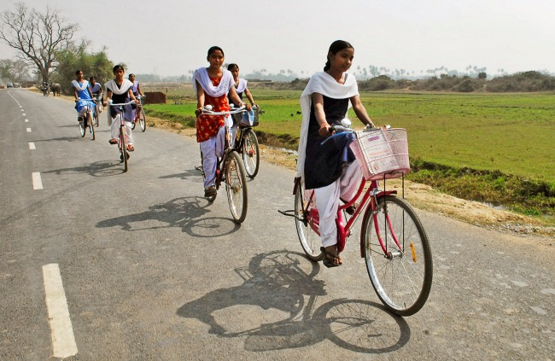
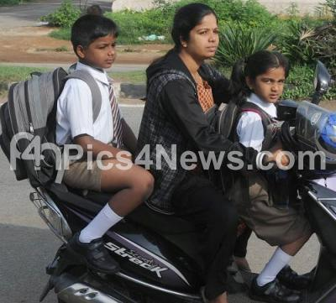
Problem statement
All most many schools/colleges in India are not providing satisfactory transport facilities to the children.
Sometimes children should travel for long distances to reach the school using various modes of transportation

Slide 4
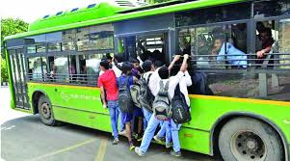
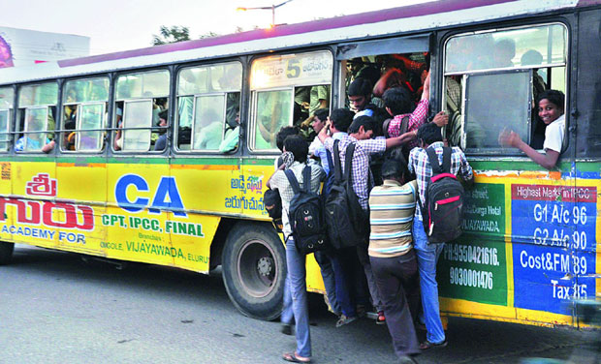
PROBLEM STATEMENT(Contd.)
The safety for children in public transport is always a major concern for Parents.

Slide 5
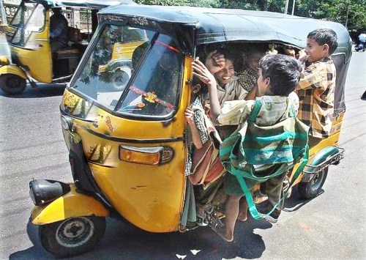
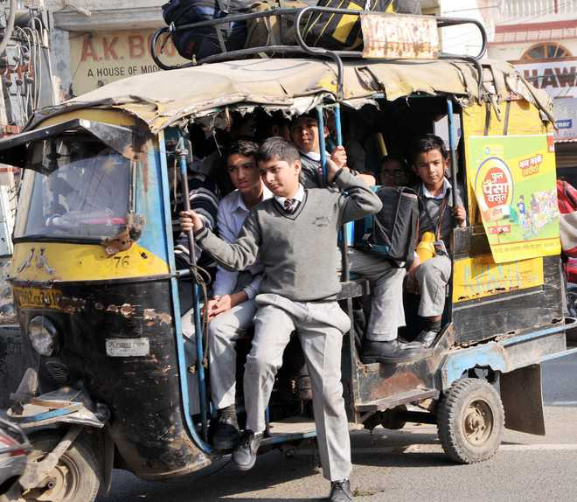
PROBLEM STATEMENT(Contd.)
As the parents have no other option they choose Private Autos/Vans to send their kids

Slide 6
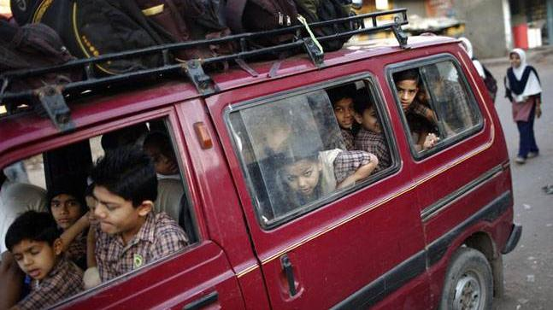
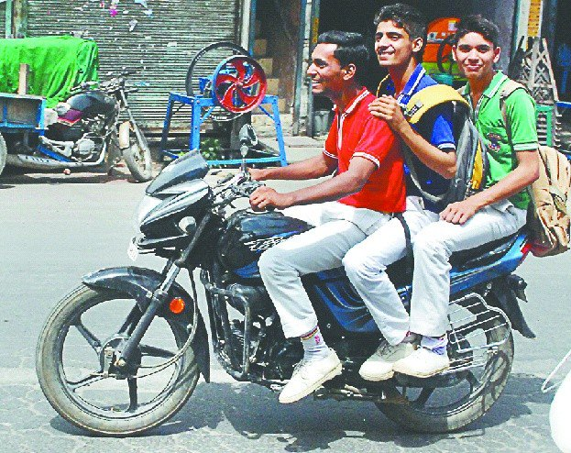
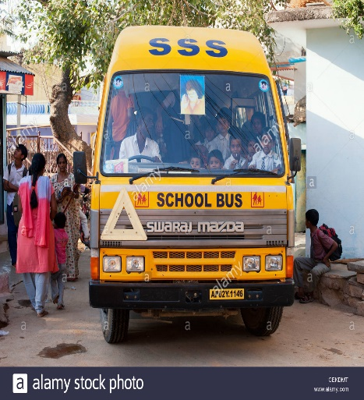
PROBLEM STATEMENT(Contd.)

Slide 7
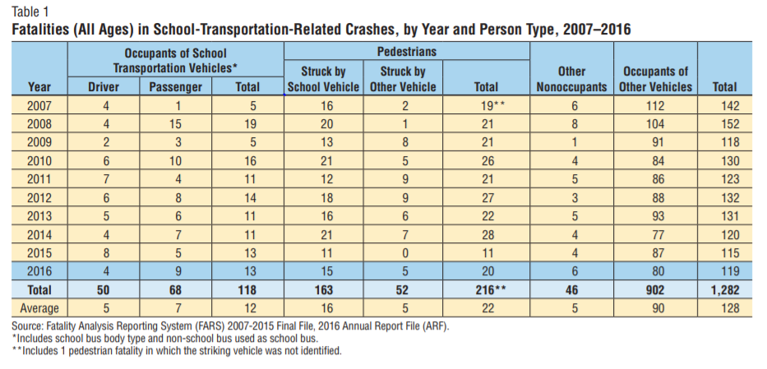
Statistics
From 2007 to 2016 there were 320,874 fatal motor vehicle traffic crashes. Of those crashes, 1,147 (0.4%) were classified as school-transportation-related.
Between 2007 and 2016, there have been 1,282 people killed in school-transportation-related crashes—an average of 128 fatalities per year. Occupants of school transportation vehicles accounted for 9 percent of the fatalities, and nonoccupants (pedestrians, bicyclists, etc.) accounted for 20 percent of the fatalities. Most (70%) of the people who lost their lives in these crashes were occupants of other vehicles involved (Table 1).

Slide 8
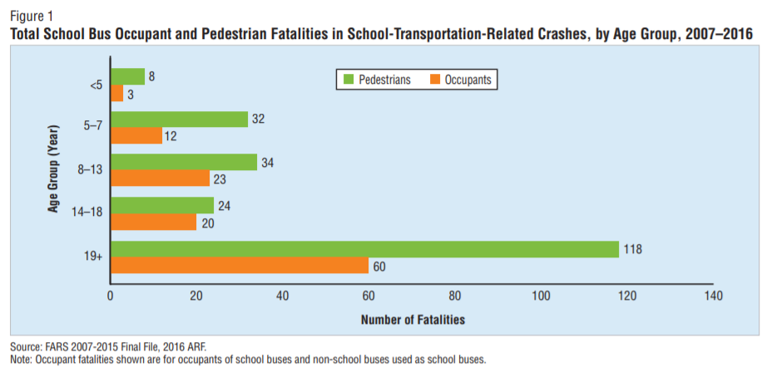

Statistics
Source:

Slide 9
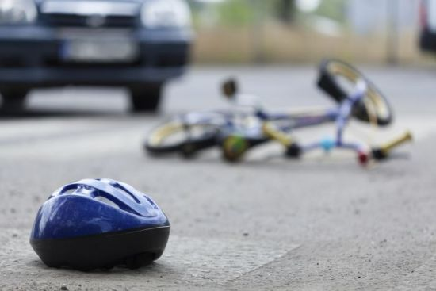
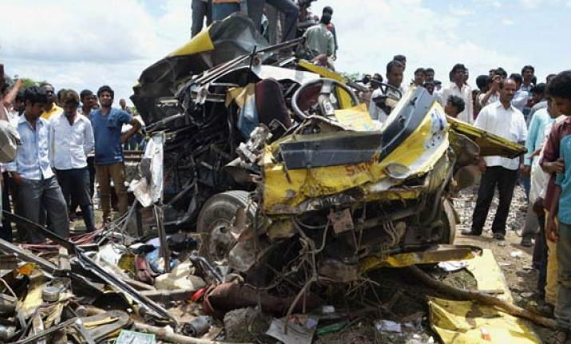
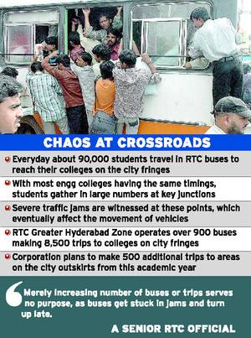
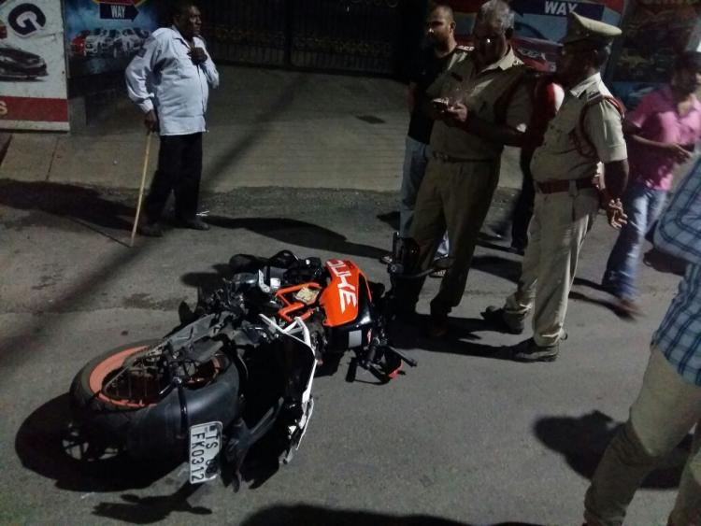
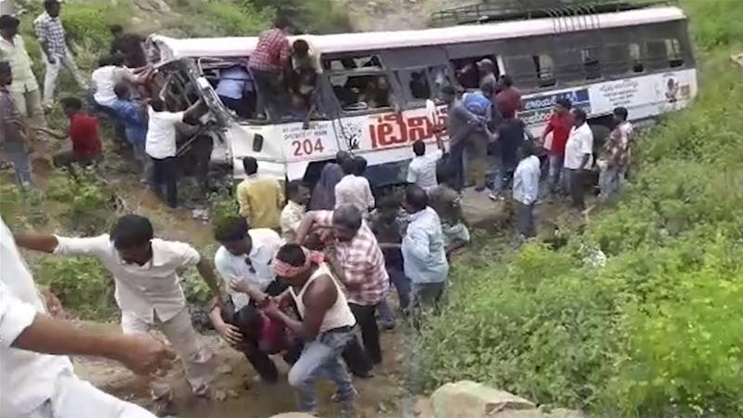
Some snaps

Slide 10
Our solution
All these are happening because of reckless speed and packed vehicles.
We are here to help you. If you are busy and you could not pick your child from school/college then, let PINGO take the pressure off and get your kids from the desired location. We will take them to school or any other destination through our medium.
Our Features:
We provide certified drivers who can read or write basic Telugu,English and Hindi ,so that they are interactive.
GPS location tracking facility so that parent can track their child.
Ongoing text notification after their child is getting into the bus and getting down the bus.
We provide door-to-door step facility if you provide your current location and destination location our medium
Parents Can make Scheduled Pickup for their child
We will pick up and drop your child daily from your home to school and vice-versa.
The payment can be done in a monthly or daily basis.
Minimum Strength in transport vehicle as per Vehicle.
.

Slide 11
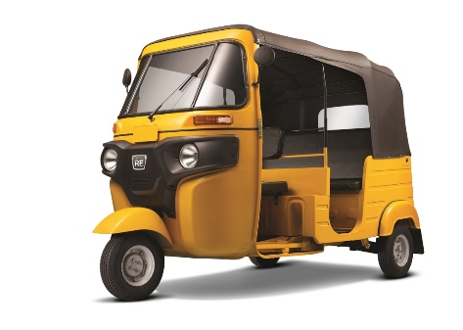
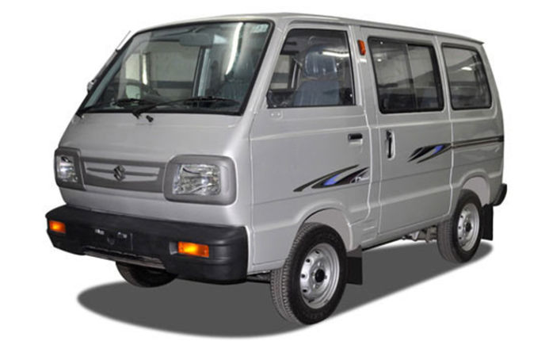
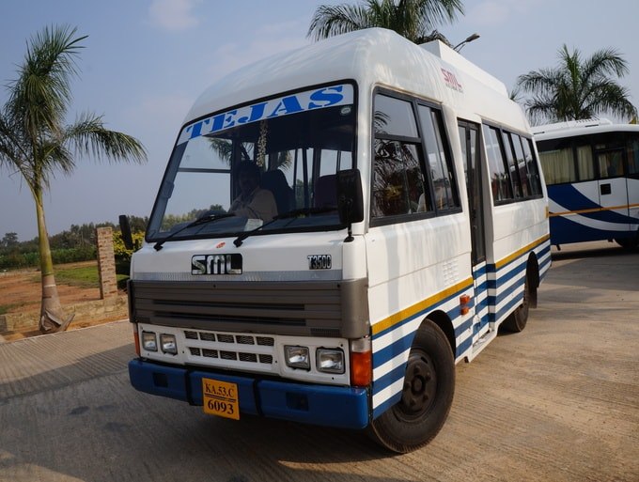
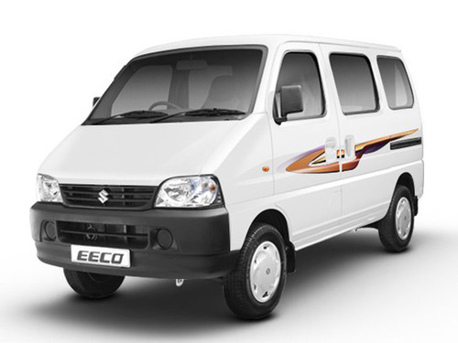
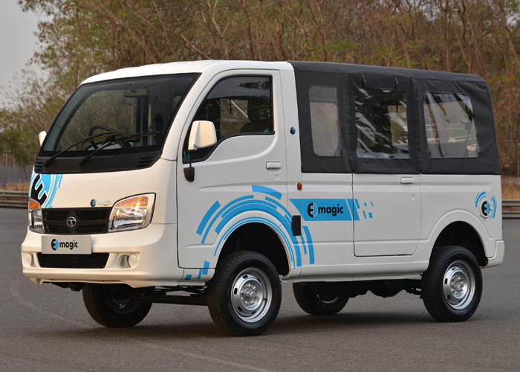
Our different mediums

Slide 12




TARGET AUDIENCE
SCHOOL STUDENTS
COLLEGE STUDENTS
SPECIAL COUCHING STUDENTS
OFFICE STAFF
CASH PARTY CHILDREN
Cash Party children tend to goto school by different cars which can be arranged on monthly basis.
SPECIAL CLASSES STUDENTS

Slide 13
REQUIREMNTS FOR PROJECT
SURVEY OF MINIMUM 500
ANDROID/WEB APPLICATION
PATENT DOCUMENTATION
VISITING CARDS
NO COST ADVERTISEMENT
FUNDING PLATFORMS

Slide 14


THANKS FOR WATCHING!
Don’t forget to contact us.
Contact us:
Follow us on:
Flat no 401, Rainbow Residency, Attapur
+91 - 8328277518
info@ezerka.org
facebook.com/ezerka
@ezerka Ezerka.inc@gmail.com

