Slide 1
Course Title: Introduction to Fixed Income Mathematics
Course Description: This course introduces the fundamental mathematical concepts used in fixed income securities, covering bond pricing, yield calculations, interest rates, and risk assessment. Students will learn to apply quantitative methods to evaluate fixed income instruments and make informed investment decisions.
Course Objectives:
Understand the basic features and types of fixed income securities.
Apply mathematical principles to calculate bond prices and yields.
Analyze interest rate risks and their impact on fixed income portfolios.
Use financial models to assess the value of fixed income securities.
Notes:
Prompt: create an introductory fixed income mathematics course, 10/16/24

Slide 2
Week 1: Introduction to Fixed Income Securities
Definition and characteristics of fixed income securities
Types of bonds (government, corporate, municipal, etc.)
Cash flows and coupon payments
Week 2: Time Value of Money
Present value and future value concepts
Discounting cash flows
Annuities and perpetuities
Week 3: Bond Pricing
Price calculation of coupon bonds
Yield to maturity (YTM) and current yield
Accrued interest and dirty vs. clean prices

Slide 3
Week 4: Yield Measures
Yield to maturity vs. yield to call
Yield curve concepts
Spread measures (G-spread, Z-spread)
Week 5: Interest Rate Risk
Duration and its significance
Modified duration and convexity
Impact of interest rate changes on bond prices
Week 6: Valuation of Zero-Coupon Bonds
Pricing zero-coupon bonds
Yield calculations for zero-coupon bonds
Comparison with coupon bonds

Slide 4
Week 7: Credit Risk and Bond Ratings
Understanding credit risk
Bond ratings and their implications
Credit spreads and their calculation
Week 8: Portfolio Management Basics
Constructing a fixed income portfolio
Immunization strategies
Performance measures (total return, excess return)
Week 9: Advanced Topics in Fixed Income
Introduction to securitization
Mortgage-backed securities
Interest rate derivatives (swaps, options)

Slide 5
Week 10: Practical Applications and Case Studies
Real-world applications of fixed income mathematics
Case studies on bond investments
Current trends in fixed income markets
Assessment:
Weekly quizzes to reinforce learning
Midterm exam covering Weeks 1-5
Final project: Analyze a fixed income portfolio or specific bond investment
Final exam covering the entire course content
Recommended Textbooks:
"Fixed Income Analysis" by Frank J. Fabozzi
"Bond Markets, Analysis, and Strategies" by Frank J. Fabozzi
Supplementary Materials:
Online resources and financial calculators
Access to bond market databases and tools
Target Audience:
This course is intended for undergraduate finance students, aspiring analysts, and professionals looking to deepen their understanding of fixed income markets.
Notes:
Prompt: create an introductory fixed income mathematics course

Slide 6
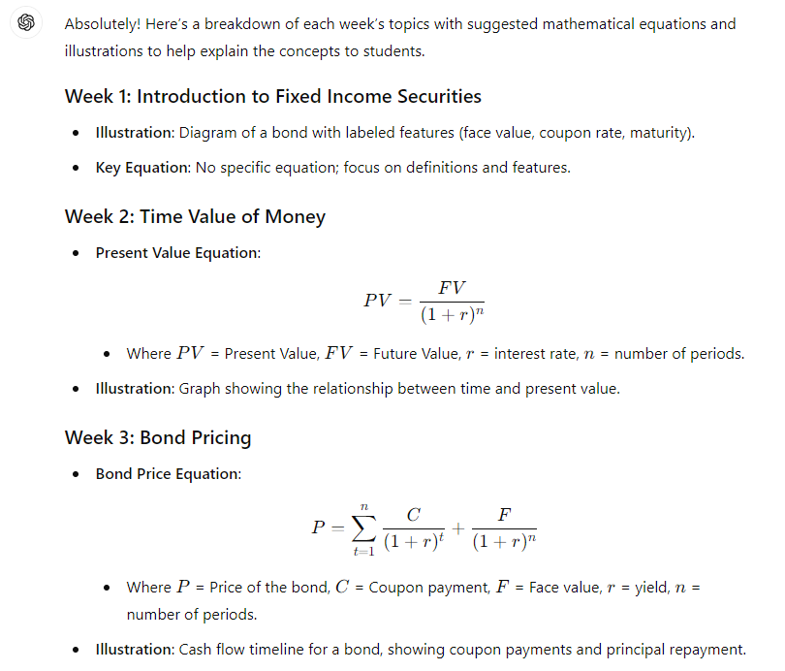
Notes:
Prompt: for each of the slides create mathematical equations and illustrations to explain the topic to students

Slide 7
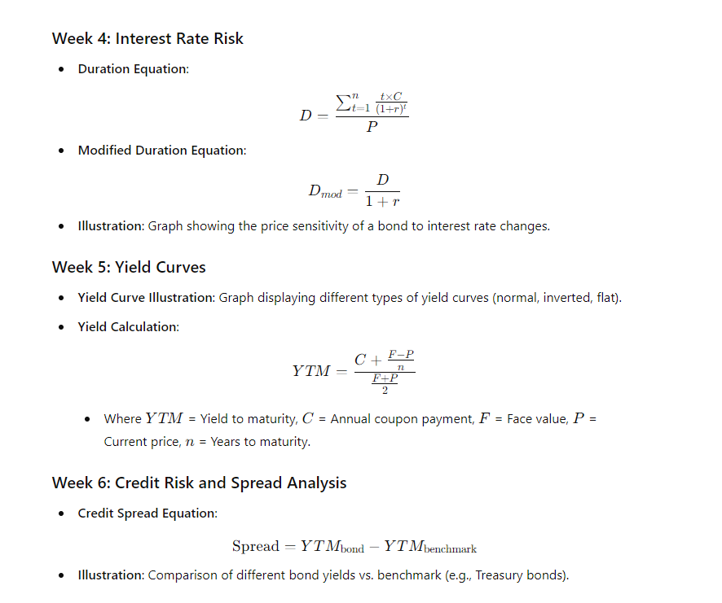
Notes:
Prompt: for each of the slides create mathematical equations and illustrations to explain the topic to students

Slide 8
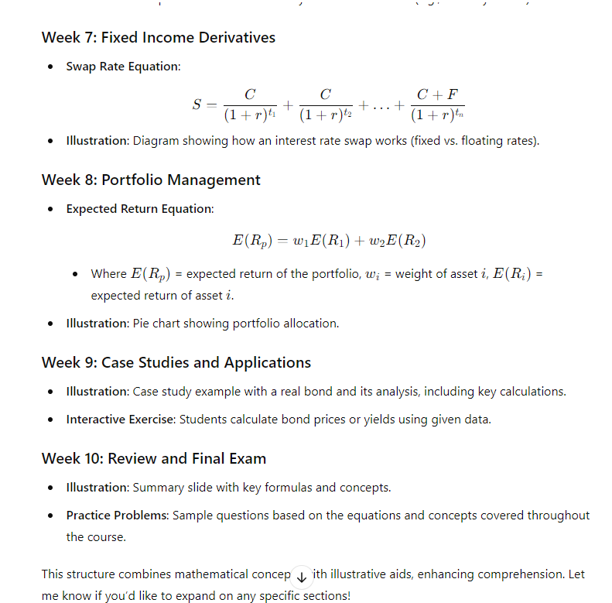
Notes:
Prompt: for each of the slides create mathematical equations and illustrations to explain the topic to students

