Slide 1
AI/ML

Slide 2
Learning about Machine Learning

Slide 3
What is Machine Learning?

Slide 4
What is Machine Learning
0 & 1
ML is an art or science making anything to turn into numbers
[0s and 1s],and finding the pattern in those numbers

Slide 5
Lets understand by example

Slide 6

Mountain

Slide 7
Pixelation in 3 Dimensions

Slide 8
Pixelation in 3 Dimensions
Y
Z
X

Slide 9
Image Classification
1 | 0 | 0 | 1 | 0 | 0 | 0 | 0 | 0 | 0
1 | 1 | 1 | 1 | 1 | 1 | 1 | 1 | 1 | 1
0 | 0 | 0 | 0 | 0 | 0 | 0 | 0 | 0 | 0
1 | 1 | 1 | 1 | 1 | 1 | 1 | 1 | 1 | 1
0 | 0 | 0 | 0 | 0 | 0 | 0 | 0 | 0 | 0
1 | 1 | 1 | 1 | 1 | 1 | 1 | 1 | 1 | 1
0 | 0 | 0 | 0 | 0 | 0 | 0 | 0 | 0 | 0
1 | 1 | 1 | 1 | 1 | 1 | 1 | 1 | 1 | 1
0 | 1 | 1 | 0 | 0 | 0 | 0 | 0 | 0 | 0
1 | 1 | 1 | 1 | 1 | 1 | 1 | 1 | 1 | 1
0 | 0 | 0 | 0 | 0 | 0 | 0 | 0 | 0 | 0
1 | 1 | 1 | 1 | 1 | 1 | 1 | 1 | 1 | 1
0 | 0 | 0 | 0 | 0 | 0 | 0 | 0 | 0 | 0
1 | 1 | 1 | 1 | 1 | 1 | 1 | 1 | 1 | 1
0 | 0 | 0 | 0 | 0 | 0 | 0 | 0 | 0 | 0
1 | 1 | 1 | 1 | 1 | 1 | 1 | 1 | 1 | 1
0 | 0 | 0 | 0 | 0 | 0 | 0 | 0 | 0 | 0
1 | 1 | 1 | 0 | 1 | 1 | 1 | 1 | 1 | 1
0 | 0 | 0 | 0 | 0 | 0 | 0 | 0 | 0 | 0
1 | 1 | 1 | 1 | 1 | 1 | 1 | 1 | 1 | 1
0 | 0 | 0 | 0 | 0 | 0 | 0 | 0 | 0 | 0
1 | 1 | 1 | 1 | 1 | 1 | 1 | 1 | 1 | 1
0 | 0 | 0 | 0 | 0 | 0 | 0 | 0 | 0 | 0
1 | 1 | 1 | 1 | 1 | 1 | 1 | 1 | 1 | 1

Slide 10
Model Training (Classification)
1 | 0 | 0 | 1 | 0 | 0 | 0 | 0 | 0 | 0
1 | 1 | 1 | 0 | 1 | 1 | 1 | 0 | 1 | 1
0 | 0 | 0 | 0 | 0 | 0 | 0 | 0 | 0 | 0
1 | 1 | 1 | 1 | 1 | 1 | 1 | 1 | 1 | 1
0 | 0 | 0 | 0 | 0 | 0 | 0 | 0 | 0 | 0
1 | 1 | 1 | 1 | 1 | 1 | 1 | 1 | 1 | 1
0 | 0 | 0 | 0 | 0 | 0 | 0 | 0 | 0 | 0
1 | 1 | 1 | 1 | 1 | 1 | 1 | 1 | 1 | 1
0 | 1 | 1 | 0 | 0 | 0 | 0 | 0 | 0 | 0
1 | 1 | 1 | 1 | 1 | 1 | 1 | 1 | 1 | 1
0 | 0 | 0 | 0 | 0 | 0 | 0 | 0 | 0 | 0
1 | 1 | 1 | 1 | 1 | 1 | 1 | 1 | 1 | 1
0 | 0 | 0 | 0 | 0 | 0 | 0 | 0 | 0 | 0
1 | 1 | 1 | 1 | 1 | 1 | 1 | 1 | 1 | 1
0 | 0 | 0 | 0 | 0 | 0 | 0 | 0 | 0 | 0
1 | 1 | 1 | 1 | 1 | 1 | 1 | 1 | 1 | 1
0 | 0 | 0 | 0 | 0 | 0 | 0 | 0 | 0 | 0
1 | 1 | 1 | 0 | 1 | 1 | 1 | 1 | 1 | 1
0 | 0 | 0 | 0 | 0 | 0 | 0 | 0 | 0 | 0
1 | 1 | 1 | 1 | 1 | 1 | 1 | 1 | 1 | 1
0 | 0 | 0 | 0 | 0 | 0 | 0 | 0 | 0 | 0
1 | 1 | 1 | 1 | 1 | 1 | 1 | 1 | 1 | 1
0 | 0 | 0 | 0 | 0 | 0 | 0 | 0 | 0 | 0
1 | 1 | 1 | 1 | 1 | 1 | 1 | 1 | 1 | 1
Mountain

Slide 11
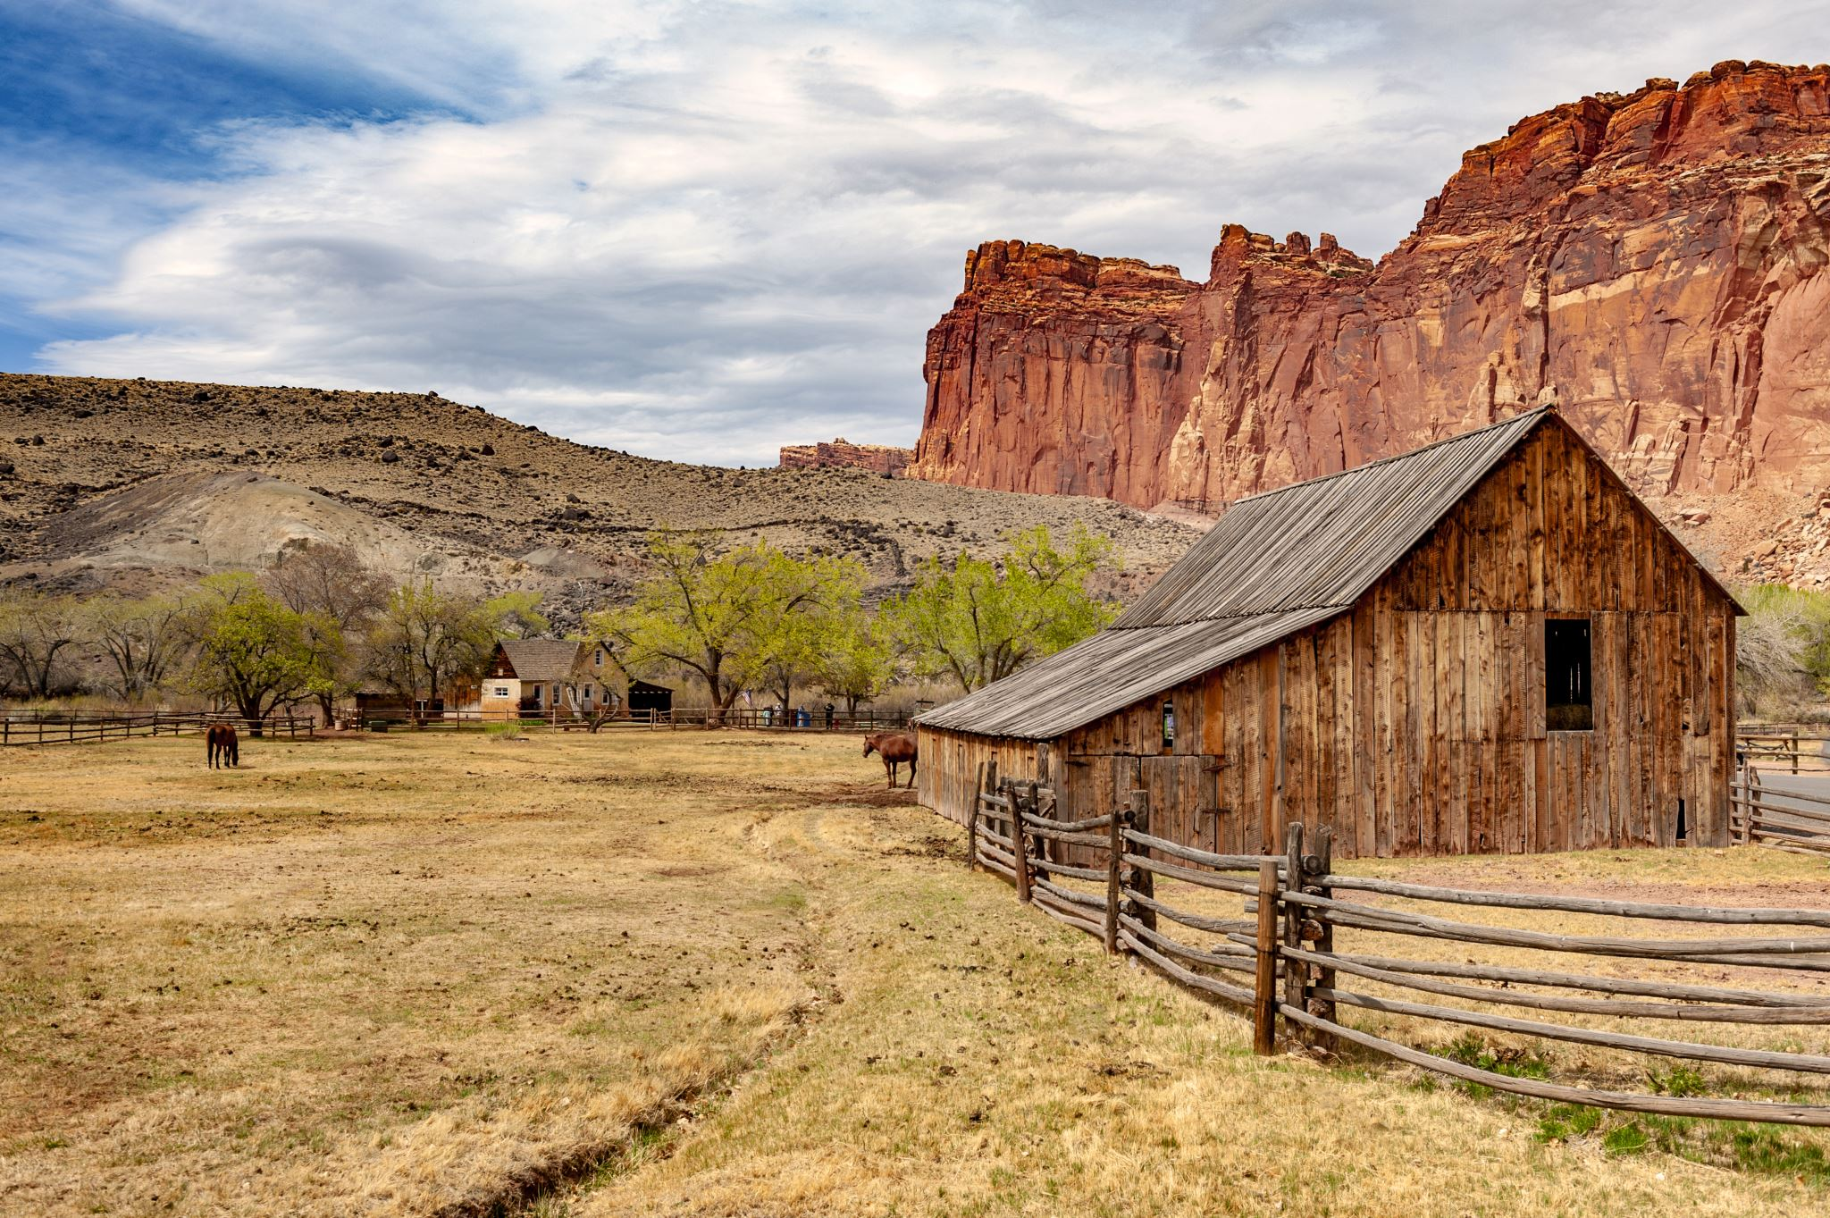
Model Evaluation (Classification)
1 | 0 | 0 | 1 | 0 | 0 | 0 | 0 | 0 | 0
1 | 1 | 1 | 0 | 1 | 1 | 1 | 0 | 1 | 1
0 | 0 | 0 | 0 | 0 | 0 | 0 | 0 | 0 | 0
1 | 1 | 1 | 1 | 1 | 1 | 1 | 1 | 1 | 1
0 | 0 | 0 | 0 | 0 | 0 | 0 | 0 | 0 | 0
1 | 1 | 1 | 1 | 1 | 1 | 1 | 1 | 1 | 1
0 | 0 | 0 | 0 | 0 | 0 | 0 | 0 | 0 | 0
1 | 1 | 1 | 1 | 1 | 1 | 1 | 1 | 1 | 1
0 | 1 | 0 | 1 | 1 | 1 | 1 | 0 | 0 | 0
0 | 0 | 0 | 0 | 1 | 1 | 1 | 1 | 1 | 1
0 | 0 | 0 | 0 | 0 | 0 | 0 | 0 | 0 | 0
1 | 1 | 1 | 1 | 1 | 1 | 1 | 1 | 1 | 1
0 | 0 | 0 | 0 | 0 | 0 | 0 | 0 | 0 | 0
1 | 1 | 1 | 1 | 1 | 1 | 1 | 1 | 1 | 1
0 | 0 | 0 | 0 | 0 | 0 | 0 | 0 | 0 | 0
1 | 1 | 1 | 1 | 1 | 1 | 1 | 1 | 1 | 1
0 | 0 | 0 | 0 | 0 | 0 | 0 | 0 | 0 | 0
0 | 0 | 0 | 1 | 0 | 0 | 0 | 0 | 0 | 0
0 | 0 | 1 | 1 | 1 | 0 | 1 | 1 | 0 | 0
1 | 1 | 1 | 1 | 1 | 1 | 1 | 1 | 1 | 1
0 | 0 | 0 | 0 | 0 | 0 | 0 | 0 | 0 | 0
1 | 1 | 1 | 1 | 1 | 1 | 1 | 1 | 1 | 1
0 | 0 | 0 | 0 | 0 | 0 | 0 | 0 | 0 | 0
1 | 1 | 1 | 1 | 1 | 1 | 1 | 1 | 1 | 1
Mountain

Slide 12
Model Accuracy (Classification)
80%
Accuracy
1 | 0 | 0 | 1 | 0 | 0 | 0 | 0 | 0 | 0
1 | 1 | 1 | 0 | 1 | 1 | 1 | 0 | 1 | 1
0 | 0 | 0 | 0 | 0 | 0 | 0 | 0 | 0 | 0
1 | 1 | 1 | 1 | 1 | 1 | 1 | 1 | 1 | 1
0 | 0 | 0 | 0 | 0 | 0 | 0 | 0 | 0 | 0
1 | 1 | 1 | 1 | 1 | 1 | 1 | 1 | 1 | 1
0 | 0 | 0 | 0 | 0 | 0 | 0 | 0 | 0 | 0
1 | 1 | 1 | 1 | 1 | 1 | 1 | 1 | 1 | 1
0 | 1 | 0 | 1 | 1 | 1 | 1 | 0 | 0 | 0
0 | 0 | 0 | 0 | 1 | 1 | 1 | 1 | 1 | 1
0 | 0 | 0 | 0 | 0 | 0 | 0 | 0 | 0 | 0
1 | 1 | 1 | 1 | 1 | 1 | 1 | 1 | 1 | 1
0 | 0 | 0 | 0 | 0 | 0 | 0 | 0 | 0 | 0
1 | 1 | 1 | 1 | 1 | 1 | 1 | 1 | 1 | 1
0 | 0 | 0 | 0 | 0 | 0 | 0 | 0 | 0 | 0
1 | 1 | 1 | 1 | 1 | 1 | 1 | 1 | 1 | 1
0 | 0 | 0 | 0 | 0 | 0 | 0 | 0 | 0 | 0
0 | 0 | 0 | 1 | 0 | 0 | 0 | 0 | 0 | 0
0 | 0 | 1 | 1 | 1 | 0 | 1 | 1 | 0 | 0
1 | 1 | 1 | 1 | 1 | 1 | 1 | 1 | 1 | 1
0 | 0 | 0 | 0 | 0 | 0 | 0 | 0 | 0 | 0
1 | 1 | 1 | 1 | 1 | 1 | 1 | 1 | 1 | 1
0 | 0 | 0 | 0 | 0 | 0 | 0 | 0 | 0 | 0
1 | 1 | 1 | 1 | 1 | 1 | 1 | 1 | 1 | 1
Mountain

Slide 13
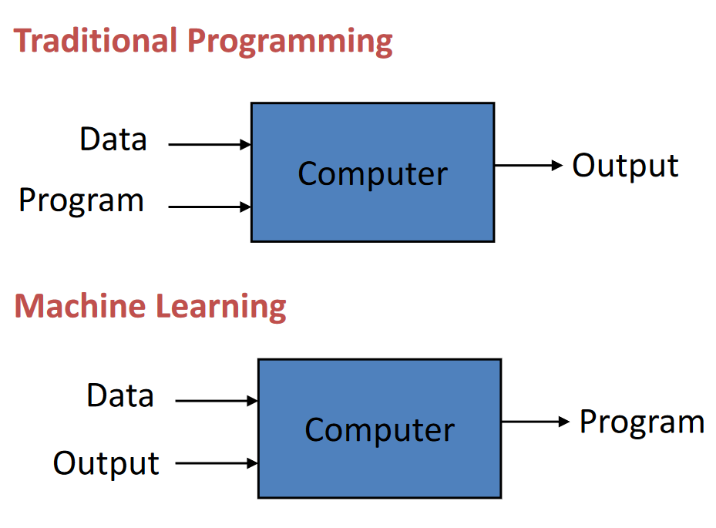
Traditional Vs Machine Learning Programming
f(input) = output

Slide 14
Traditional Vs Machine Learning Programming
f(input) = output
f(input) = output
Best fit function

Slide 15
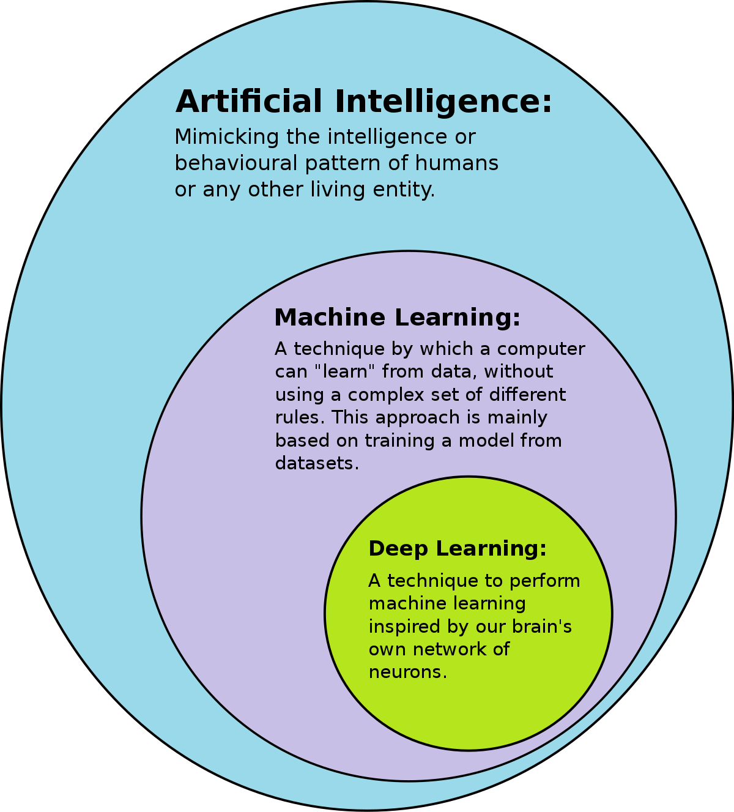
Define AI/ML
AI refers to systems or machines that mimic human intelligence to perform tasks and can iteratively improve themselves based on the information they collect
ML is an art or science making anything to turn into numbers [0s and 1s],and finding the pattern in those numbers
https://commons.wikimedia.org/wiki/File:AI-ML-DL.svg

Slide 16
How to make Machines Learn ?
[ Types of ML Systems]

Slide 17
Types of ML Systems
Supervised learning
Unsupervised learning
Reinforcement learning

Slide 18
In Supervised Learning
We “supervise” the model and help it to learn
Like a student learning new material by studying old exams that contain both questions and answers
We train the model, with lots of data
This training helps model to make better predictions
Models can improve their predictions after seeing lots of data with the correct answers
Trained models discover connections between the elements in the data that produce the correct answers

Slide 19
In Unsupervised Learning
We generally “do not supervise” model learning as much as we do in supervised training
We let the models identity the patterns among given data
Trained models discover connections between the elements in the data based on training data
Trained model employs a technique called Clustering
Clustering , refers to grouping things that exhibit similar behavior

Slide 20
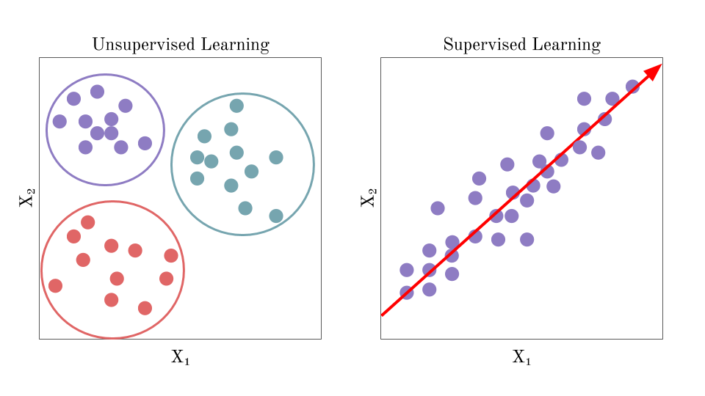
Unsupervised vs Supervised Learning

Slide 21
Using ML to Solve real world problems

Slide 22
Problem framing
Problem framing ensures that an ML approach is a good solution to the problem before beginning to work with data and train a model
Problem framing is the critical beginning for solving an ML problem
Problem framing helps us to better understand both the problem and the data in order to design and build a bridge between them
At a high level, ML problem framing consists of two distinct steps
Determining whether ML is the right approach for solving a problem
Framing the problem in ML terms

Slide 23
Understand the problem
Nature of the Application | Expected Features
eCommerce Application | Suggesting Similar Products
Streaming Video Application | Suggesting right videos
Loan App | Recommending right loan plans
State the goal
Begin by stating your goal in non-ML terms
The goal is the answer to the question
"What am I trying to accomplish?"
Clear use case for ML
ML is not a universal tool that can be applied to all problems
In reality, ML is a specialized tool suitable only for particular problems
You don't want to implement a complex ML solution when a simpler non-ML solution will work
To confirm that ML is the right approach, first verify that your current non-ML solution is optimized
If you don't have a non-ML solution implemented, try solving the problem manually using a heuristic

Slide 24
Framing an ML problem
Nature of the Application | Expected Features
Banking Application | Fraud transactions Identification | Predicting purchasing of item
Streaming Video Application | Suggesting right videos | Predicting user clicks
Loan App | Recommending right loan plans | Predictions user to apply loan
Define the ideal outcome and the model's goal
Choose the right kind of model
A classification model making predictions
A classification model's output being used in the product code to make a decision
A regression model making a numeric prediction
A regression model's output being used in the product code to make a decision
Identify the model's output
Define the success metrics

Slide 25
Framing an ML problem
Data
Abundant
Consistent and reliable
Trusted
Available
Correct
Representative
Predictions vs Actions
There's no value in predicting something if you can't turn the prediction into an action that helps users That is, your product should take action from the model's output

Slide 26
ML Keywords & Concepts

Slide 27
ML Keywords & Concepts
feature
label
labeled example
unlabeled example
inference
loss
prediction
training
data
model
training
evaluating

Slide 28
features(x)
One which helps to define an example
Ex: Bedrooms(3,2,1), City (Bengaluru), Facing (East || West || North || South)
label(y)
You will use feature(x) and predict or find the value of Label (y)
Ex: Price of the 3bedroom apartment in Bengaluru, MG Road East facing ?
model
In supervised learning, we use features and labels in training a piece of software, called a model, to make useful predictions from data
In unsupervised learning, we use features and train model to predict labels

Slide 29
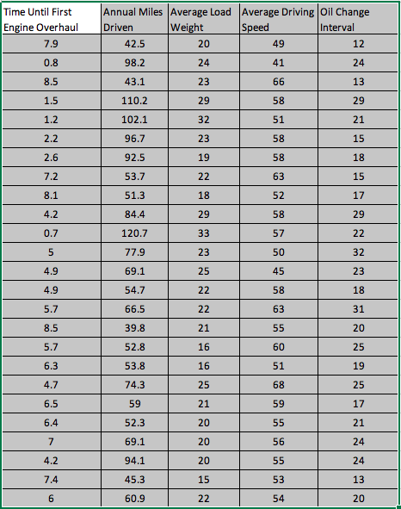
labeled example unlabeled example

Slide 30
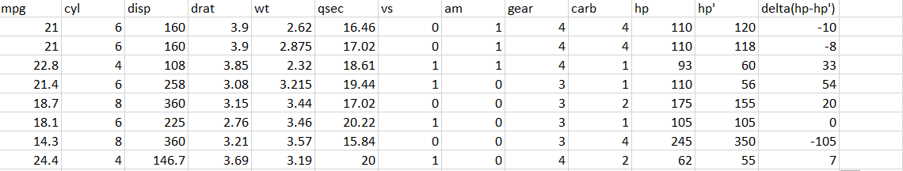
Training and Loss
Loss function = (y-y’)

Slide 31
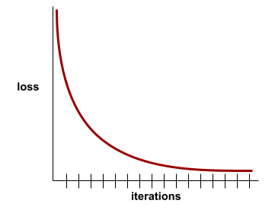
Training and Loss
A loss curve plots training loss vs. the number of iterations
A loss curve provides the following hints about training
A downward slope implies that the model is improving
An upward slope implies that the model is getting worse
A flat slope implies that the model has reached convergence

Slide 32
ML Life Cycle and Stages

Slide 33
High-level view of the ML life cycle
Problem Framing
Data Collection
Data Transformation
Model development, training and evaluation
Model
Deployment
& Maintenance,
Monitor

Slide 34
High-level view of the ML life cycle
Problem Framing
Data Collection
Data Transformation
Model development, training and evaluation
Model
Deployment
& Maintenance,
Monitor
Problem Framing/Understanding the problem
Data collection
Data Transformation
Model development, training and evaluation
Model deployment and maintenance in the production environment

