Slide 1
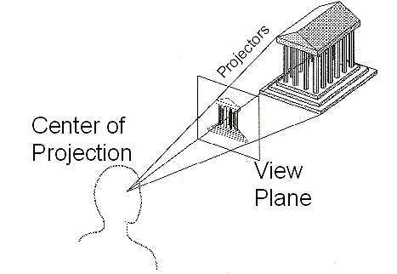
Projection
General definition
  Transform points in n-space to m-space(m<n)
In computer graphics
  Map viewing coordinates to 2D screen coordinates
cgvr.korea.ac.kr

Slide 2
Taxonomy of Projections
Planar geometric projection
Parallel
Perspective
Orthographic
Oblique
One-point
Three-point
Two-point
Top
Axonometric
Cabinet
Other
Front
Cavalier
Side
cgvr.korea.ac.kr

Slide 3
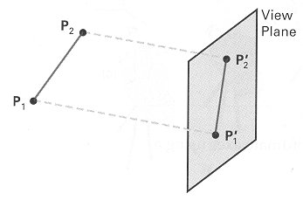
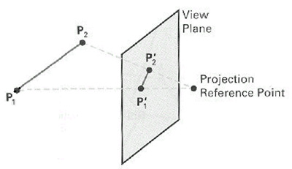
Parallel & Perspective
Parallel Projection
Perspective Projection
cgvr.korea.ac.kr

Slide 4
Taxonomy of Projections
Planar geometric projection
Parallel
Perspective
Orthographic
Oblique
One-point
Three-point
Two-point
Top
Axonometric
Cabinet
Other
Front
Cavalier
Side
cgvr.korea.ac.kr

Slide 5
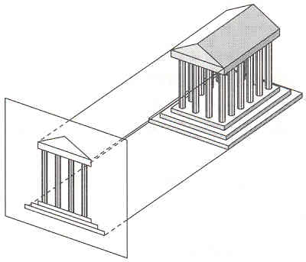
Parallel Projection
Center of projection is at infinity
  Direction of projection (DOP) same for all points
DOP
View Plane
cgvr.korea.ac.kr

Slide 6
Taxonomy of Projections
Planar geometric projection
Parallel
Perspective
Orthographic
Oblique
One-point
Three-point
Two-point
Top
Axonometric
Cabinet
Other
Front
Cavalier
Side
cgvr.korea.ac.kr

Slide 7
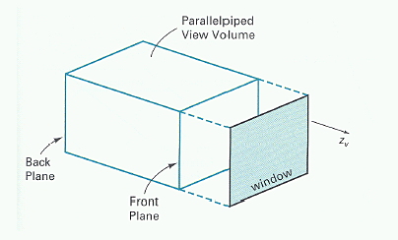
Parallel Projection View Volume
cgvr.korea.ac.kr

Slide 8
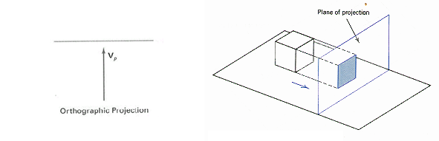
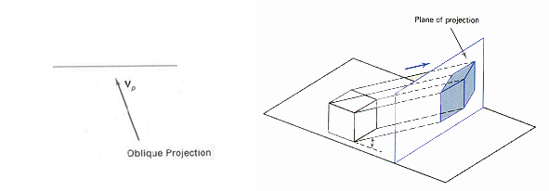
Orthographic & Oblique
Orthographic parallel projection
  the projection is perpendicular to the view plane
Oblique parallel projection
  The projectors are inclined with respect to the view plane
cgvr.korea.ac.kr

Slide 9
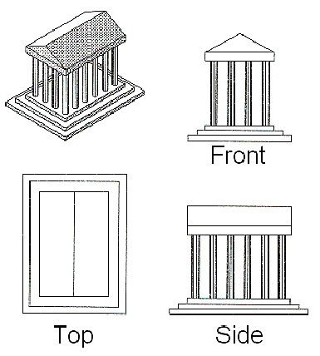
Orthographic Projections
DOP perpendicular to view plane
cgvr.korea.ac.kr

Slide 10
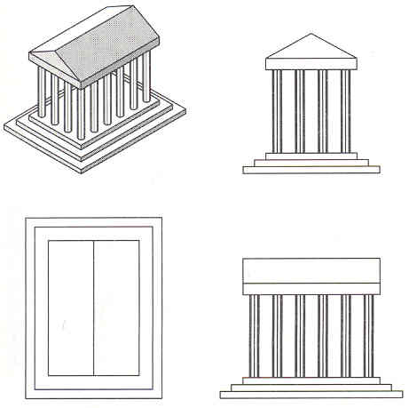
Orthographic Projections
DOP perpendicular to view plane
Front
Top
Side
cgvr.korea.ac.kr

Slide 11
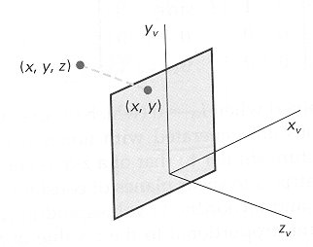
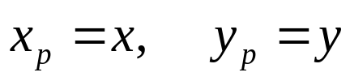
Orthographic Coordinates
cgvr.korea.ac.kr

Slide 12

Oblique Projections
DOP not perpendicular to view plane
  Cavalier
  (DOP at 45 )
  Cabinet
  (DOP at 63.4 )
cgvr.korea.ac.kr

Slide 13
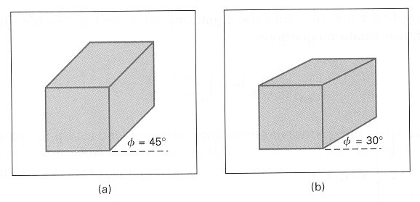

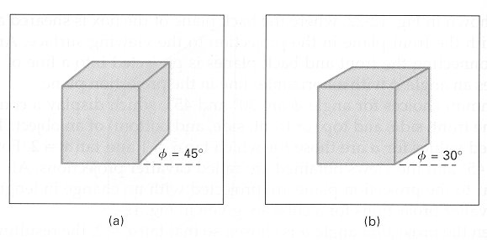

Oblique Projections
DOP not perpendicular to view plane
  Cavalier projection
  Cabinet projection
cgvr.korea.ac.kr

Slide 14
Taxonomy of Projections
Planar geometric projection
Parallel
Perspective
Orthographic
Oblique
One-point
Three-point
Two-point
Top
Axonometric
Cabinet
Other
Front
Cavalier
Side
cgvr.korea.ac.kr

Slide 15
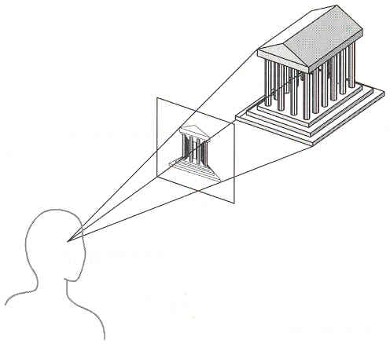
Perspective Projection
Map points onto “view plane” along “projectors” emanating from “center of projection”(cop)
Projectors
Center of Projection
View Plane
cgvr.korea.ac.kr

Slide 16
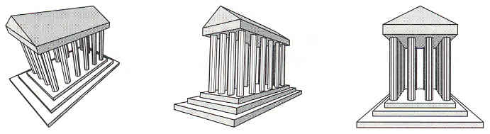
Perspective Projection
How many vanishing point?
cgvr.korea.ac.kr

Slide 17
Perspective Projection
How many vanishing point?
Three-point perspective
cgvr.korea.ac.kr

Slide 18
Perspective Projection
How many vanishing point?
Three-point perspective
Two-point perspective
cgvr.korea.ac.kr

Slide 19
Perspective Projection
How many vanishing point?
Three-point perspective
Two-point perspective
One-point perspective
cgvr.korea.ac.kr

Slide 20
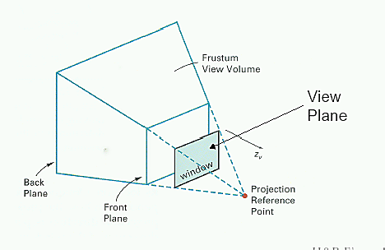
Perspective Projection View Volume
cgvr.korea.ac.kr

Slide 21
Taxonomy of Projections
Planar geometric projection
Parallel
Perspective
Orthographic
Oblique
One-point
Three-point
Two-point
Top
Axonometric
Cabinet
Other
Front
Cavalier
Side
cgvr.korea.ac.kr

Slide 22
Perspective vs. Parallel
Perspective projection
  + Size varies inversely with distance – looks realistic
  – Distance and angles are not(in general) preserved
  – Parallel line do not (in general) remain parallel
Parallel projection
  + Good for exact measurements
  + Parallel lines remain parallel
  – Angles are not (in general) preserved
  – Less realistic looking
cgvr.korea.ac.kr

Slide 23
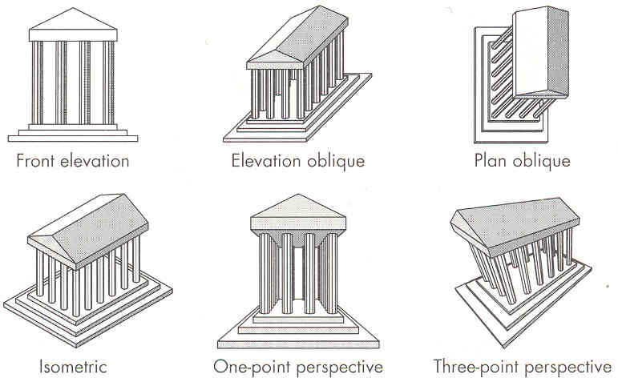
Classical Viewing
cgvr.korea.ac.kr

