Slide 1
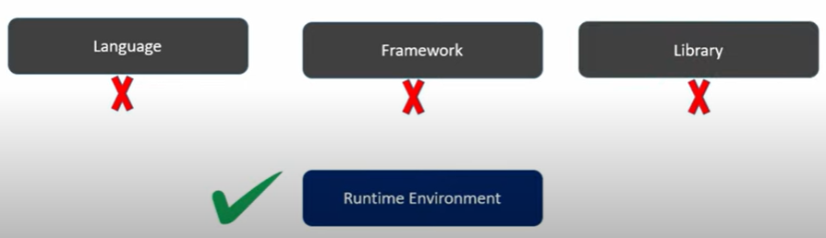
Node.js
It is an open-source, cross-platform JavaScript runtime environment that allows developers to run JavaScript outside the browser.
It is built on the V8 JavaScript engine and is primarily used for backend development.

Slide 2
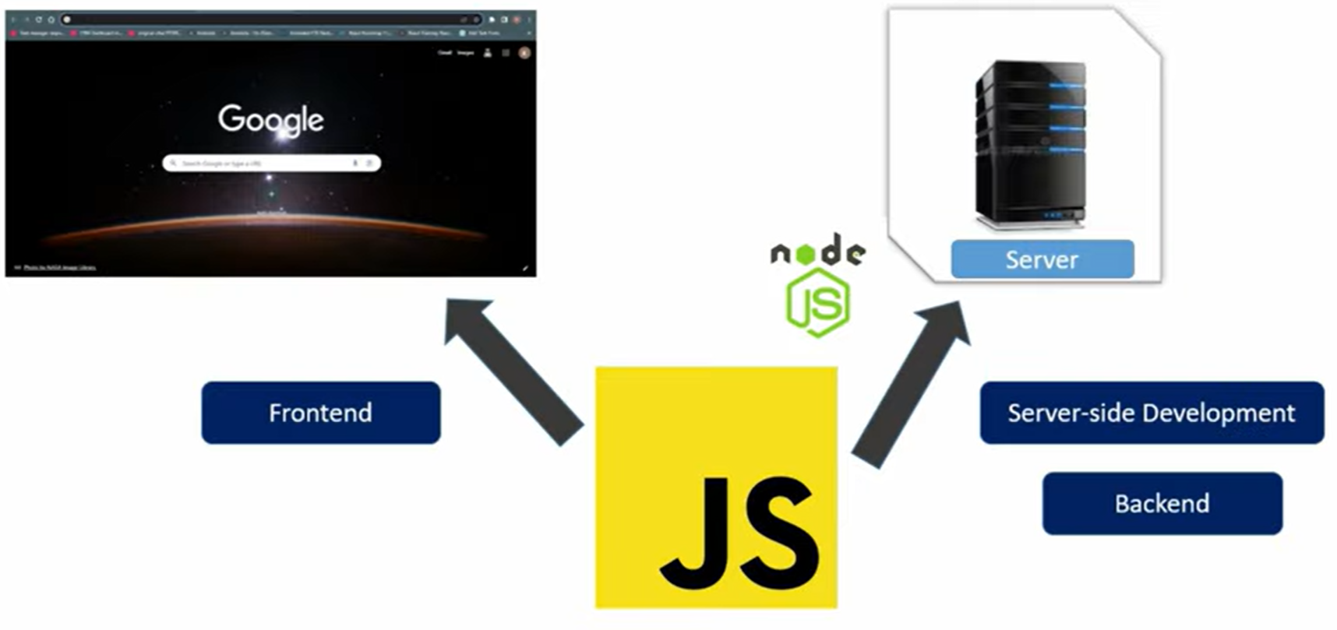

Slide 3
Features
Asynchronous & Non-blocking I/O: Handles multiple requests simultaneously.
Single-threaded Event Loop: Uses a single thread with an event-driven architecture.
Fast Execution: Built on the V8 engine, making it highly performant.
Scalability: Suitable for building scalable network applications.
Package Manager (npm): Comes with npm, the largest ecosystem of open-source libraries.

Slide 4
Advantages of 'NODE JS'
Node.js is a versatile runtime environment for JavaScript, and it is well-suitedfor building a wide range of dynamic applications, including web applications.
Authentication:Authentication is the process of verifying the identity of a user.There are various authentication methods you can use in Node.js:
Authorization:Authorization determines what actions a user is allowed to performwithin the application after they have been authenticated.
Performing user transactions with a database in a Node.js application involvesinteracting with the database to read, write, update, or delete data related to users.
Accessing APIs in a Node.js application involves making HTTP requests to external servicesor APIs to retrieve data or interact with remote resources.

Slide 5
Verify installation using:
node –v
npm -v
Download and install Node.js from https://nodejs.org.

Slide 6
REPL
R – Read
E – Eval
P – Print
L – Loop
Node will run on server not on the browser. Code we cannot save in node

Slide 7
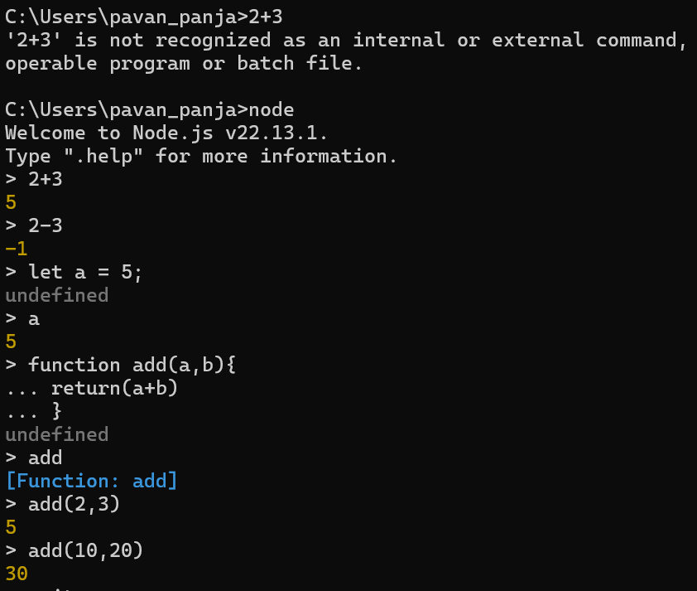
Code will not be saved once we exit from terminal, so we will use CLI

Slide 8
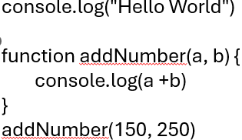
CLI – Command Line Interface
we can see the output which is coming from the node through the CLI, because node is running on a server not on the browser

Slide 9

Modules in Node.js
Modules help organize code into reusable blocks.
Built-in Modules: (fs, http, path, os, etc.)
Custom Modules: Defined by the user.
Third-party Modules: Installed via npm.

Slide 10
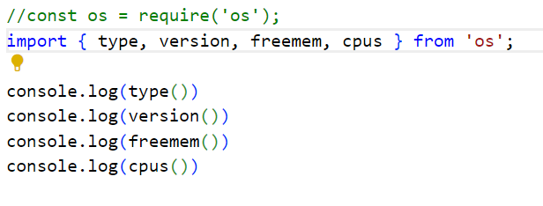
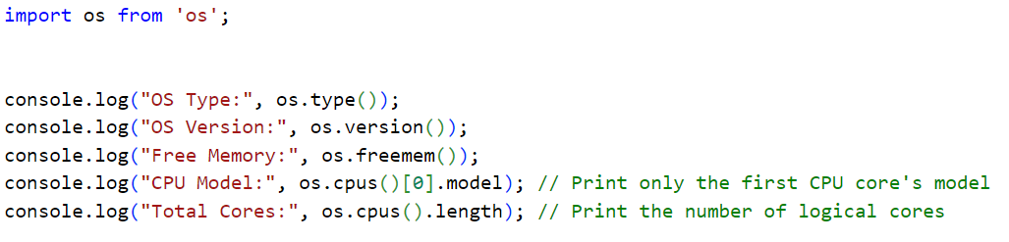
The os module provides utilities related to the operating system, like CPU info, memory usage, OS-related information.

Slide 11
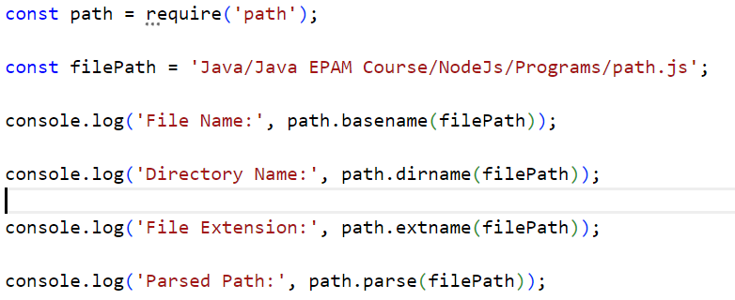
The path module provides utilities for handling and transforming file paths. Commonly Working with file paths (get directory, file name, extension), Resolving absolute and relative paths, Normalizing inconsistent paths, Parsing paths into structured objects.

Slide 12
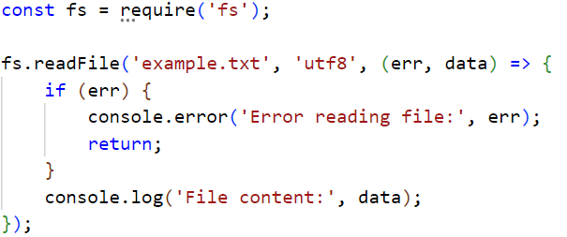
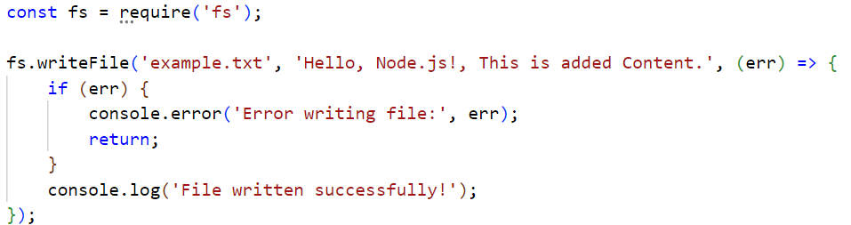
The fs (File System) module in Node.js is used to interact with the file system, such as reading, writing, updating, and deleting files.

Slide 13
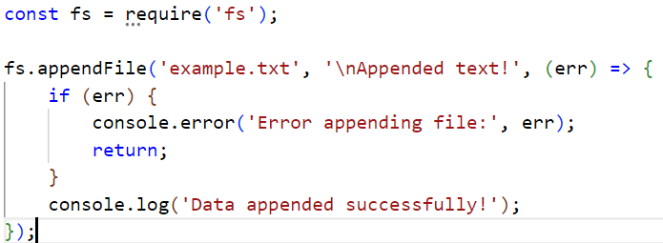
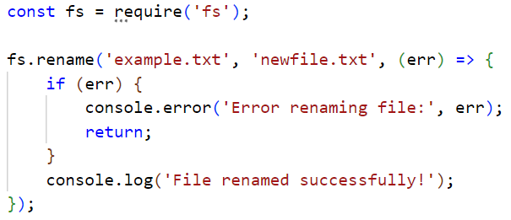

Slide 14
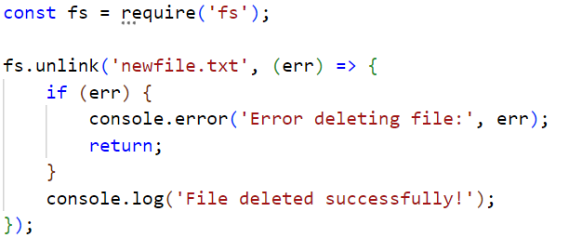
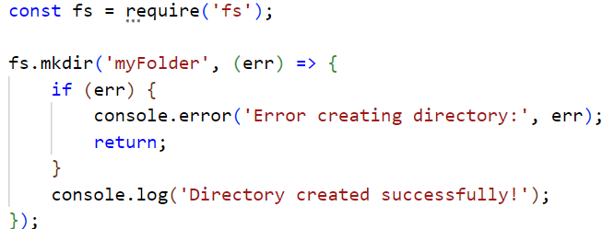

Slide 15
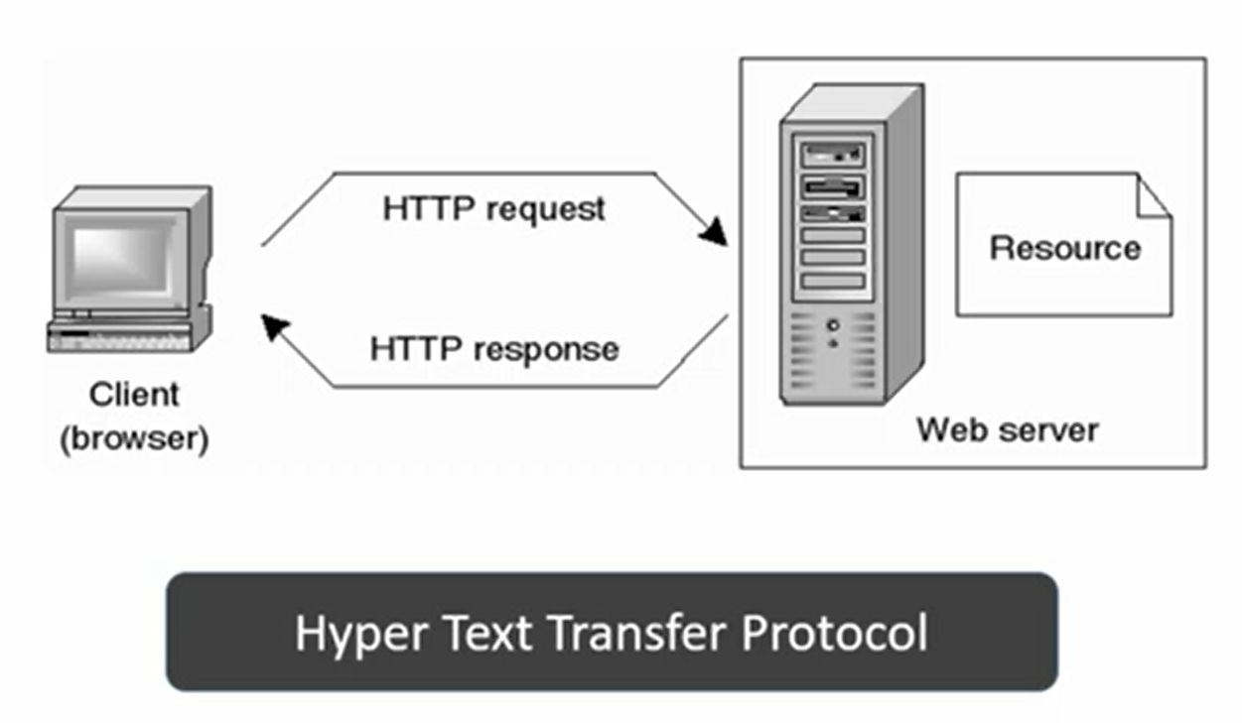
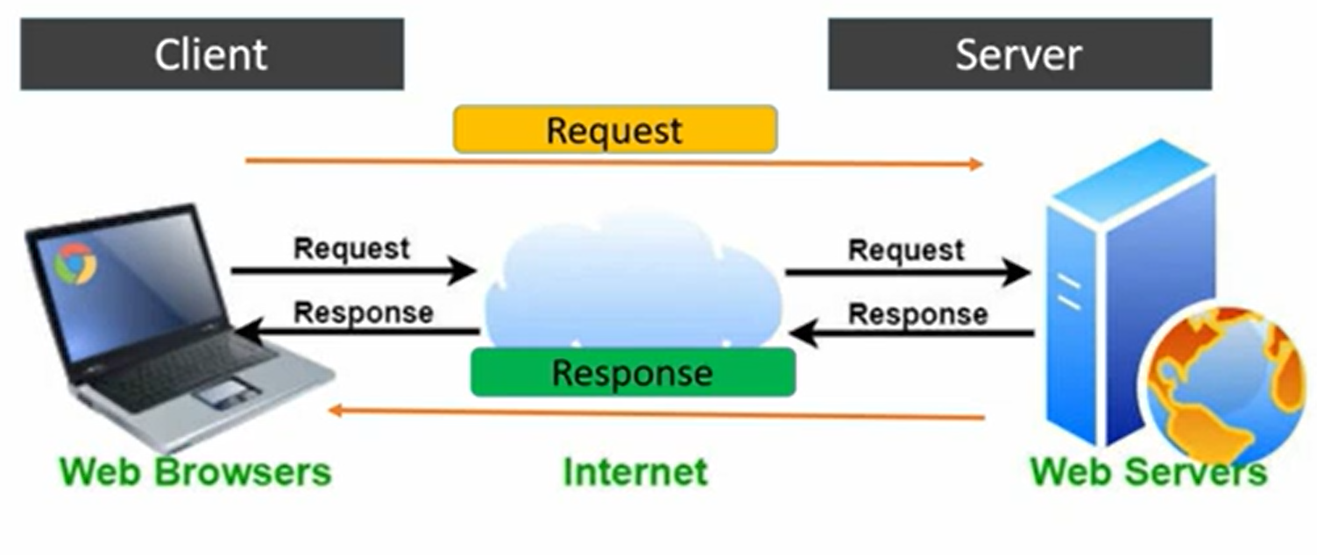
HTTP
Client Server Model/Communication

Slide 16
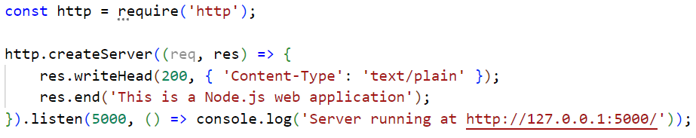
The http module in Node.js is used to create web servers and handle HTTP requests and responses.
It allows you to:
Create a server using http.createServer()
Listen for requests on a specific port
Send responses to clients

Slide 17
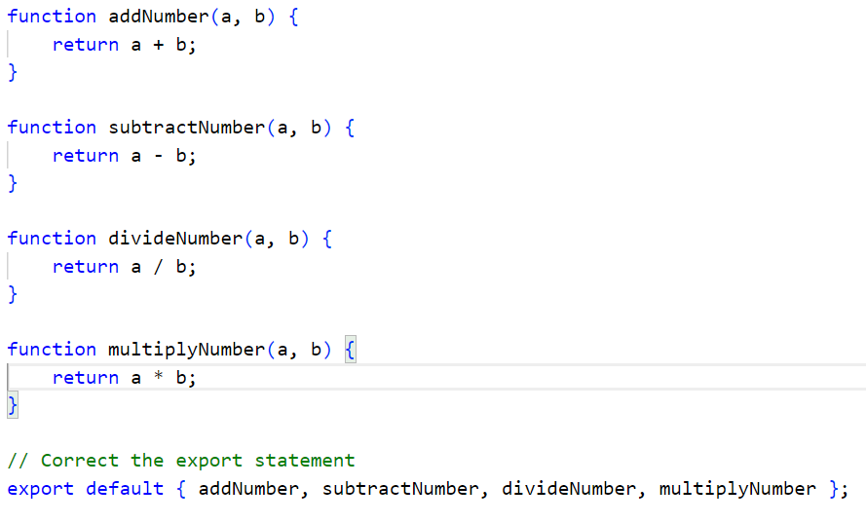
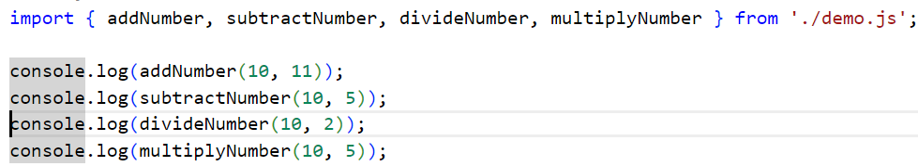
Local Modules

Slide 18
Datatypes in Node.js
Node.js contains various types of data types similar to JavaScript.
Boolean
Undefined
Null
String
Number
Node.js supports loose typing

Slide 19
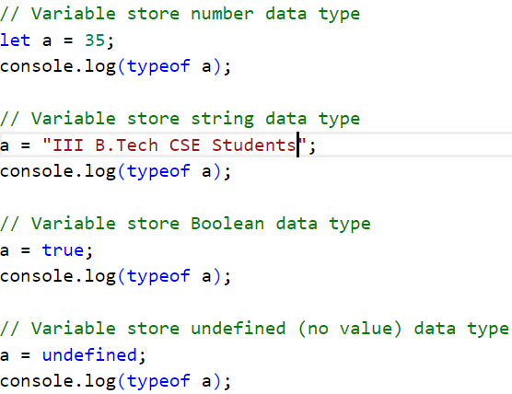

Slide 20
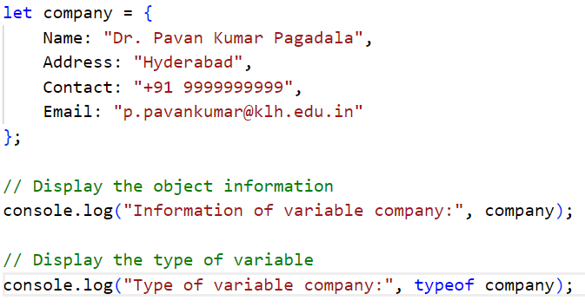
Objects and Functions
Node.js objects are the same as JavaScript objects.
Objects are similar to variables, and it contains many values which are written as name: value pairs.
Name and value are separated by a colon and every pair is separated by a comma.

Slide 21
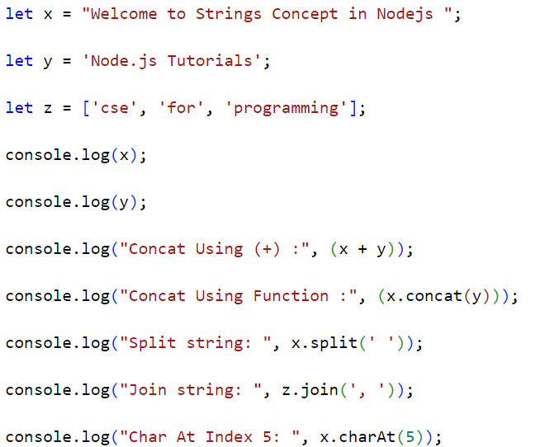
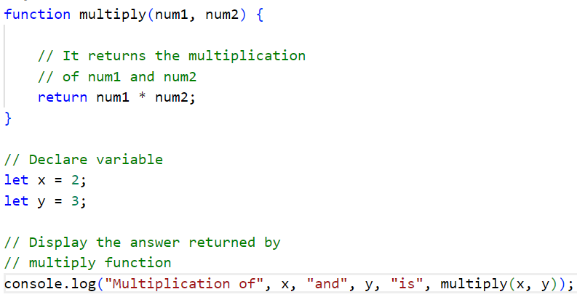

Slide 22
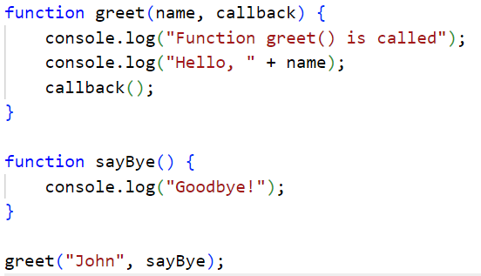
A callback is a function that is passed as an argument to another function and is executed after that function completes its operation. Node.js is asynchronous and uses callbacks to handle non-blocking operations like reading files, making API calls, or interacting with databases.

Slide 23
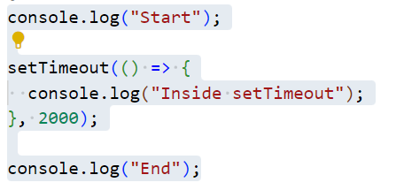
Events in Node.js
An event is any action or occurrence that a program can respond to, such as a button click, a timer, or data arriving from a network request.

Slide 24
Event loop
An event loop is a mechanism that continuously checks for events and executes corresponding event handlers (callbacks) in a non-blocking way. It is commonly used in JavaScript, Node.js, and asynchronous programming.
The event loop does not block the execution while waiting for setTimeout to complete. It continues running other code and executes the callback later.
The event loop handles async tasks by offloading them (e.g., timers, file I/O) and resuming execution once they’re done—this makes JavaScript non-blocking and efficient.

Slide 25
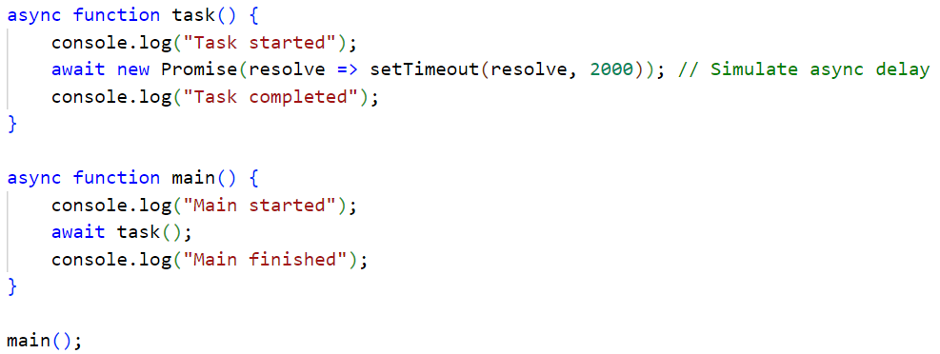

Slide 26
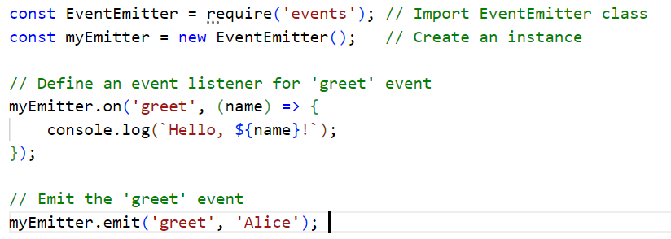
Event Emitter in Node.js
An Event Emitter in Node.js is a core module that allows you to create, listen for, and handle events asynchronously. It follows the Observer pattern, where an object (emitter) sends out events, and other parts of the program listen for and respond to those events

Slide 27
Key Differences Between CommanJS and ES6 Modules

